Slide 1
Exploring Microsoft Office 2013 Excel Comprehensive
by Mary Anne Poatsy, Keith Mulbery, Jason Davidson
Chapter 12
Templates, Styles,
and Macros
Notes:
In this chapter, you will learn how to use Microsoft Office Excel 2013 templates, themes, and styles, and how to create and use macros.

Slide 2
Objectives
Select a template
Apply themes and backgrounds
Apply cell styles
Create and use a template
Protect a cell, a worksheet, and a workbook
Notes:
The objectives of this chapter are:
Select a template
Apply themes and backgrounds
Apply cell styles
Create and use a template
Protect a cell, a worksheet, and a workbook
The objectives continue on the next slide.

Slide 3
Objectives
Create a macro
Create macro buttons
Set macro security
Create a sub procedure
Create a custom function
Notes:
The objectives of this chapter are:
Create a macro
Create macro buttons
Set macro security
Create a sub procedure
Create a custom function

Slide 4
Selecting a Template
Template—partially completed document used as a model to create other documents
Contains
Standard labels
Formulas
Formatting
May contain little or no quantitative data
Notes:
A template is a partially completed document used as a model to create other documents that have the same look and feel.
Typically, a template contains the following:
Standard labels.
Formulas.
Formatting.
Note: A template may contain little or no quantitative data.
Information on selecting a template continues on the next slide.

Slide 5
Selecting a Template
Notes:
When creating a new workbook, the FILE tab is displayed, and it contains a gallery of templates and a menu of categories.
The templates list consist of:
Recently used templates.
Sample templates installed with the software.
Templates you created.
There is also a search box to find and download online templates.

Slide 6
Applying Themes and Backgrounds
Theme—collection of formats
Coordinating colors
Fonts
Special effects
Gives a consistent look with other workbooks used in a department or organization
Notes:
A theme is a collection of formats that include coordinating colors, fonts, and special effects.
Applying a theme to a workbook gives it a consistent look with other workbooks used in a department or organization.
Information on applying themes and backgrounds continues on the next slide.

Slide 7
Applying Themes and Backgrounds
Notes:
Clicking Themes in the Themes group on the PAGE LAYOUT tab displays the Themes gallery.
The Themes gallery uses Live Preview, therefore by placing the pointer on a theme thumbnail in the gallery shows the workbook with that theme applied.
Information on applying themes and backgrounds continues on the next slide.

Slide 8
Applying Themes and Backgrounds
Notes:
Once a theme has been applied, its three elements—colors, fonts, and effects—can be customized. This includes the worksheet’s background. In addition to changing the background color, the background can be an image.
Notice the background image is placed behind any data.
To create a background image, click Background in the Page Setup group on the PAGE LAYOUT tab to open the Insert Pictures dialog box. Navigate to and select the desired image and insert.

Slide 9
Applying Cell Styles
Cell style—collection of format settings based on the current theme
Provides a consistent appearance within a worksheet and among workbooks
Control:
Font attributes
Borders and fill styles and colors
Vertical and horizontal cell alignment
Number formatting
Cell-protection settings
Notes:
A cell style is a collection of format settings based on the current theme to provide a consistent appearance within a worksheet and among similar workbooks.
Cell styles control the following formats:
Font attributes, such as font and font size.
Borders and fill styles and colors.
Vertical and horizontal cell alignment.
Number formatting, such as currency and number of decimal places
Cell-protection settings.
Information on applying cell styles continues on the next slide.

Slide 10
Applying Cell Styles
Cell Styles gallery predefined cell categories:
Good, Bad, and Neutral
Data and Model
Titles and Headings
Themed Cell Styles
Number Format
Notes:
The Cell Styles gallery contains the following five predefined cell categories:
Good, Bad, and Neutral—use to emphasize good, bad, or neutral results.
Data and Model—use to indicate special cell contents.
Titles and Headings—use to format titles and headings.
Themed Cell Styles—use Accent styles for visual emphasis.
Number Format—provide the same formatting as commands in the Number group.
Information on applying cell styles continues on the next slide.

Slide 11
Applying Cell Styles
Notes:
Click Cell Styles in the Styles group on the HOME tab to display the Cell Styles gallery. Cell Styles also uses Live Preview, so placing the pointer on a cell style in the gallery shows what the cell will look like with that cell style applied.
Note: You can also create a custom cell style and then name and save it.

Slide 12
Creating and Using a Template
Template creation guidelines:
Should contain formatted, descriptive labels, empty cells, and formulas
Avoid values in formulas; use cell references instead
Include data-validation settings
Notes:
When the supplied templates do not meet your needs, you can create your own template. Templates can be created from scratch, or an existing template can be modified and saved as a new template.
When creating a new template, the following are some guidelines for you to consider:
The template should contain formatted, descriptive labels, empty cells, and formulas.
When possible avoid values in formulas; use cell references instead.
Use an appropriate function to trap errors.
Include data-validation settings.
Information on creating and using a template continues on the next slide.

Slide 13
Creating and Using a Template
Template creation guidelines (cont.):
Include template instructions
Apply appropriate template formatting
Give worksheets meaningful names
Notes:
When creating a new template, the following are some more guidelines to consider:
Include template instructions.
Apply appropriate template formatting.
Give worksheets meaningful names.
See the textbook for additional guidelines.
To save a new template so that it appears in the Templates gallery, do a normal Save As, but change the file type to an Excel Template (.xltx). This will save the template in the default template folder C:\Users\username\Documents\CustomOfficeTemplates and place the template in the gallery.

Slide 14
Protecting a Cell, a Worksheet, and a Workbook
Locked cell— prevents users from editing the contents or formatting cells in a protected worksheet
Cells are not locked until the worksheet is protected
Locking/unlocking cells has no effect if the worksheet has not been protected
Notes:
A locked cell prevents users from editing the contents or formatting cells in a protected worksheet.
Cells are not locked until the worksheet is protected.
Locking or unlocking cells has no effect if the worksheet has not been protected.
Information on protecting a cell, a worksheet, and a workbook continues on the next slide.

Slide 15
Protecting a Cell, a Worksheet, and a Workbook
Notes:
Once the cells the users are allowed to modify are unlocked, the worksheet is ready to be protected. When a worksheet is protected, users cannot alter locked cells. After a worksheet is protected, most commands on the Ribbon are dimmed, indicating that they are not available.
Part of the process of protecting a worksheet, is entering a password so that only those who know the password can unprotect the worksheet.
As noted in the Protect Sheet dialog box, do not forget your password.
Information on protecting a cell, a worksheet, and a workbook continues on the next slide.

Slide 16
Protecting a Cell, a Worksheet, and a Workbook
Protecting a worksheet protects only the worksheet
Protect the entire workbook to prevent users from making unwanted changes
Use a password to further protect against changes
Notes:
Protecting a worksheet prevents unauthorized modifications of the worksheet, but users can make changes to other parts of the workbook. To prevent users from making unwanted changes, the entire workbook can be protected with a password.
To protect a workbook, click Protect Workbook in the Changes group on the REVIEW tab to open the Protect Structure and Windows dialog box. Click the check box to protect the workbook and create a password.

Slide 17
Creating a Macro
Macro—instructions that execute commands to automate repetitive or routine tasks
Two methods
Using the Macro Recorder
Typing instructions using Visual Basic for Applications (VBA)
Notes:
A macro is a set of instructions that execute a sequence of commands to automate repetitive or routine tasks.
In Excel, there are two methods for creating macros:
Using the Macro Recorder.
Typing instructions using Visual Basic for Applications (VBA).
Information on creating a macro continues on the next slide.

Slide 18
Creating a Macro
Macro Recorder—records commands, keystrokes, and mouse clicks
Macros not stored in Excel Workbook file format (.xlsx)
Macros stored:
Excel Macro-Enabled Workbook (.xlsm)
Excel Binary Workbook (.xlsb)
Excel Macro-Enabled Template (.xltm)
Notes:
The Macro Recorder records commands, keystrokes, and mouse clicks, and stores Excel commands as VBA code within a workbook.
Macros cannot be stored using the default Excel Workbook file format (.xlsx).
When saving a workbook containing macros, the workbook has to be stored in one of the following formats:
Excel Macro-Enabled Workbook (.xlsm).
Excel Binary Workbook (.xlsb).
Excel Macro-Enabled Template (.xltm).
Information on creating a macro continues on the next slide.

Slide 19
Creating a Macro
Accessing Macro Recorder:
From the View tab
From the Developer tab
From the status bar
Notes:
There are three ways to access the Macro Recorder:
From the View tab—Macro group contains buttons to view and record a macros.
From the Developer tab—provides more in-depth tools; it also includes commands to open the Visual Basic editor and set macro security.
From the status bar—displays the Macro Recording button to start and stop macro recordings.
Information on creating a macro continues on the next slide.

Slide 20
Creating a Macro
Notes:
To record a macro, click any of the Record Macro buttons and the Record Macro dialog box appears.
Information on creating a macro continues on the next slide.

Slide 21
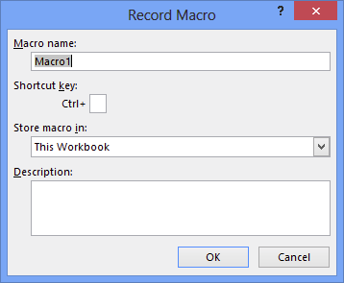
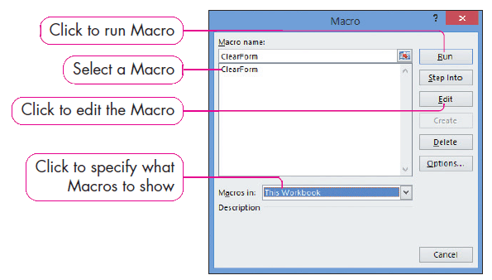
Creating a Macro
Notes:
In the Record Macro dialog box:
The macro is named.
A keyboard shortcut can be assigned.
The location where the macro is stored is entered.
A macro description is entered.
After clicking OK in the dialog box, perform the commands that are to be recorded. Finally, click one of the Stop Recording buttons.
To run, edit, or delete a macro, open the Macro dialog box either by:
Clicking the Macros arrow in the Macros group on the VIEW tab, and then selecting View Macros.
Or by clicking Macros in the Code group on the DEVELOPER tab.

Slide 22
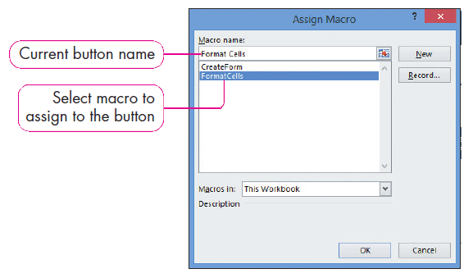
Creating Macro Buttons
Notes:
Frequently used macros can be assigned buttons on worksheets.
Begin by placing a button control on the worksheet. Click Insert in the Controls group on the DEVELOPER tab, and then select Button (Form Control) in the Insert gallery.
Drag the crosshair pointer and draw a button on the worksheet. Releasing the mouse button opens the Assign Macro dialog box.
Using the dialog box, a macro is selected from the list of macros, and the button is named.

Slide 23
Setting Macro Security
Notes:
Macro security is a concern because a macro virus can be written to perform malicious actions when run. Because of this, Excel automatically disables macros and displays a security warning that macros are disabled, and the user must click the Enable Content button to enable macros.
The Trust Center dialog box can be used to change settings to make it easier to work with macros. The Trust Center can be configured to trust files in particular folders and workbooks created by a trusted publisher. It also includes macro settings that can be selected.
To open the Trust Center:
Click the FILE tab and click Options.
Click Trust Center on the left side of the Excel Options dialog box.
Click Trust Center Settings.
Clicking Macro Settings in the Trust Center dialog box displays four macro options:
Disable all macros without notification.
Disable all macros with notification (the default).
Disable all macros except digitally signed macros.
Enable all macros.

Slide 24
Creating a Sub Procedure
Visual Basic for Applications—programming language to enhance and automate functionality
Visual Basic Editor:
Create
Edit
Execute
Debug Office application macros
VBA macros:
Sub procedures
Custom functions
Notes:
Visual Basic for Applications (VBA) is a programming language that can be used within software packages to enhance and automate functionality. Visual Basic Editor is used to create, edit, execute, and debug Office application macros, which are then stored in modules.
There are two types of VBA macros:
Sub procedures—which perform actions on a workbook.
Custom functions—which manipulate input variables and return a value.
Note: Sub procedures also can be created using the macro recorder.
Information on creating a sub procedure continues on the next slide.

Slide 25
Creating a Sub Procedure
Notes:
A Visual Basic module consists of at least one procedure, which is a named sequence of statements stored in a macro—ClearForm in this example.
A procedure or macro always begins and ends with the Sub and End Sub statements.
Keywords are special programming syntax that have special meaning with the programming language—Sub and End Sub in this example, which are colored blue.
Comments provide information or documentation about the macro but do not affect its execution. The comments in this example are indicated by an apostrophe and appear in green.
Information on creating a sub procedure continues on the next slide.

Slide 26
Creating a Sub Procedure
Notes:
When running VBA scripts on protected worksheets, run time errors can sometimes occur. This type of error is a software or hardware problem that prevents a program from working correctly.
Using the example in the text, a sub procedure was typed using the VBA editor, but when run, some of the cells were protected and could not be modified. This is corrected by temporarily unprotecting the worksheet when the macro begins and protecting it again at the conclusion of the macro.

Slide 27
Creating a Custom Function
Notes:
In your study of Excel, you have been introduced to a variety of built-in functions. If none of these functions meet your needs, you can create your own. Functions return a value based on inputs or arguments. Using the example in the text, a function named mileage is written to calculate the mileage reimbursement for driving a car for business purposes. To perform this calculation, you must know two values—how many miles were driven and what the reimbursement rate is per mile.
Looking at the code, you can see function start and end lines. The function start line includes the function name and the two arguments. The way a function returns a value is by assigning a calculation to the function name, which is seen with the function definition.

Slide 28
Summary
Workbooks can be standardized by using:
Templates
Themes
Styles
Notes:
Workbooks can be standardized by using templates, themes, and styles.
The summary continues on the next slide.

Slide 29
Summary
Protection can be applied to:
Cells
Worksheets
Workbooks
Notes:
Protection can be applied to cells, worksheets, and workbooks.
The summary continues on the next slide.

Slide 30
Summary
Macros can be created and assigned to buttons
Macro security settings can be changed using the Trust Center dialog box
Sub procedures and custom functions are created using VBA
Notes:
Macros can be created to perform special functions and then assigned to buttons. Macro security settings can be changed using the Trust Center dialog box to enable the macros within a file. Sub procedures and custom functions are created using Visual Basic for Applications.

Slide 31
Questions
Notes:
As you complete this workshop on Excel, be sure you ask questions.

Slide 32
Copyright
All rights reserved. No part of this publication may be reproduced, stored in a retrieval system, or transmitted, in any form or by any means, electronic, mechanical, photocopying, recording, or otherwise, without the prior written permission of the publisher. Printed in the United States of America.

