Slide 1
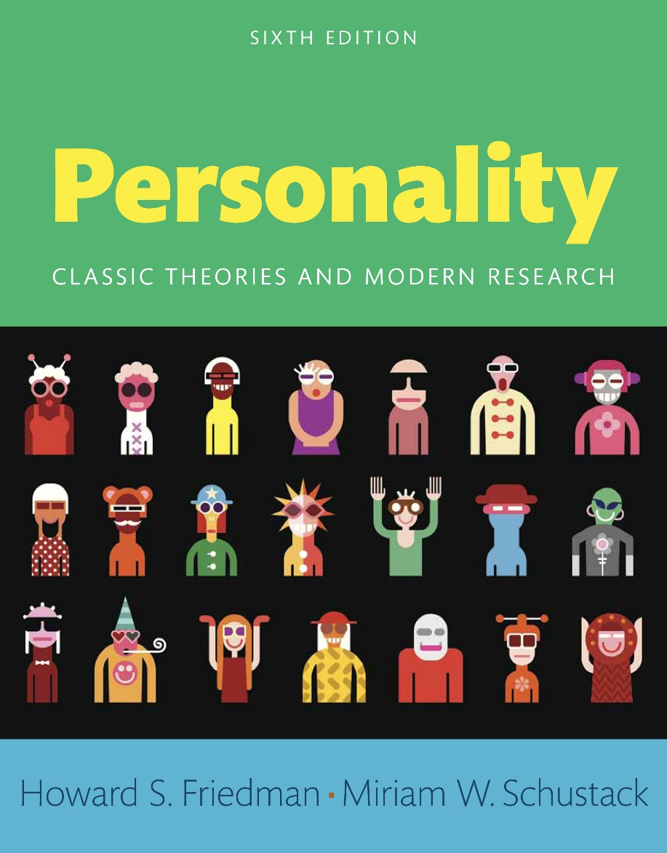
Personality
Sixth edition
Chapter 2
How Is Personality Studied and Assessed?

Slide 2
Modules
Introduction: How Is Personality Studied and Assessed?
2.1: Measuring Personality
2.2: Bias
2.3: Varieties of Personality Measures
2.4: How Not to Test Personality
2.5: The Design of Research
2.6: The Ethics of Personality Testing
Conclusion: How Is Personality Studied and Assessed?

Slide 3
Learning Objectives (1 of 2)
2.1: Report some of the parameters of measuring personality
2.2: Analyze the three major sources of bias in personality measurement
2.3: Express the different types of measures of personality
2.4: Review reasons why some personality tests should not be used

Slide 4
Learning Objectives (2 of 2)
2.5: Describe the three basic types of research designs used in studying personality
2.6: Examine the ethical context of psychological testing

Slide 5
Introduction: How Is Personality Studied and Assessed?
Objective assessment
Subjective assessment

Slide 6
2.1: Measuring Personality
Objective: Report some of the parameters of measuring personality
Characteristics of charismatic people
Affective Communication Test (ACT)
Notes:
Point 1- Characteristics of charismatic people
Attractive
Influential
Expressive
The center of attention
Point 2- Affective Communication Test (ACT)
Helps assess whether someone is especially expressive
Helps assess whether someone is likely to be an influential emotional leader in a group
Helps identify someone’s social influence process

Slide 7
2.1.1: Reliability
Internal Consistency Reliability
Test-Retest Reliability
Challenges of personality change
Notes:
Point 1- Internal Consistency Reliability
Degree of consistency is measured by seeing whether subparts or equivalent parts of a test yield the same results
Measured by a statistic called Cronbach’s coefficient alpha
Alpha - average of all possible split-half correlation coefficients
Function of the number of items and their degree of correlation
Point 2- Test-Retest Reliability
Involves the instrument’s degree of consistency on different occasions
Notion of temporal stability
Point 3- Challenges of personality change
Personality consists of patterns that dynamically direct activity
Personality may change over the long term
Expect personality stability only over shorter periods of perhaps several years

Slide 8
2.1.2: Construct Validity
Construct validity
Theory development
Content validity
Notes:
Point 1- Construct validity
Extent to which a test truly measures a theoretical construct
Ascertained by seeing if assessments predict behaviors and reactions implied by constructs
Convergent validation
Discriminant validation
Point 2- Theory development
Notoriously complex
Theories are functions of many assumptions and many hard-to-measure entities
Theory informs the assessment
Assessment in turn informs the theory
Point 3- Content validity
Whether a test measures the domain that it is supposed to measure
Unreliable items and ambiguous items are not taken into account
ACT captures many content dimensions of personal charisma

Slide 9
2.2: Bias
Objective: Analyze the three major sources of bias in personality measurement
Ethnic bias
Gender bias
Notes:
Point 1- Ethnic bias
One of the most common types of test bias
Tests fail to consider relevant cultures and subcultures of subjects
Theories developed in one culture improperly applied to another
Point 2- Gender bias
Adjustment of test scores
Gender-related expectations can account for a healthy personality

Slide 10
2.2.1: Response Sets
Methods to counter response sets
Social desirability response set
Methods to prevent social desirability response sets
Notes:
Point 1- Methods to counter response sets
Using reverse scoring
Using reverse wording nullifies acquiescence response sets
Point 2- Social desirability response sets
People presenting themselves in a favorable light
People responding to please experimenters
Point 3- Methods to prevent social desirability response sets
Present items of equal desirability
Ask test-takers to choose between the two items

Slide 11
2.3: Varieties of Personality Measures
Objective: Express the different types of measures of personality
Theoretical reasons
Methodological reasons
Notes:
Point 1- Theoretical reasons
Certain tests more or less appropriate
Consciously grasped and reported motivations measured
Point 2- Methodological reasons
Every personality measuring method suffers from inherent biases
Weaknesses of one assessment technique compensated for by the strengths of another technique

Slide 12
2.3.1: Self-Report Tests
Minnesota Multiphasic Personality Inventory (MMPI)
NEO Personality Inventory (NEO-PI)
Personality Research Form (PRF)
Notes:
Point 1- Minnesota Multiphasic Personality Inventory (MMPI)
Test-taker responds to about 500 statements
Answers include “true,” “false,” or “cannot say”
Created using criterion-related item selection
Focused on assessing psychopathology
MMPI-2 and MMPI-2-RF
Point 2- NEO Personality Inventory (NEO-PI)
Built around the idea of five basic dimensions of personality
Relies heavily on factor analysis
Starts with correlations among simple scales
Reduces this information to a few basic dimensions
Point 3- Personality Research Form (PRF)
Complementary approach to self-report scales
Measures the basic needs and motivations proposed by Henry Murray
Test driven by theory
Developed using correlational techniques

Slide 13
2.3.2: Q-Sort Tests
Overview
Advantages
Notes:
Point 1- Overview
Person given a stack of cards naming various characteristics
Asked to sort them into piles on a dimension
Examiner ensures self-reports form a desired statistical distribution
Forced normal distribution- Normal curve approximation
Used to code behavior in structured situations
Point 2- Advantages
More active than questionnaires
Sorted items can be held constant
Context can be changed
Captures more objective behavioral data in studying personality

Slide 14
2.3.3: Ratings and Judgments by Others
Stanford-Binet intelligence test
Dimensions
Advantages
Notes:
Point 1- Stanford-Binet intelligence test
Examined intelligence of extremely bright children
Further examines their personality and social skills
Point 2- Dimensions
Prudence or forethought
Conscientiousness
Freedom from vanity
Truthfulness
Point 3- Advantages
Excellent scale of conscientiousness/social dependability
Reliable
Valid
Good predictor of longevity across children’s life span

Slide 15
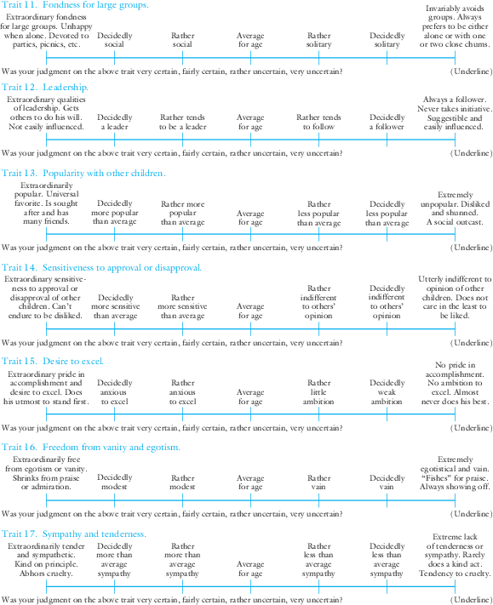
Figure 2.1: A Sample of Questions from Terman’s Longitudinal Study
Through questionnaires such as these, Terman obtained information from the parents and teachers of the children he was studying. These childhood ratings have been shown to be predictive of adult personality and accomplishment.
Notes:
Terman obtained information from parents and teachers of children
Ratings predictive of adult personality
Ratings predictive of accomplishment

Slide 16
2.3.4: Biological Measures
Phrenology
Electroencephalograms (EEGs)
Position Emission Tomography (PET)
Functional Magnetic Resonance Imaging (fMRI)
Biological assessments of diseases and genetic conditions
Notes:
Point 1- Phrenology
Assesses personality by feeling positions and shapes of bumps on people’s skulls
Different psychological characteristics represented in the brain
Highly developed abilities/deficits show up in skull distortions
Influenced subsequent thinking about biological assessment of personality
Point 2- Electroencephalograms (EEGs)
Study of neuronal activity within neocortex
Measure of evoked potential
Measures electrical potentials at the scalp
Allows more flexibility in research
Point 3- Position Emission Tomography (PET)
Shows brain activity by recording the brain’s use of radioactive glucose
Identification of systematic individual differences in thought processes
Point 4- Functional Magnetic Resonance Imaging (fMRI)
Assesses brain activity by measuring changes in oxygenated blood flow
Shows which areas of the brain are involved in particular emotional reactions
Challenging to interpret meaning of such brain processes
Point 5- Biological assessments of diseases and genetic conditions
Thyroid function test
Blood screening
Chromosome analysis

Slide 17
2.3.5: Behavioral Observations
Sir Francis Galton’s approaches
Overview
Notes:
Point 1- Sir Francis Galton’s approaches
Pioneered approaches to understanding individual differences
Pioneered techniques of behavioral observation
Collected physical measurements of people
Studied their reactions in controlled situations
Point 2- Overview
Counting people’s experiences
Understanding people’s interactions
Facial expressions of emotion coded
Experience sampling method of assessment
Present behavior a reliable and valid predictor of future behavior

Slide 18
2.3.6: Interviews
Psychotherapeutic interviews
Structured interviews
Notes:
Point 1- Psychotherapeutic interviews
To find out about a patient’s personality
Patients discuss important or troubling parts of their lives
Point 2- Structured interviews
To assess Type A behavior pattern
Characterized by tense, competitive style
Likely to develop coronary heart disease

Slide 19
2.3.7: Expressive Behavior
Overview
Expressive style of charismatic people
Notes:
Point 1- Overview
Pioneered by Gordon Allport and P. E. Vernon
An important aspect of personality
Key element of charisma
Emotional expression closely tied to dynamic, motivational aspects of personality
Point 2- Expressive style of charismatic people
Display fewer nervous, body-focused type gestures
Possess more fluent, inspiring speech

Slide 20
2.3.8: Document Analysis and Biological Studies
Document analysis
Examples of biographical studies
Notes:
Point 1- Document analysis
Letters and diaries excellent for studying personality change
Helps achieve in-depth understanding of individuals across time
Helps understand the psychological richness of a particular individual’s life
Point 2- Examples of biographical studies
Young Man Luther
Gandhi’s Truth

Slide 21
2.3.9: Projective Tests
Overview
The Rorschach test
Thematic Apperception Test (TAT)
Notes:
Point 1- Overview
Allows people to “project” their inner motivations
Drawing pictures, telling stories, completing sentences
Assumptions about nature of personality and behavior
Deep, basic motivational factors
Gauge participants’ emotional or motivational response
Point 2- The Rorschach test
Developed by Swiss psychiatrist, Hermann Rorschach
Inkblots showed to patients
Patients asked for descriptions
One of most widely used projection tests
Presents vague and ambiguous stimuli and notes their response
Point 3- Thematic Apperception Test (TAT)
Participants make up a story about a picture
Participants asked to come up with a prediction
Gauges how people place order on vague stimuli

Slide 22
2.3.10: Demographics and Lifestyle
Astrology
Demographic information
Examples of societal influences
Notes:
Point 1- Astrology
Celestial happenings may influence human behavior
Relies mostly on superstition and faith
No rigorous scientific analysis
No known scientific validity
Willingness of people to accept almost any explanation of personality
Point 2- Demographic information
Age, religion, place of birth, family size
Provides framework for better understanding individuals
Can be misleading
Twin brothers can possess different personalities
Point 3- Examples of societal influences
The Black Panthers in the 1960s
Communists in Russia in the 1920s
Hippies in California in the 1960s
Divorces in the United States in the 1970s

Slide 23
2.3.11: Online Internet Analysis of Social Media and Big Data
Reasons for organizations assessing personalities
Problems of implementing big data methods
Notes:
Point 1- Reasons for organizations assessing personalities
To understand social networks
To sell you things
To see if you are a terrorist threat
Point 2- Problems of implementing big data methods
Ethical issues
Privacy issues
Matters of potential abuse

Slide 24
2.3.12: Is There One Best Method of Assessment?
Relevant factors
Best approach
Notes:
Point 1- Relevant factors
The person
The assessor
The purpose of the assessment
Point 2- Best approach
Limiting Barnum effect
Use of multiple methods
Inherent weaknesses of each method minimized
Important traits repeatedly emerge
Triangulate in on valid personality constructs

Slide 25
2.4: How Not to Test Personality
Objective: Review reasons why some personality tests should not be used
Dubious personality assessments
Graphology
Notes:
Point 1- Dubious personality assessments
Astrology
Palm-reading
Numerology
Handwri Point 2- Graphology
ting analysis
Involves aspects of expressive style
Means of screening potential employees
No decent evidence to justify detailed assessments

Slide 26
2.5: The Design of Research
Objective: Describe the three basic types of research designs used in studying personality
Personality research
Basic elements
Notes:
Point 1- Personality research
Not a straight, linear process
Doesn’t go from hypothesis to final proof
Frequent backtracking and circling around
Point 2- Basic elements
Case studies
Correlational studies
Experimental studies

Slide 27
2.5.1: Case Studies
Process
Limitations
Notes:
Point 1- Process
In-depth study of individuals
Examine interviews
Examine documents
Analyze expressive behavior
Analyze reactions
Point 2- Limitations
Need further systematic study to become scientific
Cannot be easily generalized to other people
Do not tell much about causal relationships

Slide 28
2.5.2: Correlational Studies
Process
Limitations
Notes:
Point 1- Process
Assessment of degree of relationship between two or more variables
Use of correlation coefficients
Use of factor analyses
Point 2- Limitations
Do not tell anything about causal directions of associations
Experimental, quasi-experimental research designs better alternatives

Slide 29
2.5.3: Experimental Studies
Process
Limitations
Notes:
Point 1- Process
People randomly assigned to either treatment group or control group
Random assignment to conditions provided
Observation whether interventions caused desired effect
Point 2- Limitations
Findings cannot be generalized to others who have different characteristics
Not possible to know which moderating factors crucial
Biases in the process
Not possible to know which interventions would work

Slide 30
2.6: The Ethics of Personality Testing
Objective: Examine the ethical context of psychological testing
Paradoxes of using personality tests
Problems of some personality tests
Solutions to these problems
Notes:
Point 1- Paradoxes of using personality tests
Tests could carelessly assert dramatic personality differences among ethnic groups
Tests may be helpful in examining personality differences within ethnic groups
Testing may uncover interesting group differences
Point 2- Problems of some personality tests
Poorly constructed
Improperly used
Wrongly employed
Point 3- Solutions to these problems
Educated people well versed in understanding valid uses
Be cognizant of severe limits of tests

Slide 31
Conclusion: How Is Personality Studied and Assessed?
Qualities of personality tests
Biases to avoid
Different types of personality tests
Problems of personality testing
Solutions to such problems

