Slide 1
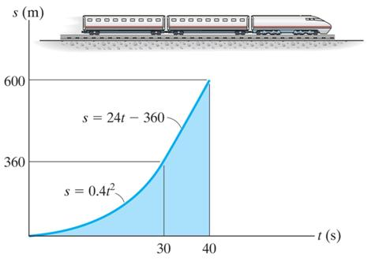
RECTILINEAR KINEMATICS: ERRATIC MOTION
Today’s Objectives:
Students will be able to:
Determine position, velocity, and acceleration of a particle using graphs.
In-Class Activities:
Check Homework
Reading Quiz
Applications
s-t, v-t, a-t, v-s, and a-s diagrams
Concept Quiz
Group Problem Solving
Attention Quiz

Slide 2
READING QUIZ
1. The slope of a v-t graph at any instant represents instantaneous
A) velocity. B) acceleration.
C) position. D) jerk.
2. Displacement of a particle over a given time interval equals the area under the ___ graph during that time.
A) a-t B) a-s
C) v-t C) s-t
Notes:
Answers:
1. B
2. C

Slide 3
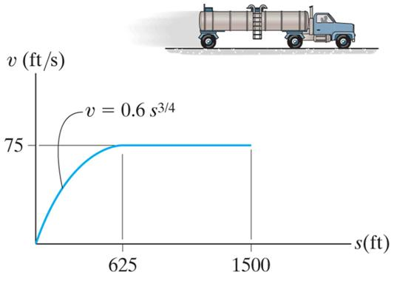
APPLICATIONS
In many experiments, a velocity versus position (v-s) profile is obtained.
If we have a v-s graph for the tank truck, how can we determine its acceleration at position s = 1500 feet?

Slide 4
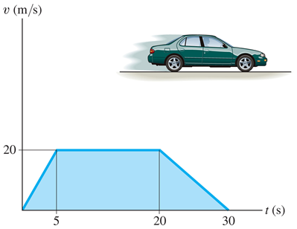
APPLICATIONS (continued)
The velocity of a car is recorded from a experiment. The car starts from rest and travels along a straight track.
If we know the v-t plot, how can we determine the distance the car traveled during the time interval 0 < t < 30 s or
15 < t < 25 s?

Slide 5
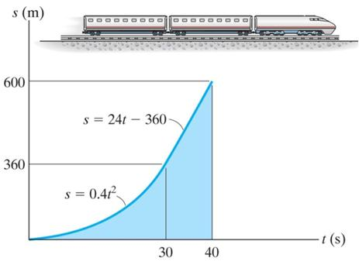
ERRATIC MOTION (Section 12.3)
Graphing provides a good way to handle complex motions that would be difficult to describe with formulas.
Graphs also provide a visual description of motion and reinforce the calculus concepts of differentiation and integration as used in dynamics.
The approach builds on the facts that slope and differentiation are linked and that integration can be thought of as finding the area under a curve.

Slide 6
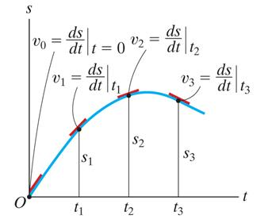
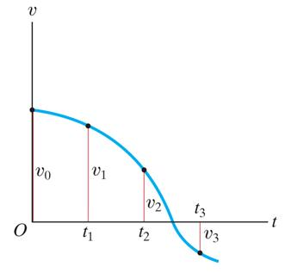
S-T GRAPH
Plots of position versus time can be used to find velocity versus time curves. Finding the slope of the line tangent to the motion curve at any point is the velocity at that point (or v = ds/dt).
Therefore, the v-t graph can be constructed by finding the slope at various points along the s-t graph.

Slide 7
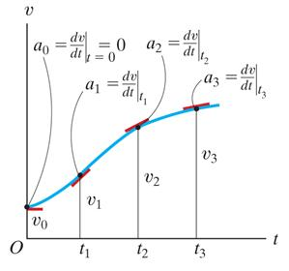
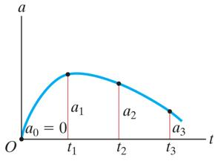
V-T GRAPH
Plots of velocity versus time can be used to find acceleration versus time curves. Finding the slope of the line tangent to the velocity curve at any point is the acceleration at that point (or a = dv/dt).
Therefore, the acceleration versus time (or a-t) graph can be constructed by finding the slope at various points along the v-t graph.
Also, the distance moved (displacement) of the particle is the area under the v-t graph during time Δt.

Slide 8
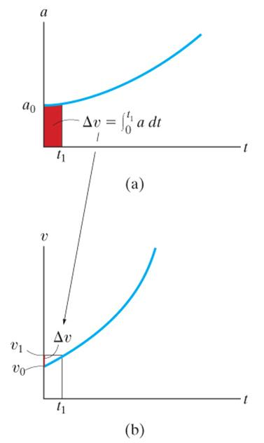
A-T GRAPH
Given the acceleration versus time or a-t curve, the change in velocity (Δv) during a time period is the area under the a-t curve.
So we can construct a v-t graph from an a-t graph if we know the initial velocity of the particle.

Slide 9
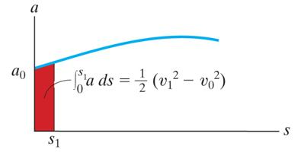
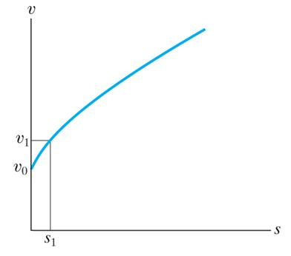
A-S GRAPH
A more complex case is presented by the acceleration versus position or a-s graph. The area under the a-s curve represents the change in velocity
(recall ∫ a ds = ∫ v dv ).
s₂
½ (v₁² – v_{o}²) = = area under the
∫
a ds
s₁
a-s graph
This equation can be solved for v₁, allowing you to solve for the velocity at a point. By doing this repeatedly, you can create a plot of velocity versus distance.

Slide 10
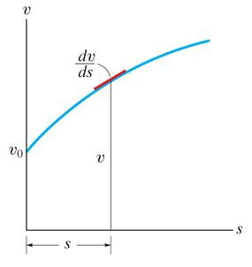
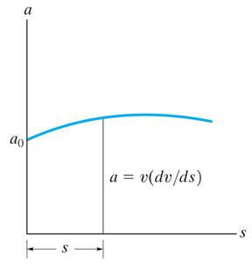
V-S GRAPH
Another complex case is presented by the velocity versus distance or v-s graph. By reading the velocity v at a point on the curve and multiplying it by the slope of the curve (dv/ds) at this same point, we can obtain the acceleration at that point. Recall the formula
a = v (dv/ds).
Thus, we can obtain an a-s plot from the v-s curve.

Slide 11
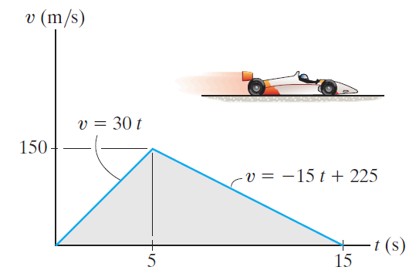
EXAMPLE
Given: The v-t graph for a dragster moving along a straight road.
Find: The a-t graph and s-t graph over the time interval shown.
What is your plan of attack for the problem?
Notes:
Source : F12-14

Slide 12
EXAMPLE (continued)
Solution: The a-t graph can be constructed by finding the slope of the v-t graph at key points. What are those?
when 0 < t < 5 s; v₀₋₅ = ds/dt = d(30t)/dt = 30 m/s²
when 5 < t < 15 s; v₅₋₁₅ = ds/dt = d(-15t+225)/dt = -15 m/s²
a(m/s²)
a-t graph
30
5
15
t(s)
-15

Slide 13
EXAMPLE (continued)
Now integrate the v - t graph to build the s – t graph.
when 0 < t < 5 s; s = ∫ v dt = [15 t² ] = 15 t² m
when 0 < t < 5 s; s − 15 (5²) = ∫ v dt = [(-15) (1/2) t ² + 225 t]
s = - 7.5 t ² + 225 t − 562.5 m
_{t}
₀
_{t}
₅
s(m)
s-t graph
1125
-7.5 t² + 225 t − 562.5
375
t(s)
15t²
5
15

Slide 14
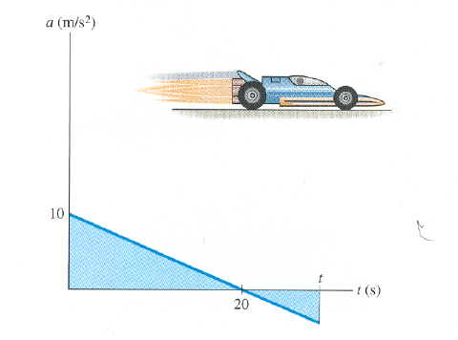
CONCEPT QUIZ
1. If a particle starts from rest and
accelerates according to the graph
shown, the particle’s velocity at
t = 20 s is
A) 200 m/s B) 100 m/s
C) 0 D) 20 m/s
2. The particle in Problem 1 stops moving at t = _______.
A) 10 s B) 20 s
C) 30 s D) 40 s
Notes:
Answers:
1. B
2. D

Slide 15
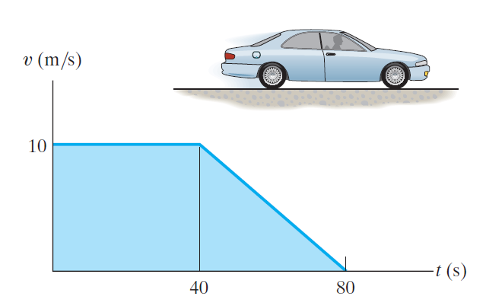
GROUP PROBLEM SOLVING I
Given: The v-t graph shown.
Find: The a-t graph, average speed, and distance traveled for the 0 - 80 s interval.
Plan:
Find slopes of the v-t curve and draw the a-t graph.
Find the area under the curve. It is the distance traveled.
Finally, calculate average speed (using basic definitions!).
Notes:
Source : P12-42

Slide 16
GROUP PROBLEM SOLVING I (continued)
Solution:
Find the a–t graph.
For 0 ≤ t ≤ 40 a = dv/dt = 0 m/s²
For 40 ≤ t ≤ 80 a = dv/dt = -10 / 40 = -0.25 m/s²
a-t graph
a(m/s²)
40
80
0
-0.25
t(s)

Slide 17
GROUP PROBLEM SOLVING I (continued)
Now find the distance traveled:
Δs₀₋₄₀ = ∫ v dt = ∫ 10 dt = 10 (40) = 400 m
Δs₄₀₋₈₀ = ∫ v dt = ∫ (20 − 0.25 t) dt = [ 20 t -0.25 (1/2) t² ] = 200 m
80
40
s₀₋₉₀ = 400 + 200 = 600 m
v_{avg(0-90)} = total distance / time
= 600 / 80
= 7.5 m/s
v = 10
v = 20 -0.25 t

Slide 18
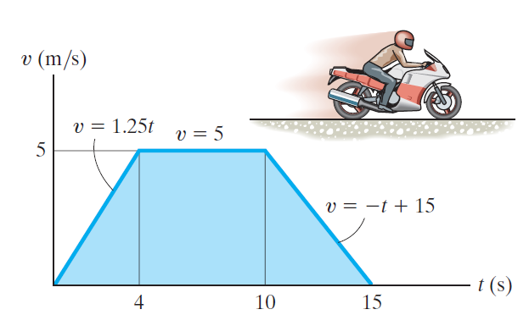
GROUP PROBLEM SOLVING II
Given: The v-t graph shown.
Find: The a-t graph and distance traveled for the 0 - 15 s interval.
Plan:
Find slopes of the v-t curve and draw the a-t graph.
Find the area under the curve. It is the distance traveled.
Notes:
Source : P12-52, P12-53

Slide 19
GROUP PROBLEM SOLVING II (continued)
Solution:
Find the a–t graph:
For 0 ≤ t ≤ 4 a = dv/dt = 1.25 m/s²
For 4 ≤ t ≤ 10 a = dv/dt = 0 m/s²
For 10 ≤ t ≤ 15 a = dv/dt = -1 m/s²
a(m/s²)
a-t graph
1.25
4
10
15
t(s)
-1

Slide 20
GROUP PROBLEM SOLVING II (continued)
Now find the distance traveled:
Δs₀₋₄ = ∫ v dt = [ (1.25) (1/2) t²] = 10 m
⁴
⁰
Δs₄₋₁₀ = ∫ v dt = [ 5 t ] = 30 m
¹⁰
⁴
Δs₁₀₋₁₅ = ∫ v dt = [ - (1/2) t² + 15 t] = 12.5 m
¹⁵
¹⁰
s₀₋₁₅= 10 + 30 + 12.5 = 52.5 m

Slide 21
ATTENTION QUIZ
1. If a car has the velocity curve shown, determine the time t necessary for the car to travel 100 meters.
A) 8 s B) 4 s
C) 10 s D) 6 s
v
75
t
6 s
2. Select the correct a-t graph for the velocity curve shown.
A) B)
C) D)
a
a
v
t
t
a
a
t
t
t
Notes:
Answers:
1. B
2. D

Slide 22
End of the Lecture
Let Learning Continue

