Slide 1
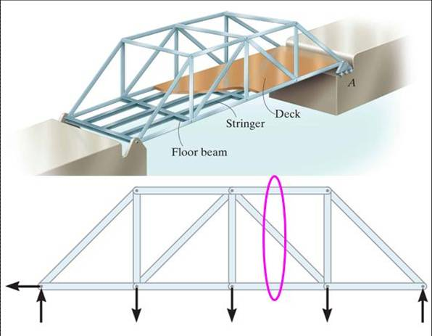
THE METHOD OF SECTIONS
Today’s Objectives:
Students will be able to determine:
Forces in truss members using the method of sections.
In-Class Activities:
Check Homework, if any
Reading Quiz
Applications
Method of Sections
Concept Quiz
Group Problem Solving
Attention Quiz

Slide 2
READING QUIZ
1. In the method of sections, generally a “cut” passes through no more than _____ members in which the forces are unknown.
A) 1 B) 2
C) 3 D) 4
2. If a simple truss member carries a tensile force of T along its length, then the internal force in the member is ______ .
A) Tensile with magnitude of T/2
B) Compressive with magnitude of T/2
C) Compressive with magnitude of T
D) Tensile with magnitude of T
Notes:
Answers:
1. C
2. D

Slide 3
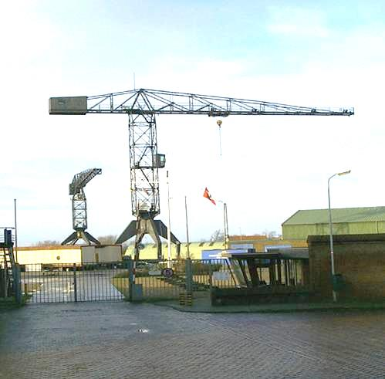
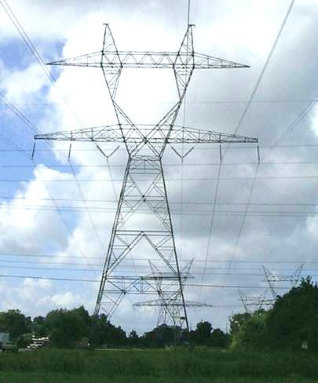
APPLICATIONS
Long trusses are often used to construct large cranes and large electrical transmission towers.
The method of joints requires that many joints be analyzed before we can determine the forces in the middle of a large truss.
So another method to determine those forces is helpful.

Slide 4
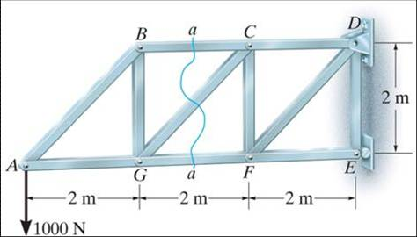
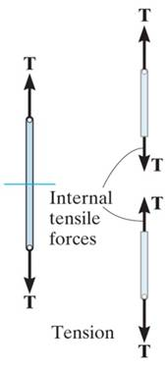
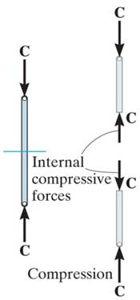
THE METHOD OF SECTIONS
In the method of sections, a truss is divided into two parts by taking an imaginary “cut” (shown here as a-a) through the truss.
Since truss members are subjected to only tensile or compressive forces along their length, the internal forces at the cut members also will be either tensile or compressive, with the same magnitude as the forces at the joint. This result is based on the equilibrium principle and Newton’s third law.

Slide 5
STEPS FOR ANALYSIS
1. Decide how you need to “cut” the truss. This is based on: a) where you need to determine forces, and, b) where the total number of unknowns does not exceed three (in general).
2. Decide which side of the cut truss will be easier to work with (goal is to minimize the number of external reactions).
3. If required, determine any necessary support reactions by drawing the FBD of the entire truss and applying the E-of-E.

Slide 6
STEPS FOR ANALYSIS (continued)
4. Draw the FBD of the selected part of the cut truss. You need to indicate the unknown forces at the cut members. Initially, you may assume all the members are in tension, as done when using the method of joints. Upon solving, if the answer is positive, the member is in tension, as per the assumption. If the answer is negative, the member is in compression. (Please note that you can assume forces to be either tension or compression by inspection as was done in the figures above.)

Slide 7
STEPS FOR ANALYSIS (continued)
5. Apply the scalar equations of equilibrium (E-of-E) to the selected cut section of the truss to solve for the unknown member forces. Please note, in most cases it is possible to write one equation to solve for one unknown directly. So look for it and take advantage of such a shortcut!

Slide 8
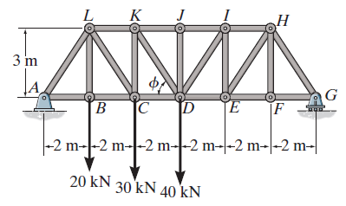
EXAMPLE
Given: Loads as shown on the truss.
Find: The force in members KJ, KD, and CD.
Plan:
a) Take a cut through members KJ, KD and CD.
b) Work with the left piece of the cut sections. Why?
c) Determine the support reactions at A. What are they?
d) Apply the E-of-E to find the forces in KJ, KD and CD.
Notes:
Source : F6-9

Slide 9
EXAMPLE (continued)
A_{X}
A_{Y}
G_{Y}
Analyzing the entire truss for the reactions at A, we get Σ F_{X} = A_{X} = 0.
A moment equation about G to find A_{Y} results in:
Σ M_{G} = A_{Y} (12) – 20 (10) – 30 (8) – 40 (6) = 0; A_{Y} = 56.7 kN

Slide 10
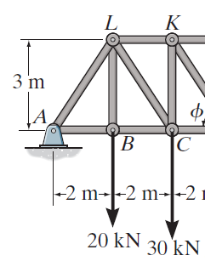
EXAMPLE (continued)
2
F_{KJ}
3
F_{KD}
F_{CD}
56.7 kN
Now take moments about point D. Why do this?
+ M_{D} = – 56.7 (6) + 20 (4) + 30 (2) – F_{KJ} (3) = 0
F_{KJ} = − 66.7 kN or 66.7 kN ( C )

Slide 11
EXAMPLE (continued)
2
F_{KJ}
3
F_{KD}
F_{CD}
56.7 kN
Now use the x and y-directions equations of equilibrium.
↑ + Σ F_{Y} = 56.7 – 20 – 30 – (3/√13) F_{KD} = 0;
F_{KD} = 8.05 kN (T)
→ + Σ F_{X} = (– 66.7) + (2/√13) ( 8.05 ) + F_{CD} = 0;
F_{CD} = 62.2 kN (T)

Slide 12
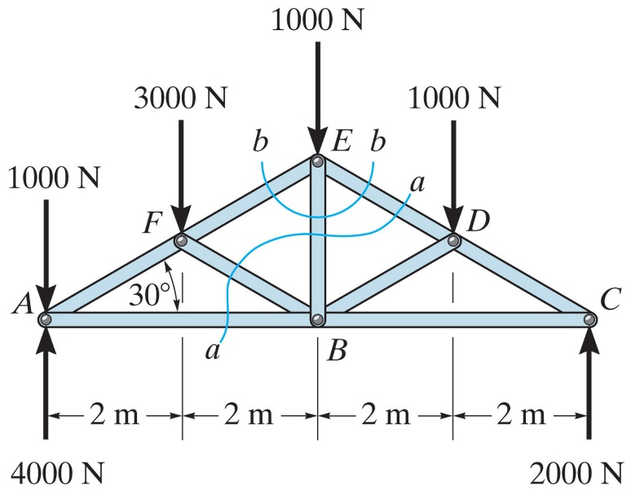
CONCEPT QUIZ
1. Can you determine the force in member ED by making the cut at section a-a? Explain your answer.
A) No, there are four unknowns.
B) Yes, using Σ M_{D} = 0 .
C) Yes, using Σ M_{E} = 0 .
D) Yes, using Σ M_{B} = 0 .
Notes:
Answer:
1. D

Slide 13
CONCEPT QUIZ (continued)
2. If you know F_{ED}, how will you determine F_{EB}?
A) By taking section b-b and using Σ M_{E} = 0
B) By taking section b-b, and using Σ F_{X} = 0 and Σ F_{Y} = 0
C) By taking section a-a and using Σ M_{B} = 0
D) By taking section a-a and using Σ M_{D} = 0
Notes:
Answer:
2. B

Slide 14
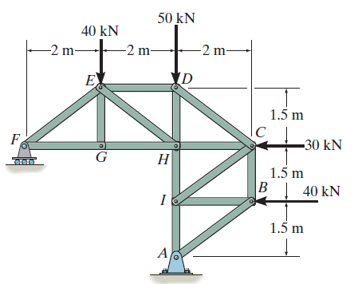
GROUP PROBLEM SOLVING
Given: Loads as shown on the truss.
Find: The forces in members ED, EH, and GH.
Plan:
a) Take the cut through members ED, EH, and GH.
b) Analyze the left section. Determine the support reactions at F. Why?
c) Draw the FBD of the left section.
d) Apply the equations of equilibrium (if possible, try to do it so that every equation yields an answer to one unknown.
Notes:
Source : P6-28

Slide 15
GROUP PROBLEM SOLVING (continued)
1) Determine the support reactions at F by drawing the FBD of the entire truss.
F_{y}
A_{x}
A_{y}
+ Σ M_{A} = – F_{y} (4) + 40 (2) + 30 (3) + 40 (1.5) = 0;
F_{y} = 57.5 kN

Slide 16
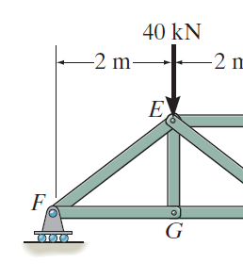
GROUP PROBLEM SOLVING (continued)
2) Analyze the left section.
F_{ED}
+ Σ M_{E} = – 57.5 (2) + F_{GH} (1.5) = 0;
F_{GH} = 76.7 kN (T)
1.5 m
4
3
F_{EH}
↑ + Σ F_{y} = 57.5 – 40 – F_{EH} (3/5)= 0;
F_{EH} = 29.2 kN (T)
F_{GH}
F_{y}= 57.5 kN
+ Σ M_{H} = – 57.5 (4) + 40 (2) – F_{ED} (1.5) = 0;
F_{ED} = -100 kN = 100 kN (C)

Slide 17
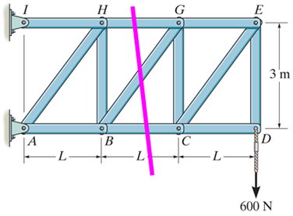
ATTENTION QUIZ
1. As shown, a cut is made through members GH, BG and BC to determine the forces in them. Which section will you choose for analysis and why?
A) Right, fewer calculations.
B) Left, fewer calculations.
C) Either right or left, same amount of work.
D) None of the above, too many unknowns.
Notes:
Answer:
1. A

Slide 18
ATTENTION QUIZ
2. When determining the force in member HG in the previous question, which one equation of equilibrium is the best one to use?
A) Σ M_{H} = 0
B) Σ M_{G} = 0
C) Σ M_{B} = 0
D) Σ M_{C} = 0
Notes:
Answer:
2. C

Slide 19
End of the Lecture
Let Learning Continue

