Slide 1
Choice of MARR and Capital Budgeting
Lecture No. 51
Chapter 15
Contemporary Engineering Economics
Copyright © 2016

Slide 2
Review: What is MARR?
MARR, Minimum Attractive Rate of Return
The required return necessary to make a capital budgeting project such as building a new factory worthwhile (profitable). It is commonly known as the discount rate (or the hurdle rate) for project evaluation.
When evaluating a project whose risk is higher than normal, the MARR could be adjusted to reflect this additional risk (also known as a risk-adjusted discount rate).

Slide 3
Choice of MARR: Overview
Choice of MARR when project financing is Known: Use i_{e} as your MARR.
Choice of MARR when project financing is Unknown: Use k as your MARR
Choice of MARR under Capital Rationing: It depends on the lending and borrowing opportunities.

Slide 4
Example 15.8: Choice of MARR when Project Financing Is Known
Given: Project cash flow information and i_{e} = 19.96%
Find: Net equity cash flow and justify the project based on i_{e}.

Slide 5
Solution
Explicit accounts
for debt flows
Equity flow

Slide 6
Example 15.9: Choice of MARR when Project Financing Is Unknown
Given: Cash flow information, debt ratio = 0.40, amount of financing required = $150,000
Find: Justify the project based on the cost of capital.

Slide 7
Solution
Without explicitly treating the debt flows, make a tax
adjustment to the discount rate, using the weighted cost of capital k.

Slide 8
Choice of MARR Under Capital Rationing

Slide 9
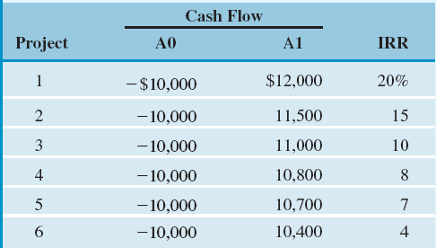
Example 15.10: Determining an Appropriate MARR as a Function of the Budget
Given: Investment opportunities with estimated IRRs
Find: Correct MARR to use as a function of budget available
Borrowing rate (k) = 10%
Lending rate (l) = 6%

Slide 10
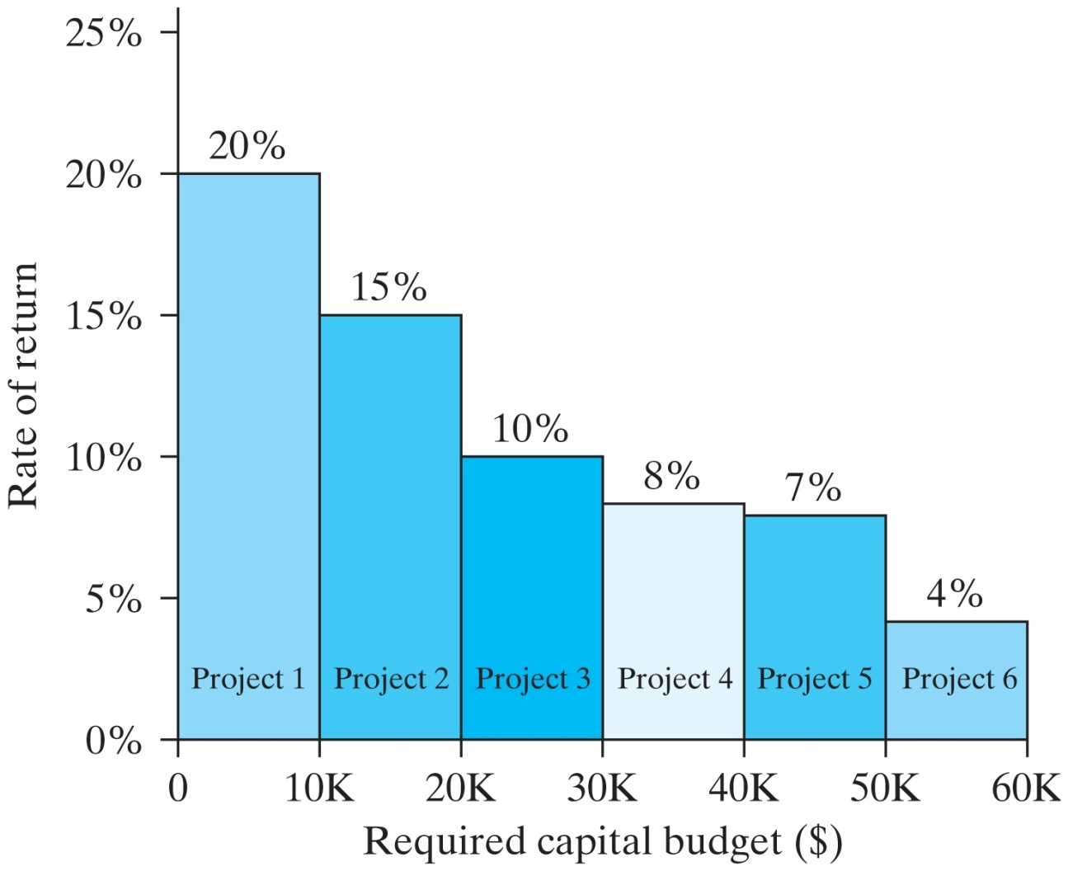
Solution
An investment opportunity schedule ranking alternatives by the RORs

Slide 11
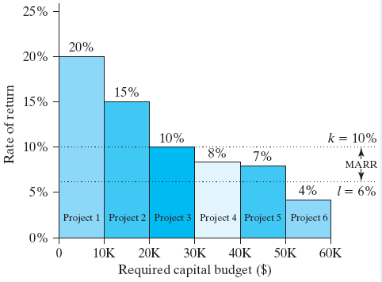
MARR as a Function of Budget
A range of MARR as a function of a budget
Available Budget | Projects Selected | Correct MARR to Use
$40,000 | 1,2,3, and 4 | MARR = 8%
$60,000 | 1,2,3, 4 and 5 | MARR = l = 6%
$0 | 1 and 2 | MARR = k = 10%

Slide 12
Capital Budgeting: Key Issues
Evaluation of Multiple Investment Alternatives
Independent projects
Dependent projects
Formulation of Mutually Exclusive Alternatives
Capital Budgeting Decisions with Limited Budgets

Slide 13
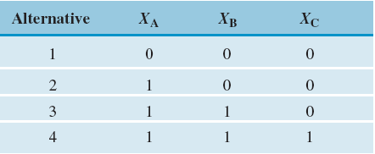
Formulation of Mutually Exclusive Alternatives
Independent Projects: Projects A and B are independent.
Dependent Projects: (A1,A2) and (B1,B2) are mutually exclusive
Dependent Projects: C is contingent
on the acceptance of both A and B.

Slide 14
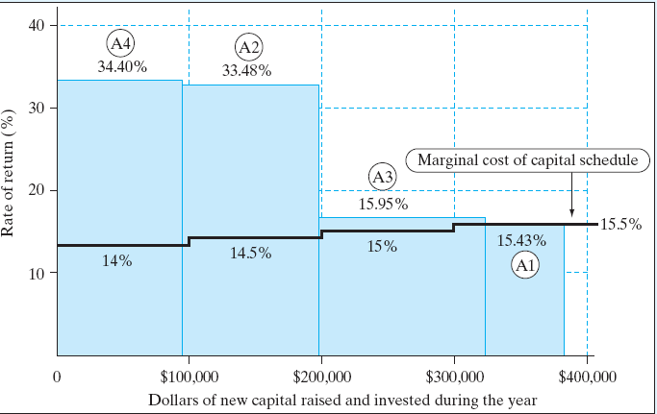
Example 15.11: Four Energy Saving Projects Under Budget Constraints (Budget Limit = $250,000)
Given: IRRs for four different energy projects
Find: (1) Optimal capital budget without budget limit; (2) best alternative with a $250,000 budget limit

Slide 15
Best Alternative with a $250,000 Budget Limit
Mutually Exclusive Decision Alternatives
Marginal Cost of Capital

Slide 16
Summary
The selection of an appropriate MARR depends generally upon the cost of capital—the rate the firm must pay to various sources for the use of capital.
The cost of equity (i_{e}) is used when debt-financing methods and repayment schedules are known explicitly.
The cost of capital (k) is used when exact financing methods are unknown, but a firm keeps it capital structure on target. In this situation, a project’s after-tax cash flows contain no debt cash flows such as principal and interest payment.
Under the capital rationing, the choice of MARR is determined by the marginal cost of capital as a function of budget.

Slide 17
Under conditions of capital rationing, the selection of MARR is more difficult, but generally the following possibilities exist:
Conditions | MARR
A firm borrows some capital from lending institutions at the borrowing rate, k, and some from its investment pool at the lending rate, l. | l <MARR< k
A firm borrows all capital from lending institutions at the borrowing rate, k. | MARR = k
A firm borrows all capital from its investment pool at the lending rate, l. | MARR = l

Slide 18
The cost of capital used in the capital budgeting process is determined at the intersection of the IOS and MCC schedules.
If the cost of capital at the intersection is used, then the firm will make correct accept/reject decisions, and its level of financing and investment will be optimal. This view assumes that the firm can invest and borrow at the rate where the two curves intersect.

Slide 19
If a strict budget is placed in a capital budgeting problem and no projects can be taken in part, all feasible investment decision scenarios need to be enumerated. Depending upon each investment scenario, the cost of capital will also likely change.
Our task is to find the best investment scenario in light of a changing cost of capital environment.
As the number of projects to consider increases, we may eventually resort to a more advanced technique, such as a mathematical programming procedure.

