Slide 1
Incremental Analysis
Lecture No. 26
Chapter 7
Contemporary Engineering Economics
Copyright © 2016

Slide 2
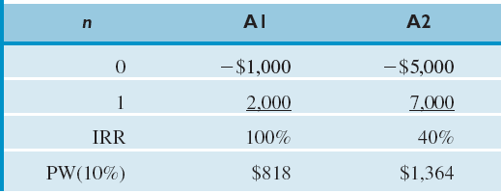
Flaws in Project Ranking by IRR
At Issue: Can we rank the mutually exclusive projects by the magnitude of its IRR?
Assuming that you have enough money to select either alternative, would you prefer A1 simply because it has a higher ROR?
Comparing Mutually Exclusive Alternatives Based on IRR

Slide 3
Who Got a Bigger Pay Raise?
At Issue: Can you say that Bill got a bigger raise than Nancy?

Slide 4
Cannot Compare Without Knowing Their Base Salaries
For the same reason, we can’t compare mutually exclusive projects based on the magnitude of their IRR. We need to know the size of the investment and its timing of cash flows over the life of the project.
 | Bill | Nancy
Base Salary | $50,000 | $200,000
Pay Raise (%) | 10% | 5%
Pay Raise ($) | $5,000 | $10,000

Slide 5
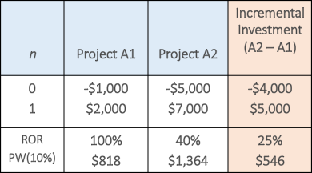
Incremental Analysis
Incremental cash flows
At Issue: Can we justify the higher cost investment, say A2? Suppose you have exactly $5,000 to invest and MARR = 10%.
Option 1: If you go with A1, the $4,000 of unspent funds will remain in your investment pool to earn 10%, so you will have $4,400 at the end of one year.
Option 2: By investing the additional $4,000 in A2, you would make an additional $5,000, which is equivalent to earning at the rate of 25%. Therefore, the higher cost investment (A2) is justified.

Slide 6
Incremental Analysis (Procedure)
Step 1: Compute the cash flow series for the difference between the projects (A, B) by subtracting the cash flow of the lower investment cost project (A) from that of the higher investment cost project (B).
Step 2: Compute the IRR on this incremental investment (IRR_{B-A} ).
Step 3: Accept the investment B if, and only if, IRR _{B-A} > MARR.
NOTE: Make sure that both IRR_{A} and IRR_{B} are greater than MARR.

Slide 7
Example 7.11: IRR on Incremental Investment: Two Alternatives
Given: Project Cash Flows
Find: Which project is a better choice at MARR = 10%?

Slide 8
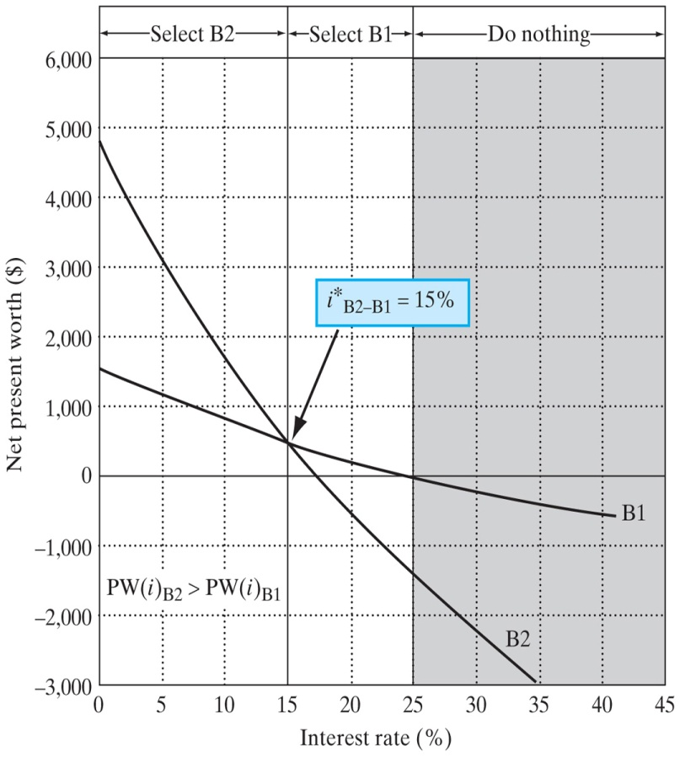
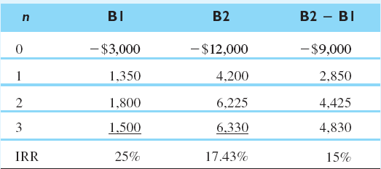
Solution
Project Cash Flows
Conclusion
Since IRR_{B2-B1}=15% > 10%, and also IRR_{B2} > 10%, select B2.

Slide 9
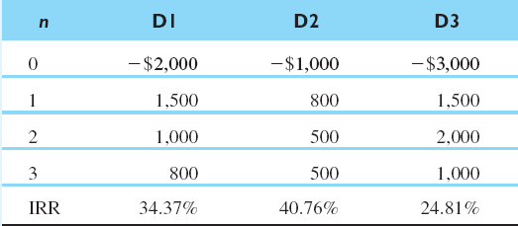
Example 7.12: IRR on Incremental Investment: Three Alternatives
Given: MARR = 15%
Find: Which project to choose?

Slide 10
Solution
Step 1: Examine the IRR for each project to eliminate any project that fails to meet the MARR.
Step 2: Compare D1 and D2 in pairs. IRR_{D1-D2}=27.61% > 15%, so select D1. D1 becomes the current best.
Step 3: Compare D1 and D3. IRR_{D3-D1}= 8.8% < 15%, so select D1 again.
Here, we conclude that D1 is the best alternative.

Slide 11
Example 7.14: Incremental Analysis for Service Projects
At Issue: Can we compare mutually exclusive service projects based on IRR criterion?

Slide 12
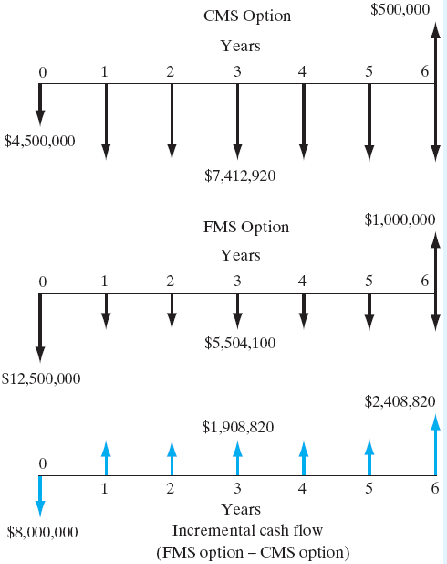
Solution
Given: MARR = 15%, incremental cash flows (FMS-CMS)
Find: Select the better alternative on the basis of IRR criterion.
ROR on Incremental Investment

Slide 13
Example 7.15: IRR Analysis for Projects with Different Lives
At Issue: Can we compare projects with different service lives based on the principle of IRR criterion?
Given: MARR = 15%, incremental cash flows on service projects (Model B − Model A)
Find: Which model to select?

Slide 14
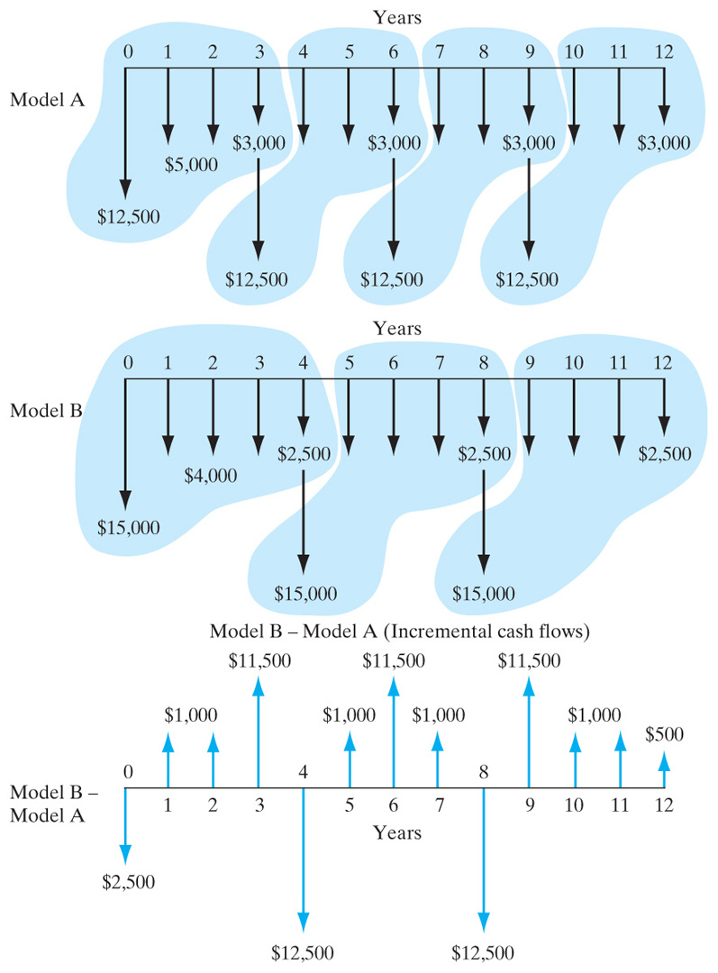
Solution
Assumptions: Project repeatability is likely. Use LCM of 12 years.
The incremental cash flows (Model B − Model A) result in a mixed investment. We need to calculate the RIC at 15%.
RIC_{B–A} = 50.68% > 15%
Select Model B.

Slide 15
Summary
Rate of return (ROR) is the interest rate earned on unrecovered project balances such that an investment’s cash receipts make the terminal project balance equal to zero.
Rate of return is an intuitively familiar and understandable measure of project profitability that many managers prefer to NPW or other equivalence methods.

Slide 16
Mathematically, we can determine the rate of return for a given project cash flow series by locating an interest rate that equates the net present worth of its cash flows to zero. This break-even interest rate is denoted by the symbol i*.
Internal rate of return (IRR) is another term for ROR that stresses the fact that we are concerned with the interest earned on the portion of the project that is internally invested, not those portions that are released by (borrowed from) the project.
To apply the rate of return analysis correctly, we need to classify an investment as either a simple or a nonsimple investment.

Slide 17
A simple investment is defined as one in which the initial cash flow is negative and only one sign change occurs in the net cash flow series, whereas a nonsimple investment is one for which more than one sign change occurs in the net cash flow series.
Multiple i*s occur only in nonsimple investments. However, not all nonsimple investments will have multiple i*s either. A unique positive i* for a project does not imply a simple investment.

Slide 18
For a pure investment, the solving rate of return (i*) is the rate of return internal to the project; so the decision rule is:
If IRR > MARR, accept the project.
If IRR = MARR, remain indifferent.
If IRR < MARR, reject the project.
IRR analysis yields results consistent with NPW and other equivalence methods.
For a mixed investment, we need to calculate the true IRR, otherwise known as the “return on invested capital (RIC).” However, if your objective is simply to make an accept or reject decision, it is recommended that either NPW or AE analysis be used to make an accept/reject decision.
To compare mutually exclusive alternatives by IRR analysis, incremental analysis must be adopted.

