Slide 1
Methods for Finding the Rate of Return
Lecture No. 24
Chapter 7
Contemporary Engineering Economics
Copyright © 2016

Slide 2
Simple versus Nonsimple Investments
Simple investment
Nonsimple investment
Definition: An investment with only one sign change in the net cash flow series
Definition: An investment in which more than one sign change occurs in the net cash flow series

Slide 3
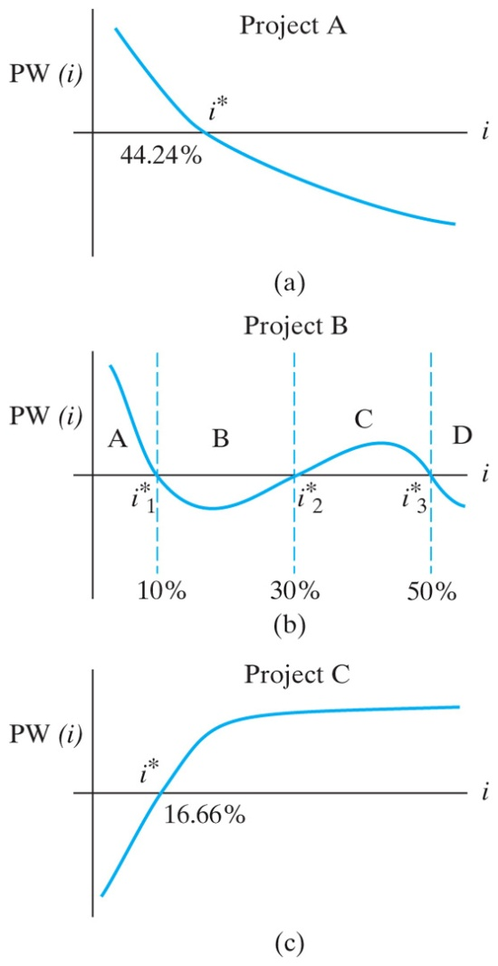
Example 7.1: Investment Classification
Period n | Net Cash Flow
 | Project A | Project B | Project C
0 1 2 3 4 | -1,000 -500 800 1,500 2,000 | -1,000 3,900 -5,030 2,145 | 1,000 -450 -450 -450
Project A: a simple investment
Project B: a nonsimple investment
Project C: a simple borrowing

Slide 4
Predicting Multiple i*s
Net Cash Flow Rule of Signs
The number of real i*s that are greater than −100% for a project with N periods is never greater than the number of sign changes in the sequence of the cash flows. A zero cash flow is ignored.
Accumulated Cash Flow Sign Test
If the sequence of accumulated cash flow series starts negatively and changes sign only once, then a unique positive i* exists.

Slide 5
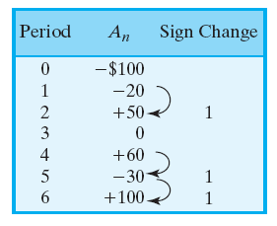
Predicting the Number of i*s
Net Cash-Flow Rule of Signs
Accumulated Cash-Flow Sign Test
Number of real i*s ≤ 3.
This implies that the project could have (0, 1, 2, or 3) i*s, but NOT more than 3.
Number of sign changes = 1, indicating a unique i*.
i* = 10.46%

Slide 6
Computational Methods
Using Excel’s financial command
Direct solution method
Trial-and-error method
Works only for simple investment
Cash flow analyzer
Online financial calculator

Slide 7
Finding Rate of Return on Excel
Period (N) | Cash Flow
0 | -$1,000
1 | -500
2 | 800
3 | 1,500
4 | 2,000
=IRR(cell range, guess)
=IRR(B3:B7,10%)

Slide 8
Other Computational Methods
 | Direct Solution | Direct Solution | Trial and Error Method | Computer Solution Method
 | Log | Quadratic
n | Project A | Project B | Project C | Project D
0 | −$1,000 | −$2,000 | −$75,000 | −$10,000
1 | 0 | 1,300 | 24,400 | 20,000
2 | 0 | 1,500 | 27,340 | 20,000
3 | 0 |  | 55,760 | 25,000
4 | 1,500

Slide 9
Direct Solution Methods
Project A
Project B

Slide 10
Trial and Error Method: Project C
Step 1: Guess an interest rate, say, i = 15%.
Step 2: Compute PW(i) at the guessed i value.
PW (15%) = $3,553
Step 3: If PW(i) > 0, then increase i. If PW(i) < 0, then decrease i.
PW(18%) = −$749
Step 4: Once you bracket the solution, then you use a linear interpolation to approximate the solution.
$3,553
0
−$749
15%
i
18%
Note: This method works only for finding i* for simple investments.

Slide 11
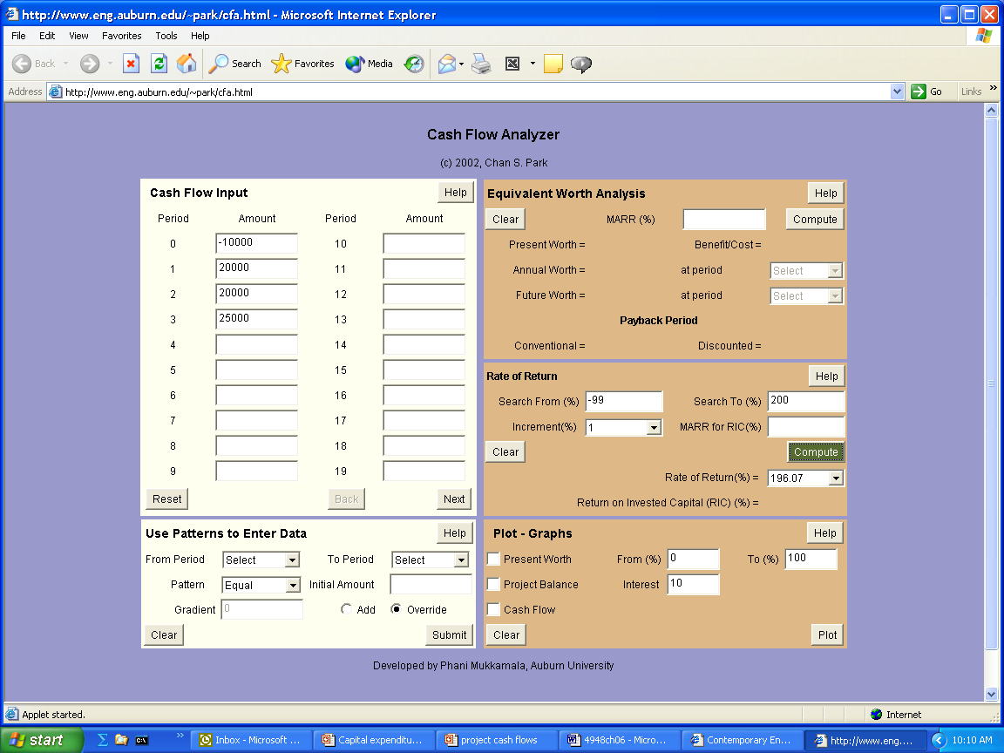
Using the Cash Flow Analyzer: Project D
Output
196%
Input data

Slide 12
Multiple Rates of Return Problem
Project cash flows
Rates of return
$2,300
0
2
1
$1,000
$1,320

Slide 13
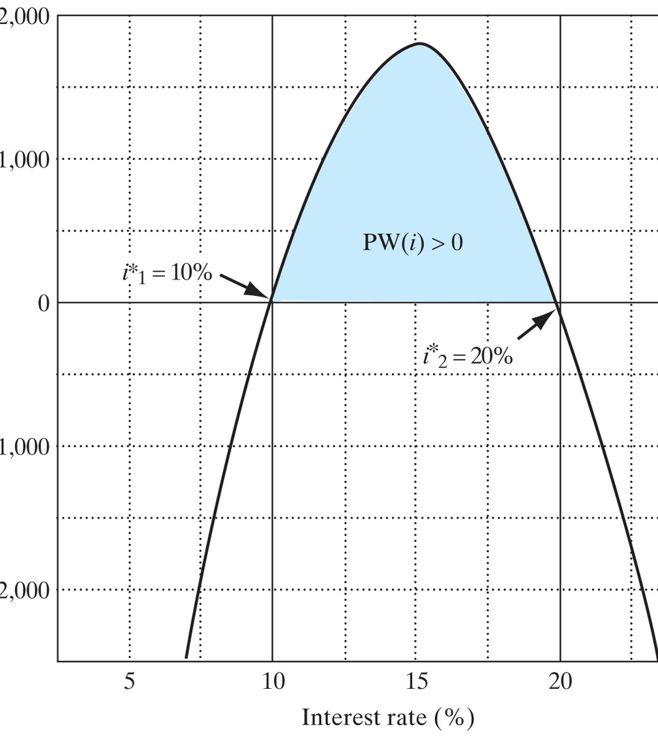
NPW Plot
At Issue: If your MARR = 15%, which ROR do you use to make an accept/reject decision—10% or 20%?

