Slide 1
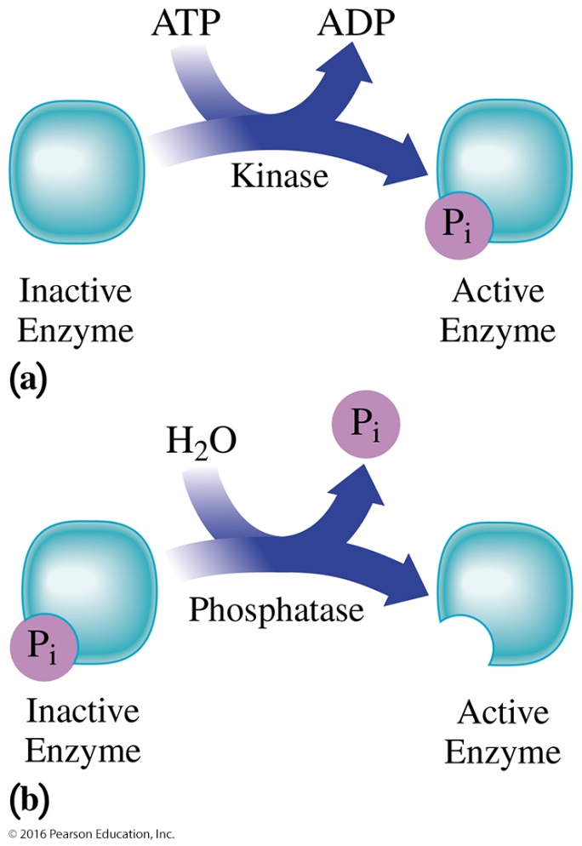
20.4 Regulation of Enzyme Activity
Phosphorylation is a type of covalent modification that activates or deactivates an enzyme.
a) A kinase activates an inactive enzyme by phosphorylation.
b) A phosphatase activates an inactive enzyme by removal of a phosphate.
Learning Goal Describe the roles of allosteric enzymes, feedback control, and covalent modification in regulating enzyme activity.

Slide 2
Enzyme Regulation
The rates of enzyme-catalyzed reactions are controlled by regulatory enzymes that
increase the reaction rate when more of a particular substance is needed.
decrease the reaction rate when that substance is not needed.
Enzyme activity can be regulated by allosteric enzymes, feedback control, and covalent modifications.

Slide 3
Allosteric Enzymes
Allosteric enzymes
bind with a regulator molecule at the allosteric site that is different from the active site.
change the shape of the enzyme, which causes a change in the shape of the active site.
can be a positive regulator that changes the shape of the active site to allow the substrate to bind more effectively.
can be a negative regulator that changes the shape of the active site to prevent the proper binding of the substrate, which decreases the rate of the catalyzed reaction.

Slide 4
Regulation by Allosteric Enzymes
A positive regulator changes the shape of the active site allowing the substrate to bind more effectively and increasing the reaction rate. A negative regulator changes the shape of the active site preventing the binding of the substrate and decreasing the reaction rate.

Slide 5
Feedback Control
In feedback control, when the end product level is high,
the end product of a series of reactions acts as a negative regulator and binds to the allosteric site.
the substrate cannot bind to the active site, and production of all of the intermediate compounds in the subsequent reaction sequence stops.

Slide 6
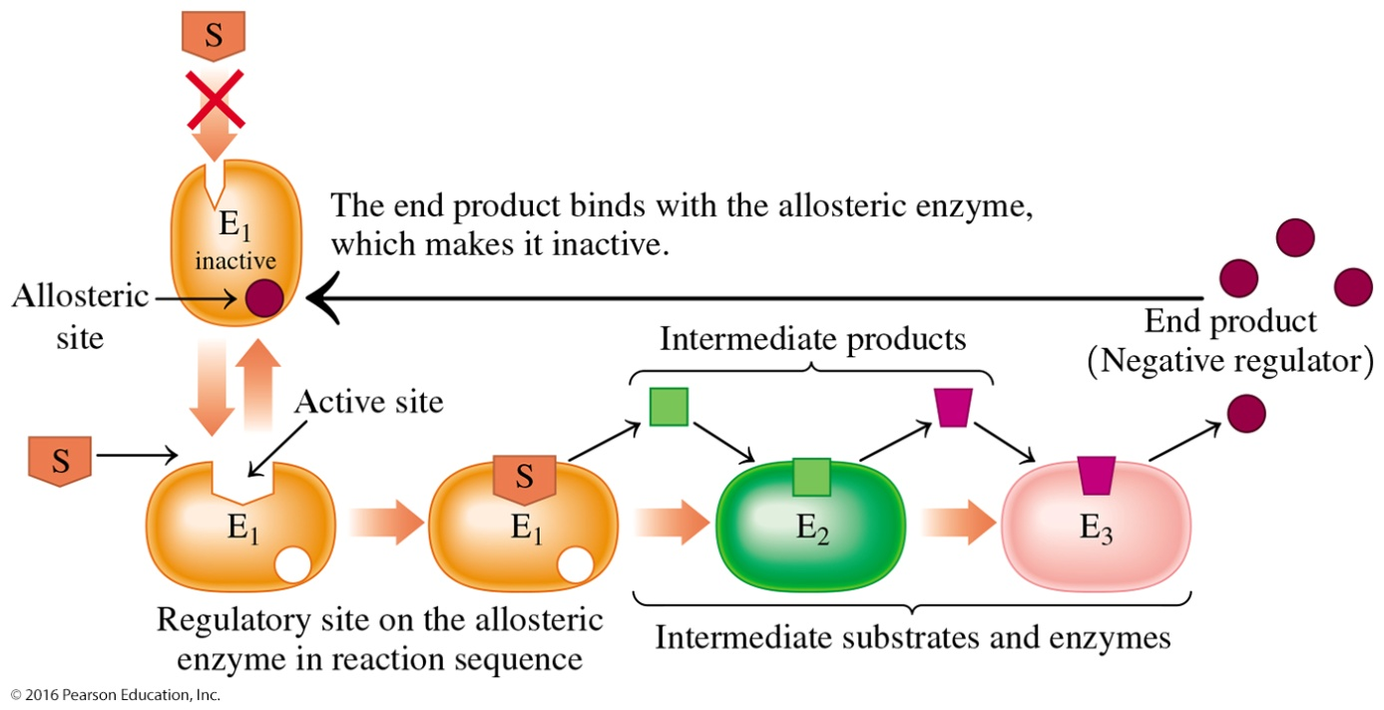
Feedback Control
In feedback control, when the level of end product is low,
the regulator dissociates from the allosteric site on the enzyme, unblocking the active site.
the initial substrate is allowed to bind to the active site again.
In feedback control, the end product binds to a regulatory site on the allosteric (first) enzyme in the reaction sequence, which prevents the formation of all intermediate compounds needed in the synthesis of the end product.

Slide 7
Covalent Modification
Covalent modification is another way in which enzymes are modified.
Enzyme activity is modified by covalent bonds to a group on the polypeptide chain that are formed or broken.
Covalent modification is reversible.
Zymogens, or proenzymes, are produced in their inactive form and can be activated at a later time when they are needed.

Slide 8
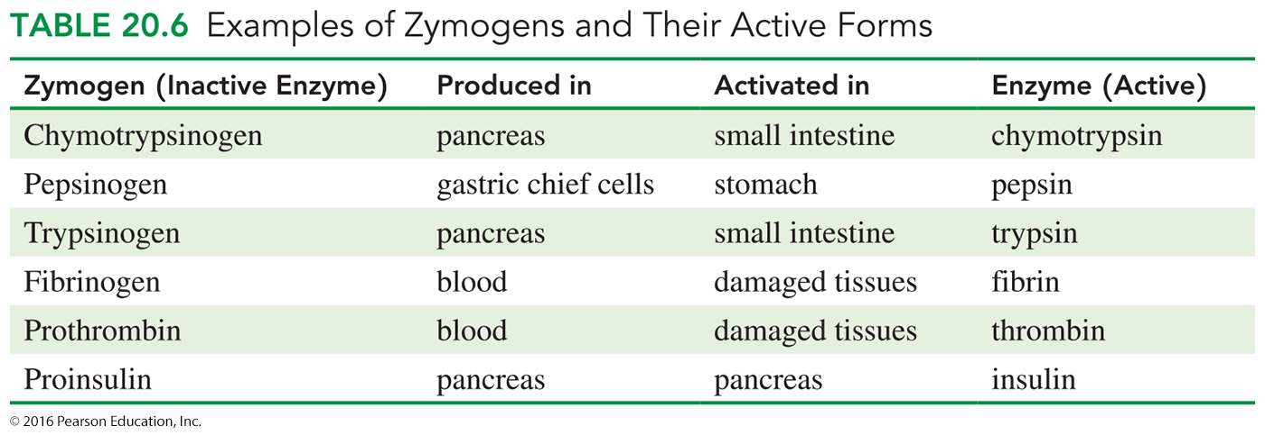
Zymogens, Proenzymes
Zymogens include
digestive enzymes; protein hormones, such as insulin; and blood clotting enzymes.
proteases, or digestive enzymes that hydrolyze protein, produced as larger, inactive forms.

Slide 9
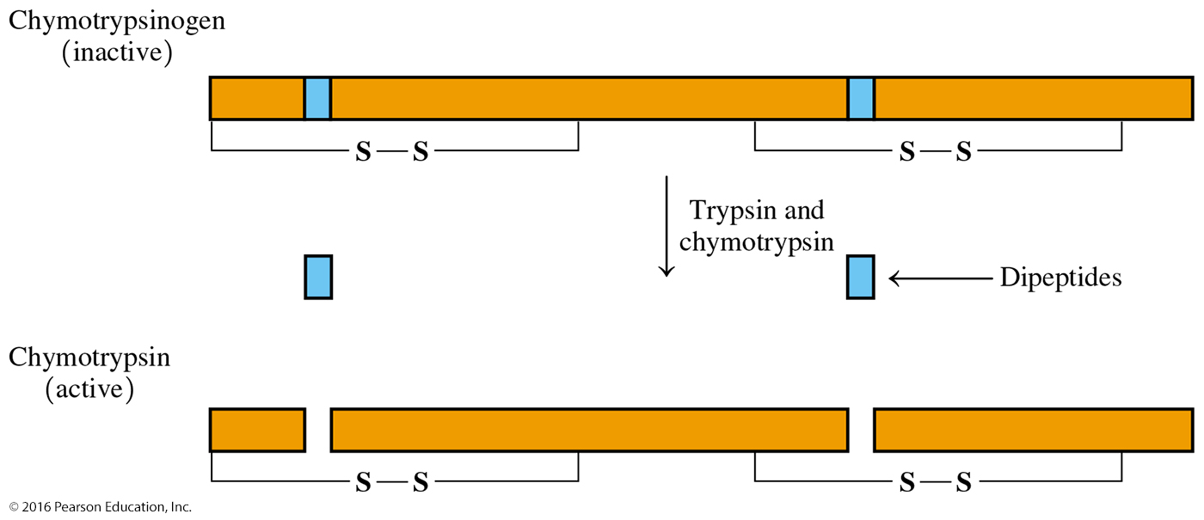
Zymogens, Proenzymes
Once a zymogen is formed, it is
transported to where the active form is needed.
converted to its active form by a covalent modification.
Zymogens such as the proteases trypsinogen and chymotrypsinogen
are stored in the pancreas until after food is ingested.
are released when triggered by hormones from the pancreas.
Once formed, trypsin catalyzes the removal of dipeptides from inactive chymotrypsinogen and trypsinogen to give the active proteases chymotrypsin and trypsin.

Slide 10
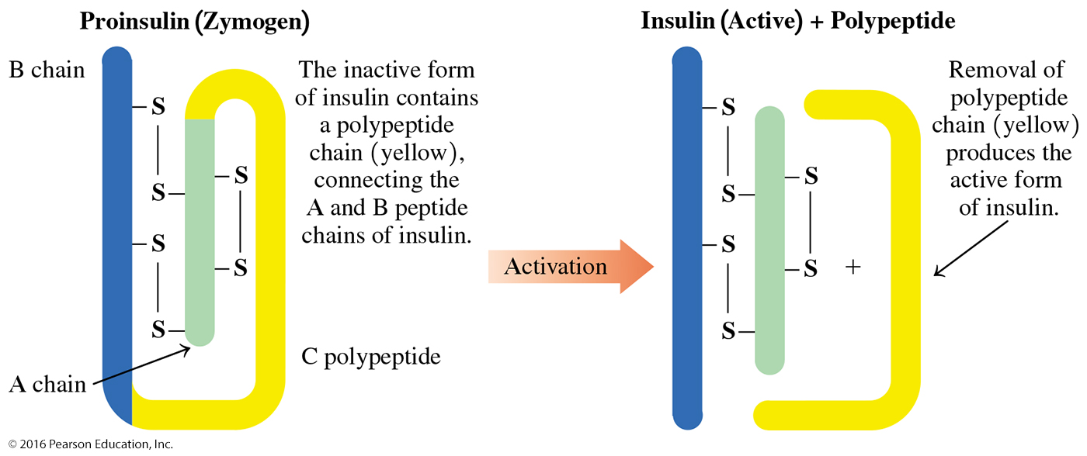
Zymogens, Insulin
The protein hormone insulin
is synthesized in the pancreas as a zymogen called proinsulin.
becomes biologically active when the polypeptide chain of 33 amino acids is removed by peptidases.
The removal of a polypeptide chain from proinsulin produces the active form of insulin.

Slide 11
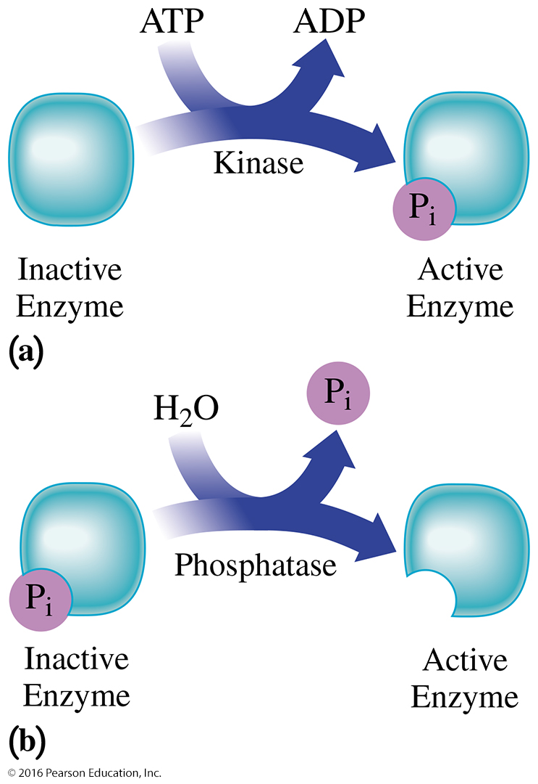
Phosphorylation
An inactive enzyme undergoes covalent modification in which an enzyme
can be activated by the addition of a phosphate group.
can be deactivated by the removal of a phosphate group.
Phosphorylation is a type of covalent modification in which an enzyme is deactivated or activated. (a) A kinase can activate an inactive enzyme by phosphorylation. (b) A phosphatase can activate an inactive enzyme by removal of
phosphate.

Slide 12
Study Check
Indicate whether the following statements describe enzyme regulation by an allosteric enzyme, a zymogen, or covalent modification:
An end product attaches to the regulatory site of the first enzyme in the reaction sequence.
Proinsulin forms in the pancreas.
Phosphorylase kinase deactivates pyruvate dehydrogenase.

Slide 13
Solution
Indicate whether the following statements describe enzyme regulation by an allosteric enzyme, a zymogen, or covalent modification:
An end product attaches to the regulatory site of the first enzyme in the reaction sequence. allosteric enzyme
Proinsulin forms in the pancreas. zymogen
Phosphorylase kinase deactivates pyruvate dehydrogenase. covalent modification

