Slide 1
8.6 Volume and Moles, Avogadro’s Law
The molar volume of a gas at STP is about the same as the volume of three basketballs.
The volume of 1 mole of gas is 22.4 liters.
Learning Goal Use Avogadro’s law to calculate the amount or volume of a gas when the pressure and temperature are constant.

Slide 2
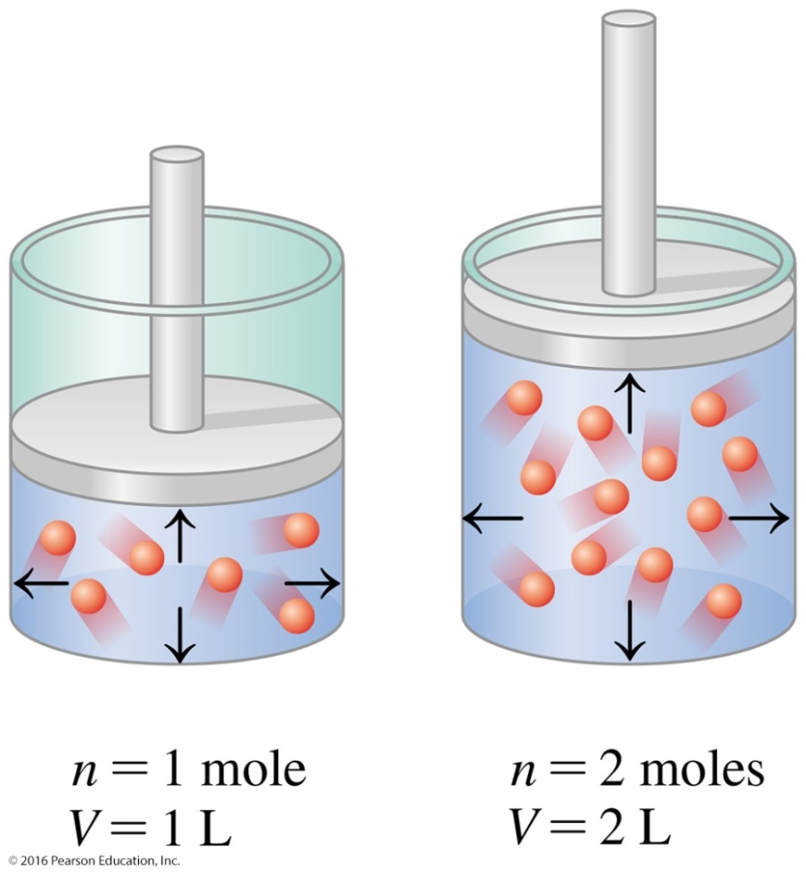
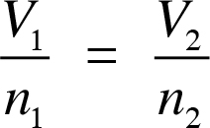
Avogadro’s Law: Volume and Moles
In Avogadro’s law,
the volume of a gas is directly related to the number of moles (n) of gas.
T and P are constant.

Slide 3
Calculations Using Avogadro’s Law
If 0.75 mole of helium gas occupies a volume of 1.5 L, what volume (L) will 1.2 moles of helium occupy at the same temperature and pressure?
A. 0.94 L
B. 1.8 L
C. 2.4 L

Slide 4
Calculations Using Avogadro’s Law
If 0.75 mole of helium gas occupies a volume of 1.5 L, what volume (L) will 1.2 moles of helium occupy at the same temperature and pressure?
STEP 1 Organize the data into a table of initial and final conditions.
Pressure and temperature remain constant.

Slide 5
Calculations Using Avogadro’s Law
STEP 2 Rearrange to solve for unknown quantity V₂.
STEP 3 Substitute the values into the gas law equation and calculate.
The answer is C.
×
×

Slide 6
Standard Temperature and Pressure
The volumes of gases can be compared at STP, Standard Temperature and Pressure, when they have
the same temperature.
a standard temperature (T) of 0 °C or 273 K.
the same pressure.
a standard pressure (P) of 1 atm (760 mmHg).

Slide 7
Molar Volume, STP
At standard temperature and pressure (STP), 1 mole of a gas occupies a volume of 22.4 L, which is called its molar volume.
Use this equality as a conversion factor for gas at STP:
22.4 L = 1 mole gas

Slide 8
Molar Volume
Avogadro’s law indicated that1 mole of any gas at STP has a volume of 22.4 L.

Slide 9
Guide to Using Molar Volume

Slide 10
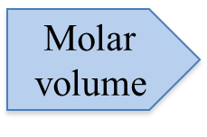
Calculations Using Molar Volume
What is the volume occupied by 2.75 moles of N₂ gas at STP?
STEP 1 State the given and needed quantities.
Pressure and temperature remain constant.
STEP 2 Write a plan to calculate the needed quantity.
Moles N₂ Volume N₂

Slide 11
Calculations Using Molar Volume
STEP 3 Write conversion factors including 22.4 L/mole at STP.
At STP, 22.4 L = 1 mole N₂.
STEP 4 Set up the problem with factors to cancel units.
$$×$$

Slide 12
Study Check
1. What is the volume at STP of 4.00 g of CH₄?
A. 5.60 L B. 11.2 L C. 44.8 L
2. How many grams of He are present in 8.00 L of gas at STP?
A. 25.6 g B. 0.357 g C. 1.43 g

Slide 13
Solution
STEP 1 State given and needed quantities.
1. What is the volume at STP of 4.00 g of CH₄?
Pressure and temperature remain constant.
2. How many grams of He are present in 8.00 L of gas at STP? Pressure and temperature remain constant.
ANALYZE Given Need
THE 4.00 grams CH₄(g) volume CH₄(g) PROBLEM at STP at STP

Slide 14
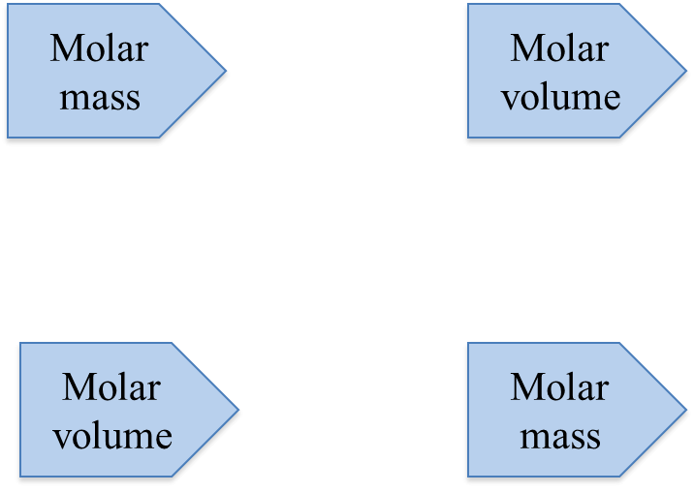
Solution
STEP 2 Write a plan to calculate the needed quantity.
1. What is the volume at STP of 4.00 g of CH₄?
mass CH₄ moles CH₄ volume CH₄
2. How many grams of He are present in 8.00 L of gas at STP?
volume He moles He mass He

Slide 15
Solution
STEP 3 Write conversion factors including 22.4 L/mole at STP.
1. What is the volume at STP of 4.00 g of CH₄?
22.4 L = 1 mole of CH₄
1 mole of CH₄ = 16.05 g CH₄

Slide 16
Solution
STEP 3 Write conversion factors including 22.4 L/mole at STP.
2. How many grams of He are present in 8.00 L of gas at STP?
1 mole of He = 4.00 g He
22.4 L = 1 mole of He

Slide 17
Solution
STEP 4 Set up the problem with factors to cancel units.
1. What is the volume at STP of 4.00 g of CH₄?
The answer is A, 5.60 L
2. How many grams of He are present in 8.00 L of gas at STP?
The answer is C, 1.43 g.
×
×
×
×

