Slide 1
6.2 Writing Formulas for Ionic Compounds
Ionic compounds consist of positive and negative charges held together by the strong electrical attractions between oppositely charged ions.
Learning Goal Using charge balance, write the correct formula for an ionic compound.

Slide 2
Properties of Ionic Compounds
Ionic compounds
consist of positive and negative ions.
have attractions called ionic bonds between positively and negatively charged ions.
have high melting points.
are solids at room temperature.

Slide 3
NaCl, An Ionic Compound
Sodium chloride is more commonly known as table salt. The magnification of NaCl crystals shows the arrangement of Na⁺ and Cl⁻ ions in an NaCl crystal.

Slide 4
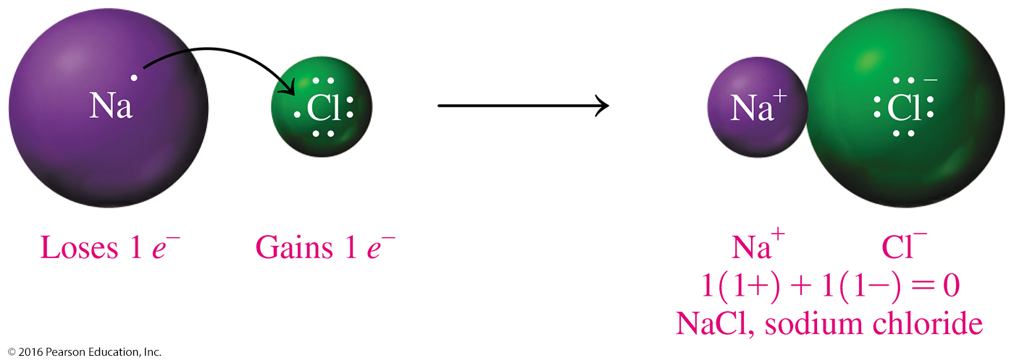
Formulas of Ionic Compounds
In a chemical formula,
the symbols and subscripts are written in the lowest whole-number ratio of the atoms or ions.
the sum of ion charges equals zero.
the total positive charge = total negative charge.

Slide 5
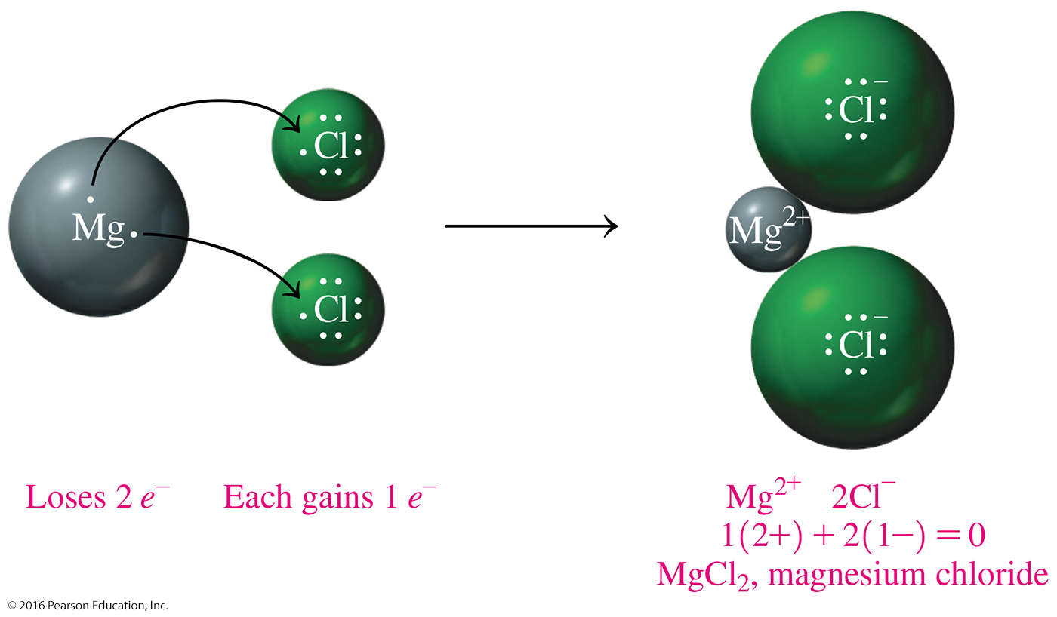
Subscripts in Formulas
Core Chemistry Skill Writing Ionic Formulas

Slide 6
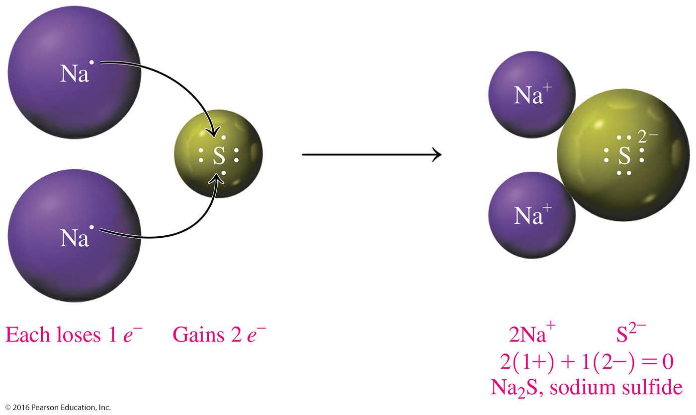
Writing Ionic Formulas from Ion Charges
To balance ionic charge in an ionic compound,
total positive charge = total negative charge

Slide 7
Study Check
Write the ionic formula of the compound formed with Ba²⁺ and Cl⁻ ions.

Slide 8
Solution
Write the ionic formula of the compound formed with Ba²⁺ and Cl⁻ ions.
Write the symbols of the ions:
Ba²⁺ Cl⁻
Balance the charges:
1(2+) + 2(1−) = 0
Writing the cation first and the anion second gives the formula BaCl₂.

Slide 9
Study Check
Select the correct formula for each of the following ionic compounds.
1. Na⁺ and O²⁻
A. NaO B. Na₂O C. NaO₂
2. Al³⁺ and Cl⁻
A. AlCl₃ B. AlCl C. Al₃Cl
3. Mg²⁺ and N³⁻
A. MgN B. Mg₂N₃ C. Mg₃N₂

Slide 10
Solution
Select the correct formula for each of the following ionic compounds.
Na⁺ and O²⁻ B. Na₂O Check:
2Na⁺ + O²⁻ = 2(1+) + 1(2−) = 0
Al³⁺ and Cl⁻ A. AlCl₃ Check:
Al³⁺ + 3Cl⁻ = (3+) + 3(1−) = 0
Mg²⁺ and N³⁻ C. Mg₃N₂ Check:
3Mg²⁺ + 2N³⁻ = 2(3+) + 2(3−) = 0

