Slide 1
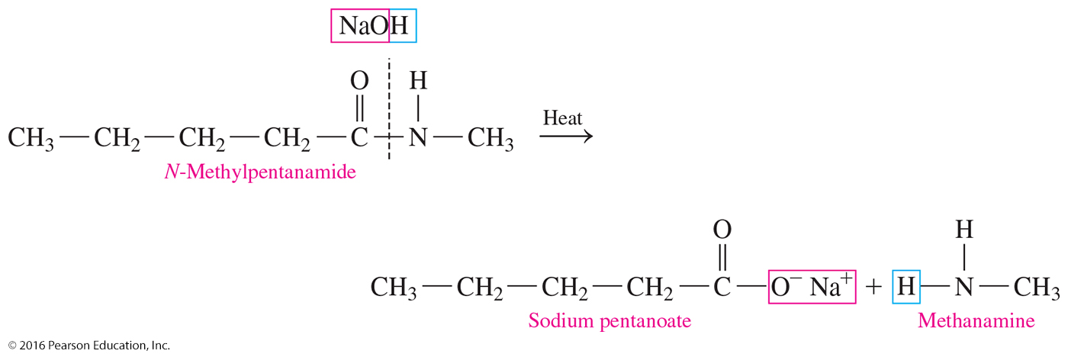
18.6 Hydrolysis of Amides
In a reverse reaction of amidation, hydrolysis occurs when water and an acid or a base split an amide.
Learning Goal Write balanced chemical equations for the hydrolysis of amides.

Slide 2
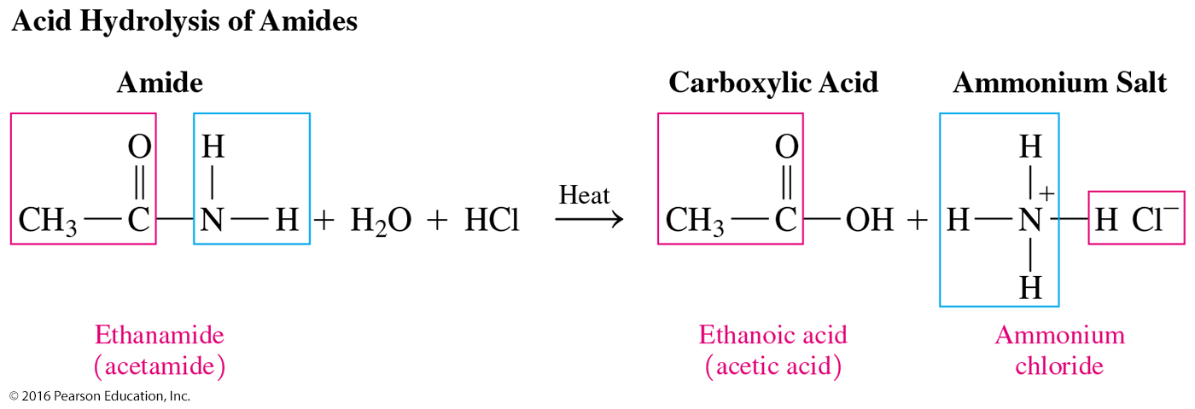
Acid Hydrolysis of Amides
Amides undergo acid hydrolysis with heat to produce a carboxylic acid and an ammonium salt.
Core Chemistry Skill Hydrolyzing Amides

Slide 3
Base Hydrolysis of Amides
Amides undergo base hydrolysis with heat to produce a carboxylate salt and an amine or ammonia.

Slide 4
Base Hydrolysis of Amides
Draw the condensed structural formulas and give the IUPAC names for the products from the hydrolysis of N-methylpentanamide with NaOH.
ANALYZE Given Need
THE hydrolysis of products, condensed
PROBLEM N-methylpentanamide structural formulas,
with NaOH IUPAC names

Slide 5
Base Hydrolysis of Amides
Draw the condensed structural formulas for the products from the hydrolysis of N-methylpentanamide with NaOH.
In the base hydrolysis of the amide,
the amide bond is broken between the carboxyl carbon atom and the nitrogen atom.
the products are the carboxylate salt and an amine.

Slide 6
Study Check
Draw the condensed structural formula for the hydrolysis of the following amide with HCl:
heat
+ H₂O + HCl →

Slide 7
Solution
Draw the condensed structural formula for the hydrolysis of the following amide with HCl:
heat
+ H₂O + HCl →

Slide 8
Concept Map

