Slide 1
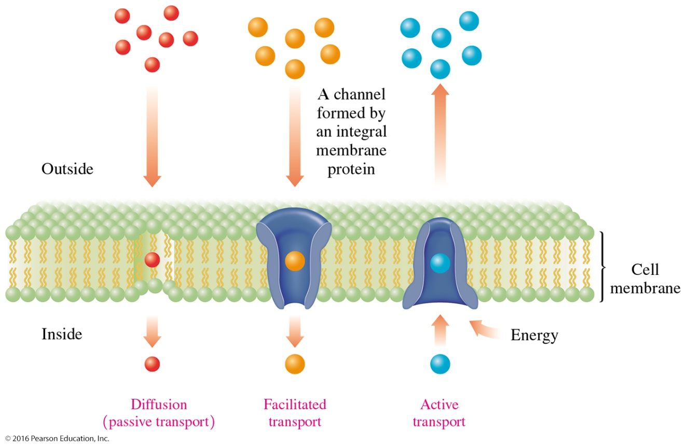
17.7 Cell Membranes
Substances are transported across a cell membrane by either diffusion, facilitated transport, or active transport.
Learning Goal Describe the composition and function of the lipid bilayer in cell membranes.

Slide 2
Cell Membranes
Cell membranes
are semipermeable so that nutrients can enter the cell and waste products can leave.
separate cellular contents from the external environment.
consist of a lipid bilayer made of two rows of phospholipids.
have an inner portion made of the nonpolar tails of phospholipids, with the polar heads at the outer and inner surfaces.

Slide 3
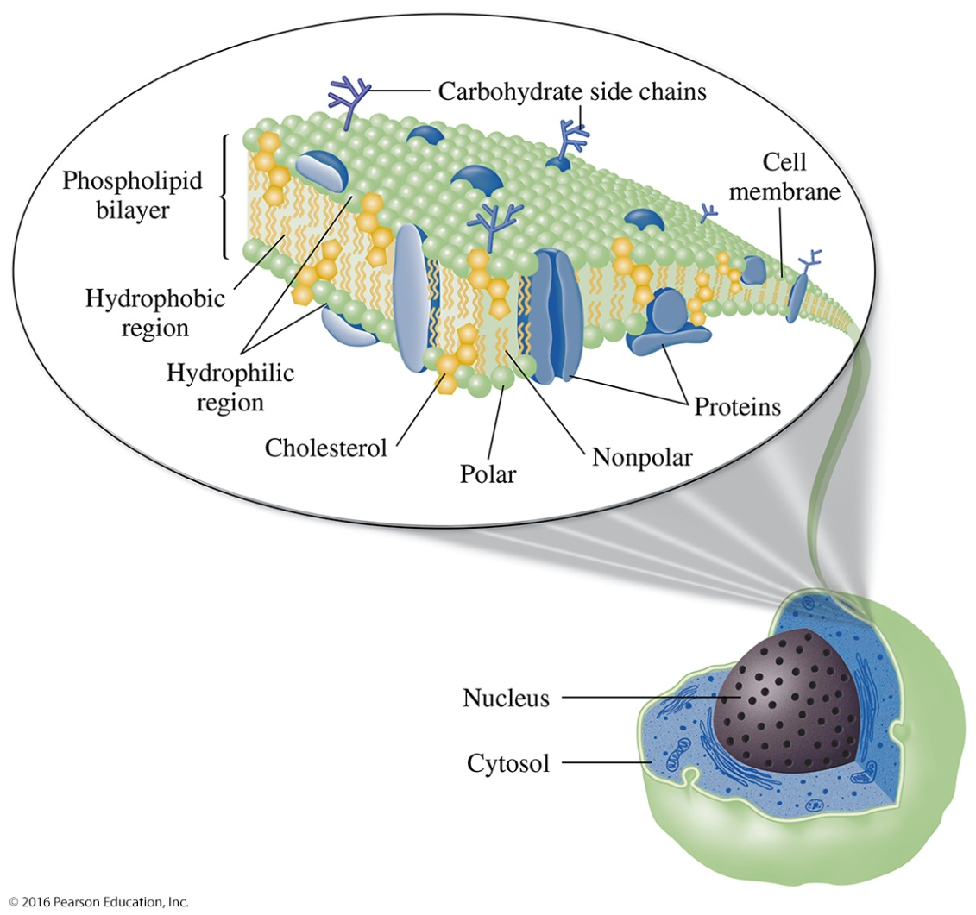
Fluid Mosaic Model, Cell Membrane
In the fluid mosaic model of a cell membrane,
proteins and cholesterol are embedded in a lipid bilayer of phospholipids.
the bilayer forms a membrane-type barrier with polar heads at the membrane surfaces and the nonpolar tails in the center, away from the water.

Slide 4
Fluid Mosaic Model, Cell Membrane
The lipid bilayer
contains phospholipids with unsaturated fatty acids with kinks in the carbon chains.
contains proteins, carbohydrates, and cholesterol molecules.
is not a rigid, fixed structure but one that is dynamic and fluid-like.
has proteins and carbohydrates on the surface that communicate with hormones and neurotransmitters.

Slide 5
Transport through Cell Membranes
The transport of substances through cell membranes involves
diffusion (passive transport), which moves particles from a higher to a lower concentration.
facilitated transport, which uses protein channels to increase the rate of diffusion.
active transport, which moves ions against a concentration gradient.

Slide 6
Transport Pathways through Cell Membranes
Substances are transported across a cell membrane by diffusion (passive) transport, facilitated transport, or active transport.
General, Organic, and Biological Chemistry: Structures of Life, 5/e
Karen C. Timberlake
© 2016 Pearson Education, Inc.

Slide 7
Study Check
The transport of particles across a cell membrane from high concentration to low concentration is called
A. facilitated transport.
B. diffusion.
C. active transport.

Slide 8
Solution
The transport of particles across a cell membrane from high concentration to low concentration is called
B. diffusion.

Slide 9
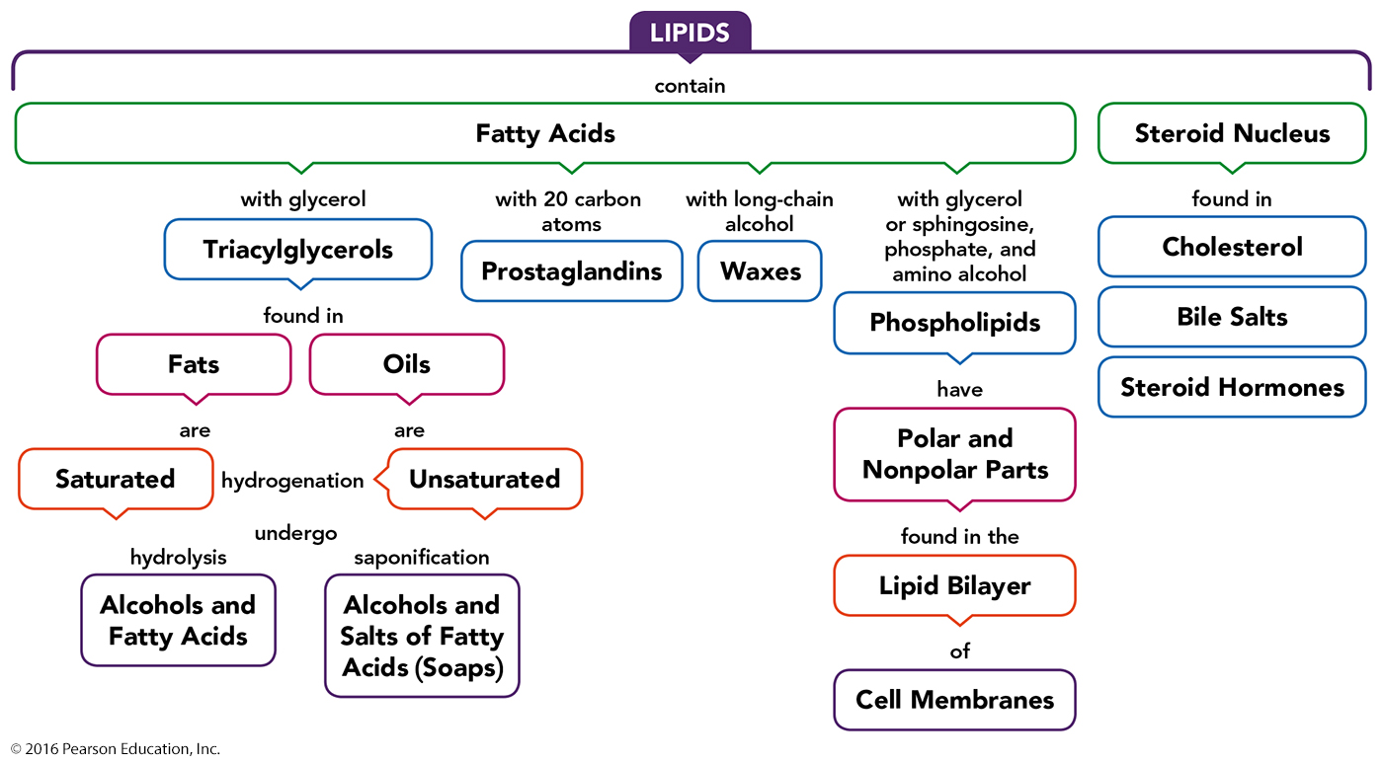
Concept Map

