Slide 1
14.2 Physical Properties of Aldehydes and Ketones
Aldehydes and ketones contain a polar carbonyl group with a partial negative charge on the carbonyl oxygen atom and a partial positive charge on the carbon atom.
Learning Goal Describe the boiling points and solubilities of aldehydes and ketones.

Slide 2
Polarity of Carbonyl Group
At room temperature, methanal (formaldehyde), and ethanal, (acetaldehyde) are gases.
Aldehydes and ketones containing 3 to 10 carbon atoms are liquids.
The polar carbonyl group with a partially negative oxygen atom and a partially positive carbon atom has an influence on the boiling points and the solubility of aldehydes and ketones in water.

Slide 3
Boiling Points of Aldehydes and Ketones
Aldehydes and ketones have
dipole–dipole interactions between polar groups.
higher boiling points than alkanes and ethers of similar mass as a result of dipole–dipole interactions.
lower boiling points than alcohols of similar mass because they do not form hydrogen bonds.

Slide 4
Boiling Points of Aldehydes and Ketones
For aldehydes and ketones, the boiling points of both aldehydes and ketones increase as the number of carbon atoms and dispersion forces increase, raising their higher boiling points.

Slide 5
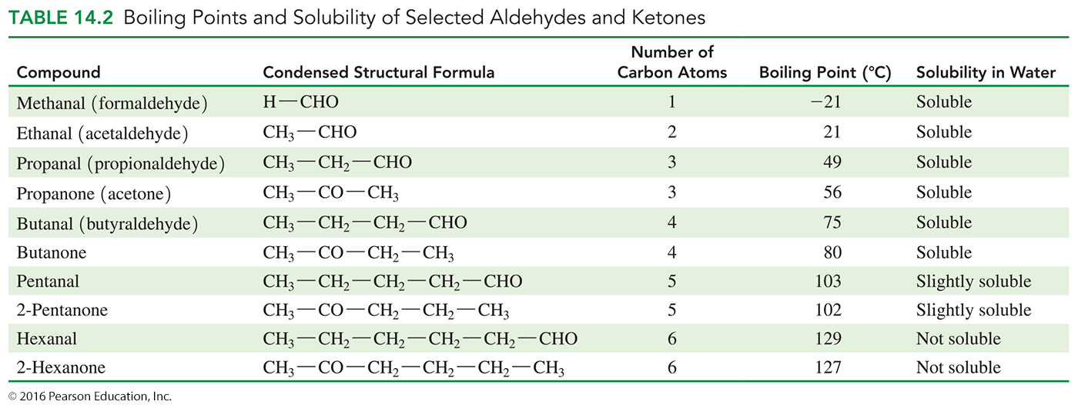
Boiling Points of Aldehydes and Ketones

Slide 6
Solubility of Aldehydes and Ketones
Aldehydes and ketones
with one to four carbons are soluble in water.
with five or more carbons are not very soluble in water.
form hydrogen bonds with water between the carbonyl oxygen and hydrogen atoms of water.

Slide 7
Study Check
Select the compound in each pair that would have the
higher boiling point. Explain.
A. An alcohol forms hyrogen bonds.
B. There are dipole–dipole attractions between the carbonyl groups.
C.
CH₃—CH₂—CHO
or
CH₃—CH₂—OH
or
CH₃—CH₂—CH₃
or
CH₃—CO—CH₃

Slide 8
Solution
Select the compound in each pair that would have the
higher boiling point. Explain.
A. An alcohol forms hyrogen bonds.
The aldehyde has a lower boiling point than the alcohol, as alcohols can form hydrogen bonds with each other.
B. There are dipole–dipole between the carbonyl
The ketone has a higher boiling than the alkane because of dipole–dipole interactions between the carbonyl groups.
CH₃—CH₂—CHO
or
CH₃—CH₂—OH
or

Slide 9
Solution
Select the compound in each pair that would have the
higher boiling point. Explain.
C.
Ketones have a higher boiling point than alkanes because of increased dipole–dipole interactions between the carbonyl groups.
CH₃—CH₂—CH₃
or
CH₃—CO—CH₃

Slide 10
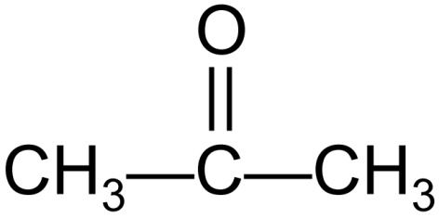
Study Check
Indicate if each of the following is or is not soluble in water:
A. CH₃—CH₂—CH₃
B. CH₃—CH₂—OH
C.
D.

Slide 11
Study Check
Indicate if each of the following is or is not soluble in water:
A. CH₃—CH₂—CH₃ Not soluble in water
CH₃—CH₂—OH Forms H-bonds; soluble in water
C.
D.
Not soluble; aldehyde has more than five carbon atoms.
Soluble; ketones with four or
fewer carbon atoms are soluble in water.

