Slide 1
Sample Problem 1.1 A Study Plan for Learning Chemistry
Which of the following activities would you include in your study plan for learning chemistry successfully?
a. skipping lecture
b. going to the professor’s office hours
c. keeping a problem notebook
d. waiting to study until the night before the exam
e. becoming an active learner
Solution
Your success in chemistry can be improved by
b. going to the professor’s office hours
c. keeping a problem notebook
e. becoming an active learner
Study Check 1.1
Which of the following will help you learn chemistry?
a. skipping review sessions
b. working assigned problems
c. staying up all night before an exam
d. reading the assignment before a lecture
Answer
b and d

Slide 2
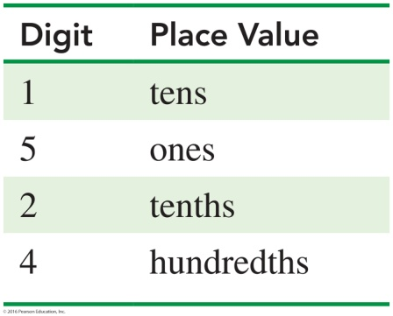
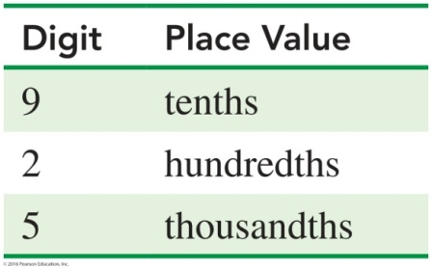
Sample Problem 1.2 Identifying Place Values
A bullet found at a crime scene has a mass of 15.24 g. What are the place values for the digits in the mass of the bullet?
Solution
Study Check 1.2
A bullet found at a crime scene contains 0.925 g of lead. What are the place values for the digits in the mass of the lead?
Answer

Slide 3
Sample Problem 1.3 Calculating a Percentage
In the forensic laboratory, a bullet found at a crime scene may be used as evidence in a trial if the percentage of three metals, usually lead, tin, and antimony, is a match to the composition of metals in a bullet from the suspect’s ammunition. If a bullet found at the crime scene contains 13.9 g of lead, 0.3 g of tin, and 0.9 g of antimony, what is the percentage of each metal in the bullet? Express your answers to the ones place.
Solution
Total mass = 13.9 g + 0.3 g + 0.9 g = 15.1 g
Percentage of lead
Percentage of tin
Percentage of antimony
Study Check 1.3
A bullet seized from the suspect’s ammunition has a composition of lead 11.6 g, tin 0.5 g, and antimony 0.4 g.
a. What is the percentage of each metal in the bullet? Express your answers to the ones place.
b. Could the bullet removed from the suspect’s ammunition be considered as evidence that the suspect was at the crime scene?

Slide 4
Sample Problem 1.3 Calculating a Percentage
Continued
Answer
a. The bullet from the suspect’s ammunition is lead 93%, tin 4%, and antimony 3%.
b. The bullet in part a does not match the bullet from the crime scene and cannot be used as evidence.

Slide 5
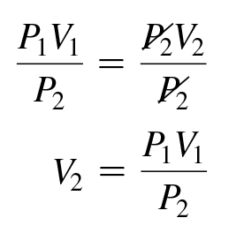
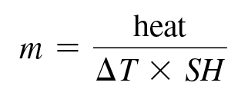
Sample Problem 1.4 Solving Equations
Solve the following equation for V₂:
P₁V₁ = P₂V₂
Solution
P₁V₁ = P₂V₂
To solve for V₂, divide both sides by the symbol P₂.
Study Check 1.4
Solve the following equation for m:
heat = m × ΔT × SH
Answer

Slide 6
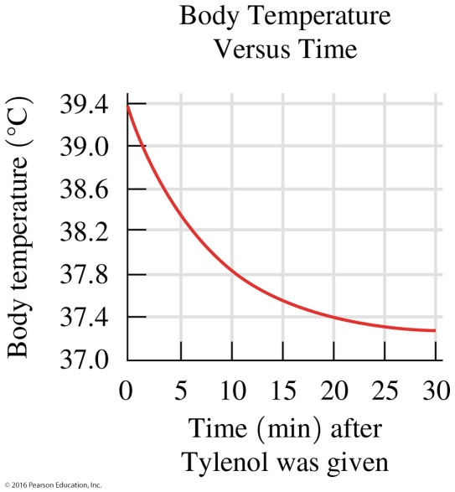
Sample Problem 1.5 Interpreting a Graph
A nurse administers Tylenol to lower a child’s fever. The graph shows the body temperature of the child plotted against time.
a. What is measured on the vertical axis?
b. What is the range of values on the vertical axis?
c. What is measured on the horizontal axis?
d. What is the range of values on the horizontal axis?
Solution
a. temperature in degrees Celsius
b. 37.0 °C to 39.4 °C
c. time, in minutes, after Tylenol was given
d. 0 min to 30 min
Study Check 1.5
a. Using the graph in Sample Problem 1.5, what was the child’s temperature 15 min after Tylenol was given?
b. How many minutes elapsed before the temperature decreased to 38.0 °C?
Answer
a. 37.6 °C b. 8 min

Slide 7
Sample Problem 1.6 Scientific Notation
Write each of the following in scientific notation:
a. 3500 b. 0.000 016
Solution
a. 3500
Step 1 Move the decimal point to obtain a coefficient that is at least 1 but less than 10. For a number greater than 1, the decimal point is moved to the left three places to give a coefficient of 3.5.
Step 2 Express the number of places moved as a power of 10. Moving the decimal point three places to the left gives a power of 3, written as 10³.
Step 3 Write the product of the coefficient multiplied by the power of 10.
3.5 × 10³
b. 0.000 016
Step 1 Move the decimal point to obtain a coefficient that is at least 1 but less than 10. For a number less than one, the decimal point is moved to the right five places to give a coefficient of 1.6.
Step 2 Express the number of places moved as a power of 10. Moving the decimal point five places to the right gives a power of negative 5, written as 10⁻⁵.
Step 3 Write the product of the coefficient multiplied by the power of 10.
1.6 × 10⁻⁵

Slide 8
Sample Problem 1.6 Scientific Notation
Continued
Study Check 1.6
Write each of the following in scientific notation:
a. 425 000 b. 0.000 000 86
Answer
a. 4.25 × 10⁵ b. 8.6 × 10⁻⁷

