Slide 1
7
Sampling and Sampling Distributions

Slide 2
Introduction
In a typical statistical inference problem, you want to discover one or more characteristics of a given population.
However, it is generally difficult or even impossible to contact each member of the population.
Therefore, you identify a sample of the population and then obtain information from the members of the sample.
There are two main objectives of this chapter:
To discuss the sampling schemes that are generally used in real sampling applications.
To see how the information from a sample of the population can be used to infer the properties of the entire population.

Slide 3
Sampling Terminology
A population is the set of all members about which a study intends to make inferences, where an inference is a statement about a numerical characteristic of the population.
A frame is a list of all members of the population. The potential sample members are called sampling units.
A probability sample is a sample in which the sampling units are chosen from the population according to a random mechanism.
A judgmental sample is a sample in which the sampling units are chosen according to the sampler’s judgment.

Slide 4
Methods for Selecting Random Samples
Different types of sampling schemes have different properties.
There is typically a trade-off between cost and accuracy.
Some sampling schemes are cheaper and easier to administer, whereas others are more costly but provide more accurate information.

Slide 5
Simple Random Sampling (slide 1 of 2)
The simplest type of sampling scheme is called simple random sampling.
A simple random sample of size n has the property that every possible sample of size n has the same probability of being chosen.
Simple random samples are the easiest to understand, and their statistical properties are the most straightforward.
There are several ways simple random samples can be chosen, all of which involve random numbers.

Slide 6
Simple Random Sampling (slide 2 of 2)
Simple random samples are used infrequently in real applications. There are several reasons for this:
Because each sampling unit has the same chance of being sampled, simple random sampling can result in samples that are spread over a large geographical region.
This can make sampling extremely expensive, especially if personal interviews are used.
Simple random sampling requires that all sampling units be identified prior to sampling. Sometimes this is infeasible.
Simple random sampling can result in underrepresentation or overrepresentation of certain segments of the population.

Slide 7
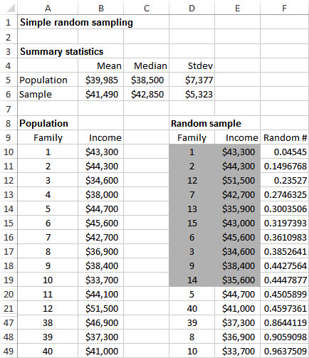
Example 7.1: Random Sampling.xlsm
Objective: To illustrate how Excel’s® random number function, RAND, can be used to generate simple random samples.
Solution: Consider the frame of 40 families with annual incomes shown in column B to the right.
Choose a simple random sample of size 10 from this frame.
To do this, first generate a column of random numbers in column F using the RAND function.
Then, sort the rows according to the random numbers and choose the first 10 families in the sorted rows.

Slide 8
Using StatTools to Generate Simple Random Samples
The method describe in Example 7.1 is simple but somewhat tedious, especially if you need to generate more than one random sample.
Fortunately, a more general method is available in StatTools.
This procedure generates any number of simple random samples of any specified sample size from a given data set.
It can be found in the Data Utilities dropdown list on the StatTools ribbon.

Slide 9
Example 7.2: Accounts Receivable.xlsx (slide 1 of 2)
Objective: To illustrate StatTools’s method of choosing simple random samples and to demonstrate how sample means are distributed.
Solution: Data set contains 280 accounts receivable for Spring Mills Company.
Variables include: Size (customer size), Days (number of days since the customer was billed), and Amount (of the bill).
Generate 25 random samples of size 15 each from the small customers only, calculate the average amount owed in each random sample, and construct a histogram of these 25 averages.
By generating a fairly large number of random samples from the population of accounts receivable, you can begin to see what the sampling distribution of the sample mean looks like.
The resulting histogram, which is approximately bell-shaped, approximates the sampling distribution of the sample mean.

Slide 10
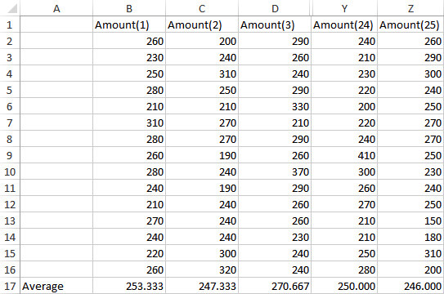
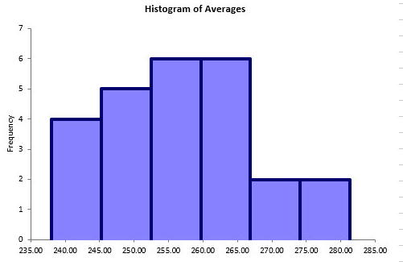
Example 7.2: Accounts Receivable.xlsx (slide 2 of 2)

Slide 11
Systematic Sampling
A systematic sample provides a convenient way to choose the sample.
First, divide the population size by the sample size, creating “blocks.”
Next, use a random mechanism to choose a number between 1 and the number in each “block.”
In general, one of the first k members is selected randomly, and then every kth member after this one is selected.
The value k is called the sampling interval and equals the ratio N/n, where N is the population size and n is the desired sample size.

Slide 12
Stratified Sampling (slide 1 of 2)
Suppose various subpopulations within the total population can be identified. These subpopulations are called strata.
Instead of taking a simple random sample from the entire population, it might make more sense to select a simple random sample from each stratum separately. This sampling method is called stratified sampling.
There are several advantages to stratified sampling:
It is particularly useful when there is considerable variation between the various strata but relatively little variation within a given stratum.
Separate estimates can be obtained within each stratum—which would not be obtained with a simple random sample from the entire population.
The accuracy of the resulting population estimates can be increased by using appropriately defined strata.

Slide 13
Stratified Sampling (slide 2 of 2)
The key to using stratified sampling effectively is selecting the appropriate strata.
What is appropriate depends on the company’s objectives and its product.
There are many ways to choose sample sizes from each stratum, but the most popular method is to use proportional sample sizes.
With proportional sample sizes, the proportion of a stratum in the sample is the same as the proportion of that stratum in the population.
The advantage of proportional sample sizes is that they are very easy to determine.
The disadvantage is that they ignore differences in variability among the strata.

Slide 14
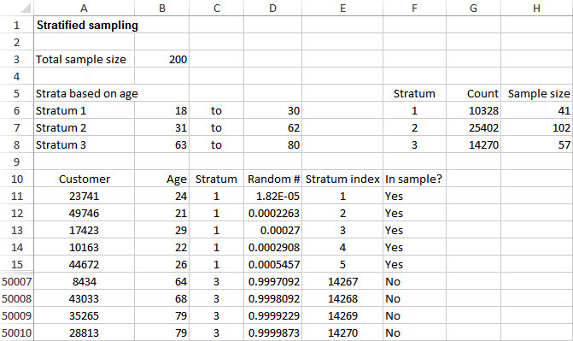
Example 7.3: Stratified Sampling.xlsx
Objective: To illustrate how stratified sampling, with proportional sample sizes, can be implemented in Excel.
Solution: The frame consists of all 50,000 people in the city of Midtown who have a particular retailer’s credit card.
First, the company stratifies these customers by age (18-30, 31-62, 63-80).
Then the company selects a stratified sample of size 200 with proportional sample sizes.

Slide 15
Cluster Sampling
In cluster sampling, the population is separated into clusters, such as cities or city blocks, and then a random sample of the clusters is selected.
The primary advantage of cluster sampling is sampling convenience (and possibly lower cost).
The downside is that the inferences drawn from a cluster sample can be less accurate for a given sample size than other sampling plans.
The key to selecting a cluster sample is to define the sampling units as the clusters—the city blocks, for example.
Then a simple random sample of clusters can be chosen.
Once the clusters are selected, it is typical to sample all of the population members in each selected cluster.

Slide 16
Multistage Sampling Schemes
The cluster sampling scheme is an example of a single-stage sampling scheme.
Real applications are often more complex than this, resulting in multistage sampling schemes.
For example, in Gallup’s nationwide surveys, a random sample of approximately 300 locations is chosen in the first stage of the sampling process.
City blocks or other geographical areas are then randomly sampled from the first-stage locations in the second stage of the process.
This is followed by a systematic sampling of households from each second-stage area.

Slide 17
An Introduction to Estimation
The purpose of any random sample, simple or otherwise, is to estimate properties of a population from the data observed in the sample.
The mathematical procedures appropriate for performing this estimation depend on which properties of the population are of interest and which type of random sampling scheme is used.
For both simple random samples and more complex sampling schemes, the concepts are the same.

Slide 18
Sources of Estimation Error (slide 1 of 2)
There are two basic sources of errors that can occur when you sample randomly from a population:
Sampling error is the inevitable result of basing an inference on a random sample rather than on the entire population.
Nonsampling error is quite different and can occur for a variety of reasons:
Nonresponse bias—occurs when a portion of the sample fails to respond to the survey.
Nontruthful responses—are particularly a problem when there are sensitive questions in a questionnaire.

Slide 19
Sources of Estimation Error (slide 2 of 2)
Measurement error—occurs when the responses to the questions do not reflect what the investigator had in mind (e.g., when questions are poorly worded).
Voluntary response bias—occurs when the subset of people who respond to a survey differs in some important respect from all potential respondents.
The potential for nonsampling error is enormous.
However, unlike sampling error, it cannot be measured with probability theory.
It can be controlled only by using appropriate sampling procedures and designing good survey instruments.

Slide 20
Key Terms in Sampling (slide 1 of 2)
A point estimate is a single numeric value, a “best guess” of a population parameter, based on the data in a random sample.
The sampling error (or estimation error) is the difference between the point estimate and the true value of the population parameter being estimated.
The sampling distribution of any point estimate is the distribution of the point estimates from all possible samples (of a given sample size) from the population.

Slide 21
Key Terms in Sampling (slide 2 of 2)
A confidence interval is an interval around the point estimate, calculated from the sample data, that is very likely to contain the true value of the population parameter.
An unbiased estimate is a point estimate such that the mean of its sampling distribution is equal to the true value of the population parameter being estimated.
The standard error of an estimate is the standard deviation of the sampling distribution of the estimate.
It measures how much estimates vary from sample to sample.

Slide 22
Sampling Distribution of the Sample Mean
The sampling distribution of the sample mean X has the following properties:
It is an unbiased estimate of the population mean, as indicated in this equation:
The standard error of the sample mean is given in the equation where σ is the standard deviation of the population, and n is the sample size.
It is customary to approximate the standard error by substituting the sample standard deviation, s, for σ, which leads to this equation:
If you go out two standard errors on either side of the sample mean, you are approximately 95% confident of capturing the population mean, as shown below:

Slide 23
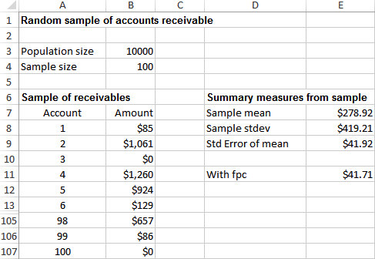
Example 7.4: Auditing Receivables.xlsx
Objective: To illustrate the meaning of standard error of the mean in a sample of accounts receivable.
Solution: An internal auditor for a furniture retailer wants to estimate the average of all accounts receivable.
First, he samples 100 of the accounts, as shown below.
Then he calculates the sample mean, the sample standard deviation, and the (approximate) standard error of the mean.

Slide 24
The Finite Population Correction
Generally, sample size is small relative to the population size.
There are situations, however, when the sample size is greater than 5% of the population.
In this case, the formula for the standard error of the mean should be modified with a finite population correction, or fpc, factor:
The standard error of the mean is multiplied by fpc in order to make the correction:

Slide 25
The Central Limit Theorem
For any population distribution with mean μ and standard deviation σ, the sampling distribution of the sample mean X is approximately normal with mean μ and standard deviation σ/√n, and the approximation improves as n increases. This is called the central limit theorem.
The important part of this result is the normality of the sampling distribution.
When you sum or average n randomly selected values from any distribution, normal or otherwise, the distribution of the sum or average is approximately normal, provided that n is sufficiently large.
This is the primary reason why the normal distribution is relevant in so many real applications.

Slide 26
Example 7.5: Wheel of Fortune Simulation.xlsx (slide 1 of 2)
Objective: To illustrate the central limit theorem by a simulation of winnings in a game of chance.
Solution: The population is the set of all outcomes you could obtain from a single spin of the wheel—that is, all dollar values from $0 to $1000.
Each spin results in one randomly sampled dollar value from this population.
Each replication of the experiment simulates n spins of the wheel and calculates the average—that is, the winnings—from these n spins.
A histogram of winnings is formed, for any value of n, where n is the number of spins.
As the number of spins increases, the histogram starts to take on more and more of a bell shape.

Slide 27
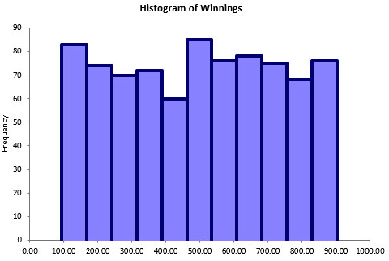
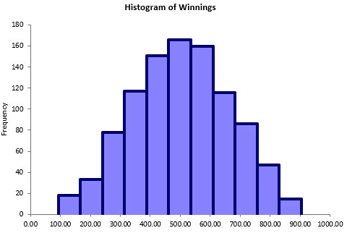
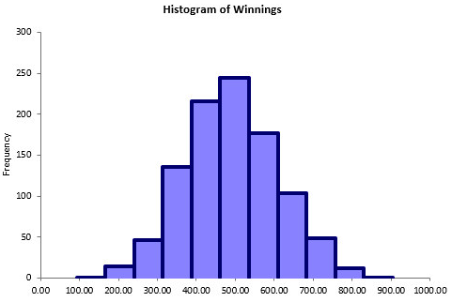
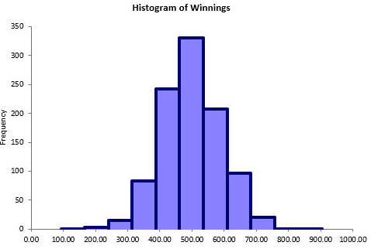
Example 7.5: Wheel of Fortune Simulation.xlsx (slide 2 of 2)
Single Spin Three Spins
Six Spins Ten Spins

Slide 28
Sample Size Selection
The problem of selecting the appropriate sample size in any sampling context is not an easy one, but it must be faced in the planning stages, before any sampling is done.
The sampling error tends to decrease as the sample size increases, so the desire to minimize sampling error encourages us to select larger sample sizes.
However, several other factors encourage us to select smaller sample sizes, including:
Cost
Timely collection of data
Increased chance of nonsampling error, such as nonresponse bias

Slide 29
Summary of Key Ideas for Simple Random Sampling
To estimate a population mean with a simple random sample, the sample mean is typically used as a “best guess.” This estimate is called a point estimate.
The accuracy of the point estimate is measured by its standard error. It is the standard deviation of the sampling distribution of the point estimate.
A confidence interval (with 95% confidence) for the population mean extends to approximately two standard errors on either side of the sample mean.
From the central limit theorem, the sampling distribution of X is approximately normal when n is reasonably large.
There is approximately a 95% chance that any particular X will be within two standard errors of the population mean μ.
The sampling error can be reduced by increasing the sample size n.

