Slide 1
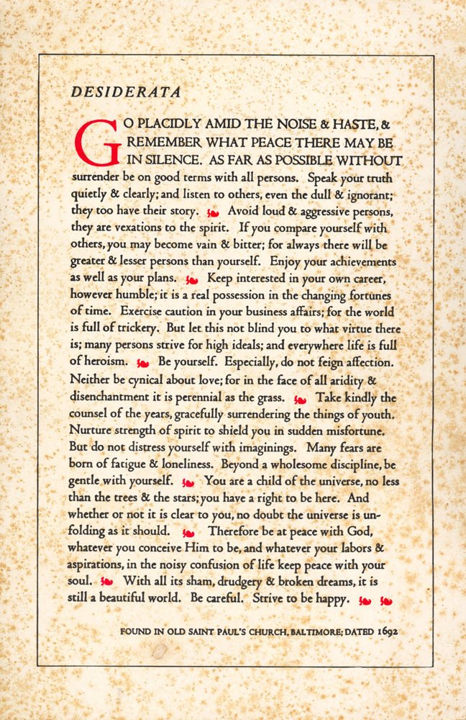
Avoid loud and aggressive persons, they are vexations to the spirit…
But let this not blind you to what virtue there is; many persons strive for high ideals; and everywhere life is full of heroism.
- Desiderata

Slide 2
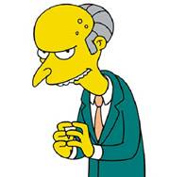
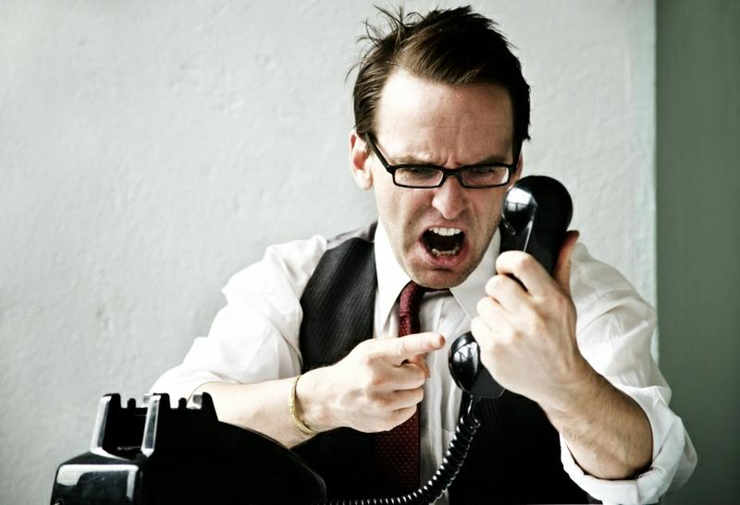
What is a Difficult Person?
SELFISH
CONTROLLING
PERFECTIONIST
UNTRUTHFUL
WORKAHOLIC
STEALS ENERGY
DIFFERENT VALUES
PERSONAL PROBLEMS

Slide 3
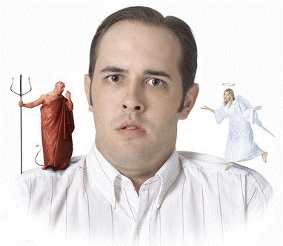
A difficult person is someone we find difficult… somebody loves them (probably)
A difficult person isn’t always difficult
Many times a difficult person is a good person who is under stress at work or home

Slide 4
Extraverts often:
Have high energy
Talk more than listen
Think out loud
Act, then think
Like to be around people a lot
Prefer a public role
Can sometimes be easily distracted
Prefer to do lots of things at once
Are outgoing & enthusiastic
E or I
Introverts often:
Have quiet energy
Listen more than talk
Think quietly inside their heads
Think, then act
Feel comfortable being alone
Prefer to work "behind-the-scenes"
Have good powers of concentration
Prefer to focus on one thing at a time
Are self-contained and reserved

Slide 5
Sensors often:
Focus on details & specifics
Admire practical solutions
Notice details & remember facts
Are pragmatic - see what is
Live in the here-and-now
Trust actual experience
Like to use established skills
Like step-by-step instructions
Work at a steady pace
S or N
Intuitives often:
Focus on the big picture & possibilities
Admire creative ideas
Notice anything new or different
Are inventive - see what could be
Think about future implications
Trust their gut instincts
Prefer to learn new skills
Like to figure things out for themselves
Work in bursts of energy

Slide 6
Thinkers often:
Make decisions objectively
Appear cool and reserved
Are most convinced by rational arguments
Are honest and direct
Value honesty and fairness
Take few things personally
Are good at seeing flaws
Are motivated by achievement
Argue or debate issues for fun
T or F
Feelers often:
Decide based on their values & feelings
Appear warm and friendly
Are most convinced by how they feel
Are diplomatic and tactful
Value harmony and compassion
Take many things personally
Are quick to compliment others
Are motivated by appreciation
Avoid arguments and conflicts

Slide 7
Judgers often:
Like to have things settled
Take responsibilities seriously
Pay attention to time & are usually prompt
Prefer to finish projects
Work first, play later
Seek closure
See the need for most rules
Like to make & stick with plans
Find comfort in schedules
J or P
Perceivers often:
Like to keep their options open
Are playful and casual
Are less aware of time and may run late
Prefer to start projects
Play first, work later
May have difficulty making some decisions
Question the need for many rules
Like to keep plans flexible
Want the freedom to be spontaneous

Slide 8
Two Truths:
Difficult People are Everywhere
They’re Not Going Away
So How Do We Manage It?

Slide 9
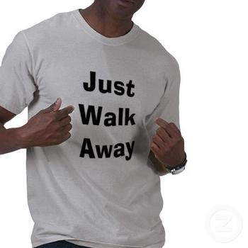
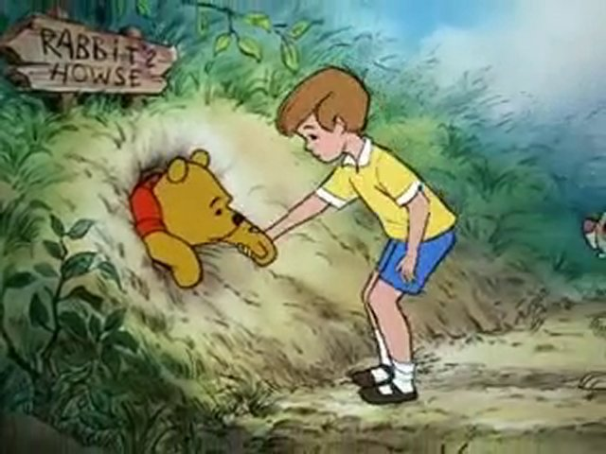
The Easy Answer:
Have nothing to do with them.
The Harsh Reality:
Sometimes we can’t avoid them.

Slide 10
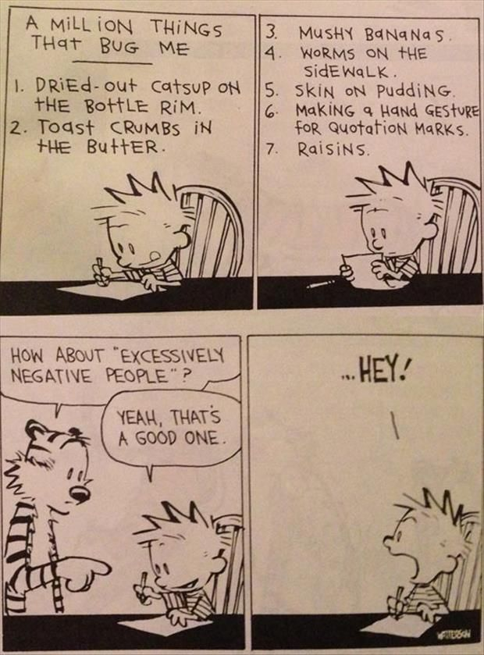
Recognize What’s Difficult About Someone
Do They:
Sap Energy
Generate Negativity
Require Unreasonable Control
Dump Their Problems on Us
Make Impossible Demands
Fail to Respect Us
Make Us Responsible for Their Personal Issues

Slide 11
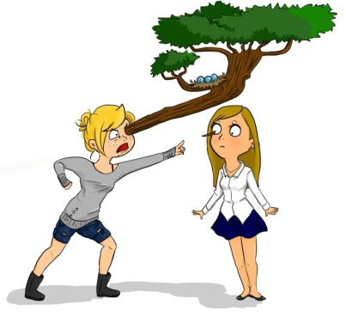
Before We Proceed
Ask…
Who’s being difficult – me or them?

Slide 12
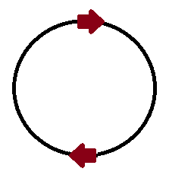
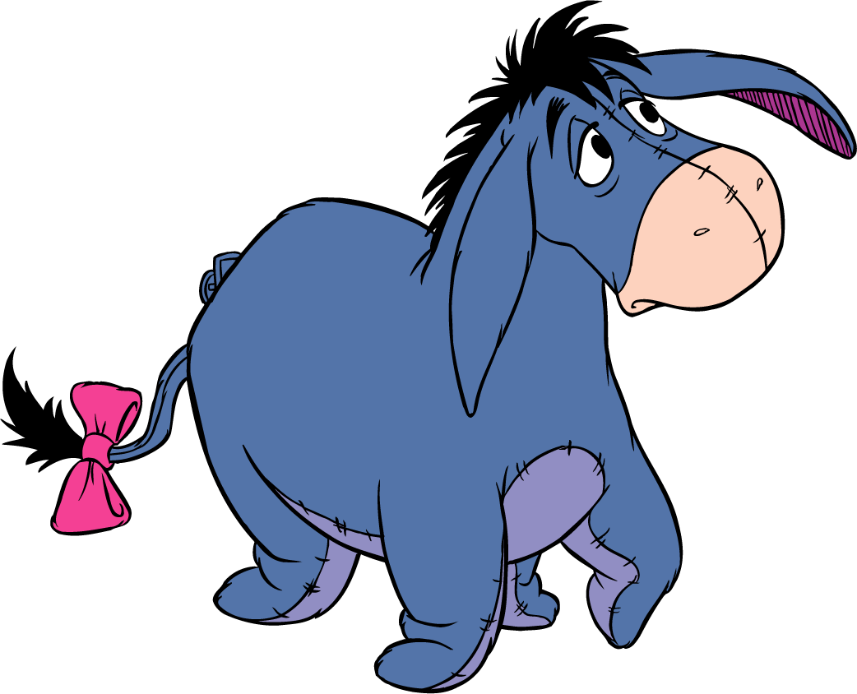
TWO KEYS:
Be Active
Be Confident
Active people focus on strengths and empowerment. Passivity breeds victimization
Confidence comes from success. What do I do well? I can change my world!
ACTION CONFIDENCE

Slide 13
Strategies
Space boundary
It’s not all about friendship
Avoid being “the ear” – BE POSITIVE
Remain respectful
Communicate

Slide 14
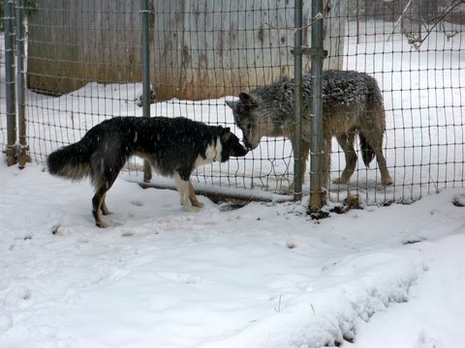
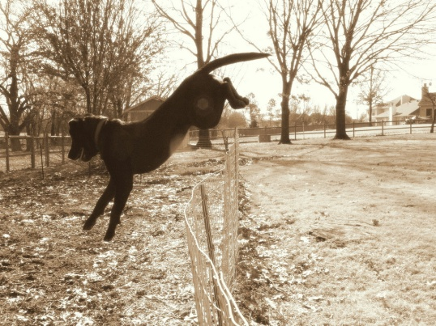
[----SPACE BOUNDARIES----]
Keep conversations work related
No one can complain that we’re too polite
No one can complain that we’re “on task”
Boundaries should be expressed
Boundaries protect our independent, emotional space

Slide 15
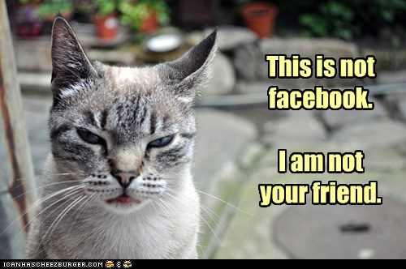
It’s Not All About Friendship
We cannot change people
We cannot worry about or control what others think
Some people will not be our friend
We are responsible for our own well-being

Slide 16
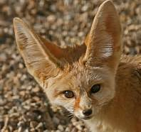
DON’T BE “THE EAR”
Some people like to “dump” – it helps them thrive (misery loves company)
Some people are “dark clouds”
Be solution oriented and positive

Slide 17
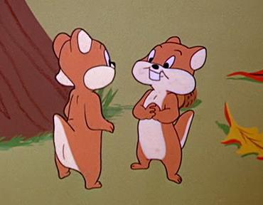
R-E-S-P-E-C-T
It’s not personal; they can remain negative
People can’t see themselves
Problems could simply be personality conflicts
What’s worse than one difficult person in the room?
Don’t live up to criticism

Slide 18
Communicate
Remain open-minded
Ask for clarification
If overworked, ask for priorities
Most people aren’t aware of our issues

Slide 19
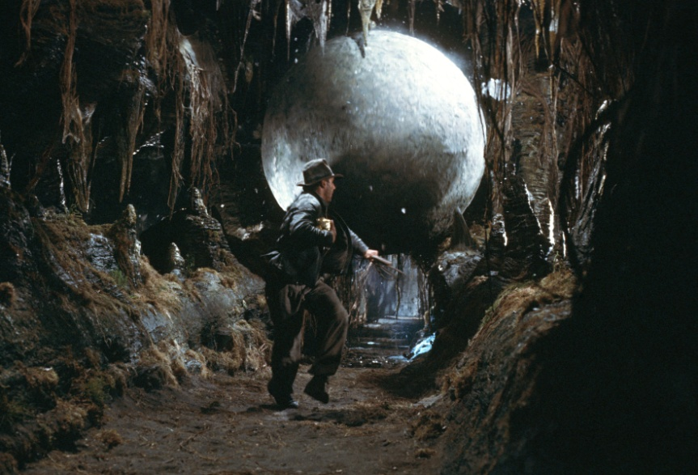
Things to Watch For
Automatic Thoughts
Double Binds
Scapegoating
Martyr Thinking

Slide 20
Personal Rules for Handling People
I cannot change people
I will remain independent of others’ emotions
I will monitor my internal dialogue
I cannot worry about others’ dialogues
I am responsible for my life
I will seek to understand

Slide 21
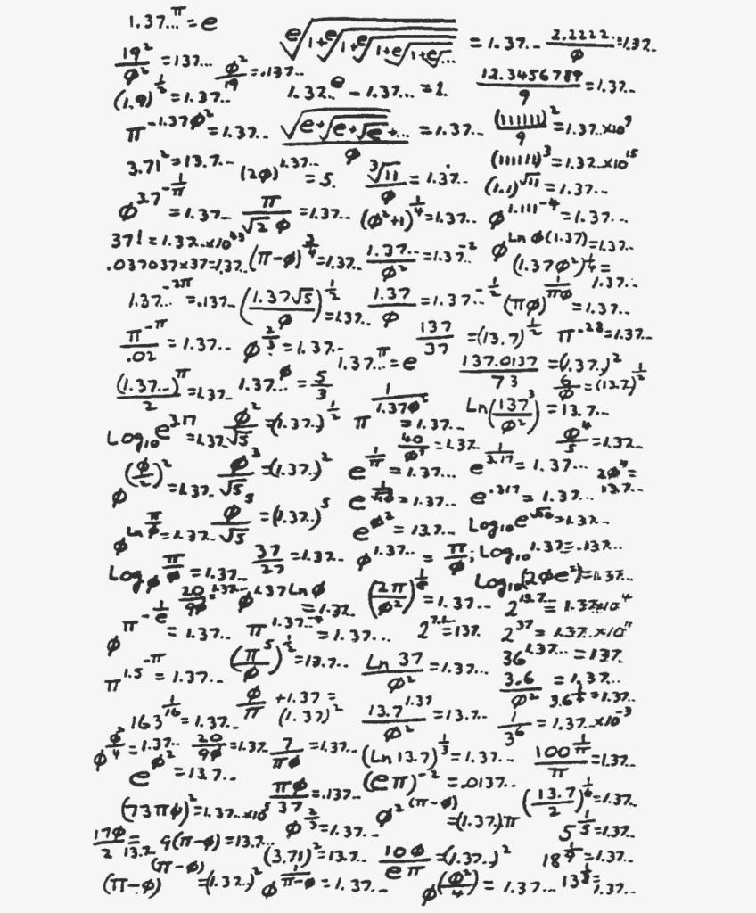
Questions?

