Slide 1
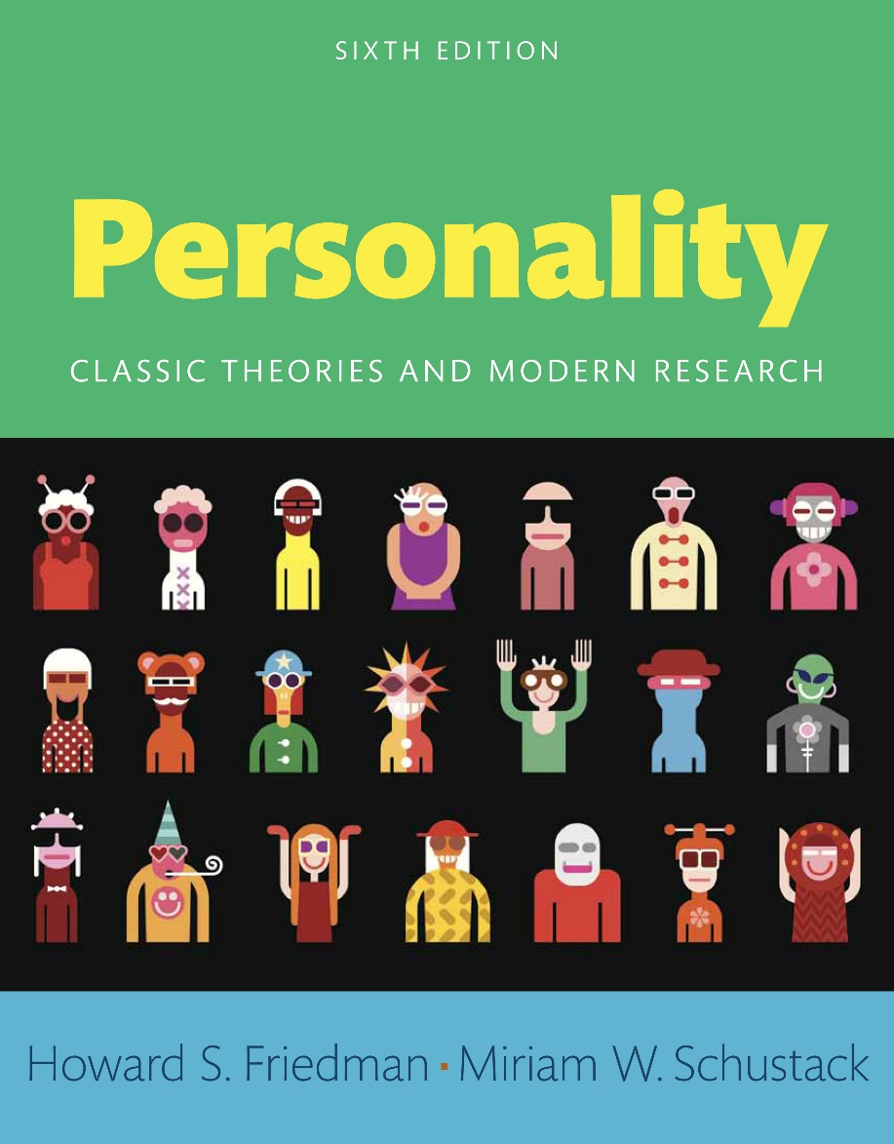
Personality
Sixth edition
Chapter 4
Neo-Analytic and Ego Aspects of Personality

Slide 2
Modules (1 of 2)
Introduction: Neo-Analytic and Ego Aspects of Personality
4.1: Carl G. Jung and Selfhood
4.2: Alfred Adler
4.3: Karen Horney
4.4: Anna Freud and Heinz Hartmann
4.5: Object Relations Theories
4.6: Erik Erikson

Slide 3
Modules (2 of 2)
4.7: Modern Approaches to Identity
Conclusion: Neo-Analytic and Ego Aspects of Personality: Identity

Slide 4
Learning Objectives (1 of 2)
4.1: Probe the development of the Carl Jung school of psychology as distinct from that of Freud
4.2: Recognize the three fundamental social issues that need to be addressed as suggested by Alfred Adler
4.3: Describe Karen Horney's theories on culture and feminism
4.4: Report the work done by Anna Freud and Heinz Hartmann on psychoanalysis

Slide 5
Learning Objectives (2 of 2)
4.5: Analyze the object relations theories as propagated by different theorists
4.6: Examine how identity formation is a lifelong process as propagated by Erik Erikson
4.7: Express the modern approaches to identity

Slide 6
Introduction: Neo-Analytic and Ego Aspects of Personality
Cliques and puppy love
Complexes
Neo-analytic

Slide 7
4.1: Carl G. Jung and Selfhood
Objective: Probe the development of the Carl Jung school of psychology as distinct from that of Freud
Examples
Explanation
Notes:
Point 1- Examples
Absalom and King David
Children feuding with parents
Employees complaining about bosses
Followers denouncing their gurus
Point 2- Explanation
Humans programmed to see and accept certain truths
Our past experiences
Cumulative past experiences of ancestors

Slide 8
4.1.1: Background to Jung’s Approach
Childhood beliefs
Beginnings of his theory
Notes:
Point 1- Childhood beliefs
He was the child he outwardly appeared to be
He was a wise and cultured gentleman of previous century
Point 2- Beginnings of his theory
Soul stones
Correspondence with Freud
Existence of universal archetypes
“The Red Book”
Analytic psychology

Slide 9
4.1.2: Jung’s Analytic Psychology
The conscious ego
The personal unconscious
The collective unconscious
Complex
Functions and attitudes
Notes:
Point 1- The conscious ego
Similar in scope and meaning to Freud’s
Conscious aspect of personality
Embodies the sense of self
Point 2- The personal unconscious
Thoughts and feelings not part of conscious awareness
Contains unimportant thoughts
Contains actively repressed information
Contains retrospective and prospective material
Influences how we react to others
Point 3- The collective unconscious
Most controversial component of psyche
Comprises deeper level of unconsciousness
Made up of archetypes
Animus and anima
Persona and shadow
Point 4- Complex
Group of emotionally charged feelings related to particular themes
Libido –describes general psychic energy
Word association test
Point 5- Functions and attitudes
Four functions of the mind
Extroversion
Introversion

Slide 10
Figure 4.1: Fear of Snakes.
Evidence ranging from Eve’s encounter in the Book of Genesis to modern experimental research in primatology and experimental psychology (Shibasaki & Kawai, 2009) suggests that humans share an evolved fear of snakes. People are quick to notice snakes, very quickly learn to fear snakes, and can react to snake stimuli outside of conscious awareness (Ohman & Mineka, 2003). Such findings may indicate that the human brain has a form of “collective unconscious.
Notes:
Humans share evolved fear of snakes
People quick to notice snakes
People quickly learn to fear snakes
People react to stimuli outside of conscious awareness
Human brain possesses “collective unconscious”

Slide 11
4.2: Alfred Adler
Objective: Recognize the three fundamental social issues that need to be addressed as suggested by Alfred Adler
Early life
Theoretical constructs
Notes:
Point 1- Early life
Frail child; came close to death multiple times
Suffered from rickets, severe pneumonia
Twice run over on the street
Felt powerless and fearful
Determined to become a physician
Point 2- Theoretical constructs
Inferiority complex
Organ inferiority
Masculine protest

Slide 12
4.2.1: Adler’s Differences with Freudian Theory
Overview
Point of contention
Notes:
Point 1- Overview
Disagreements between Freud and Adler heated and intense
Adler quit as president of the Vienna Psychoanalytic Society
Started his own society, the Society for Free Psychoanalysis
Point 2- Point of contention
Emphasis on origin of motivation
For Freud, sexuality and pleasure prime motivators
For Adler, motivations much more complex
Adler much more concerned than Freud with social conditions

Slide 13
4.2.2: Adler’s Individual Psychology
Striving for superiority
Concepts
The role of birth order
Personality typology
Notes:
Point 1- Striving for superiority
Inferiority complex
Superiority complex
Point 2- Concepts
Aggression drive
Perfection striving
Occupational tasks
Societal tasks
Love tasks
Point 3- The role of birth order
First-born children
Second-born children
Last-born children
Point 4- Personality typology
Ruling-Dominant
Getting-Leaning
Avoiding
Socially Useful

Slide 14
4.3: Karen Horney
Objective: Describe Karen Horney's theories on culture and feminism
Life history
Similarities with Adler
Notes:
Point 1- Life history
Conflicting feelings toward her father; close to her mother
Married Oskar Horney
Underwent psychoanalysis with Karl Abraham
Somewhat detached from her children
Point 2- Similarities with Adler
Importance of self-realization
Growth for each individual
Focused on social world and social motivations

Slide 15
4.3.1: Rejection of Penis Envy
Horney’s reasons
What women really wanted
Notes:
Point 1- Horney’s reasons
Women felt inferior due to societal reasons
Overemphasis on women to secure a man’s love
Environment where femininity inferior; masculinity superior
Women saw themselves as subordinates
Point 2- What women really wanted
“Masculine” things as a way to gain power; however, not a penis
Autonomy
Control

Slide 16
4.3.2: Basic Anxiety
Reasons
Different styles
Notes:
Point 1- Reasons
Lack of warmth
Stability
Respect
Involvement
Point 2- Different styles
Passive
Aggressive
Withdrawn

Slide 17
4.3.3: The Self
Real self
Despised self
Ideal self
Notes:
Point 1- Real self
Inner core of personality
We perceive about ourselves
Potential for self-realization
Damaged by parental neglect and indifference
Point 2- Despised self
Produced by parental neglect
Consists of perceptions of inferiority and shortcomings
Based on others’ negative evaluations of us
Resulting feelings of helplessness
Point 3- Ideal self
What one views as perfection and hopes to achieve
Molded by perceived inadequacies
“Tyranny of the should”

Slide 18
4.3.4: Neurotic Coping Strategies
Moving toward
Moving against
Moving away
Notes:
Point 1- Moving toward
Always attempting to make others happy
To gain love
To secure the approval and affection of others
Overidentifying with a Despised Self
See themselves as unworthy of love
Point 2- Moving against
Striving for power
Striving for recognition
Striving for admiration
Overidentifying with the Ideal Self
Point 3- Moving away
Withdrawal of emotional investment from interpersonal relationships
Avoid being hurt in those relationships
Individuals want to overcome the Despised Self
Feel incapable of ever becoming the Ideal Self
Hide behind independence and solitude

Slide 19
4.3.5: Horney’s Impact on Psychoanalytic Thinking
Transcending emphases
Horney’s beliefs
Notes:
Point 1- Transcending emphases
Biological
Anatomical
Individualistic
Point 2- Horney’s beliefs
Importance of a warm, stable family
Impact of society and culture
People could overcome unconscious demons
Neurotic internal demands for perfection

Slide 20
4.4: Anna Freud and Heinz Hartmann
Objective: Report the work done by Anna Freud and Heinz Hartmann on psychoanalysis
Anna Freud’s works
Heinz Hartmann’s works
Notes:
Point 1- Transcending emphases
Biological
Anatomical
Individualistic
Point 2- Horney’s beliefs
Importance of a warm, stable family
Impact of society and culture
People could overcome unconscious demons
Neurotic internal demands for perfection

Slide 21
4.5: Object Relations Theories
Objective: Analyze the object relations theories as propagated by different theorists
Overview
Overlap in theories
Notes:
Point 1- Overview
Refers to mental representation of significant others
Child learns about self and others
Child interacts with other people
Point 2- Overlap in theories
Object relations psychologists
Ego psychologists
Neo-analytic psychologists

Slide 22
4.5.1: Margaret Mahler and Symbiosis
Symbiotic psychotic children
Normal symbiotic children
Notes:
Point 1- Symbiotic psychotic children
Unable to form a sense of self
Do not have an autonomous being
Struggle between a need for autonomy and a longing to surrender
Point 2- Normal symbiotic children
Form healthy ties with their mothers
Develop empathy
Sense of being a separate but loving person

Slide 23
4.5.2: Melanie Klein, Heinz Kohut, and the Relational Perspective
Klein’s contributions
Kohut’s works
Relational perspective
Notes:
Point 1- Klein’s contributions
Worked closely with children
Developed “play therapy”
Examined infants’ reactions to weaning
Point 2- Kohut’s works
Studied narcissistic personality disorder
Played the part of therapist-parent with patients
Point 3- Relational perspective
Effects of culture on identity
Effects of culture on gender and sexual discrimination
More clinical
More humanistic
More philosophical

Slide 24
4.5.3: The Contributions of Object Relations Approaches
Overview
Neo-analytic ideas
Notes:
Point 1- Overview
View the ego as a much more independent entity
The concept of social self
Social context
Social identity
Point 2- Neo-analytic ideas
Psychic archetypes
Strivings for mastery
Sibling rivalries

Slide 25
4.6: Erik Erikson
Objective: Examine how identity formation is a lifelong process as propagated by Erik Erikson
People who expanded psychoanalytic theorizing
Erikson’s contributions
Notes:
Point 1- People who expanded psychoanalytic theorizing
Adler
Horney
Erikson
Point 2- Erikson’s contributions
Moved psychoanalytic thought beyond childhood
Adulthood continuing developmental process
Influenced by own previous stages

Slide 26
4.6.1: Erikson’s Life Path
Early life
Adulthood
Notes:
Point 1- Early life
Felt a lack of belongingness
Became a wandering artist
Could not find true meaning in work
Point 2- Adulthood
Became fascinated with child development
Psychoanalytic training with Anna Freud
Became an American citizen
Changed his name from Erik Homburger to Erik H. Erikson
Developed a theory about personality development

Slide 27
4.6.2: Identity Formation and Ego Crises
Identity formation
Ego crises
Notes:
Point 1- Identity formation
A lifelong process
Individuals could and did undergo significant change
Individuals must take personal responsibility for their lives
Personality develops through a series of eight stages
Point 2- Ego crises
Trust versus mistrust
Autonomy versus shame and doubt
Identity versus role confusion
Generativity versus stagnation

Slide 28
4.7: Modern Approaches to Identity
Objective: Express the modern approaches to identity
Focus areas
Notes:
Point 1- Focus areas
Who are we today?
What defines us?
What influences us?
What do we hope to become?

Slide 29
4.7.1: Personal and Social Identity
Defunct hypotheses
Acceptable explanations
Notes:
Point 1- Defunct hypotheses
Identity as an internal and personal construct
Identity an external, socially defined construct
Point 2- Acceptable explanations
Self-monitoring
Self-presentation
Dispositional orientation
Situational orientation
Functionalist approach

Slide 30
4.7.2: The Role of Goals and Life Tasks
Personal projects
Personal strivings
Life tasks
Notes:
Point 1- Personal projects
Goals or activities that people are currently working on
Specific tasks and immediate goals
Motivate people on a daily basis
Point 2- Personal strivings
Overarching goals
May be satisfied by a number of different behaviors
Point 3- Life tasks
Age-determined issues
People are currently concentrating on

Slide 31
4.7.3: Possible Selves and the Search for a Meaningful Life
Higgins’s theory
Baumeister’s view of identity
Notes:
Point 1- Higgins’s theory
Actual self
Ideal self
Ought self
Point 2- Baumeister’s view of identity
More philosophical
Share concepts of identity creation and functional importance of ego

Slide 32
Conclusion: Neo-Analytic and Ego Aspects of Personality: Identity
Notion of conscious “self”
Jungian contributions
Adler’s works
Karen Horney’s contributions
Erik Erikson’s influences

