Slide 1
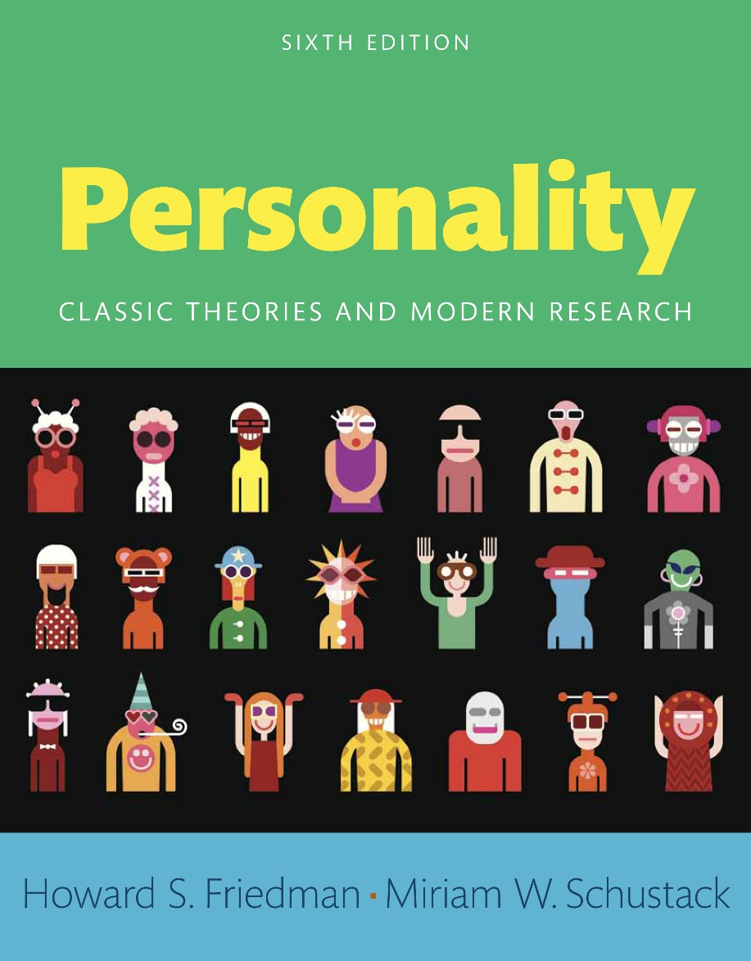
Personality
Sixth edition
Chapter 14
Love and Hate

Slide 2
Modules
Introduction: Love and Hate
14.1: The Personality of Hate
14.2: Evaluating Hate
14.3: The Personality of Love
14.4: Love Gone Wrong
Conclusion: Love and Hate

Slide 3
Learning Objectives
14.1: Investigate the different motivations for hate
14.2: Review causes and cures for hate
14.3: Investigate the different motivations for love
14.4: Investigate the relationship between personality and sexual behavior

Slide 4
Introduction: Love and Hate
Motivations for hate
Cause and cures for hate
Motivations for love
Relationship between love and sexual behavior

Slide 5
14.1: The Personality of Hate
Objective: Investigate the different motivations for hate
Love vs hate
Famous mass murderers
Notes:
• Point 1- Love vs hate
• Love given a godly form
• Hate the form of the devil
• Point 2- Famous mass murderers
• Hitler
• Ted Bundy

Slide 6
14.1.1: Biological Explanations of Hate
Ethology
Ethological solutions
Notes:
Point 1- Ethology
Study of animal behavior patterns in natural environments
Characterized aggression as the product of adaptive evolutionary processes
Point 2- Ethological solutions
Organized sport
War games
Sense of inevitability

Slide 7
14.1.2: Psychoanalytic Approaches to Hate
Thanatos
Defense mechanism
Antisocial personality disorder
Notes:
Point 1- Thanatos
Drive towards death and self-destructive power
Greek god of death
Consistent with Freud’s analysis of self-destruction
Point 2- Defense mechanism
Projection
Displacement
Point 3- Antisocial personality disorder
Psychopaths
Sociopaths

Slide 8
14.1.3: Neo-Analytic Views of Hate
Nonbiological
Unresolved psychosocial stages
Notes:
Point 1- Nonbiological
Early social experiences
Rejection
Point 2- Unresolved psychosocial stages
Does not develop adequate trust
Punished for pursuing autonomy
Initiative punished

Slide 9
14.1.4: Hate and Authoritarianism
Fromm’s theory
Authoritarian personality
Notes:
Point 1- Fromm’s theory
Advances in civilization isolate people and give them more freedom
People surrender this freedom to counteract the loneliness
Point 2- Authoritarian personality
Has a cruel penchant
Generated by negative relationship with parents

Slide 10
14.1.5: The Humanistic Perspective on Hate
Carl Rogers
Abraham Maslow
Notes:
Point 1- Carl Rogers
Believed negative emotion stems from lack of positive regard
Emphasized need for unconditional positive regard
Incongruence between perception and experience
Point 2- Abraham Maslow
Fears and doubts are roots of immaturity and hatred
Result of deficient environment

Slide 11
14.1.6: Hatred as a Trait
Raymond Cattell
Hans Eysenck
Seymour Feshbach
Notes:
Point 1- Raymond Cattell
Used factor analysis to extract common human traits
Identified traits that characterize killers
Point 2- Hans Eysenck
High psychoticism
Impulsive
Cruel
Tough-minded
Antisocial
Point 3- Seymour Feshbach
Anger as an emotional reaction
Empathy and altruism can counter anger

Slide 12
14.1.7: Cognitive Approaches to Hate
Cognitive simplicity
Well-adjusted vs maladjusted
Notes:
Point 1- Cognitive simplicity
Unable to make distinction among others
Permits dismissing whole groups as enemies
Point 2- Well-adjusted vs maladjusted
Evaluate others realistically; constrain people to fit their construal
Do not see everybody as a threat; see others as having hostile intentions
Distortions begin at an early age

Slide 13
14.1.8: Learning Theory
Classical learning theory
Operant learning theory
Social learning theory
Notes:
Point 1- Classical learning theory
Hateful emotions are conditioned responses
For example, violent abuse by mother during childhood
Point 2- Operant learning theory
Emphasizes role of reinforcements and punishments
Aggression may escalate with triggers
Point 3- Social learning theory
Hateful behavior is learned from observing others
Secondary drives that motivate actions

Slide 14
14.1.9: Cultural Differences in Hatred
Role of society
Culture of honor
Notes:
Point 1- Role of society
Huge difference in averages
Even with United States, North versus South
Point 2- Culture of honor
Violent responses to perceived slights
Emphatic defense of reputation
Higher rates of masculine risk-taking

Slide 15
14.2: Evaluating Hate
Objective: Review causes and cures for hate
Source of hate
Childhood
Solution
Notes:
Point 1- Source of hate
Arise from combination of forces
Innate capacity
Evidence points to capacity not inevitability
Point 2- Childhood
Abusive and unstable
Interpretations of events
Reward
Point 3- Solution
Physical health
Good relationship with parents
Society rewards only good behavior

Slide 16
14.3: The Personality of Love
Objective: Investigate the different motivations for love
Male approach to love
Female approach to love
Notes:
Point 1- Male approach to love
Attracted to women suited to conceive and carry healthy offspring
Attracted to women in their reproductive age
Point 2- Female approach to love
Physical attractiveness
Ability to provide necessities

Slide 17
14.3.1: Psychoanalytic Explanations for Love
Freud’s view
Object relation theory
Notes:
Point 1- Freud’s view
Love arises from sexual instincts
From mother–oral gratification
From lover–sexual satisfaction
Point 2- Object relation theory
Mother as nurturer
Love for mother becomes prototype for future love

Slide 18
14.3.2: Neo-Analytic Explanations for Love
Sixth stage of psychosocial development
Models of attachment from childhood
Three romantic styles
Notes:
Point 1- Sixth stage of psychosocial development
Early 20s
Mature love develops
Intimacy versus isolation
Point 2- Models of attachment from childhood
Defines quality of adult relationships
Involves unresolved anxiety
Point 3- Three romantic styles
Secure lovers
Avoidant lovers
Anxious-ambivalent lovers

Slide 19
14.3.3: Cognitive Approaches to Love
Classifying types of love
Different approaches
Notes:
Point 1- Classifying types of love
Good friends
Intimate friends
Point 2- Different approaches
Liking and respect distinguished from love or passion
Comparing infatuation to sexual exploitation to true love
Over two dozen scales to measure and define love

Slide 20
14.3.4: Humanistic–Existential Perspectives on Love
Etiology of love
Maslow’s need for love
Erich Fromm’s theory of love
Erich Fromm’s types of love
Rollo May’s types of love
Notes:
Point 1- Etiology of love
Disdain the simple behaviorist view
Those who realize potential find true love
Persons must accept themselves before they can give love
Point 2- Maslow’s need for love
Love comes after physiological and safety needs
Two types of love – being love and deficiency love
Point 3- Erich Fromm’s theory of love
Human suffer from sense of alienation
Sees love as a special characteristic
Alleviate feelings of loneliness
Point 4- Erich Fromm’s types of love
Motherly love
Brotherly love
Erotic love
Point 5- Rollo May’s types of love
Sex
Eros
Philia
Authentic

Slide 21
14.3.5: Cultural Differences in Love
Culture and love
Good marriages
Notes:
Point 1- Culture and love
Arranged marriages
Love marriages
Point 2- Good marriages
Practical attitudes about love
Less idealism about sex
Passionate love correlates with marital satisfaction

Slide 22
14.3.6: The Trait and Interactionist Approaches
Lonely people
Psychosocial problems
Solution
Notes:
Point 1- Lonely people
Have trouble forming relationships
Do not trust easily
Do not open up
Point 2- Psychosocial problems
Social inadequacy
Health ailments
Lower incomes
Point 3- Solution
Developing skills
Changing environment
Joining groups

Slide 23
14.4: Love Gone Wrong
Objective: Investigate the relationship between personality and sexual behavior
Personality
Relationship between teenage sexual activity and subsequent mortality risk
Sexual aggression
Notes:
Point 1- Personality
Extroverts are sexually adventurous
Seek extra stimulation
Engage in French kissing
Wider variety of sexual activities
Point 2- Relationship between teenage sexual activity and subsequent mortality risk
Sexually active teenagers have higher mortality risk
Lower on conscientiousness
Greater abusers of alcohol in adulthood
Less willing to get a good education
Point 3- Sexual aggression
Men’s attitude predict sexual aggression
Aggressors tend to be cold, impulsive, tough, and cruel
Pornography is a significant predictor

Slide 24
Conclusion: Love and Hate
Love inspires
Hate shocks and fascinates
Aggression is the product of an adaptive process
Freud attributes aggression to death instinct
Humanistic-existential view attributes aggression to thwarting natural tendencies

