Slide 1
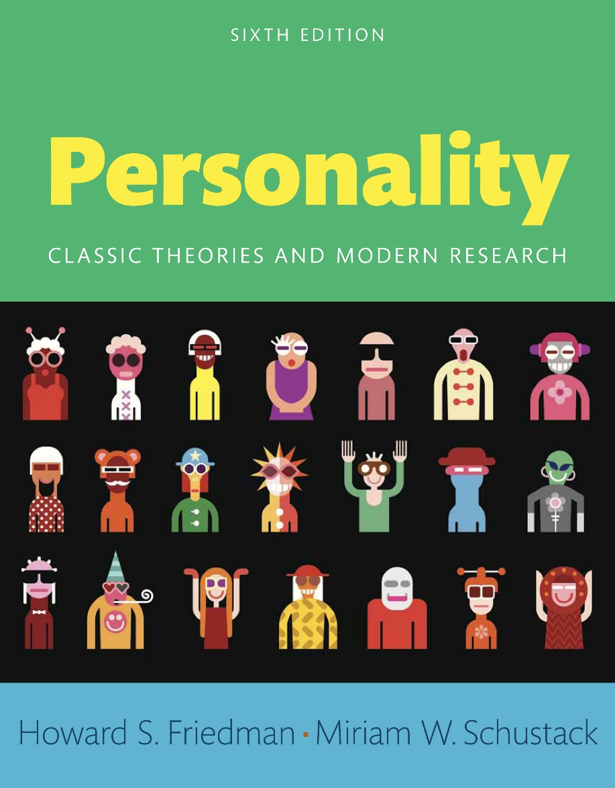
Personality
Sixth edition
Chapter 11
Male–Female Differences

Slide 2
Modules
Introduction: Male-Female Differences
11.1: Do Males and Females Differ?
11.2: A Brief History of Gender Difference in Personality
11.3: Biological Influences on Gender Differences
11.4: Gender Differences in Personality from the Eight Perspectives
11.5: Cross-Cultural Studies of Gender Differences
11.6: Love and Sexual Behavior
Conclusion: How Is Personality Studied and Assessed?

Slide 3
Learning Objectives (1 of 2)
11.1: Examine the physical and psychological differences between males and females
11.2: Inspect the historical difference in the portrayal of women and men
11.3: Describe how gender differentiation and development occur biologically
11.4: Describe how the eight basic approaches to personality address gender differences

Slide 4
Learning Objectives (2 of 2)
11.5: Contrast the way gender differences are perceived across cultures
11.6: Contrast the differences between men and women in love and sexual behavior

Slide 5
Introduction: Male-Female Differences
Use of eight basic aspects of personality to examine male–female differences
Masculinity
Femininity

Slide 6
11.1: Do Males and Females Differ?
Objective: Examine the physical and psychological differences between males and females
Differences between men and women
Female characteristics
Male characteristics
Notes:
Point 1- Differences between men and women
Men tend to be physically stronger than women
Women appear to be constitutionally stronger than men
Male children are more susceptible to a variety of diseases and disabilities
Girls are more neurologically mature than boys
Women tend to outlive men
Point 2- Female characteristics
Emotional
Nurturing
Submissive
Communicative
Sociable
Point 3- Male characteristics
Rational
Independent
Aggressive
Dominant
Objective

Slide 7
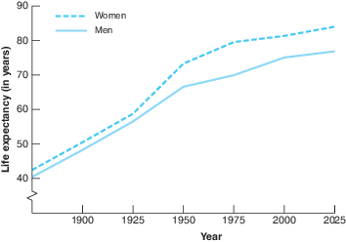
Figure 11.1: Projected Life Expectancy at Birth in the United States
As overall life expectancies in the United States and Canada (and the rest of the world) have increased, women’s life expectancies have remained greater than men’s. The reasons for this difference are still being researched, but in addition to biology, differences in masculinity–femininity seem highly relevant. (Data are projections from U.S. Census Bureau.)
Notes:
Overall life expectancies in the United States and Canada have increased
Women’s life expectancies have remained greater than men’s
Reasons for this difference still being researched
In addition to biology, differences in masculinity–femininity seem highly relevant

Slide 8
11.1.1: Evidence for Gender Differences
Gender differences in the expression of two social characteristics
Gender differences in personality and behavior
Notes:
Point 1- Gender differences in the expression of two social characteristics
Aggression
Communication
Point 2- Gender differences in personality and behavior
Dependency
Suggestibility
Nurturance

Slide 9
11.2: A Brief History of Gender Difference in Personality
Objective: Inspect the historical difference in the portrayal of women and men
Yin and yang
Identification of women as not only different but lesser
Notes:
Point 1- Yin and yang
Yin represents the female—passive, shaded, and cold
Yang portrays the male element—active, light, and hot
Point 2- Identification of women as not only different but lesser
Plato described women as weaker and inferior
Aristotle depicted women as incomplete and incompetent
Thomas Aquinas provided a religious rationale for the inferiority of women

Slide 10
11.2.1: Nineteenth-Century Views
Functionalists’ views on women’s tasks
Functionalists’ beliefs on maternal instinct
Notes:
Point 1- Functionalists’ views on women’s tasks
Pregnancy
Childbirth
Lactation
Point 2- Functionalists’ beliefs on maternal instinct
Domains where women nurtured others
Relationships with their spouses and close friends

Slide 11
11.3: Biological Influences on Gender Differences
Objective: Describe how gender differentiation and development occur biologically
Genetic sex
Influences of female development
Notes:
Point 1- Genetic sex
Determined at the moment of conception
Female’s egg with its X chromosome joins with the male sperm with its X or Y chromosome
Point 2- Influences of female development
Hormones secreted by the mother
Placenta
Female fetus’s ovaries

Slide 12
11.3.1: The Effects of Prenatal Sex Hormones on Gender Behavior
Evidence of effect of prenatal hormones on gender behavior
Turner’s syndrome
Notes:
Point 1- Evidence of effect of prenatal hormones on gender behavior
Experimental data from animal studies
Studies of humans who have experienced prenatal genetic or hormonal anomalies
Point 2- Turner’s syndrome
When a child is born with a single X chromosome, an X0
Individuals have female external genitals but no ovaries

Slide 13
11.3.2: The Influence of Hormones during and after Puberty
Hyperandrogenism
Cyclical oscillations in women’s hormones
Notes:
Point 1- Hyperandrogenism
When female athletes are found to produce very high levels of testosterone
They are barred from competition unless they reduce their testosterone levels
Done via surgery or hormone-suppressing drugs
Point 2- Cyclical oscillations in women’s hormones
Mood swings
Violence
Inability to make decisions
Mental illness
Decreases in coordination

Slide 14
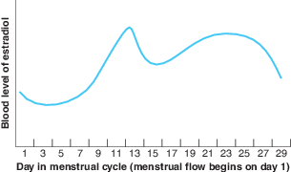
Figure 11.3: Cyclical Variation in Blood Levels of Estradiol in Females
Estradiol, a form of estrogen, shows a distinctive pattern of variation over the course of the menstrual cycle in premenopausal women, which is often related to mood and behavior. It has been argued that these and related hormone swings help account for emotionality, as well as females’ varying interest in sexual activity and varying appeal to men at different times of the month.
Notes:
Estradiol is a form of estrogen
It shows a distinctive pattern of variation over the course of the menstrual cycle in premenopausal women
It is often related to mood and behavior

Slide 15
11.4: Gender Differences in Personality from the Eight Perspectives
Objective: Describe how the eight basic approaches to personality address gender differences
Physiological and biological gender differences
Notes:
Point 1- Physiological and biological gender differences
Permanent
Unchangeable
Morally correct or divinely ordained

Slide 16
11.4.1: The Psychoanalytic Approach
Reasons for gender differences in traits
Castration anxiety
Notes:
Point 1- Reasons for gender differences in traits
Aggression
Jealousy
Passivity
Rationality
Dependency
Point 2- Castration anxiety
Importance of his penis for pleasure
Threats from his parents about masturbation
Fact that he has noted that girls do not have this valued appendage

Slide 17
11.4.2: The Neo-Analytic Approaches
Erikson’s views on male traits
Erikson’s views on female characteristics
Notes:
Point 1- Erikson’s views on male traits
Active
Exploring
Warring
Pragmatic
Point 2- Erikson’s views on female characteristics
Nurturance
Gentleness
Peacefulness

Slide 18
11.4.3: Biological/Evolutionary Approaches
Natural selection
Men engaging in sexual activity
Notes:
Point 1- Natural selection
Evolutionarily imperative for men to have as many sexual contacts as possible
Men need to perpetuate their genes
Men have almost inexhaustible supplies of sperm
Point 2- Men engaging in sexual activity
Masturbation
Heterosexual and homosexual contacts
Casual sex

Slide 19
11.4.4: The Behaviorist Approach
Behavioral learning techniques
Gender – a salient characteristic
Notes:
Point 1- Behavioral learning techniques
Reinforcement (operant learning)
Modeling
Conditioning
Generalization
Vicarious learning
Point 2- Gender – a salient characteristic
Boys imitate the traits and behaviors they see in men
Girls are more likely to learn to perform like the women they see

Slide 20
11.4.5: The Cognitive Approach
Gender schema theory
Usefulness of gender schemas
Notes:
Point 1- Gender schema theory
Our culture and gender-role socialization provide us with gender schemas
Organized mental structures that delineate our understanding
Point 2- Usefulness of gender schemas
Operate as cognitive filters or lenses through which we process gender-relevant information
Affect our perceptions of others (and ourselves)
Assist us in making decisions about our resulting behavior

Slide 21
11.4.6: Trait Approaches to Masculinity and Femininity
Bem’s classification of individuals
Achievement motivation
Notes:
Point 1- Bem’s classification of individuals
Feminine
Masculine
Androgynous
Undifferentiated
Point 2- Achievement motivation
Drive to strive for success
Women were not as motivated to achieve as men

Slide 22
11.4.7: Humanistic Approaches
Maslow’s personality theory
Reasons for women’s low dominance
Notes:
Point 1- Maslow’s personality theory
Minimized the importance of masculine and feminine personality traits
Importance of self-actualization
Point 2- Reasons for women’s low dominance
Norms
Education
Status
Expectations

Slide 23
11.4.8: Interactionist Approaches
Decoding verbal and nonverbal messages
Overview
Notes:
Point 1- Decoding verbal and nonverbal messages
Women are better at understanding (decoding) others’ nonverbal behaviors
Women are also better at expressing accurate, decipherable nonverbal messages
Point 2- Overview
Instrumental behavior involves being oriented to objectives that are task-focused and separate from the interpersonal system
Expressive behavior involves the emotional well-being of one’s social or family group

Slide 24
11.5: Cross-Cultural Studies of Gender Differences
Objective: Contrast the way gender differences are perceived across cultures
Egoistic dominance
Areas with no dependable gender differences
Notes:
Point 1- Egoistic dominance
Trying to control the behavior of others in order to meet their own needs
With boys more egoistically dominant
Point 2- Areas with no dependable gender differences
Dependency
Prosocial dominance
Sociability

Slide 25
11.6: Love and Sexual Behavior
Objective: Contrast the differences between men and women in love and sexual behavior
Stereotypes in American society
Gender-similar aspects of sexuality
Notes:
Point 1- Stereotypes in American society
Women are interested in love
Men are interested in sex
Point 2- Gender-similar aspects of sexuality
Erotica
Women’s fantasies
Erotic thoughts

Slide 26
Conclusion: Do Males and Females Differ?
Nature of man versus the nature of woman
Gender as key influence on perceptions of personality
Gender differences in personality

