Slide 1
CM 101 Training
Section 1: Cost Management Overview
  What are costs and why is managing costs important?
  Army’s overall objectives
  Change enablers to support Cost Management
  The process of Cost Management and how it differs from Budget Management
Section 2: Cost Model Components
  Defining the various cost objects (which replace APCs/JONOs) within a Cost Model, e.g. organizations, products, services, jobs, etc.
  Understanding decision points of where to capture information
Section 3: Cost Flow Methods
  The difference between cost capturing, allocations, and assignment
Section 4: Cost Model Build
  Reflecting organizational structures
  Replacing APC/JONO’s
1
Notes:
1

Slide 2
Section 2 Objective & Agenda
Section 2: Cost Model Components
Understanding of the master data available to define the cost model
Lesson 1: Cost Elements
Lesson 2: Cost Terms
Lesson 3: Cost Centers
Lesson 4: Activity Types
Lesson 5: Payroll & Labor Tracking
Lesson 6: WBS Elements
Lesson 7: Orders
Lesson 8: Business Processes
Lesson 9: Statistical Key Figures
2

Slide 3
The Army Cost Model Objects
(Master Data)
Notes:
GFEBS Cost Objects have been defined for use by the Army as below:
3

Slide 4
Lesson 1: Cost Elements
Objective(s):
To understand what the Cost Element cost object represents, key definition criteria (guiding principles), uses, and how defined for the Cost Model
Notes:
4

Slide 5
SAFM-CE Army Cost Model
Cost Element Definition
Cost Element Definition:
A Cost Element is the lowest level component for classifying costs and revenues (as negative costs) of a resource and indicates the category/type associated with a posting (e.g. allocation type, revenue, expense)
GFEBS replaces the concept of EORs with GL Accounts in Financials (FI), Commitment Items in Budgeting (FM) and Cost Elements in Cost Management (CO)
Notes:
5

Slide 6



SAFM-CE Army Cost Model
Guiding Principles for Cost Elements
Principle #1: External Alignment | Alignment to support external reporting requirements for financial reporting of P/L items.
Principle #2: Transparency | Provide the lowest level of transparency necessary for managing revenues/expenses not already supported within another data element
Manage Travel
by Cost Center
OMB Object
Class 21 - Travel
Individual Transactions
Flight
Hotel
6100.21T0
6100.21P0
OC21
Meal
Notes:
6

Slide 7
SAFM-CE Army Cost Model
Cost Element Uses
Capture actual costs (expenditures, imputed costs, allocations, etc.)
Plan cost by organizations (Cost Centers), activity types or products/services
Reporting of individual expense categories or grouped together to support internal (management) and external (OMB/SFIS) reports
Move costs from one org/location to another: e.g. similar to some “cost transfers” currently performed
Primary (consumed from outside) versus Secondary (consumed from inside)
Maintain debit/credit integrity for expense related postings within the Controlling component of GFEBS
Notes:
7

Slide 8
Primary Cost Elements
Expenditures externally sourced, such as most of today’s EORs (excluding the 2700s)
Typically (but not necessarily e.g., depreciation) indicative of cash out flows
Start with the USGL indicator, such as 6100 or 6400 for expenses
Are a 1:1 match with the General Ledger Account utilized for Financial Accounting
Director of
Logistics (DOL)
Cost Center: CIF
DOL Support $$$
Labor $$$
Material $$$
Military
Labor
Contracts $$$
Travel $$$
Military Labor $$$
Facilities $$$
CIV
HR
Examples:
6100.11B1 Civilian Base Pay - Full-time Permanent
6100.11B3 Civilian Base Pay - Other than Full-time Permanent
6100.21T0 TDY Travel
6100.252A Information Technology Services – Processing
6400.13H0 VSIP TAX -15% Remittance to CSRDF
MIL
HR
Notes:
8

Slide 9
Secondary Cost Elements
Assigned/service fees to an object for consuming products/services providing by another object. (e.g. 2714 Shop Stock)
Non-cash outlays (would have occurred with the Primary Cost Element posting)
Start with a 9 series preface to indicate that they are not associated with the General Ledger, e.g. internal only
There are multiple types of secondary cost elements to support allocations, charge outs, overhead surcharges, etc.
Director of
Logistics (DOL)
Cost Center: CIF
DOL Support $$$
Labor $$$
Material $$$
Military
Labor
Contracts $$$
Travel $$$
Military Labor $$$
Facilities $$$
CIV
HR
Examples:
9000.2714 MATERIAL SHOP STOCK
9300.0100 LABOR CHARGE - REG
9300.01OT LABOR CHARGE - OT
9400.0150 MILITARY LABOR CHARGE
MIL
HR
Notes:
9

Slide 10
Cost Elements Example
Director of
Logistics (DOL)
Cost Center: CIF
9200.0100 Support Allocation $$$
6100.11B1 Full-Time Perm $$$
6100.26XX Material $$$
Military
Labor
6100.25YY Contracts $$$
6100.21T0 Travel $$$
9700.0150 Mil Labor Imputed $$$
9400.SQFT Facilities $$$
Total $$$$$
9300.0100 Labor Charge Reg - $$$
9400.0150 Mil Labor Charge - $$$
CIV
HR
Total - $$$$
Over/Under Absorption $$$$
MIL
HR
Notes:
10

Slide 11
SAFM-CE Army Cost Model
How Cost Elements are Defined
For Primary Cost Elements:
  Started with EORs for both pay and non-pay
  Evaluated information embedded in code/EOR
  Determined if another GFEBS data element could hold that info and collapsed where possible (e.g. C-Type, Vendor, Type of Interest Payment)
  Reviewed external reporting requirements such as OMB Object Classes, USGL, SFIS mappings
  When a GL Account it determined a Primary Cost Element is also created with the exact same code
  Once live, new Primary Cost Elements are typically rarely added and as needed to support external reporting
Notes:
11

Slide 12
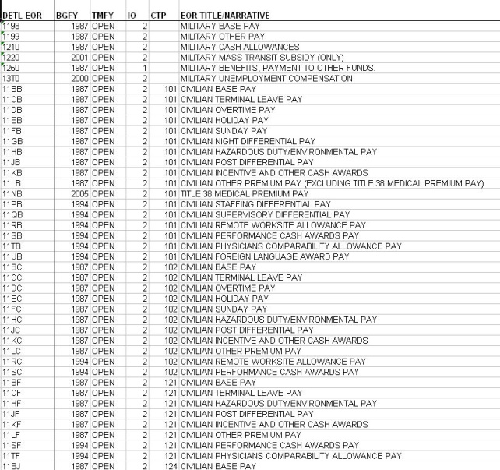
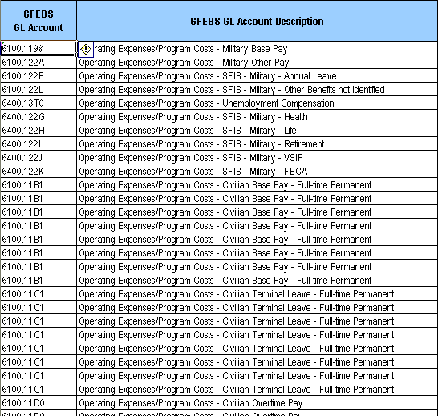
EOR crosswalk to GL Discussion
EORs will no longer be used in GFEBS; yet, the same information previously maintained through EORs will be supported via different methods
C-type is removed from Accounts in GFEBS and reported via BI Labor Report
500+
37-100
Labor EORs
60+ in GFEBS as:
FI GL Accounts
Primary Cost Elements
Commitment Items
Labor
Report by
C-Type
GFEBS BI
Notes:
12

Slide 13
SAFM-CE Army Cost Model
How Cost Elements are Defined
For Secondary Cost Elements:
  Determined types of cost allocations/ assignments to be supported (assumed all possible in GFEBS)
  Determine internal management reporting detail needs, continues to expand with maturity
  Identified impacts for budget/non-budget relevant in funds management
  Secondary Cost Elements are constantly being added as assignments/allocations are updated/changed in order to provide transparency for management reporting
Notes:
13

Slide 14
Cost Element Groups
Cost Elements can be grouped together to support
  Reporting: e.g. all labor related primary cost elements into a group called Payroll Labor
  Reconciliation: e.g. the primary cost element used to procure shop stock with the secondary cost element used to allocate shop stock to manage the under/over absorption
  Allocations: e.g. allocating a combination of cost elements to multiple receivers
  Hierarchies: e.g. by creating cost element groups within cost element groups a hierarchy is generated which can be utilized to meet OMB Object Class and SFIS reporting requirements
OMB OCs
11
11.1
11.3
11.5
11.7
12
13
21
…
Notes:
14

Slide 15
Lesson 1: Wrap-Up
A Cost Element is the lowest level component for classifying costs and revenues (as negative costs) and indicates the category/type associated with a posting (e.g. allocation type, revenue, expense)
There are two types of Cost Elements: Primary and Secondary
Primary Cost Elements represent those obtained from the external market, the initial posting
Secondary Cost Elements represent costs incurred from within the Army
EORs and the EOR information will be supported via GFEBS through GL Accounts, Commitment Items, and Primary Cost Elements
Cost Elements can be grouped together to support internal and external reporting including to generate hierarchies such as OMB Object Class
Notes:
15

Slide 16


Lesson 2: Cost Terms
Objective(s):
Understand the key terms involved with Cost Management

Slide 17
Cost Terms
There is a language to Cost Management, however there are many dialects!
There is an inconsistency of cost terms in the market driven by outgrowth from manufacturing to the introduction of service costing
Cost terms additionally differ based on costing philosophy (e.g. standard costing, activity-based costing, theory of constraints, etc.)
Army has determined the Cost Terms to be propagated to provide a level set language for understanding Cost information

Slide 18
Many Types Costs
Direct costs— A cost such as labor, materials/supplies that can be directly traced to producing a specific output of an organization, product/service.
Indirect costs – A cost that cannot be directly traced to a specific organization, product/service output.
Funded Costs -- The value of goods or services received because of an obligation of funds (obligation authority), by the organization performing the work.
Unfunded costs -- A cost that are financed by another organization's or activity's appropriations.
Variable Costs -- A cost that changes with change in output.
Fixed Cost -- A cost that remains the same regardless of the change in output.
Recurring Cost -- A cost that is incur repeatedly for each organization and/or product/service produced .
Non-Recurring Cost -- A cost that is unusual and unlikely to occur again.
Avoidable Costs -- A cost incurred on an object that will no longer be incurred due to a decision to change the output.
Unavoidable Cost -- A cost incurred on an object that will be incurred regardless of the decision to change.
Common Understanding of Types of Cost is Necessary for Informed Decision Making
Each Decision Should be Focused on Only Relevant Cost that Impact the Decision
Notes:
This summary slide should not be here. The concept of the pairing logic should be here.
1 – Control – direct/indirect
2 – Money Source - Funded vs Unfunded
3 – Related to output – Variable or fixed
4 – frequency – Recurring/Non Recurring
5 – Impacted by decisions and actions – avoidable/unavoidable

Slide 19
Type of Cost Functions
Recurring or
Non Recurring
Avoidable or
Type Cost is a
Direct or
Fixed or
Funded or
Unavoidable
Indirect
Variable
Unfunded
Function of …
X
X
X
X
X
X
X
Output Qty
X
X
X
X
Product Produced
X
X
Source of Funds
X
X
X
X
Overhead
X
Provider
X
X
X
Relevant Time Range
Notes:
I don’t like this slide – Misleading
For Example – Generically overhead is Indirect, but the column implies it could be both –
Rather this slide should be pushed down to the last slide – as an example – to have limited illustration…
Need to see how Steve uses this slide. - Really need to combine the concepts of 71 and 72

Slide 20

Funded vs Unfunded
The terms Funded and Unfunded define the relationship of the appropriation dollars consumed to the organization utilizing those funds.
Classification of the dollars input (utilized) in relationship to the organization responsible for the output

Slide 21
Funded Costs
Funded Costs – The value of goods or services received because of an obligation of funds (obligation authority), by the organization performing the work. (e.g. civilian labor, building and grounds maintenance). These costs are funded in the Annual Operating Budget of the organization.
  Labor
  Materials
  Contracts
  Travel
  Facilities
Example 1:
Example 2:
Director of
Logistics (DOL)
Cost Center/Resource Pool
Cost Center/Resource Pool
Central Issue Facility
Central Issue Facility

Slide 22
Unfunded Costs
Unfunded Costs – Costs that are financed by another organization's or activity's appropriations. These costs do not result in any obligation of funds by the organization; examples include depreciation, military labor, and military rations.
Military
Labor
Cost Center/Resource Pool
Example:
Central Issue Facility
Depreciation

Slide 23
Direct vs. Indirect Costs
Direct and Indirect define the relationship of the cost incurred to the output provided
Direct and Indirect are often contentious terms since they imply responsibility for control (view changes depending on where you sit in the organization)
Cost Center
$$$
$$ Relationship with # output…
# HRS
CIV
HR
# HRS
MIL
HR
Notes:
Need a Specific Example to Use
Direct – vs Indirect –
Use CIF – Manager and DOL when compared person sewing the machine.

Slide 24
Direct Costs
Director of
Logistics (DOL)
Direct Costs – A cost such as labor, materials/ supplies that can be directly traced to producing a specific output of an organization, product/service
Cost Center: CIF
DOL Support $$$
Labor $$$
Material $$$
Military
Labor
Contracts $$$
Travel $$$
Military Labor $$$
Facilities $$$
CIV
HR
MIL
HR
Notes:
NOTE – Military labor is a red herring to this slide –should be deleted.

Slide 25
Indirect Costs
Director of
Logistics (DOL)
Indirect Costs – Costs that cannot be directly traced to a specific output. They are often allocated on some predetermined basis and are generally synonymous with overhead, such as general and administrative expenses.
Cost Center: CIF
DOL Support $$$
Labor $$$
Material $$$
Contracts $$$
Travel $$$
Military Labor $$$
Facilities $$$
CIV
HR
MIL
HR

Slide 26
Recurring vs Non Recurring
The terms Recurring and Non-Recurring define regularity of the occurrence of the expense
Recurring Costs are those that incur repeatedly for each organization and/or product/service produced (e.g. payroll, materials)
Non-Recurring Costs are those that are unusual and unlikely to occur again (e.g. Hurricane, GFEBS deployment)

Slide 27
Fixed vs Variable
Fixed and Variable define the influence on the dollar relationship of the cost incurred to the output provided
Are defined within a relevant time, such as the plan cycle (i.e. 1 year.)
Cost Center
Influence on $$s in relationship with # output…
$$$
# HRS
CIV
HR
# HRS
MIL
HR

Slide 28
Fixed and Variable Costs
Fixed Cost - A cost that remains the same regardless of the change in output, within a relevant range (e.g., rent, supervisor).
Variable Costs - A cost that changes with change in output (e.g., cost of material, labor, utilities).
Cost Center: CIF
Fix Var
DOL Support $$$
Labor $$$ $$$
Material $$$
Military
Labor
Contracts $$$ $$$
Travel $$$
Military Labor $$$
CIV
HR
Facilities $$$
MIL
HR
CNTR
HR

Slide 29

The Prices Video
Notes:
29

Slide 30
Decision Specific
Cost Concepts
Avoidable Costs - A cost incurred on an object that will no longer be incurred due to a decision to change the output, such as contract labor to operate the test range
Unavoidable Cost - A cost incurred on an object that will be incurred regardless of the decision to change output, such as depreciation on equipment

Slide 31
Lesson 2: Wrap-Up
Cost Management has a language of its own and terms have a different meaning then when used for other purposes
Common understanding of types of cost is necessary for informed and decision making
Types are usually in pairs and can only be one or the other (e.g. Funded or Unfunded)
Each cost can have multiple types considered (e.g. Funded, Direct, Unavoidable)
Each decision should be focused on only relevant cost that impact the decision

Slide 32
Exercise # 1: List Cost Differences
Funded vs. Unfunded
Recurring vs. Non-recurring
Fixed vs. Variable
Avoidable vs. Unavoidable
Direct vs. Indirect
Notes:
Facilitated Session
Fixed and Variable – depends on who you are.
If I am providing space as my output then the custodial cost is variable on the square feet of output; even though the output number is fairly static.
If I am CIF – the output measure is uniforms distributed – then the square footage cost if probably very fixed.

Slide 33
Answers to 1 through 4
Direct costs - directly traced to producing a specific output
Indirect costs - cannot be directly traced to a specific output
Recurring Costs – those costs that occur year over year
Non-Recurring Costs – one time within the year of execution and not planned to happen again
Variable Costs - changes with change in output
Fixed Cost - remains the same regardless of the change in output (within a relevant range)
Avoidable Costs - will no longer be incurred due to a decision to change the output
Unavoidable Cost - will be incurred regardless of the decision to change output

Slide 34

Question #5: Provide Examples of When Labor is?
Direct
Indirect
Funded
Unfunded
Recurring
Non-Recurring
Variable
Fixed
Avoidable
Unavoidable
Answer: Discussion
Notes:
Examples - Sewing Machine operator in CIF - Direct, Funded, Recurring, Variable and Unavoidable

Slide 35
Lesson 3: Cost Centers
Objective(s):
To understand what the Cost Center cost object represents, key definition criteria (guiding principles), uses, and how defined for the Cost Model
Notes:
Relate the APC’s to GFEBS Master Data Element

Slide 36
Full Cost Understanding
Starts with Cost Center Structure
Garrison Commander
School
House
FORSCOM
MSE
DPW
DRM
TRNG
RM
1BCT
2BCT
Fund Center
Cost Centers
Cost Center Groups
Notes:
Funds Centers are ASN’s, within the ASN there are multiple directorates, divisions, etc.
These organizations are the basis for a Cost Center Structure
CC Structure tends to follow the TDA Structure
These units can be rolled up for reporting to get slices of the total cost

Slide 37
SAFM-CE Army Cost Model
Cost Center Definition
Cost Center Definition:
A cost center is a responsibility center that incurs costs and has a manager who is accountable for those costs.
This definition lends itself to multiple varied utilizations of the cost center object to reflect the costs of an organization
Further criteria/principles along with the Cost Center’s purpose must be utilized to better indicate when a Cost Center is appropriate
The purpose of the Cost Center object is to serve as the base for the management optimization model – the model utilized to reflect the business, it’s inputs, conversions, and outputs in order to support management decisions
The Cost Center is the first cost object to be defined for the Cost Model
To support the appropriate definition of a Cost Center within an entity, Guiding Principles should be considered
Notes:
Most people hear “CC” and think of anything that captures cost
Actually an organization
Needs to represent a physical place
First piece of the Cost Model, these organizations decide what resources are consumed.

Slide 38
SAFM-CE Army Cost Model
Definition Standards for Cost Center
Standard #1: Materiality | Cost Center costs needs to be significant in relation to all costs to be captured Exceptions to Materiality are based on external regulations reporting requirements
Standard #2: Life Span | The life span of a Cost Center crosses multiple years Short term life spans indicate a project or event not a Cost Center
Standard #3: Management Control | There must be a manager who is responsible for controlling the resources (e.g. people, equipment, supplies, etc.) of the Cost Center and the Cost Management Processes: output planning and corresponding resource demands, decision support and corrective actions, measurement of efficiency/ effectiveness of the outputs of the Cost Center
Standard #4: Span of Labor Control (if Labor Related) | Must be more than 2 and less than 20 employees. Industrial studies recommend 5-12 as standard number of employees within a labor related Cost Center due to affectivity of supervision. Sensitive personal information may be apparent for cost centers with only one employee, such as payroll. With the introduction of Pay Banding, it becomes necessary to protect salary information. Exceptions to Span of Control standard occur based on other standards such as Materiality, Cost Assignment Accuracy not impacted by the aggregation, and Management Control not required for corrective actions
Standard #5: Contains at Least 1 Resource Pool | A Resource Pool (called activity types within GFEBS, GCSS, LMP) provides quantitative output of the Cost Center and has an assignment unit of measurement, e.g. a Citrix Farm Cost Center has a Resource Pool of machines providing CPU Minutes (CPUMINs), the Human Resource Cost Center provides Labor Hours (LABHRs), the Building 3 Cost Center provides Square Footage (SQFT), etc.
Notes:
Reference Slide Only
There are rules around the creation of these pieces of Master Data
Needs to be long-term in nature
Needs to have a manager
Needs to have a resource pool for tracking output, will discuss later.

Slide 39
SAFM-CE Army Cost Model
Definition Standards for Cost Center
Tenant #6: Functionality | Cost Center is defined by the unique function performed and the measurement of the outcome of the products and services for that function Exceptions to Functionality are made based on other standards such as Materiality, Control and Span of Labor Control
Tenant #7: Locality | Cost center reside in one physical location (e.g. same building) Exceptions to Locality are made based on other tenants such as Materiality and Control
Standard #8: Cost Assignments Accuracy | Cost Center is defined to the level of the organizational structure such that accuracy of the assignment of costs to the products/services is not impacted by aggregation

Slide 40









SAFM-CE Army Cost Model
Cost Centers Uses
DRM/G8
People Related: e.g. DRM/G8 office
Facilities Related: e.g. Warehouses, Hospitals, Office Space
Equipment Related: e.g. Citrix farm accessing GFEBS, Cranes/Trucks
Blended: e.g. mix of resources within a organization, e.g. Vehicles and Mechanics
Building Type 1
Building Type 2
Network Admin
Equipment
Motor Pool
Notes:
Examples (e.g. G-8, G-6, RMO)
Most are either People Related or Blended

Slide 41
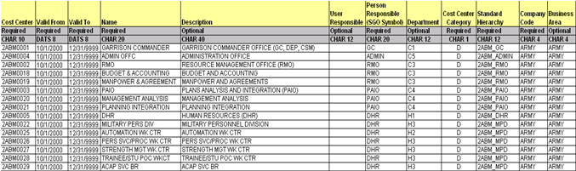
Cost Center Creation
Review of “working” TDAs
Review of wirecharts
Interviews at each location identify other organizations that need to be added to the list of Cost Centers
Analysis of UIC codes to identify all MTOE units which are within an ASN
Compliance with Standard Command structures defined (e.g. IMCOM SGO, MEDCOM MTFs, etc.)
Output
Notes:
Capture Teams assist with creation of building out Cost Centers
These Cost Centers are loaded into GFEBS in advance of going live

Slide 42
Cost Center Information
GFEBS Cost Center Attributes
Cost Center | Postal Code
Valid From / To | PO Box Postal Code
Name | Region
Description | Language Key
User Responsible | Telephone 1
Person Responsible | Telephone 2
Department (PD Major/Minor) | Telebox Number
Cost Center Category | Telex Number
Standard Hierarchy | Fax Number
Company Code | Teletex Number
Business Area | Printer Destination
Functional Area | Data Communication Line Number
Title | UIC Code
Name 1 | OUID
Name 2 | DMIS ID
Name 3 | TDA Paragraph
Name 4 | FDC (Function Designator Code)
House Number and Street | Area of Responsibility
Location City | Program Area
District | Interface Indicator
Country | FCA Code
Jurisdiction | Command Defined Field
PO Box
Notes:
APC Code have attributes, ERP’s will have their own attributes
Yellow = standard
Blue = custom

Slide 43
SAFM-CE Army Cost Model
Cost Center Hierarchy
In addition to defining the Cost Centers and the attribute information for each individual Cost Center, the Cost Centers need to be identified on a standard hierarchy
There is a single standard hierarchy which every Cost Center will reside on to ensure that all costs can be reported from a single hierarchy
Alternative hierarchies can be defined as needed to meet management objectives
The Cost Center Hierarchy is utilized to support Informal Budget Distribution and Budget Execution Status of Available Fund report aggregation
Notes:
APCs have a linear relationship, in ERPs master data tends to have a grouping component.
Part of defining the master data is building out this hierarchy
Hospital
Dept of Med
Clinics
This hierarchy rolls up the entire way to Army level
Transparency
Can also pull by directorate, or break by other attributes depending on installation need

Slide 44
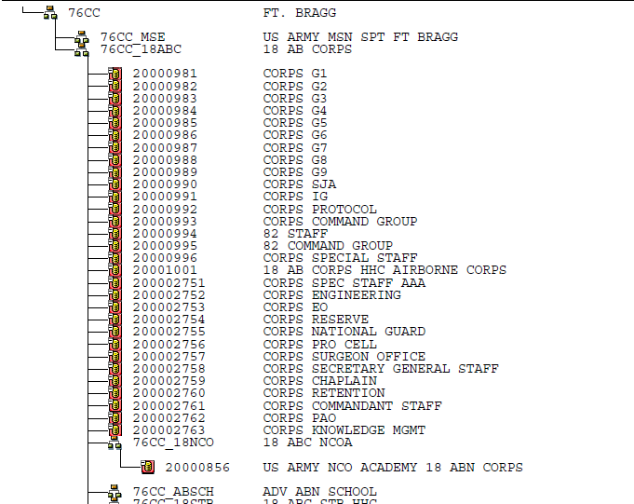
GFEBS: Cost Center Example –
Hierarchy
Notes:
44

Slide 45
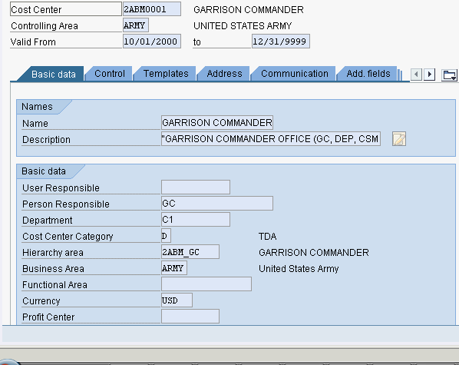
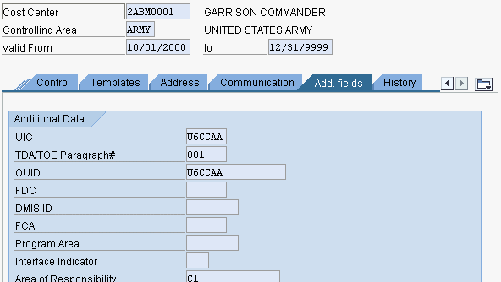
GFEBS: Cost Center Example –
Center
Notes:
45

Slide 46
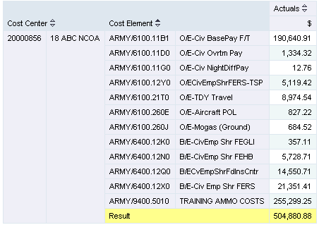
GFEBS: Cost Center Example –
Center Actual Report
Notes:
46

Slide 47
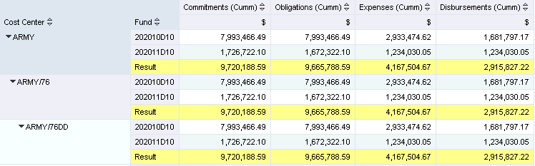
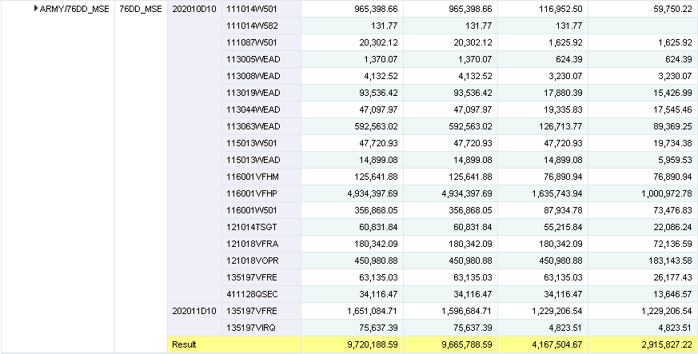
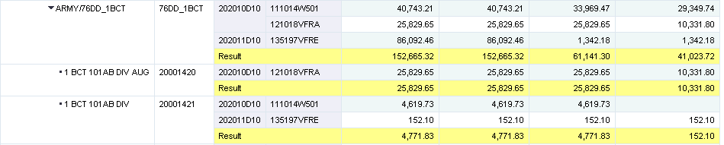
Budget Reporting with a Cost View

Slide 48
Lesson 3: Wrap-Up
A cost center is a responsibility center that incurs costs and has a manager who is accountable for those costs
Costs of the cost center are material in nature (worth capturing vs. the cost of capturing)
A cost center has a long life span of more than 1 year (typically years) and has a manager responsible for the resources consumed and the outputs produced by the cost center
Every cost center resides on the standard hierarchy
Alternative cost center hierarchies can exist as well
CC Hierarchy is utilized to support Informal Budgets and Status of Available Funds Reporting

Slide 49
Questions:
  A cost center is a cost object used to represent any APC?
    True
    False
A cost center is utilized to capture the revenues generated by the outputs of an organization
  True
  False

Slide 50
Answers:
  A cost center is a cost object used to represent any APC?
    True
    False
X
A cost center is utilized to capture the revenues generated by the outputs of an organization
  True
  False
X

Slide 51
Questions:
A cost center can be assigned to more than 1 standard hierarchy?
  True
  False
There is only one cost center in every fund center (ASN)
  True
  False

Slide 52
Answers:
A cost center can be assigned to more than 1 standard hierarchy?
  True
  False
X
There is only one cost center in every fund center (ASN)
  True
  False
X

Slide 53
Lesson 4: Activity Types
Objective(s):
To understand what the Activity Type cost object represents, key definition criteria (guiding principles), uses, and how defined for the Cost Model

Slide 54
SAFM-CE Army Cost Model
Activity Type Definition
Activity Type Definition:
An Activity Type is a cost object that represents a group of resources within a Cost Center. These resource groups have capacity and a unit of measure such as: labor hours, machine hours, square footage, etc. Activity Types are consumed and utilized to the produce the products and services of the organization.
The term activity type is often confused with an activity, of the Activity-Based Costing approach – however it does not represent an activity. Activities are generally identified with a verb, e.g. Pick Items, Pack Box, Ship Pallet
A more appropriate translation is Resource Pool, e.g. groups of like kind resources within an organization that perform an activity such as TECH HR, SUPV HR, MACHR
Activity Types have a rate/output associated are the utilization of capacity to perform “work” to generate a product/service, e.g. TECH HR @ $10/Hr
Notes:
New initiative, there are currently maintenance standard rates and shop stock rates that are used.
Isn’t an activity, not a verb. This is a capacity measure, may be USED to define an activity such as pick, pack, ship.
Have both a rate and quantity associated with them (dollars/hour).
4. Resource Pool, a group of resources that have similar skill sets and perform similar functions.

Slide 55


SAFM-CE Army Cost Model
Activity Type Uses
Cost Center
Activity Type
RMO
People e.g. RMO
  Manager & Analyst
ANLY HR
MGR HR
Motor Pool
Blended e.g. Motor Pool
  Mechanic & Vehicle
MECH HR
VEHC HR
Notes:
Group by Like Kind Resources
Equipment hours/ Vehicle Hours
Tend to be functionally specific
Admin, workers, managers

Slide 56
SAFM-CE Army Cost Model
Guiding Principles for Activity Types
Principle #1: Interchangeability | Meets the interchangeability criterion which requires that the attributes of two or more resources be such that they can be substituted for each other without impacting the cost and ability to produce the output
Principle #2: Similar | be of a similar technology
Principle #3: Responsibility | the responsibility of one manager or team
Principle #4: Homogeneous | their costs must conform with the homogeneity principle, e.g. be similar in the resources they consume
Principle #5:Planable | outputs and related costs are able to be planned
Principle #6: Captured | actual information (quantities and costs) can be collected or imputed
Principle #7:Co-located | they must not be geographically dispersed
Notes:
Reference Slide

Slide 57

SAFM-CE Army Cost Model
Activity Type Uses
Capture Capacity or Planned Output, e.g. grandma works 2088 Hrs or machine runs 3500 Hrs (10 Hrs/Day for 350 days)
Holds the rate for the output of the resource pool, e.g. $2 Hr, $5 Hr, $20 Hr
Assigns capacity consumed by products/ services, e.g. Hrs/min worked per dress, which then valuates based on the rate
Cost per Dress differs based on Resource/Activity Type used
Interchangeable
Not Similar Technology
Not Homogenous – needs resources (input cost structure) of food versus laborer versus electricity
Notes:
If I’m trying to fix a uniform, are grandma, manual machine or sewing machine interchangeable?
Must be similar in technology, these aren’t
Labor pools of menders vs. machines
Everyone will be assigned an activity type, regardless of civilian or military

Slide 58
Capacity Management
Activity Types facilitate capacity management and there are various types of capacity (e.g. Productive, Non-Productive, Idle/Excess, etc.)
Activity Types provide the capacity information required to optimize the conversion of inputs to generate the most outputs – meeting the “Efficiently” portion of the Cost Management definition
Activity Types are defined as master data, however they exist only in conjunction with a Cost Center
  Activity Type = MACHR is assigned to Cost Center 1 and Cost Center 2 resulting in CC1/MACHR and CC2/MACHR each of which holds their own rate, their planned output, captures actuals, etc.
Notes:
Activity Types in relation to capacity.
Activity Types can’t function as stand alone master data, must be associated with a Cost Center.

Slide 59
SAFM-CE Army Cost Model
How Activity Types are Defined
The project and production related areas are familiar with the concepts of labor and equipment rates and often have std. rates for charging level of effort for like kind resources to work on an order, e.g. IFS
Maintenance shop rates are reviewed and then grouped/expanded upon into like kind resources
Equipment Activity Types are defined based on a review and grouping of equipment, e.g. Dump Truck 6T
Vehicle Activity Types are defined based on GSA classification into groupings
Notes:
Two Types of Activity Types:
Machines
Bulk come from IFS
Standard Shop Rates to charge work out for Demand Maintenance Orders

Slide 60
Activity Types
Non-Labor Examples
Notes:
1. Reviewed IFS and ascertain that equipment types are being used and associate an Activity Type.

Slide 61
SAFM-CE Army Cost Model
How Activity Types are Defined
Current Labor definitions from OPM, DOL, NSPS are reviewed (e.g. GS, WG, NSPS)
Labor series/categories, bands (e.g. 1 – 4 depending on labor classification), and type of work (e.g. regular versus overtime) generate starting point for labor activity types
Controlling Area | Activity Type | Valid-From Date | Valid To Date | General Name | Description | Activity Unit
Army | 10032 | 10/1/2000 | 12/31/9999 | ACC & BUDGET GRP RG1 | Accounting And Budget Group RG1 | HR
Army | 10033 | 10/1/2000 | 12/31/9999 | ACC & BUDGET GRP RG2 | Accounting And Budget Group RG2 | HR
Army | 10034 | 10/1/2000 | 12/31/9999 | ACC & BUDGET GRP RG3 | Accounting And Budget Group RG3 | HR
Army | 10035 | 10/1/2000 | 12/31/9999 | ACC & BUDGET GRP RG4 | Accounting And Budget Group RG4 | HR
Army | 10036 | 10/1/2000 | 12/31/9999 | ACC & BUDGET GRP OT1 | Accounting And Budget Group OT1 | HR
Army | 10037 | 10/1/2000 | 12/31/9999 | ACC & BUDGET GRP OT2 | Accounting And Budget Group OT2 | HR
Army | 10038 | 10/1/2000 | 12/31/9999 | ACC & BUDGET GRP OT3 | Accounting And Budget Group OT3 | HR
Army | 10039 | 10/1/2000 | 12/31/9999 | ACC & BUDGET GRP OT4 | Accounting And Budget Group OT4 | HR
Notes:
People
Comes from Faces to Spaces activity completed by DASA-CE Capture Team
Bands are needed to stratify the variance in the standard rates.
These don’t correlate specifically to NSPS Bands, we understand that NSPS is being phased out.
A tool to assist with this calculation has been created and will be given to you for deployment.
Need to fit into a group that has been established, there is no way to create one off Activity Types.

Slide 62
Faces to Spaces to
Activity Types
The Cost Center and Activity Type will be updated on the DCPS accounting information as the default Cost Center/Activity Type for an employee
To determine the Activity Type for each person an exercise of mapping people (Faces) to cost centers (Spaces) occurred, and then an Activity Type is assigned
The Activity Type is associated with the ATAAPS entry for time tracking or via the work order confirmation process (confirmations associate labor and non-labor activity types to the work order supported

Slide 63
Lesson 4: Wrap-Up
An Activity Type is a cost object that represents a group of resources within a Cost Center. These resource groups have capacity and a unit of measure such as: labor hours, machine hours, square footage, etc. Activity Types are consumed and utilized to the produce the products and services of the organization.
There are several guiding principles for the definition of an Activity Type which should be considered
The Activity Type is the cost object which supports capacity management
Each person will be assigned their default activity type based on NSPS, WG, GS, cost center assigned, etc.

Slide 64
Question:
Resources within Activity Types
(Check All that Apply) are:
similar technology
homogeneous
able to be planned for $s and qtys
interchangeable
tracked in actual or imputed
the responsibility of one manager/team
what provide the capacity for “work” to be performed
Principle #1: Interchangeability | Meets the interchangeability criterion which requires that the attributes of two or more resources be such that they can be substituted for each other without impacting the cost and ability to produce the output
Principle #2: Similar | be of a similar technology
Principle #3: Responsibility | the responsibility of one manager or team
Principle #4: Homogeneous | their costs must conform with the homogeneity principle, e.g. be similar in the resources they consume
Principle #5:Planable | outputs and related costs are able to be planned
Principle #6: Captured | actual information (quantities and costs) can be collected or imputed
Principle #7:Co-located | they must not be geographically dispersed

Slide 65
Answer:
Resources within Activity Types
(Check All that Apply) are:
similar technology
homogeneous
able to be planned for $s and qtys
interchangeable
tracked in actual or imputed
the responsibility of one manager/team
what provide the capacity for “work” to be performed
✓
Principle #1: Interchangeability | Meets the interchangeability criterion which requires that the attributes of two or more resources be such that they can be substituted for each other without impacting the cost and ability to produce the output
Principle #2: Similar | be of a similar technology
Principle #3: Responsibility | the responsibility of one manager or team
Principle #4: Homogeneous | their costs must conform with the homogeneity principle, e.g. be similar in the resources they consume
Principle #5:Planable | outputs and related costs are able to be planned
Principle #6: Captured | actual information (quantities and costs) can be collected or imputed
Principle #7:Co-located | they must not be geographically dispersed
✓
✓
✓
✓
✓
✓

Slide 66
Lesson 5:
Capture Payroll/Labor Costs
Objective(s):
To understand how payroll and labor costs can be captured, maintenance required, and what information can be reported/analyzed
Notes:
66

Slide 67
Payroll vs. Labor Process
Payroll Process - the tracking of time for attendance purposes and corresponding payment to employees as well as accruing for work performed but not yet paid
Labor Process - the tracking of time for recordation to a specific cost of outputs (services, customers, course, etc.)

Slide 68

Capture Payroll/Labor Costs
Time Tracking vs. Attendance
 | Mon | Tues | Wed | Thur | Fri
Bob Dylan | 8 | 9 | 8 | 8
Bob Dylan- Holiday |  |  |  |  | 8
TOTAL |  |  |  |  |  | 41
ATTENDANCE
Bob Dylan | Mon | Tues | Wed | Thur | Fri
Land Ops | 3 | 4 | 2 | 2
Maint. Work | 2 | 3 | 4 | 4
Idle Time | 2 | 2 | 2 | 2
Holiday |  |  |  |  | 8
TOTAL |  |  |  |  |  | 41
TIME TRACKING
Notes:
Time Tracking is the posting of the hours worked by task
Attendance is indicating that an employee is present for work
68

Slide 69
Capture Civilian Payroll Costs
Overview
DCPS remains the operational system for calculating and disbursing Civilian payroll
Reports gross disbursements from ARMY
Utilizes Primary Cost Elements
Accruals for work earned but not paid is also a part of the GFEBS payroll process
DCPS line of account changes with GFEBS
  No more APCs/JONOs therefore a cost object had to be utilized
  DCPS doesn’t support all the GFEBS cost objects
  People are management within Cost Centers
  Within GFEBS ALL Payroll costs post to a Cost Center and then most be associated with the products/services/customers

Slide 70
Capture Civilian Payroll Costs
Ongoing
DCPS Employee LOA
  When people shift organizations they need to update the Cost Center in the record
  On the Employee LOA an Activity Type is assigned as well
    Identifies type of resource pool - e.g. Budget/Accounting
    Is utilized to charge out for organizations doing Labor Tracking

Slide 71

Capture Civilian Payroll Costs
Analysis
Payroll reporting provides
  Payroll costs per organization
  Information by employee by budget address
  Visibility over paid hrs by pay type/GRC – REG, OT, Holiday
  C-type information
  Variance analysis showing Employee Actuals versus Std. Rate charged out
REPRESENTS THE EXPENSES CURRENTLY RESIDING ON THE COST CENTER
DCPS
2ABM0065 Ammo Supply Point
Name | Cost Element | Actuals | Quantity
Perm | 6100.11B1 | $4,200 | 80 hrs
Overtime | 6100.11D0 | $1,500 | 20 hrs
Benefits | 6100.12Y0 | $ 800
TOTAL |  | $6,500 | 100 hrs
XXXXXXXXXXXXXXXXXX
XXXXXXXXXXXXXXXXXX
XXXXXXXXXXXXXXXXXX
XXXXXXXXXXXXXXXXXX
XXXXXXXXXXXXXXXXXX
XXXXXXXXXXXXXXXXXX
XXXXXXXXXXXXXXXXXX

Slide 72
Capture Labor Costs
Overview
No Army wide approach for time tracking currently
Army’s need for Time Tracking
  Labor accounts for nearly 70% of Army AFP
  Visibility into what tasks are being performed by who and to which output
  Ability to determine what Products/Services are worked on
  Visibility into non-productive time
  Need to bill reimbursable customers for services rendered
Work is tracked by cost center to receiving Cost Object
  Quantity of hours worked are charged out by standard rates
  Rates are established to represent groups of similar work
Military labor costs will be imputed based on composite rates by rank

Slide 73
Capture Labor Costs
Overview
Military and Contractor Hours may also be tracked
Labor charge outs do not always signify cash movement (e.g. non-budget relevant)
Labor is tracked by using a secondary cost element
Generates additional budget availability on Cost Center (e.g. performs “cost transfer” between sender budget) address and receiver budget address
Utilize a std. rate by activity-type – not employee
  Rates must be maintained for movements/personnel actions – if new combination
  Std. rates requires variance analysis
  Rates updated annually with calendar year – with pay increases

Slide 74
Capture Labor Costs
Setup
Can utilize an already identified Labor Tracking interface to GFEBS
  ATAAPS Interface
  WMT Interface
  CIMS Interface
Additional Manual Time Tracking Load Sheets – for command specific labor tracking systems or to charge reimbursable customers
Notes:
74

Slide 75
Capture Labor Costs
Ongoing
When using Labor Tracking system, employee LOAs must be maintained for:
  Cost Center when employee moves
  Activity Type when changing kind of work (e.g. Budget/Acct to say Admin)
Rates must be maintained for movements/ personnel actions
  New combinations of cost centers/activity types
  Used for variance analysis
  Rates Updated annually with calendar year – i.e. pay increases

Slide 76

Capture Payroll/Labor Costs Analysis
DCPS
2ABM0065: AMMO SUPPLY
Name | Cost Element | Amount | Quantity
Perm | 6100.11B1 | $4,200 | 80 hrs
OT | 6100.11D0 | $1,500 | 20 hrs
BEN | 6100.12Y0 | $ 800
Labor | 9300.0100 | ($6500) | 100 hrs
RECEIVING JOB ORDER #1
60 hrs
at
$60/hr
Name | Cost Element | Amount | Quantity
Labor | 9300.0100 | $3,600 | 60 hrs
CIV HR
20 hrs
at
$75/hr
RECEIVING JOB ORDER #2
Qty is valuated
with rate
Name | Cost Element | Amount | Quantity
Labor | 9300.0100 | $1,500 | 20 hrs
ATAAPS
20 hrs
at
$60/hr
2ABM0065: AMMO SUPPLY
Name | Cost Element | Amount | Quantity
Labor | 9300.0100 | $1,200 | 20 hrs
Notes:
76

Slide 77
Lesson 5: Wrap Up
  Payroll process is the reporting of attendance with the corresponding disbursement to the employees
  Capturing payroll costs through DCPS requires modification to DCPS LOA’s. Updated information will be part of “Faces to Spaces” deployment exercise.
  Payroll process includes the accruals, but not the earmarking of funds to ensure availability for future payroll
  Labor-tracking is the capture of hours worked on specific tasks. Attendance is the recording of presence only.
  Labor charge outs are used to charge hours out based on a std. rate. This rate corresponds to a Cost Center/Activity Type combination and updated annually (calendar year)

Slide 78
Lesson 5: Quiz
All employees are assigned to a __________ during the “Faces to Spaces” exercise.
__________ are used to charge out labor allocations in order to assign quantity and a dollar amount to specific tasks. Also leveraged in variance analysis to ensure that the correct amounts are being allocated.
__________ is responsible for updating the employee’s DCPS LOA information prior to an installation using GFEBS.
Time Tracking is the tracking of whether or not an employee came to work
  True
  False
Explain how the employee’s LOA should look in both the payroll and Time Tracking Source System

Slide 79
Lesson 5: Answers
Cost Center
All employees are assigned to a __________ during the “Faces to Spaces” exercise.
__________ are used to charge out labor allocations in order to assign quantity and a dollar amount to specific tasks. Also leveraged in variance analysis to ensure that the correct amounts are being allocated.
__________ is responsible for updating the employee’s DCPS LOA information prior to an installation using GFEBS.
Time Tracking is the tracking of whether or not an employee came to work
  True
  False
Explain how the employee’s LOA should look in both the payroll and Time Tracking Source System:
The same
Std. Rates
DCPS CSR
X

Slide 80
Exercise #2
For your organization:
Cost Centers
Activity Types
What are the kinds of products/services performed which time tracking can be captured
What are some primary and secondary cost elements that would be posted to the orgs
Notes:
80

Slide 81
Lesson 6: WBS Elements
Objective(s):
To understand what the Project WBS Element cost object represents, uses, and how defined for the Cost Model

Slide 82
SAFM-CE Army Cost Model
Project & WBS Element Definition
Project Definition:
An object used to plan, collect, monitor and control costs for large scale time-based events in Project Systems, when extensive scheduling and resource management capabilities are required. Projects have a definite start and end.
Work Breakdown Structure (WBS) Definition:
WBS elements are activities in the Project used for planning and updating cost data. Some examples of WBS Elements are: Tasks, Partial tasks that are further subdivided, and work packages.

Slide 83
SAFM-CE Army Cost Model
WBS Element Uses
Projects and WBS Elements are master data elements of the Project System (PS) will be utilized to support project oriented areas such as environmental, maintenance, R&D, RDT&E, etc
PS will be utilized to replace the IFS functionality and will utilize Projects/ WBS Elements as cost objects for tracking the costs associated with repairs and SSPs
MEDCOM uses WBS Elements to represent all non-organizational costs that need to be recorded
  Needed to support interface with DMLSS and cost reporting in EAS IV.

Slide 84
SAFM-CE Army Cost Model
WBS Element Uses
Even though WBS Elements are master data for the PS module of GFEBS they are cost objects for the Cost Model and fully integrated within the Controlling module
WBS Elements are utilized to represent reimbursing work (e.g. MIPRS, Direct Charge)
  The receiver of the MIPR is responsible for creating the WBS Element

Slide 85
Sample WBS
Elements Defined
Example is for IMCOM CLS for DPW related Services (types of services)
WBS Elements have parent child relationships and inherit the funding information from the parent or can have a different budget address

Slide 86
Lesson 6: Wrap-Up
Work Breakdown Structure (WBS) Element is a cost object defined and maintained within a Project residing in the Project Systems (PS) module
WBS Elements are cost objects and therefore fully integrated within the Controlling module for use within the Cost Model
WBS Elements will be utilize to support Maintenance functionality which is integrated with Plant Maintenance orders
WBS Elements are utilized for Reimbursables

Slide 87
Lesson 6: Quiz
A WBS Element is (check all that apply)?
  master data of the controlling module
  a component of a Project System
  utilized to support Maintenance activities
  Provides project accounting
  support reimbursables

Slide 88
Lesson 6: Answers
A WBS Element is:
  a component of a Project System
  utilized to support Maintenance activities
  used to provided project accounting
  used to support reimbursables
A WBS Element is not - master data of the controlling module
✓
✓
✓
✓

Slide 89
Lesson 7: Orders
Objective(s):
To understand what the Order cost object represents, key definition criteria (guiding principles), uses, and how defined for the Cost Model

Slide 90
SAFM-CE Army Cost Model
Order Definition
Order Definition:
Orders are cost objects used to plan, collect, monitor, and settle the costs of specific jobs and tasks. Orders are used to monitor the costs of short term projects and event/job costing.

Slide 91
SAFM-CE Army Cost Model
Kinds of Orders
There are various kinds or Orders which are utilized to distinguish the purpose of the Order; such as,
  Sales Orders (located within the Sales and Distribution module) and used for revenue/reimbursables
  Production Orders (located in Production Planning module) and used for manufacturing (e.g. uniforms, ammo)
  Maintenance Orders (located in Plant Maintenance module) and used for maintenance (e.g. IFS/Maximo related functionality)
  Internal Orders (located in the Controlling module) and used for event costing such as marketing/recruiting campaigns, Katrina, Special Olympics, projects not requiring the rigor of a Project Structure
All Orders are cost objects and included in the Cost Model regardless of which GFEBS module creates the Order

Slide 92
SAFM-CE Army Cost Model
Order Types
Internal Orders are utilize to represent many of the current APCs/JONOs
Non-logical auto-generated number within a range which is defined by the Order Type
There are Internal Orders Types for each Command
  ZSSP – IMCOM (i.e. 10000000 – 19999999)
  ZFC1 – FORSCOM (i.e. 50000000 – 59999999)
  ZAC1 – ACCESSIONS
  ZNG1 – NATIONAL GUARD
  ZTR1 – TRADOC (i.e. 40000000 – 49999999)
  ZMC1 – MEDCOM
  Etc.
Notes:
92

Slide 93
SAFM-CE Army Cost Model
Guiding Principles for Internal Orders
Principle #1: Time Frame | Orders are short term in nature
Principle #2: Lot Size | Internal Order have a lot size of 1; therefore intended to represent a single event not multiple occurrences
Principle #3: Revenues | Main revenue collection cost object within the controlling module when CO-PA is not utilized
Principle #4: Collectors | Internal orders are not intended to replace the rigor of the Project/WBS Element structure, e.g. collectors versus project management objects

Slide 94
SAFM-CE Army Cost Model
Internal Order Uses
Collect revenues which are not associated with Sales Orders. Order Type ZFIN has been created to capture miscellaneous revenues such as gains, interest, cash receipts (meals), etc.
Capture one-time events which management wants to have visibility into, e.g. hurricane Katrina, the annual IMI conference, presidential visit to an installation, Special Olympic support, etc.
Manage small projects not requiring formal Project Management controls such as planning/scheduling, pert and Gantt charts, etc.
Represent products/services such as SSPs, Training Classes, Ad Campaign, etc.
Can be marked as Statistical meaning for reporting purposes only

Slide 95
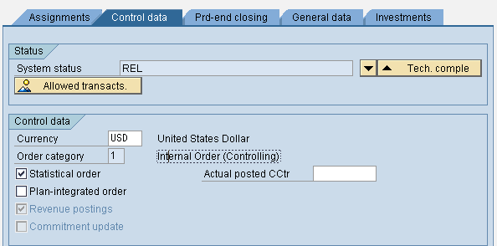
Statistical Internal Orders
Command Cost Center
Statistical Internal Orders are for reporting purposes
Another Cost Object – typically the Cost Center must be on the transaction as well for the ”real” posting
$20,000
Conference 1
Conference 2
$5,000
$15,000
Notes:
Talk to the Internal Order Master Data that must be captured at the APC Level for reporting purposes, but budget execution must take place at Cost Center Directorate Level.
95

Slide 96
Internal Orders vs. WBS Elements
 | Internal Orders | Project/WBS Elements
Cost Collection | Discrete, Time Based Events | Same
Time Period | Definitive Beginning and End | Same
Ownership of Resources | People can be assigned to work on but are not assigned to an Internal Order | Same
Status (Real/Statistical) | Can be defined as Real or Statistical. Statistical Orders receive informational postings only for cost reporting but cannot further allocate | Same
Grouping Options | Can be grouped; no Standard Hierarchy requirement | Project/WBS Elements is a structured hierarchy
Networks | Not Applicable | Provides how the work is performed (routing)
Controlling | Limited status management | Advanced status management, project reporting and controlling
Financial Controls | Collector | Budgeting and Controlling

Slide 97
Example of Internal Order Use: Capturing Kinds of Travel Costs
DTS is the operational system utilized by the Army to support the travel process.
To associate travel processed and completed to the financial system, a DTS Line of Accounting is created within DTS.
To support multiple requirements an updated DTS LOA (10X20) and process is utilized by organizations deployed to GFEBS
  FMR Compliance for Funds Availability Check
  BTA SFIS Compliance for 4 digit year identifier
  Multiple Cost Objects versus a single APC.
Notes:
Not subsuming the DTS systems
Similar to being able to pass audit requirements, other caveats are part of the change to an ERP system: SFIS Compliance, DOD FMR, Availability Check

Slide 98
Capture Travel Costs
Setup
Need to first determine where the travel cost needs to be recorded: Organization? Event? Project? Customer?
  Customer: directly to WBS Element representing that reimbursement
  Event: (e.g. GFEBS Training) then to the order representing that event
  Organization: then to a Cost Center
Need to identify if further transparency required (e.g. emergency leave, TDY in transit)
Notes:
Are you traveling to support an American Red Cross Initiative? Traveling to Support G-8? Traveling to Support the GFEBS Project
Is further information needed? Does it matter that while traveling for G-8 I was pulled in transit to fly elsewhere?
No, because G-8 might make the cost up elsewhere.
98

Slide 99
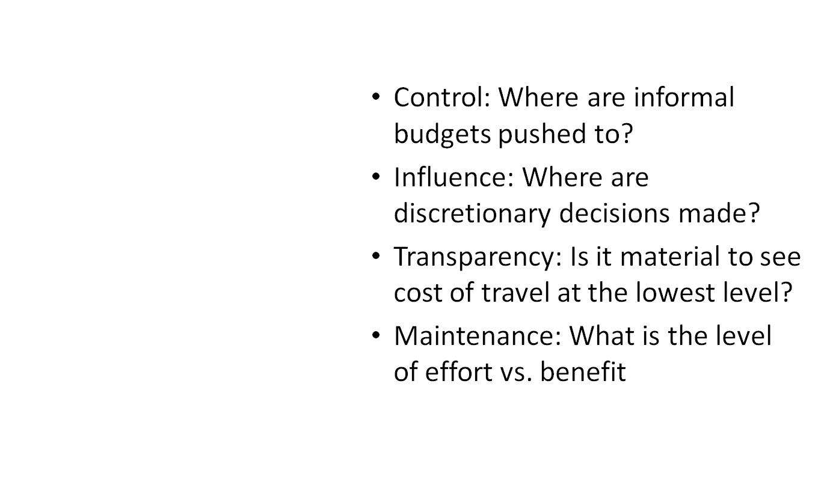
Capture Travel Costs to
Cost Center (Org)
FC
Org 1
Org A
1A
1A1
Org 3
Org 2
Org B
1B
1A2
Notes:
Sometimes when we go out for pre-deployment, people get anxious because they think we’re dictating that LOA’s needed to be created for every organization. If you pay for all travel out of organizations then yes, but you can post it at a higher level if all travel is posted to a higher level.
There are times when there are more LOA’s in DTS for an installation, then APCs. Why is this? Traveler’s can’t select the right LOA in DTS.

Slide 100
Capture Travel Costs
Internal Order
  DTS LOA’s can capture costs directly to orders being used to reflect events (conferences, products, SSP’s, FCA codes, etc)
  If “kind” of travel is needed then IO’s can reflect that level therefore multiple cost objects can by on DTS LOA (e.g. Emergency Travel, TDY, etc)
  Can consume multiple budget addresses on same order which requires multiple DTS LOAs with the same internal order number
Notes:
Travel for specific event or reason
Can setup different LOAs that spend multiple kinds of money but hitting the same IO, so if you have a FORSCOM/IMCOM conference that CMD wants to track costs for but every different Funds Center must pay to send their resources

Slide 101
Lesson 7: Wrap-Up
Orders are cost objects used to plan, collect, monitor, and settle the costs of specific jobs and tasks. Orders are used to monitor the costs of short term projects and event/job costing.
There are multiple order types which are used for various focused purposes; e.g. Sales Orders, Maintenance Orders, Internal Orders, etc.
Internal Order Type ZSSP will include all non-DPW CLS-SSPs
Internal Orders provided a sub-view of the costs within a Cost Center or a cross Cost Center view

Slide 102
Questions
An Internal Order is interchangeable with Cost Center?
  True
  False
Like a Cost Center, Internal Orders can capture costs only?
  True
  False
Internal Orders can be identified as statistical (informational only) or real (capture and transfer costs)?
  True
  False

Slide 103
Answers
An Internal Order is interchangeable with Cost Center?
  True
  False
X
Like a Cost Center, Internal Orders can capture costs only?
  True
  False
X
Internal Orders can be identified as statistical (informational only) or real (capture and transfer costs)?
  True
  False
✓

Slide 104
Lesson 8: Business Process
Objective(s):
To understand what the Business Process cost object represents, key definition criteria (guiding principles), uses, and how defined for the Cost Model

Slide 105
Lesson 8: Business Process
Objective(s):
To understand what the Business Process cost object represents, key definition criteria (guiding principles), uses, and how defined for the Cost Model

Slide 106
SAFM-CE Army Cost Model
Business Process Definition
Business Process Definition:
A business process is a cost object used to capture costs of cross-functional (cost center) activities.
Business Processes are the “work” being performed by the Cost Center/Activity Types
Typically related to an action such as a “verb”, e.g. Pick Items, Pack Boxes, Ship Pallet

Slide 107
SAFM-CE Army Cost Model
Guiding Principles for Business Process
Principle #1: Analytical | Utilized when management needs more insight into “what” the resource pools are doing in order to make process improvement decisions
Principle #2: Detail | Defined in areas where further detail is necessary to support cost-to-serving a customer
Principle #3: Billing | Mechanism for making cross-functional (cost center) charging of a single rate
Principle #4: Capacity | Utilized to represent the consumption of capacity, not the capacity itself (e.g. no “Idle” activity/business processes)

Slide 108
SAFM-CE Army Cost Model
Business Process Uses
Used to support activity-based costing initiatives
For utilization of a single consolidated rate of a similar activity performed across several cost centers
Represent repetitive services that are not Order based (e.g. Process Help Desk Ticket)

Slide 109
SAFM-CE Army Cost Model
How Business Processes are defined
Utilized to associate the goods for free to the consumers
Assignments/Allocation using Business Processes will be defined in conjunction with the DASA-CE Cost Team

Slide 110
SAFM-CE Army Cost Model
Business Processes Std. Hierarchy
There is a Business Process Std. Hierarchy to which all business processes must be assigned when created.
The currently defined Business Process Hierarchy groups processes into Services, this will be augmented as other commands are included into the Cost Model
Additionally, alternative hierarchies can be generated as needed
Groups of processes can also be generated to support ad-hoc reporting or cost allocations

Slide 111
Lesson 8: Wrap-Up
A business process is a cost object used to capture costs of cross-functional (cost center) activities
Reflect the utilization of capacity of a resource pool (activity type)
Can have a rate associated supporting a $/per occurrence of the process being charged to the receiver
Must be assigned to the Business Process Std. Hierarchy but can also be assigned to alternative groups for reporting

Slide 112
Questions
A Business Process is interchangeable with an Activity Type
  True
  False

Slide 113
Answer
A Business Process is interchangeable with an Activity Type
  True
  False
X

Slide 114
Lesson 9: Statistical Key Figures
Objective(s):
To understand what the Statistical Key Figure represents, uses, and how defined for the Cost Model

Slide 115
SAFM-CE Army Cost Model
Statistical Key Figure (SKF) Definition
Statistical Key Figure Definition:
A Statistical Key Figure is a piece of information about the cost object it is assigned to, e.g. # FTE for a cost center, # telephones, etc.
There are two types of statistical key figures:
  Fixed value - Fixed values are carried forward from the period posted to all subsequent posting periods for the year
  Total value - Total values exist only for the period posted
P1 P2 P3 P4
2 2 2 3
21 24 19 23
CC #1000
# Courses
# Students Enrolled

Slide 116
SAFM-CE Army Cost Model
Statistical Key Figure Uses
As a basis (cost driver) for cost assignments, e.g. # telephones to allocate out the phone bill
To measure performance, e.g. # surveys SKF can be planned for the year and then actuals captured to report progress
To calculate a unit cost rate in unit cost report. This report is designed specifically for the Army and allows for some or all of the costs on the cost object selected to be divided by the SKF on that cost object to calculate a Unit Cost rate of the SKF, e.g. $/meal

Slide 117
SAFM-CE Army Cost Model
How SKFs are defined
Identify the workload measures of the organizations
Review off-line reports that merge financial information with outputs produced
SKFs have to be associated with a cost object and the information must then be captured and maintained (directly or via some system feed)

Slide 118
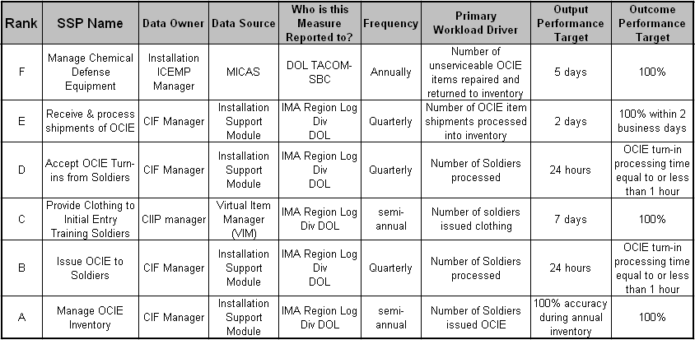

SSP Workload Example
CLS SBC 25 - CIF
GFEBS

Slide 119
Lesson 9: Wrap-Up
A Statistical Key Figure is a piece of information about the cost object it is assigned to, e.g. # FTE for a cost center, # telephones, etc.
There are two types of SKFs; Fixed which pre-populates the same data for each period until changed and Total which represents the total value of that SKF for that period only
Utilized as cost drivers/basis for cost allocations and performance reporting
Must be assigned to a cost object

Slide 120
Questions
  _______ statistical key figure varies each period.
  _______ statistical key figure is static from the period of entry through to the end of the year.
There is a limited number of SKFs that can be assigned to a Cost Object?
  True
  False

Slide 121
Answers
  Total Value statistical key figure varies each period.
  2. Fixed Value statistical key figure is static from the period of entry through to the end of the year.
There is a limited number of SKFs that can be assigned to a Cost Object?
  True
  False
X

Slide 122
Exercise #3
For your organization:
Identify what object for your products/services – Project/WBS Element or Internal Orders
What Statistical Key Figures (SKF) could be tracked?
Notes:
122

