Slide 1
Cost management 101
DASA-CE Training

Slide 2
Who are We?
COMMAND SITE SMEs: Command Site resources identified in some manner to provide subject matter expertise and information for a GFEBS related effort (e.g. Supervisors, Users, etc.)
COMMAND COST TEAM: Command HQ resources identified to support the deployment of Cost Management functionality within the new applications, e.g. GFEBS, GCSS-A. (Not every command has a specific Cost Team)
DASA-CE COST TEAM: A specialty group supporting Army Commands in the transformation to a “Cost Culture” utilizing ERP tools (e.g. GFEBS, GCSS)
  Provides Cost Management (CM) Training
  Assists Commands in defining Cost objectives
  Provides CM Capture Teams to develop CM Master Data with sites and then provided to GFEBS
GFEBS: Various teams focusing on specific objectives in order to make the overall program a success
COMMAND
SITE
SMEs
COMMAND
Cost
Team
DASA-CE
Cost
Team
GFEBS
- Deployment - Training
- O & S - Site Support
Notes:
GFEBS represents a very wide scope of system implementation, including things like funds management, reimbursable, processing and handling, plant maintenance etc. This effort is separate and distinct from the world of GFEBS
This cost Team is specifically charged with helping the Army establish cost management practices.
Team represents the DASA-CE organization’s Deputy Assistant Secretary Army Cost & Economics
Target is to establish a “Cost Culture” – How much does it cost to…
Recruit a soldier
Train a chaplain
Provide a training course
Etc
Anything you as an RM need to manage

Slide 3
DASA-CE Cost Mission
Enable the Army in Transitioning to a Cost Culture utilizing ERP applications (e.g. GFEBS, GCSS, etc.)
  Define the Cost Model across the Army (HQ Design)
    Identify Command Strategic Objectives (e.g. products/services)
    Determine methods/mechanisms to determine Full Costs of Objectives
  Train Cost Concepts (approx. 12 hr Training Session)
    Not specific GFEBS training on running cost transactions
    Builds a language to transition from legacy to future
    Aids field in understanding level of effort to perform Budget Execution vs Cost Management
    Focus is on Cost Management terms, processes, structures, reporting, etc.

Slide 4
DASA-CE Cost Mission
(Continued)
Enable the Army in Transitioning to a Cost Culture utilizing ERP applications (e.g. GFEBS, GCSS, etc.) Cont’d :
  Support the definition and collection of master data to be loaded for cut-over into GFEBS , etc. (CM Build)
    Training and supporting the “Capture Teams” – Command specific teams working in conjunction with the DASA-CE CM team to gather all the data required for the waves
    Aid with determining best approach for defining the CM master data to meet all information needs (Informal Budget, Budget Execution, and Cost Management)
  Provide on-going support
    Create/Change CM Master Data via requests
    Identify future requirements and incorporate with GFEBS
  Provide Policy and Guidance
    Army Cost Management Handbook
    Army Cost Management Maturity Model

Slide 5
DASA-CE CM Schedule
(Macro-level)
FY2010
FY2011
FY2012
1
2
3
4
1
2
3
4
1
S
O
N
D
J
F
M
A
M
J
J
A
S
O
N
D
J
F
M
A
M
J
J
A
S
O
N
D
J
COST MANAGEMENT TRAINING
CYCLE
MOCK
CNV
WAVE 2 SE
HQ
DESIGN
CM
TRNG
CM
BUILD
CYCLE
MOCK
CNV
WAVE 3 WE
HQ
DESIGN
CM
TRNG
CM
BUILD
CYCLE
MOCK
CNV
WAVE 4 NE
HQ
DESIGN
CM TRNG & BUILD
CYCLE
MOCK
CNV
WAVE 5 PAC, EUR & AR
HQ
DESIGN
CM TRNG & BUILD
CYCLE
MOCK
CNV
WAVE 6 ARNG
HQ
DESIGN
CM
TRNG
CM
BUILD
CYCLE
MOCK
CNV
WAVE 7 NE (BRAC) & AR
HQ
DESIGN
CM
TRNG
CM
BUILD
CYCLE
MOCK
CNV
WAVE 8 Contingency (All Other)
7/17/2013
5
Notes:
5
Deployment strategy involves –
Releases -- refer to functionality in system
Waves –refer to systematic implementation over time
Sites – typically refer to forts or installations that include mission, installation and tenant organizations

Slide 6
Mission #1: Cost Model
Conceptual Design
Intro Mtg.
Strategic Session(s)
Operational Sessions
Confirmation
Session(s)
Command Pilot
1
2
3
4
5
Inputs:
Overview Presentation
Inputs:
CM Training
APC Files
TDA Files
HQ Reports
Inputs:
CM Training
HQ Objectives from #2
APC Files
TDA Files
OPs Reports
Inputs:
Findings Pres. to HQ
Finalized Master Data Templates
Inputs:
GFEBS Load of Master Data
Build Allocations/ Assignments
GFEBS Update for Reporting Needs
Outputs:
Identified POCs
Scheduled #2/#3 Mtg.
Outputs:
CC Structures & Attributes
Products & Attributes
Non-Fin Metrics
Identified #3 Locations & POCs
Outputs:
Δ CC Structures & Attributes
Δ Products & Attributes
Non-Fin Metric Systems Reviewed
Identified Pilot Construct Resources
Outputs:
CCs & Hierarchy
Internal Orders
WBS Elements
Identify Cost Allocations & Assignments
Reports
Outputs:
Command Review
Identify Areas for Enhancement
Resourcing Strategy for Follow-on Waves, e.g. “Capture Team”
Notes:
6
DASA-CE Capture Team will come as part of pre-deployment process
Talk with HQ determine which financial and non-financial metrics need to be captured
Look at the field’s needs, b/c HQ doesn’t know
Present all findings, determine info that is needed (e.g. TRADOC Courses can be broken into classes, battle lab simulations, FOBS)
Ask the Questions: Do we NEED to capture cost by class? Are you really going to cancel a class for low attendance.
TRADOC: No, only the cost of a COURSE
Due to deployment schedule, there is no longer the ability to backwards plan and pick a “best” organization to go-live, based on locale.

Slide 7
Cost Model Roll-Out
Cost Mgmt Training 101
Command Roll-Out
Steps to
Completed
6
1
6
7
Course Info:
Approx. 12 hrs
Focus on Cost Management principles and how to's in GFEBS
Resource & Operational/Business Mgrs.
Approx. 50 per class
Inputs:
Δ/Create CC Structures & Attributes
Δ/Create Products & Attributes
Non-Fin Metric Systems Implemented
Educate and Integrate Command Participants
Learning Objectives:
Budget vs. Costs
Cost terms/Definition
Defining CM master data structures and uses (replaces APCs)
Different Reporting Capabilities
PASS THE EXAM!
Outputs:
CCs & Hierarchy
Internal Orders
WBS Elements
Cost Allocations & Assignments
Reports
Notes:
7
Come out and do the training and bridge the gap between GFEBS training and current view
Command rolls out and is supported by O & S

Slide 8
What is the Costing Conceptual Design?
The translation of the business objectives, needs, and requirements into a management decision support model (Cost Model)
The replacement of the legacy financial codes (APCs/JONOs-MRRNs)
“The Continuum” – maturation over years, replacing as-is, adding quantity measures, performing cost assignments, etc.
The CCD influences/defines the set-up of tools providing cost management information, e.g. GFEBS, GCSS, Data Warehouses, etc.
Notes:
How do we take your legacy business and put into GFEBS
Command objectives (FORSCOM: BCT, TRADOC: Course, IMCOM: CLS)
How do we associate those to what we’re capturing (org, event, product, serve)
How can we associate these costs to our customers or outputs
Doesn’t happen overnight (maturation process once you’ve been live

Slide 9
Mission #2: CM 101 Training
CM 101 Training
Section 1: Cost Management Overview
  What are costs and why is managing costs important?
  Army’s overall objectives
  Change enablers o support Cost Management
  The process of Cost Management and how it differs from Budget Management
Section 2: Cost Model Components
  Defining the various cost objects (which replace APCs/JONOs) within a Cost Model, e.g. organizations, products, services, jobs, etc.
  Understanding decision points of where to capture information
Section 3: Cost Flow Methods
  The difference between cost capturing, allocations, and assignment
Section 4: Cost Model Build
  Reflecting organizational structures
  Replacing APC/Jonos
9
Notes:
9

Slide 10
Mission #3: CM Master Data Build
OUTPUT
VALIDATION
Conversion Team
GFEBS TEAM
CONVERT
DASA-CE / GFEBS
INPUT
VALIDATION
CORRECT
Consolidation Team
DASA-CE CORE TEAM
CONSOLIDATE
DATA
VALIDATION
CORRECT
Team 2
Team 4
CAPTURE TEAMS
CONTROL
Team 1
Team 3
Team 5
DATA
VALIDATION
CORRECT
COMMAND SITE POCS
CREATE
DASA-CE / Army

Slide 11
Master Data: Cost Centers
A Cost Center = Organization; which:
  Incurs costs
  Has a manager who is accountable for those costs
  Has a long life span of more than 1 year (typically years)
  Can be assigned informal budget
A Cost Center accounts for resources:
  People: Ops & Maintenance, DOIM IT Support, etc.
  Facilities: Warehouses, Hospitals, Office Space
  Equipment: IT server farm, Cranes/Trucks
  Blended: mix of resources within a organization, e.g. Vehicles and Mechanics

Slide 12
Master Data: Activity Types
An Activity Type represents a group of resources within a Cost Center. These resource groups have capacity and a unit of measure such as: labor hours, machine hours, square footage, etc.
Activity Type Uses:
  Capture Capacity or Planned Output, e.g. technician works 2088 Hrs or machine runs 3500 Hrs (10 Hrs/Day for 350 days)
  Holds the rate for the output of the resource pool, e.g. $2 Hr, $5 Hr, $20 Hr
  Assigns capacity consumed by products/ services, e.g. Hrs/min worked per diagnostic test, which then valuates based on the rate

Slide 13
Master Data: Things You Do
Various other Cost Objects are used to represent the things that the Cost Centers/Orgs are providing: Internal Orders, Projects/Work Breakdown Structures, Maintenance Orders, etc.
  Internal Orders: are short term in nature, represent an event or job, do not replace the rigor of the Project/WBS Element structure, e.g. Courses, CLS-SSPs, Pre-Deployment, Professional Certification
  WBS Elements: sub-tasks within Projects used for planning, executing, and costing and managing dependencies, e.g MEDCOM MRMC Labs projects, DPW Minor Constructions, Environmental clean-ups. Additionally, WBS Elements are used for reimbursable work either through a MIPR or as a Direct Charge.
  Business Process: Captures costs of cross-functional activities (the “work” performed by the Cost Center/Activity Types) and typically related to an action such as a “verb”, e.g. Pick Items, Pack Boxes, Ship Pallet

Slide 14
Master Data: Things You Track
A Statistical Key Figure (SKF) is a piece of information about the cost object it is assigned to, e.g. # FTE for a cost center, # telephones, # of Students in a Class, # of Ads within a Campaign
SKFs are used to:
  Capture non-financial information
  Calculate the basis (cost driver) for cost assignments, e.g. # telephones to allocate out from the phone bill
  Measure performance, e.g. # tests SKF can be planned for the year and then actuals captured to report progress
  Calculate a unit cost rates

Slide 15
Mission #4: On-Going Support
There is a CM Cost Team that supports changes to the cost model such as new master data (e.g. Organizations)
CM Cost Team helps to define cost assignments and maintains those rules
Performs CO Period-End Close for the cost assignments
Integrates with system programs GFEBS, GCSS-A, etc.) to provide Cost Management related business requirements

Slide 16
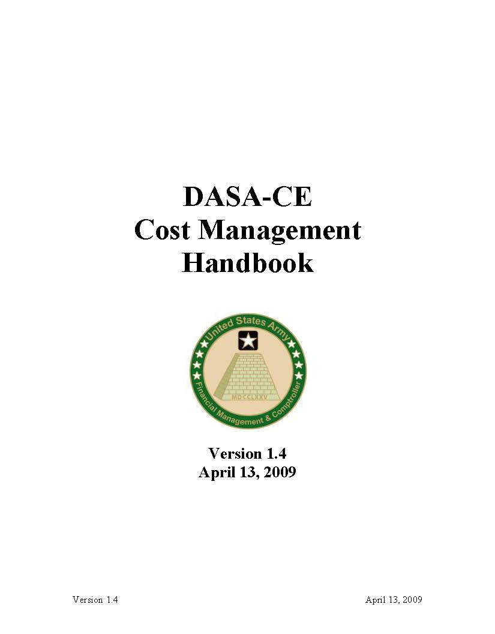
Mission #5: Cost Mgmt
Policy and Guidance
Policy & Guidance
Training (Operational & Resource Mgrs)
Cost Management 101 - Cost Management Overview Cost Object (ERP) Definitions Cost Flow Methods Cost Analysis and Reporting
GFEBS – Cost Management Training These courses are either computer-based or instructor-led training classes to learn how to operate within the GFEBS cost module.
Cost Management Certificate Course The program of instruction (POI) is designed to teach the fundamentals of cost management with a view to developing a cadre of Army personnel who are professionally knowledgeable, analytically competent, and personally motivated to serve as proactive change agents within their respective Enterprise line and staff organizations.
Self Study-Cost Management Community of Practice https://www.us.army.mil/suite/page/593701
Cost Management Courses in all Professional Development Programs
Tools
16
Notes:
16

Slide 17
Lesson 1:
Demand & Define “Cost”
Objective(s):
To understand the demand for “cost” information and how “cost” is defined within the Army

Slide 18

Cost - Who’s Asking?
We are cutting budget by 10% what will be the effect on output?
How much money is being spent in my jurisdiction?
How will this BRAC effect my constituents?
What is the cost versus the benefits of this additional request?

Slide 19
Cost Demands - Legislated
Actions Requiring Costs & Performance
  Chief Financial Officers Act (1990)
  Government Performance Results Act (1993)
  President’s Management Agenda (2002)
  OMB Performance Assessment Rating Tool
  OSD Requires Army Performance Budget
Public Sector GAAP (SFFAS 4) Full Cost (1995)
  Army Developed GFEBS Costing Module
OSD Actions to Increases Cost Management
  Acquisition Reform (1997)
  OSD (AT&L) Issues ABC Guidance (1999)
  Business Transformation / Lean Six Sigma

Slide 20
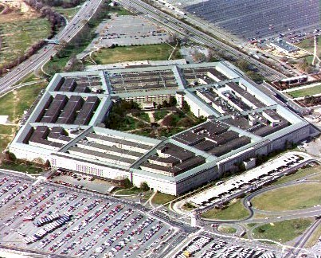
Cost - Who’s Asking?
We need to process more recruits this year, how much additionally will that cost?
Training needs to refresh soldiers fast than previously planned how will that change performance targets?
How do our IT operations compare to the outside world?

Slide 21
Cost Demands: Army Leadership
From Chief of Staff, Army 2009:
Most Army processes lack a cross-functional focus and cost-benefit analysis which leads to grossly inefficient application of resources.
Large budgets in the past few years have produced a consumption-based culture that focuses on accomplishing missions without concern for more efficient delivery of capabilities.
From 2008 Army Posture Statement:
Integral to achieving our goals is the development of an Army-wide cost-management culture in which leaders better understand the full cost of the capabilities they use and provide and incorporate cost considerations into their planning and decision-making. This approach will enable us to achieve readiness and performance objectives more efficiently.
From HONORABLE Nelson Ford, ASA (FM&C):
The cultural change that is essential to Army financial management, and without which all the other improvements will leave us short of achieving our goals, is the adoption and integration of cost management into the Army culture.

Slide 22
Cost Priorities - ASA(FM&C)
Provide accurate, reliable, and timely financial information and integrated functional performance data to Army decision makers
Improve Army accountability and enable full cost management
Exchange information with customer and stakeholders
Achieve efficiencies and operate effectively
Enable the Army to receive and unqualified audit opinion on annual financial statements with respect to Army General Funds

Slide 23

Cost - Who’s Asking?
Congress is cutting our budget, how can I explain the resulting cut in service?
Everyone wants increased speed at the same quality but how much does that speed cost?
Hurricane relief diverted my resources, how can I explain the need for additional funding?
Notes:
Could you tell your customers the full cost of providing them their products or services?
Could you answer the same question by quarter or for the next quarter?
Could you tell customers how changes in their behaviors might affect their costs?
How would you determine the cost to operate your DOL or Course?
What costs would you include?
What is your “show me” source?

Slide 24
Cost - Who’s Asking?
Regardless of who’s asking the cost question is being asked….
How can you answer when asked?
Notes:
New

Slide 25

An Easy Definition of Cost

Slide 26


An Easy Definition of Cost
…..”a cost is the value of money that has been used up to produce something”*
# Clean Dishes
* en.wikipedia.com 11/26/09
Notes:
Everyone is asking the cost question from inside the organization and even the outside users. Further out internal processes support a budget view but generally miss the full cost approach. But before we go further and talk about how great cost management is what exactly is cost?
Management accounting isn’t just about tracing and tracking a transaction through a set of books. Its really about representing how business is being done and measuring operational success with the help of both financial and management information.
The simpleist definition is found in Wikipedia, our baseline in our technical world….

Slide 27



Cost in More Detail
Resources
Resources
Consumed
“Cost is a monetary measure of the sacrifice associated with:
expending resource functionality to achieve a specific objective, or
utilizing resource output required to achieve a specific objective, or
the provision of resource functionality or resource output while not using it.
* www.rcainstitute.com - RCA Taxonomy
Notes:
With a little more detail to the definition we get into the idea that cost includes a lot of information in addition to the budgetary control. It includes all resources assigned to complete a mission even those that are in not a part of the Budget.

Slide 28
The Management Processes
Resource
Managers
Operational
Managers
$
Inputs
Outputs
Conversion
“Work”
Resources:
Labor
Material
Equipment
Supplies
Contracts
Assets
Products Services:
Courses
Services Support Programs
Tests
Research Projects
Training Events
Work Performed by Organizations (Cost Centers) to Produce Products and Services for Customers
28
Notes:
28
28

Slide 29






Cost = Converting and Measurement of Work
Cost Center
Asset / Equipment
Project / Program
Internal Order
WBS / Work Order
Organization - Labor, Materials, Supplies
Resources/Inputs
Plant, Property & Equipment
Building Project, Weapon System
Outputs
Services, Events (SSP, Course)
Job (Set of Tasks) – Maint & Repair
29

Slide 30
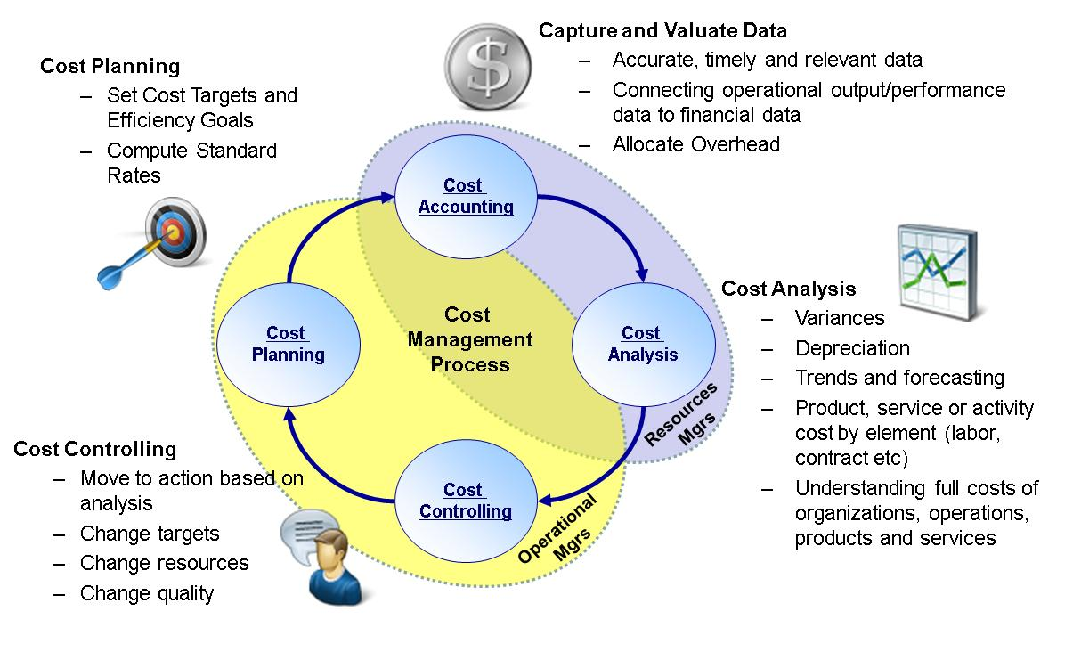
Cost Management Process
Managing Business Operations Efficiently & Effectively Through the Accurate Measurement & Thorough Understanding of the "Full Cost" of an Organization's Business Processes, Products & Services in Order to Provide the Best Value to Customers.

Slide 31

Army Cost Management Framework
X
X
X
ARFORGEN
Heavy
Available / Deploy
Light
Stryker
Train / Ready
Reset
Train Units
Operations &
Activities
Command & Intelligence
Operating Forces
Readiness
Depot Maint / Repair of Mil Eqt
Ordnance
S&T & R&D
Systems Acquisition, T&E,
Engineering, & Contracting
Research
Procure
Sustain
Distribute
Dispose
Operation Planning & Control
Material
Cost Management Construct
Financial Management / Budget
Communications, Computing, & Info Systems
Program / Budget Construct
Civ Education / Training
Civ Personnel Svcs
Mil Education / Training
Mil Personnel Svcs
Prof. Development Educ.
Acquire & Train
Manage (Pay)
& Distribute
Develop & Educate
Force Development
Human
Capital
Community & Family Svcs
Environmental Security &
National Resource Svcs
Health Svcs
Installation / Facility Mgt
Facility
Installation
Command Programs
Centrally Managed
Programs
Services &
Infrastructure
Common
to CEs
Unique to CE
Note: Program / Budget and Cost Management constructs shown represent subset of overall framework

Slide 32
The Army Cost Framework
Full Cost
Organizations
Full Cost
Product/Services
Full Cost
Customers
IMCOM:
Garrison
Services:
Food Services,
Transportation,
CIF, etc.
- Tenants
Projects:
- SW Development
Smart Munitions
Quick MEDS
AMC:
RDEC
- PEO Aviation
- CMDS PM
- FORSCOM
Units:
Optempo,
Mobilization,
Events, Etc.
FORSCOM:
3rd Army - 1st BCT
- Mission
Commander
32

Slide 33
What are some examples of how Your Command is impacted by the Army’s optimization strategies, i.e. ARFORGEN Process?
Answer:
Reset/Train
Ready
Available
Man
Euip
Train
Sustain
Operate
- HQDA
- IMCOM / REGION
- GARRISON
    Population Shifts (Deployments, Training, Etc.)
    Family Programs
    Facilities Utilization
    Maintenance & Repair
    Etc. ..
TRADOC
  Infantry School
    Course ABC
    Course XYZ
  National Training Center
    Event 123
    Event 456
    Etc…
Notes:
DPW – Prioritized Deployments; program priority changes

Slide 34
Lesson 1: Wrap-Up
Many different requests for Cost information
Cost is the value of money for resources that have been consumed to produce something
Cost Management is managing business operations Efficiently & Effectively through the accurate Measurement & Thorough Understanding of the "Full Cost" of an organization's business processes, products & services in order to provide the Best Value to Customers
The Army Cost Framework focuses on the Army product of BCT and supporting products/services

Slide 35
Lesson 2: Cost Culture
Objective(s):
Understand the level of effort for deploying cost awareness throughout the Army, i.e. generating a Cost Culture

Slide 36
What is a Cost Culture?
Comprises the Attitudes, Experiences, Beliefs & Values of an Organization
A Shared Behavior by People & Groups in an Organization
Most Experts Agree that it is the Shared “Taken-For-Granted” Assumptions, Beliefs, Values, Expectations & Rules that Members of a Work Unit Team or a Corporate Organization Hold
A Cost Culture is the Cultural Shift from “Accomplish the Mission at Any Cost” to “Accomplish the Mission Considering Cost”
Notes:
With 20+ Years of cost demands – one thing was definitely learned - Cost Measurement Difficult, Requires Cultural Change and Change is fought with Resistance
Culture is the combined way an organization operates. Moving to a culture of cost is a big change
Not where cost trumps everything simply that its considered and knowm

Slide 37
Why Focus on Cost Culture?
Deploying Systems, Improving Cost Models, Issuing Policies, Training Staff, Recruiting Experts
will not Enhance the Army’s ability to manage costs
unless Army Soldiers / Civilians Understand & Value the Need to Manage Costs
Knowing Our Costs & Managing Them To Increase Our Mission Capability Must Become Ingrained in Our Culture
Leaders Must Demand Cost Information & Use It In Decision-making — Otherwise It Provides No Utility To The Army
We Need A Lifestyle Change, Not A Diet!

Slide 38
Creating A Cost Culture
Cost Culture Vision:
Leaders Use Cost
Information for
Effective Decision-
Making &
Performance
Management by …
Understanding Both Near & Long-Term Cost Implications of Their Decisions
Making Effective Trade-Off Decisions to Achieve Best Use of Limited Resources
Holding Subordinates Accountable for Improving the Efficiency & Effectiveness of operations
Cost Culture Take - Aways:
Know the True Cost of What You Do - Not Knowing Cost Makes Everything Appear Free -- “Free Goods Have Infinite Demand”
Cost Management is Not Easy -- You Have to Know What Drives Costs & Take Action to Control Costs
Cost Management Goes Beyond “Do More With Less” - It Is Optimizing Resources to Efficiently and Effectively Meet Mission -- “Focused on Continuous Improvement”
Notes:
12
Basic business axiom = free goods have unlimited demand.
Cost management and building a model that shows the spender what it costs to do whatever they are trying to do will result in the spender trying to use less than they would use otherwise. (e.g. you know what your home telephone costs are per minute, why don’t you know what your business costs are? Answer: because you are not paying the bill.)
Cost management says you should be aware of what your real costs are and therefore will try to bring them down.
Every instance of its use shows that is what happens
Introduce the driver concept

Slide 39
Growing into the Cost Culture
Cost Management
“What It Should Cost”
Outcomes
STANFINS/SOMARDS
Managerial/Cost Accounting
Cost and Performance
Budget Allocations
Obligations
Execution reporting
Financial Accounting
Limited Analysis
Cost Allocations
Cost Centers
Cost Drivers
Cost Planning
Cost Control
Feedback and corrective action
Goals, results and predictive tools
Cost Measurement
“What It Actually Cost”
Inputs & Outputs
“What did we spend?” Input
39
Notes:
Growing to a cost culture doesn’t happen in one attempt. Rather it’s a process transitioning budget control as the primary focus to a focus of management information and decision making.
This is a big shift but it is and has been a core desire of Army to get to a cost management perspective. One limitation on achieving this target of culture change is that of the financial system STANFINS and SOMARDS were budget centric with little to offer in terms of cost management. Even with the system constraints the Army’s desire for cost information was still fighting toward the cost culture and the current APC code set is the result.
39

Slide 40
Moving to a Cost Culture
“A Culture of Entitlement”
“A Culture of Influence”
Budget-focused
Spend rate driven – inputs
Performance objective -99.9% obligated
Free goods has infinite demands
Cost and performance focused
Results driven - output & outcome
Performance objective – resource consumption optimization (efficiency & effectiveness)
Use what is necessary to obtain the objective
From Budget to Cost
Notes:
People - Need to transition from budget to Cost
Processes - Process is integrated and inter-related
Systems – Data needs to be information

Slide 41
Lesson 2: Wrap-Up
Culture is the Shared “Taken-For-Granted” Assumptions, Beliefs, Values, Expectations & Rules that Members of a Work Unit Team or a Corporate Organization Hold
Change management is required to move towards a Cost Culture
Change management impacts the areas of People & Other Resources, Processes, Policies & Procedures, and Technology
Cultural shift to a Cost Culture is a maturation process moving from “What We Spent”, to “What It Actually Costs”, to “What It Should Costs”

Slide 42
Question: What is the biggest obstacle to establishing a cost culture in the Army for you?
Answer: Discussion
Notes:
Some discussion notes:
Need executive direction to make change
How does the staff level get impowered

Slide 43
Lesson 3: Cost Enablers
Objective(s):
Identify enablers for change to support a cost culture

Slide 44



Army Cost Culture Change
“Making a Square a Circle”
“A Culture of Entitlement”
“A Culture of Influence”
Budget-focused
Spend rate driven – inputs
Performance objective -99.9% obligated
Free goods has infinite demands
Cost and performance focused
Results driven - output & outcome
Performance objective – resource consumption optimization (efficiency & effectiveness)
Use what is necessary to obtain the objective
Develop/Recruit Analysts
Enhance Training
Performance Focus
Policy
How
To’s
Process Improvement (Lean 6-Sigma)
Integrated Business Design
ERP Applications e.g. (GFEBS, LMP, GCSS)
Business Warehouses
Executive Scorecards
Enablers of Change
44
Notes:
People - Need to transition from budget to Cost
Processes - Process is integrated and inter-related
Systems – Data needs to be information

Slide 45
Change Enabler: People
Cost Management Policy & Guidance
Cost Management Training
  CM101 Training Course
  Cost Mgmt Certification Course
  Cost Benefit Analysis Training
Enhancing Cost Analysis Skills
  ASA(FM&C) Conducting CP11 Staffing Assessment
  Integrate Cost Analysis Skills into Operational Career Programs
Develop/Recruit Analysts
Enhance Training
Performance Focus

Slide 46
Cultural Change Video

Slide 47
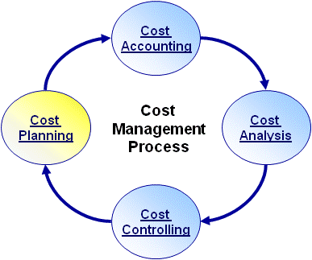
Change Enabler: Process
Establish Cost Management Process
Incorporate Cost Impact into routine decision-making
Require Cost/Benefit Analysis as part of Resource Decisions
Policy
How
To’s
Process Improvement (Lean 6-Sigma)
Integrated Business Design

Slide 48
Change Enabler: ERP Technology
What is it?:
  Used to refer to software/ hardware “intended to manage all information and functions of a business or company from shared data stores”*
  Utilizes a shared database, ensuring data integrity, that may be centralized or distributed
  Manages multiple functions within a business such as Property, Accounting, Sales, Production, Procurement, etc.
  Army programs such as GFEBS, GCSS-A, LMP utilize the SAP ERP software
Property
Supplies
Accounting
Property
Property
Supplies
Supplies
Accounting
AS-IS Landscape:
Hundreds of stand alone systems
Focus on single function
Management of various software versions
Maintenance of separate hardware platforms
ERP Shared Data Storage
* www.wikipedia.com 11/26/09
Notes:
48

Slide 49
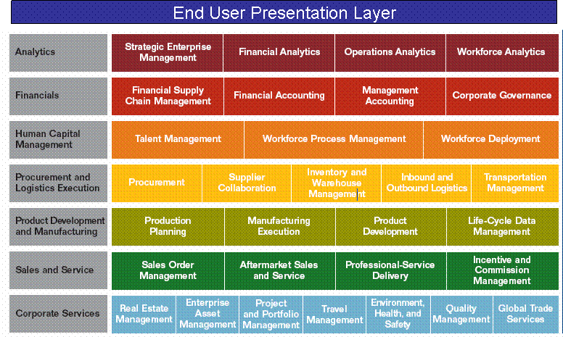
Change Enabler: Vision
Accounting
Accounting
DODAAC/UIC -> APC/JONO Crosswalks
Operations -> Financials
Supplies
Property
Property
Supplies
Supplies
Property
AS-IS Landscape:
Operational systems tend to work on DODAACs and UIC
Financial systems work on APCs/JONOs
Crosswalks/systems are maintained to align operational level of detail to correct financial view, e.g. FCM
TO-BE Landscape:
Operational functions integrated with Financial processes
Focus of system is capturing operational transactions which then provide a financial view
Level of information capturing is far lower than Financial focused system dealt with, e.g. by full 6 UIC code versus parent AA
Notes:
49

Slide 50
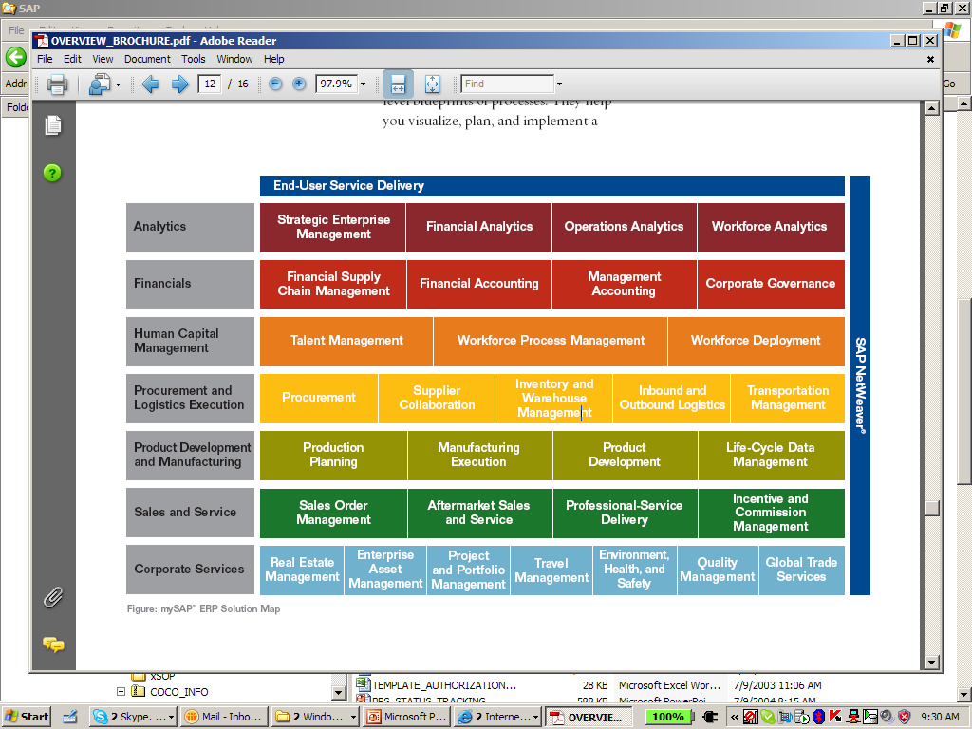
Change Enabler: Enterprise Wide
Commercial Off the Self System that Integrates All Facets of the Business
End User Presentation Layer
GFEBS
Data Warehousing Analytics

Slide 51
Enterprise Resource Planning (ERP)
ERP Functionality Integrates Management Accounting (Cost Management) with the Financial & Budget Accounting
End User Presentation Layer
Cost Management
Integrated with Finance & Budget Accounting
Data Warehousing Analytics
End User Presentation Layer
Public Sector
Budget Accounting
51

Slide 52
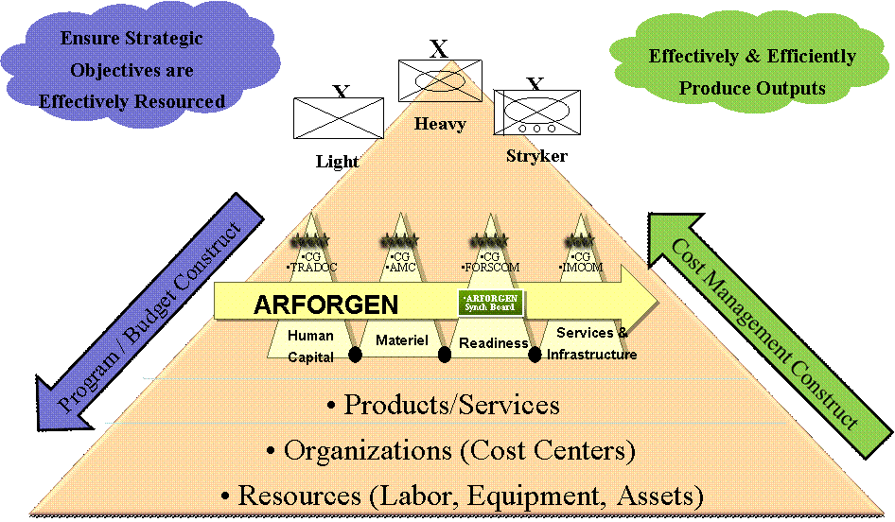

Enhanced Ability to Capture Cost
Cost Objects
Organizational
Real Property /
Program / Project
Task / Activity
Special Event or
Entities
Equipment
Initiative
ERP (SAP)
Cost Centers
Assets / Real
Project / WBS
Business Process
Internal Order
Cost Collectors
Estate Objects
• Installation
• Acquisition
• Services
• BRAC
• Brigade
• Building
• RDTE Project
• Instructional Course
• Training Event
Army Examples
• School
• Training Range
• MILCON Project
• Repair Process
• Mandatory
• Directorate
• Weapon System
• System Test
• Test Run
Training
• Lab
• Support to
Olympics
Cost assigned Directly or Indirectly
Customer / Product
Brigade
Tenant
Command
Weapon System
PEO / PM
Course

Slide 53
Enterprise Resource Planning (ERP) ERP Benefits
ERPs Help to Streamline & Integrate the Processes & Systems Providing the Following Benefits:
  Increases Productivity Across Organizations
  Improves Standardization & Efficiency of Processes
  Increases Access, Consistency & Transparency of Data
  Provides Collaboration Across Business Domains
  Provides IT Economies of Scale
  Enhances Analytics & Improves Accuracy of Data

Slide 54
GFEBS System Components
ECC – Enterprise Central Component
BI – Business Intelligence
FI – Financial Acct. & Mgmt.
Cost By
Report
FM – Funds Acct. & Mgmt.
CO – Cost Acct. & Mgmt.
Unit Cost
Report
MM – Materials Mgmt.
and Procurement
PPE – Property, Plant &
Equipment [PM, PS, RE, AA]
Detailed
Labor
Report
SD – Sales & Reimbursables
Optimized for Data Input
Transaction Processing
Real-time; recon analysis
Structured reporting
Optimized for Data Extraction
Analytical Processing
Near real-time; trending analysis
Slice-n-dice reporting (pivot)

Slide 55
Simultaneous Update
ECC – Enterprise Central Component
FI - None
FM - Commitment
CO - None
FI - None
FM - Obligation
CO - None
FI – Financial Acct. & Mgmt.
FM – Funds Acct. & Mgmt.
PR
PO
CO – Cost Acct. & Mgmt.
MM – Materials Mgmt.
and Procurement
Pay
GR
PPE – Property, Plant &
Equipment [PM, PS, RE, AA]
SD – Sales & Reimbursables
FI - AP/Cash
FM - Disbursement
CO - None
FI - Expense/AP
FM - Expenditure
CO - Expense
Optimized for Data Input
Transaction Processing
Real-time; recon analysis
Structured reporting

Slide 56
Lesson 3: Wrap-Up
An ERP is an enabler to Cost Management “Culture” by providing the technology necessary
The Army Cost Model is being designed into GFEBS which utilizes the SAP ERP application
The ERP application is operational focused generating financial information as an outcome of an operational transaction
The ERP application has a transactional component and an analytical component
The transactional component has real-time integration for the various value streams/function modules

Slide 57
Question #1: What are the Enablers of Business
Culture Change

Slide 58
Answer #1: What are the Enablers of Business
Culture Change
People/Other Resources
Processes, Policies & Procedures
Tools & Technologies

Slide 59
Question # 2
What are some of the major changes due to moving to an ERP?
Notes:
59

Slide 60
Answer # 2
The major changes of moving to an ERP are:
  Single shared database
  Integrated functions, i.e. operational and financial
  Visibility of level of detail due to operational focus
Notes:
60

Slide 61

Lesson 4: Cost vs Budget
Objective(s):
Understand how Costs differ from Budget
BUDGET
EXECUTION
COST
Notes:
This section is primarily about lining up terminology

Slide 62
Where We Are Currently
Focused on the “Budget” domain
The “Budget” domain consists of creation of the Budget requests/submissions, determination of the year of execution Budget (e.g. availability control and informal Budgets), actual execution, and reporting of the status of execution against the Budget (i.e the PPB&E process)
Primary focus of budget execution is the Obligation (consumption of the Budget)
Budget Accounting focuses on 4 series accounts – status of Budget and consumption
Budget Management focuses on the status of available funds, which includes both current and prior years funds
Notes:
Focus on spending

Slide 63
Budget Terms
Budget = What Can Be Spent
Obligation = a promise to procure a product/ service (e.g. to spend)
Budget ≠ Obligations
Budget – Obligations = Availability (e.g. what is left to spend)
Expenditure is the receipt of the product/service which was obligated (e.g. what was spent)
Expenditures or collection of expenses/expenditures determines Costs
Notes:
Set some terminology –
Key though is that cost is Expenditure oriented.

Slide 64




Budget - Color of Money
Appropriations
Program Elements
Fund Centers
$
OMA
$
IMCOM
BOS
$
$
SRM
Jackson
AFH
$
Benning
Knox
GFEBS
$
RDT&E
Elements
Of Resources
Supplies
Training
Travel
Equipment
Labor
Etc.

Slide 65



Cost Versus Budget
Knowing your Obligations is not the same as knowing your Costs!
A legally binding commitment by the federal government that will result in outlays, immediately or in the future. Budgetary resources must be available before obligations can be incurred legally.
Obligations
Costs
The price or cash value of resources used (expenditures) to produce a program, project or activity. All relevant costs may not appear in the organization’s budget.
Cost ≠ Obligation
Full cost can exceed individual business unit budget allocations
Costs
Obligations
Cost will contain expenses from different years, source of funds, organizations, etc.
Notes:
NEEDS CORRECTION – See RED
Note here –
Cost do not equal obligations
Cost is focused on FULL cost and can exceed obligations
Discuss what is full cost – of a training program, examples

Slide 66
Budget vs Cost Domains
Budget Formulation
Budget Execution
Cost Management
Budget
  President’s financial plan and the priorities for the Federal Government
Budget Authority
  Authority to incur obligations
Cost
  Valuation of resources used to produce outputs, basis for decision making
Focus
  requirements
Focus
  availability, obligations
Focus
  full costs, Plan vs Actual
Key Data Elements
  appropriation, FTE
Key Data Elements
  appropriations, EOR’s, PE, MDEP, projects, BLIN, etc.
Key Data Elements
  operational entity (e.g. cost centers), services, rates, products, projects, etc.
Questions
  What do I need?
  What will I ask for?
Questions
  What funding did I get ?
  What obligations were executed?
Questions
  What was expensed?
  What did I get for it?
  How well was it used?

Slide 67

Enhance Budgeting with Cost
Budget Flow
ASA(FM&C)
PEGs
II PEG
MACOMs
IMCOM
MSC
MSC
MSC
Regions
Installations
Other Directorates
Dir of Logistics
Transportation
CIF
Food Services
25A –
Manage
CIF
25B –
Issue
OCIE
25C –
Provide
Clothing
25D –
Accept
OCIE
25E –
Receive
Shipments
25F –
Manage
Chemical
Notes:
The Culture of budget – drive costs to a budgetary stopping point.
Not relevant to go lower for budget – but its’not low enough for cost.
Stop = Funds only go so far. We generally do not care about funding and control and the lowest level of detail. But this level of detail is where cost is incurred and where resources are converted to outputs.

Slide 68
Lesson 4: Wrap-Up
Budget ≠ Obligations ≠ Costs
Budget Management is primarily “input” focused (color of money) where Cost Management is primarily “output” focused (products/services)
The Budget and Cost domains have different purposes, focuses, questions, optimization goals, while sharing the “expenditure” data stream
Budget – Type or “Color” of Money
Cost – Conversion of resources to outputs

Slide 69
Quiz
Question #1: Cost = Budget
True
False
Question #2: Cost = Obligation
True
False

Slide 70
Quiz Answers
Question #1: Cost = Budget
True
False
✓
Question #2: Cost = Obligation
True
False
✓
Notes:
NEED TO FLY IN ANSWERS ONE AT A TIME!

Slide 71
Quiz
Question #3: _______________ provides ‘authority’ and control of the conversion activity in order to provide the agreed upon outputs of the agency (primarily input focused)
Question #4: ______________ provides ‘efficiency and effectiveness’ and control of the conversion activity in order to provide the agreed upon outputs of the agency (primarily output focused)

Slide 72
Quiz Answers
Question #3: ____Budget______ provides ‘authority’ and control of the conversion activity in order to provide the agreed upon outputs of the agency (primarily input focused)
Question #4: __Cost Management_ provides ‘efficiency and effectiveness’ and control of the conversion activity in order to provide the agreed upon outputs of the agency (primarily output focused)

Slide 73
Lesson 5:
Cost Management
Objective(s):
Understand the definition of Cost Management
Understand the key components of the Cost Management Process
Identify who is involved in performing Cost Management

Slide 74
Cost Management is a New Process
Cost Accounting / Management is New to Most of Army as a formalized process
Provides Financial and Managerial Information
Cuts Across financial and operational organizations
Is Driven by Information Needs of the Operational Army not solely the Financial Community

Slide 75
Cost Management
Managing Business Operations Efficiently & Effectively Through the Accurate Measurement & Thorough Understanding of the "Full Cost" of an Organization's Business Processes, Products & Services in Order to Provide the Best Value to Customers.
Efficiently is to doing things "right“, e.g. in the best and most economical way, wasting no resources
Effectively is to do the "right" things, e.g. setting targets to achieve an overall goal (the effect) and attaining the goal
Full Costs is the inclusion of all and only those costs related to generating the output
Best Value is a qualitative measurement to be taken into consideration
Notes:
Managing Business Operations
FULL cost

Slide 76
Cost Management
Managing Business Operations Efficiently & Effectively Through the Accurate Measurement & Thorough Understanding of the "Full Cost" of an Organization's Business Processes, Products & Services in Order to Provide the Best Value to Customers.
Cost
Accounting
Cost
Management
Process
Cost
Planning
Cost
Analysis
Cost
Controlling
Notes:
Establish how cost information is captured, stored and analyzed.
Start with Planning - Dollars and Quantities.
Start with Cost Accounting – Foundation / Capture

Slide 77
Cost Planning
Cost Planning is the use of a Cost Model for “should-cost” forecasting to make informed decisions
Cost
Accounting
Often Performed for:
  Budget Requirements Requests
  Costs Estimations
  Output Quantities
  Capacity Management
  Risk Analysis
  Various Time Frames: Out year / Current year, Quarterly, Monthly
  Standard Rates
  Defining Targets to Measure Efficiency and Effectiveness
Cost
Planning
Cost
Management
Process
Cost
Analysis
Cost
Controlling
Notes:
Planning – Both in terms of the $ but since we are talking about efficiency and effectiveness – Quantity as well

Slide 78
Cost Accounting
Cost Accounting translates the operational value chain into financial values
Cost
Accounting
  Cost Accounting is the dollar valuation of the cost measurements resulting from business operations
  Cost Measurement has meaning only when considering its purpose
  Defining Cost Measurement should be carefully considered and evaluated
  Alternative cost methods should be evaluated under operating environment
Cost
Planning
Cost
Management
Process
Cost
Analysis
Cost
Controlling
Purpose Is the key to Understanding the Army ERP Cost Design (GFEBS): To Provide Operational Managers With Relevant “True” Cost
Information to Make Sound Economic Decisions*
* Source: The Federal Accounting Standards Advisory Board (FASAB) No. 4. Managerial Cost Accounting Standards
Notes:
Translates ---- Combines the operational value chain with financial values -

Slide 79
Cost Analysis
Cost Analysis is the integration of functional outcome data with cost data to produce valid and verifiable information to conduct various forms of analysis
Cost
Accounting
Sample types of analysis include:
Organizational performance
Analysis of alternatives
Variance analysis
Economic analysis
Cost / Risk assessments
Trending
Cost
Planning
Cost
Management
Process
Cost
Analysis
Cost
Controlling

Slide 80
Costs Analysis Types
Forecasting: using prior period information to predict future dollars and quantities
Variance Analysis: comparison analysis of standard vs. Actuals, Plan vs. Actuals, or multiple periods (e.g. Jan vs. Feb)
Trend Analysis: Analysis of cost/qty over multiple consecutive time frames (e.g. Monthly to Month, Year to Year, etc.)
Economic Analysis: Analysis of economic benefits of multiple options over different pans of time

Slide 81


More Costs Analysis Types
Cost/Benefit Analysis: Analysis of Decision to examine costs versus return
Life Cycle Cost Estimate: Estimate of program or project over the full life cycle from concept development to disposal
Cost/Risk Analysis: Analysis assessing cost in reference to probability/risk of potential outcome

Slide 82

Analysis Supported by ERP Reporting
The various types of analysis are supported by ERP reporting by providing:
  Real-time, accurate data
  Drill-down capabilities to generating document (e.g. transparency and audit/integrity)
  Standard definitions, business rules, and methods (commonality in what the data means)
  Multiple cost assignments and views

Slide 83
Cost Controlling
Cost Controlling is to take “Best Value” and/or “Best Practice” actions to realign the organization to achieve the defined objectives
Actions taken based on information provided from Cost Analysis results
Redeployment of resources between outputs
Change outputs (e.g. do more or less)
Update/revision of plan information, e.g. updated Std. Rate
Execution of trade-off decisions, e.g. OT versus external support
Cost
Accounting
Cost
Planning
Cost
Management
Process
Cost
Analysis
Cost
Controlling

Slide 84





Cost Management Involves
Capture and Valuate Data
  Accurate, timely and relevant data
  Connecting operational output/performance data to financial data
  Allocate Overhead
Cost Planning
  Set Cost Targets and Efficiency Goals
  Compute Standard Rates
Cost
Accounting
Cost Analysis
  Variances
  Depreciation
  Trends and forecasting
  Product, service or activity cost by element (labor, contract etc)
  Understanding full costs of organizations, operations, products and services
Cost
Planning
Cost
Management
Process
Cost
Analysis
Cost Controlling
  Move to action based on analysis
  Change targets
  Change resources
  Change quality
Cost
Controlling

Slide 85
Cost Management Process
(Who Is Involved?)
RM
Cost
Accounting
OM
Cost
Planning
Cost
Management
Process
Cost
Analysis
Cost
Controlling
Resource Managers (RM)
- Operational Managers (OM)
Notes:
The RM (Resource Managers) - typically focused on accumulating the costs and reporting
OM - Focuses on efficiency
This is not an RM only JOB

Slide 86
Lesson 5: Wrap-Up
Cost Management = Managing Business Operations Efficiently & Effectively Through the Accurate Measurement & Thorough Understanding of the "Full Cost" of an Organization's Business Processes, Products & Services in Order to Provide the Best Value to Customers.
Cost Management Process consists of Cost Planning, Cost Accounting, Cost Analysis, and Cost Controlling
Cost Management involves Operational Managers and Resource Managers

Slide 87
Question #1: What are the 3 Key Components of the Cost Management Definition?

Slide 88
Answer #1: What are the 3 Key Components of the Cost Management Definition?
ANSWER:
efficiently and effectively
"full cost"
best value to customers.
Cost Management: Managing business operations efficiently and effectively through the accurate measurement and thorough understanding of the "full cost" of an organization's business processes, products and services in order to provide the best value to customers.

Slide 89
Question #2: Which Sections of the Cost Management Process Primarily Involve:
- Resource Managers (RM)?
- Operational Managers (OM)?
RM
Cost
Accounting
OM
Cost
Planning
Cost
Management
Process
Cost
Analysis
Cost
Controlling

Slide 90
Question #3: Which Sections of the Cost Management Process Primarily Involve:
- HQDA/COMMAND HQ?
- FIELD LEVEL - Garrisons, Schools, MSEs … & Below?

Slide 91
Answer #3: Which Sections of the Cost Management Process Primarily Involve:
- HQDA/COMMAND HQ?
- FIELD LEVEL - Garrisons, Schools, MSEs … & Below?
Cost
Accounting
Answer:
Field
HQ
Cost
Planning
Cost
Management
Process
Cost
Analysis
Cost
Controlling
Notes:
Reverse the bullets so the fly in matches the discussion.

