Slide 1
Training Agenda/Objectives
Day 1: Cost Management Overview
  Understanding of why managing costs are important, Army’s overall objectives, the process of Cost Management, how it differs from Budget, and key cost terms
Day 2: Cost Object Definition
  Understanding of an ERP, how to build a Cost Model, and the various cost objects within a Cost Model (e.g. organization, products, job orders, etc.)
Day 3: Assignment of Costs
  Understanding of cost allocations/assignments, how to chose which to utilize when, how to valuate the results of the assignments (Std. vs Actual), and rate creation
Day 4: Analysis and Reporting
  Understanding of the results of the Cost Model and how various types of analysis and decisions are supported

Slide 2
Day 4 Objective & Agenda
Day 4: Analysis and Reporting
Understanding of the results of the Cost Model and how various types of analysis and decisions are supported
  Lesson 1: Exercise
  Lesson 2: Analysis
  Lesson 3: Reporting
  Lesson 4: Summary/Key Take-Aways

Slide 3
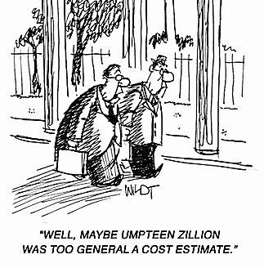

Slide 4
Lesson 1: Exercise
Objective(s):
Break out into teams
Define Cost Centers/Activity Types
List types of costs
Identify senders (provide services) and customer (who your team provide services to)
Sample Outputs

Slide 5
Lesson 2: Analysis
Objective(s):
Understand different types of analysis and how reporting can support analysis

Slide 6
Current Status
What kinds of analysis occur now?
  Spend rate
  Trade-offs
  Others?

Slide 7
Costs Analysis Types
Forecasting: using prior period information to predict future dollars and quantities
Variance Analysis: comparison analysis of standard vs Actuals, Plan vs Actuals, or multiple periods (e.g. Jan vs Feb)
Trend Analysis: Analysis of cost/qty over multiple consecutive time frames (e.g. Monthly to Month, Year to Year, etc.)
Economic Analysis: Analysis of economic benefits of multiple options over different pans of time

Slide 8
More Costs Analysis Types
Cost/Benefit Analysis: Analysis of Decision to examine costs versus return
Life Cycle Cost Estimate: Estimate of program or project over the full life cycle from concept development to disposal
Cost/Risk Analysis: Analysis assessing cost in reference to probability/risk of potential outcome

Slide 9
Analysis Supported by ERP Reporting
The various types of analysis are supported by ERP reporting by providing:
  Real-time, accurate data
  Drill-down capabilities to generating document (e.g. transparency and audit/integrity)
  Standard definitions, business rules, and methods (commonality in what the data means)
  Multiple cost assignments and views

Slide 10
Sample Analysis
Price Variance
Change in Total Cost
No Change in Activity
Drives Change in Unit $
Quantity Variance
Change in Activity
No Change in Total Cost
Drives Change in Unit Cost
Cost Variance
Change in Activity
No Change in Unit Cost
Drives Change in Total Cost

Slide 11
Budget Execution
Before & After GFEBS
The way GFEBS reports Budget Execution information is very different than current environment
The current view of COED is called Cumulative in GFEBS reporting
Both views of Budget Execution will be provided

Slide 12
Lesson 2: Wrap-Up
There are many kinds of analysis each with a different purposes and supporting different decisions
ERP reporting supports/enahnces analysis through real-time, accurate, transparent data buolt within a common framework of definitions, business rules, and processes
Reports are generated around the type of analysis being performed
Some reports within GFEBS will provide the ability to see COED as cumulative
D3L2_p6

Slide 13
Question
  ERPs support analysis by (check all that apply):
  Real-time, accurate data
  Drill-down capabilities to generating document (e.g. transparency and audit/integrity)
  Standard definitions, business rules, and methods (commonality in what the data means)
  Multiple cost assignments and views
  Does the analysis for you
✓
✓
✓
✓
X
D3L2_p6

Slide 14
Lesson 3: Reporting
Objective(s):
Understand an overview of the types of cost reports supported by GFEBS

Slide 15
GFEBS Cost Reports for Multiple Needs
By Appropriation
Direct Funds
Reimbursements
Full Cost
  Direct Funds
  Mil Pay
  Foreign Labor
  Indirect Funds
  Overhead

Slide 16
GFEBS System Components
ECC – Enterprise Central Component
BI – Business Intelligence
FI – Financial Acct. & Mgmt.
Cost By
Report
FM – Funds Acct. & Mgmt.
CO – Cost Acct. & Mgmt.
Unit Cost
Report
MM – Materials Mgmt.
and Procurement
PPE – Property, Plant &
Equipment [PM, PS, RE, AA]
Detailed
Labor
Report
SD – Sales & Reimbursables
Optimized for Data Input
Transaction Processing
Real-time; recon analysis
Structured reporting
Optimized for Data Extraction
Analytical Processing
Near real-time; trending analysis
Slice-n-dice reporting (pivot)
D2L1_p11

Slide 17
Why ECC vs BI
ECC:
Real-time
Drill-down to originating document
Reconciliation
Period-End and year-end closing activities
Support external reporting
Utilized for auditing activities
Usually researching a smaller data set
Typically set to time-out within 15 minutes to maintain system resources for receiving postings
BI:
Nightly, 4 hrs, near real-time
Drill-down to some level of aggregation – detailed line items researched in ECC
Reconciliation
Support internal reporting
Utilized for costs analysis activities
Usually researching a large data set
Typically set to time-out within 90 minutes to support end-users performing analysis

Slide 18
ECC Report Types
Plan vs Actual Variances – each cost object has a standard report for comparing Plan/Actual/Var which contains the dollars and the activity type and SKF quantities
Trend Analysis Reports – std. reports are available to compare Quarter to Quarter, Period by Period
Statistical Key Figure/Quantity Reports – period-based reports on the quantities of SKFs
Rate Reports (Activity Types and Business Processes) – provides the rates per each Cost center/Activity Type and Business Processes

Slide 19
ECC Report Capabilities
Multiple Filters – every std. report has multiple filters/parameters, e.g. From To and Ranges such as single value of a Cost Center of a Range of Cost Centers are a Group of Cost Centers
User Defined Layout/Variants – each report has a standard layout provided with the ability for the end user to add/remove/change fields and save the layout as their default for ease of report
Excel Integration – the reports can be executed as Excel if desired
Export Functions – reports can be exported into various formats such as xls, csv, etc.

Slide 20
BI Report Types
Standard Reports – most of the std. reports within ECC are provided within BI as well
Cost By – provides the cost by all cost objects, budget plan, cost plan, variances, with multiple attributes
Unit Cost – Generates a $$/# based on the selection parameters chosen
Detailed Labor Report – provides information by employee for payroll and ATAAPs
Audit Labor Report – utilized to reconcile and make adjustments for payroll related issues

Slide 21
BI Reporting Capabilities
User Defined Variants – like in ECC, users can define filter values and save as a variant for repeated use for data set they are always working with
Ad-hoc reports – the report structure is pre-define, however the users can drag-n-drop fields in as needed to generate their own versions of the report
Favorites – users can save their own versions of the report as a favorite and then execute that report when performing analysis

Slide 22
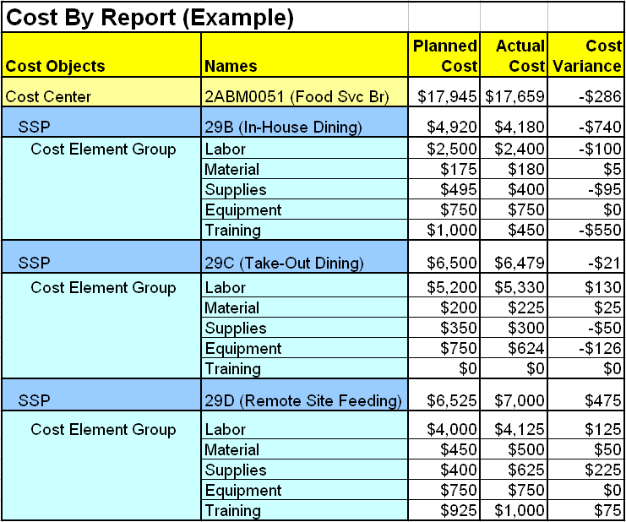
Cost By Report

Slide 23
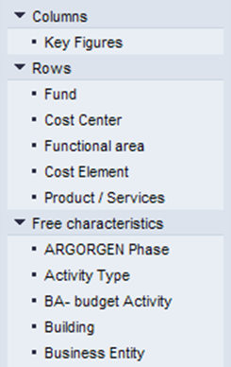
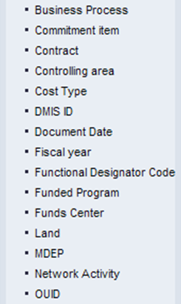
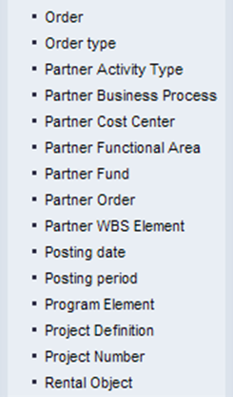
Cost By Report Variables

Slide 24
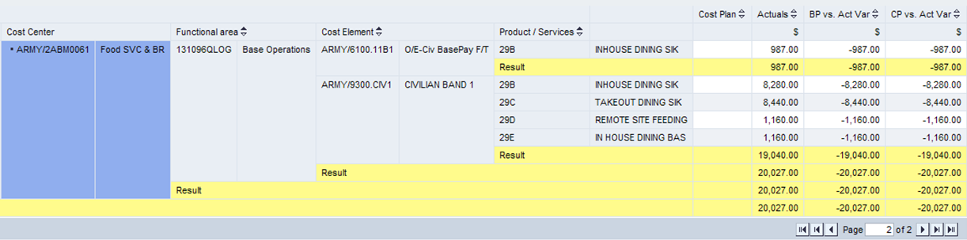
GFEBS Sample Cost By

Slide 25
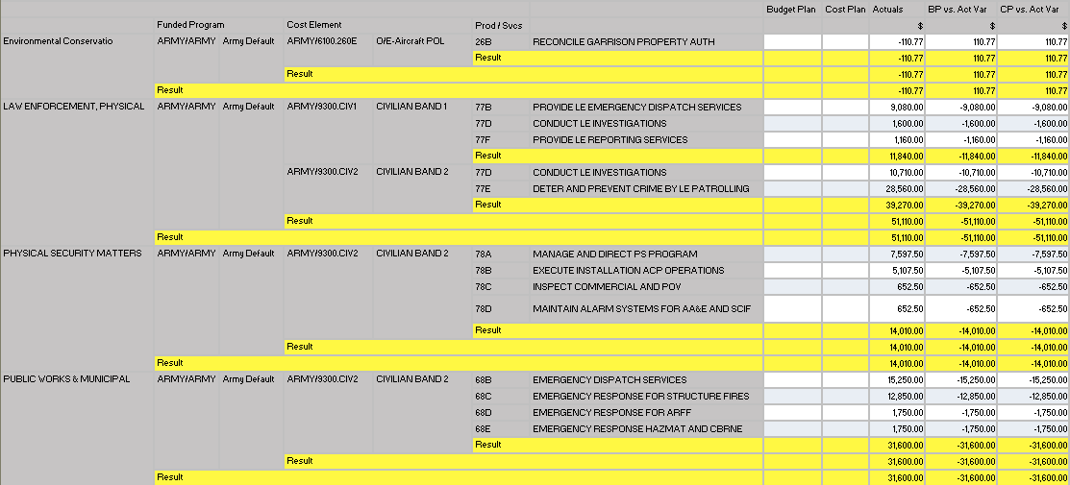
Exportable Cost By Report for Analysis

Slide 26
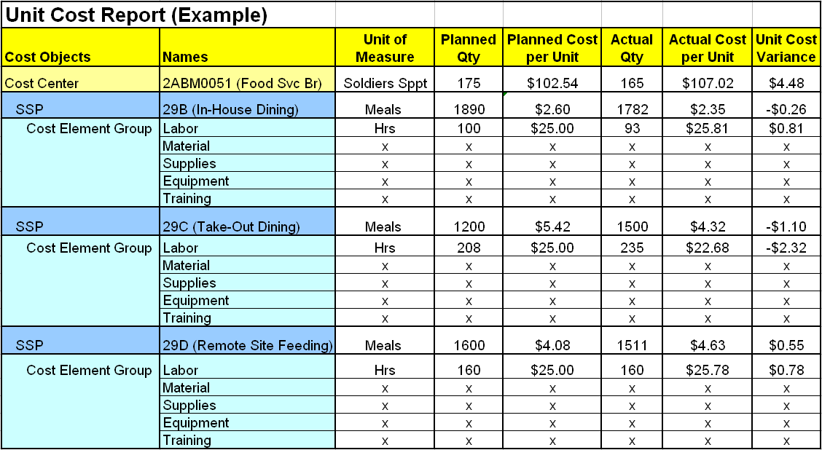
Unit Cost Report

Slide 27
CCD – Cost Model
Full Cost
Organizations
Full Cost
Product/Services
Full Cost
Customers
Director of
Logistics)
SSPs Provided
Cost Center
SSPA: Manage
OCIE Inventory
Brigade XXX
SSPB: Issue
OCIE to Soldier
Military
Labor
Cost Center/Resource Pool
Central Issue facility
TRADOC YYY
SSPC: Issue
Clothing to Initial
Training Soldier
Depreciation
CIV
HR
Civilian
Employees
SSPD: Accept
OCI Turn-Ins
Brigade ZZZ
Reports provide the information of the results of the Cost Model
CNT
HR
SSPE: Receive
& Process
Shipments
Contractors
Military
MIL
HR
SSPF: Manage
Chemical Defense
Equipment
. . Etc.
D4L_p

Slide 28
Lesson 3: Wrap-Up
There are hundreds of standard reports provides from both ECC and BI
Several special reports have been generated to support Army specific needs, Cost By, Detailed Labor, Unit Cost Rate, etc.
ECC and BI provide different reporting abilities
Users can create their own filters, views of the data within the reports and favorites
D3L2_p6

Slide 29
Question:
_____ Real-time
_____ Nightly, 4 hrs, near real-time
_____ Drill-down to originating document
_____ Reconciliation
_____ Smaller data set
_____ Time out normally around 15 mins
_____ Larger data set
_____ Time out normally around 90 mins
ECC
BI
ECC
Both
ECC
ECC
BI
BI

Slide 30
Lesson 4: Summary/Key Take-Aways
Objective(s):
Highlight the most important concepts addressed throughout the training

Slide 31

Need to Understand What the Resources Buy – The Army Product
X
X
X
X
Sets Framework for Developing Army-wide Cost Structure
X
X
X
X
Heavy
Heavy
Heavy
X
X
Light
X
Light
X
Light
X
X
Stryker
X
Stryker
Stryker
UA
UA
UA
UA
SUST
SUST
SUST
SUST
SUST
SUST
FCS
FCS
FCS
Force Generation
$ to Reset
$ to Train
$ to Deploy
Training (Ind)
Training (Unit)
$ / Student Trng Day
$ / Mile
$ / Course Day
$ / Flying Hour
$ / Weapon System
Base Support
Personnel
Equipment
$ / Service
Military
-
$ / Soldier
$ / Brigade
-
New
$ / Brigade
Civilian
-
$ / FTE
$ / Brigade
-
Conversion
$ / Installation (SRM, BOS,
Contractor
-
$ / FTE
Ratio: Sppt $ / Brigade $
ENVR, FP)
D4L_p

Slide 32
Management Domains
Financial Management
Budget
Management
Inputs
Outputs
Conversion
“Work”
Cost Management
All business operations, regardless of industry or function, require the conversion of inputs into the outputs of the organization
Budget Management provides ‘authority’ and control of the conversion activity in order to provide the agreed upon outputs of the agency (primarily input focused)
Cost Management provides ‘efficiency and effectiveness’ and control of the conversion activity in order to provide the agreed upon outputs of the agency (primarily output focused)
Financial Management provides ‘historical and comparative’ information of an externally defined view of the conversion activity
D4L_p

Slide 33
Cost Management
Managing Business Operations Efficiently & Effectively Through the Accurate Measurement & Thorough Understanding of the "Full Cost" of an Organization's Business Processes, Products & Services in Order to Provide the Best Value to Customers.
Cost
Accounting
Cost
Management
Process
Cost
Planning
Cost
Analysis
Cost
Controlling
D4L_p

Slide 34

Army Cost Culture Change
“Making a Square a Circle”
“A Culture of Entitlement”
“A Culture of Influence”
Budget-focused
Spend rate driven – inputs
Performance objective -99.9% obligated
Free goods has infinite demands
Cost and performance focused
Results driven - output & outcome
Performance objective – resource consumption optimization (efficiency & effectiveness)
Use what is necessary to obtain the objective
Develop/Recruit Analysts
Enhance Training
Performance Focus (NSPS)
Policy
How
To’s
Process Improvement (Lean 6-Sigma)
Integrated Business Design
ERP Applications e.g. (GFEBS, LMP, GCSS)
Business Warehouses
Executive Scorecards
Enablers of Change
D4L_p

Slide 35

Enhanced Ability to Capture Cost
Cost Objects
Organizational
Real Property /
Program / Project
Task / Activity
Special Event or
Entities
Equipment
Initiative
GFEBS (SAP)
Cost Centers
Assets / Real
Project / WBS
Business Process
Internal Order
Cost Collectors
Estate Objects
• Installation
• Acquisition
• Service Support
• BRAC
• Brigade
• Building
• RDTE Project
Program (SSP)
• Training Event
Army Examples
• School
• Training Range
• MILCON Project
• Instructional Course
• Mandatory
• Directorate
• Weapon System
• System Test
• Repair Process
Training
• Lab
• Test Run
• Support to
Olympics
Cost assigned Directly or Indirectly
Customer / Product
Brigade
Tenant
Command
Weapon System
PEO / PM
Course
D4L_p

Slide 36
CCD – Cost Model
Full Cost
Organizations
Full Cost
Product/Services
Full Cost
Customers
Director of
Logistics)
SSPs Provided
Cost Center
SSPA: Manage
OCIE Inventory
Brigade XXX
SSPB: Issue
OCIE to Soldier
Military
Labor
Cost Center/Resource Pool
Central Issue facility
TRADOC YYY
SSPC: Issue
Clothing to Initial
Training Soldier
Depreciation
CIV
HR
Civilian
Employees
SSPD: Accept
OCI Turn-Ins
Brigade ZZZ
Results of the Analysis Workshops are aggregated and utilized to generate the Cost Model
CNT
HR
SSPE: Receive
& Process
Shipments
Contractors
Military
MIL
HR
SSPF: Manage
Chemical Defense
Equipment
. . Etc.
D4L_p

Slide 37
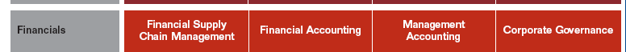
Costing Conceptual Design
Full Cost
Organizations
Full Cost
Product/Services
Full Cost
Customers
Director of
Logistics)
SSPA: Manage
OCIE Inventory
Brigade
XXX
Military
Labor
SSPB: Issue
OCIE to Soldier
What/Why information is entered, stored, used, and presented
Central Issue facility
SSPC: Issue
Clothing to Initial
Training Soldier
TRADOC
YYY
Depreciation
CIVHR
SSPD: Accept
OCI Turn-Ins
Civilian
Employees
Contractors
CNTHR
SSPE: Receive
& Process
Shipments
Brigade ZZZ
Military
Labor
MILHR
SSPF: Manage
Chemical Defense
Equipment
. . Etc.
Cost
Accounting
Cost
Planning
Cost
Analysis
How the information is entered, stored, used, and presented
Cost
Management
Process
Cost
Controlling
End User Presentation Layer
Where the information is entered, stored, used, and presented
Public Sector
D4L_p
Budget Accounting

Slide 38
Many Types Costs
Direct costs— A cost such as labor, materials/supplies that can be directly traced to producing a specific output of an organization, product/service.
Indirect costs – A cost that cannot be directly traced to a specific organization, product/service output.
Funded Costs -- The value of goods or services received because of an obligation of funds (obligation authority), by the organization performing the work.
Unfunded costs – A cost that are financed by another organization's or activity's appropriations.
Variable Costs -- A cost that changes with change in output.
Fixed Cost -- A cost that remains the same regardless of the change in output.
Sunk Cost -- A cost incurred in the past that will not be affected by any present or future decision.
Incremental Cost: The increase or decrease in costs that would result from a decision to increase or decrease output levels.
Avoidable Costs – A cost incurred on an object that will no longer be incurred due to a decision to change the output.
Unavoidable Cost: A cost incurred on an object that will be incurred regardless of the decision to change.
Common Understanding of Types of Cost is Necessary for Informed Decision Making
Each Decision Should be Focused on Only Relevant Cost that Impact the Decision

Slide 39
Cost Objects
Cost Center - A cost center is a responsibility center that incurs costs and has a manager who is accountable for those costs.
Activity Type - An Activity Type is a cost object that represents a group of resources within a Cost Center. These resource groups have capacity and a unit of measure such as: labor hours, machine hours, square footage, etc. Activity Types are consumed and utilized to the produce the products and services of the organization.
Cost Element - A Cost Element is the lowest level component for classifying costs and revenues (as negative costs) of a resource and indicates the category/type associated with a posting (e.g. allocation type, revenue, expense)
WBS Element - WBS elements are activities in the Project used for planning and updating cost data. Some examples of WBS Elements are: Tasks, Partial tasks that are further subdivided, and work packages.
Order - Orders are cost objects used to plan, collect, monitor, and settle the costs of specific jobs and tasks. Orders are used to monitor the costs of short term projects and event/job costing.
Business Process - A business process is a cost object used to capture costs of cross-functional (cost center) activities.
Other:
Statistical Key Figure - A Statistical Key Figure is a piece of information about the cost object it is assigned to, e.g. # FTE for a cost center, # telephones, etc.
D4L_p

Slide 40
Cost Allocations/Assignment
Direct Activity Allocation - The direct recording and posting of either an activity type (resource driver) or a process (activity driver) quantity. This method is a direct charging of the quantity to the receiver.
Assessment Cycle - A value-based allocation method that uses an aggregate account to move both primary (G/L accounts) and secondary cost elements (internal allocation accounts) between senders and receivers.
Distribution Cycle - An allocation method that allocates cost in the original detailed account structure and is only available for primary costs movements.
Indirect Activity Allocation - The allocation of quantities (rather than dollars) using the cycle-supported allocation basis such as fixed portion, fixed percentage, and so on. Has ability to inversely determine a sender quantity based on receiver information.
Target = Actual – The imputed output quantity of one driver based on another and posts quantities with their corresponding values. The relationship is defined through planning rather than a cycle.
Template Allocation - A tool that facilitates simple to complex assignments of costs between cost objects using Boolean (“IF-THEN”) logic. Used to establish a quantity-based relationship between these types of cost objects for allocations to be made based on operational metrics in a timely manner.
Overhead Costing Sheet - A costing sheet is an allocation mechanism for associating costs to a receiver based on static business rules
D4L_p

Slide 41

Cost Management Enables Optimization
Providers/Inputs
Outputs/Consumers
relating
Cost
of Brigade
Weapon Sys $
(VAMOSC)
HQDA
Military Pay
Contracts (CLS)
Direct
$
assign
$
$
Army Service Component Commands
Direct Reporting Unit
$
Unit Training
  Ground OPTEMPO
Direct
$
Army Commands
Installation
  SSP₁ (Labor Tracking)
assign
$
School Training
  Initial Entry
Equip the Force
  Acquisition
assign
$
Direct
$
$
GFEBS enables Army
to “slice and dice” data
for decision-making

