Slide 1
Cost Management

Slide 2
Training Agenda/Objectives
Day 1: Cost Management Overview
  Understanding of why managing costs are important, Army’s overall objectives, the process of Cost Management, how it differs from Budget, and key cost terms
Day 2: Cost Object Definition
  Understanding of an ERP, how to build a Cost Model, and the various cost objects within a Cost Model (e.g. organization, products, job orders, etc.)
Day 3: Assignment of Costs
  Understanding of cost allocations/assignments, how to chose which to utilize when, how to valuate the results of the assignments (Std. vs Actual), and rate creation
Day 4: Analysis and Reporting
  Understanding of the results of the Cost Model and how various types of analysis and decisions are supported

Slide 3
Riddle Me This….?
Could you tell your customers the full cost of providing them their products or services?
Could you answer the same question by quarter or for the next quarter?
Could you tell customers how changes in their behaviors might affect their costs?
How would you determine the cost to operate your DOL or provide a specific Service/SSP?
  What costs would you include?
  What is your “show me” source?
Let’s view a real life example of Cost Management in action!

Slide 4
Pa & Ma Kettle Math Video

Slide 5
Day 1 Objective & Agenda
Day 1: Cost Management Overview
Understanding of why managing costs are important, Army’s overall objectives, the process of Cost Management, how it differs from Budget, and key cost terms
  Lesson 1: Cost Awareness
  Lesson 2: Cost Culture
  Lesson 3: Cost vs. Budget
  Lesson 4: Cost Management
  Lesson 5: Cost Terms

Slide 6
Lesson 1: Cost Awareness
Objective(s):
To understand the external and internal factors requiring the Army to instill Cost Management as a fundamental approach for day to day activities

Slide 7
Army Stakeholders
Taxpayers, Congress, OSD, Customers
External
Internal
ARMY
HQ
ARMY HQ
Strategic
IMCOM HQ
IMCOM HQ
Management
Installations
IMCOM
Installations
Operation

Slide 8
External Stakeholder Demands: Government Industry Mandates
There Has Been A Push For The Past Decade for the Ability to Explain How Well An Organization Is Performing versus What It Is Performing
More Questions Are Being Asked About - How Much Does It Cost To? How Efficient Are We At? Versus Where Did You Spend the Budget?
Questions on Efficiency Fall Into the Domain of Management Accounting; Questions of Which Funds Were Expended Are the Domain of Budget Accounting

Slide 9
Cost – Government History
Actions Requiring Costs & Performance
  Chief Financial Officers Act (1990)
  Government Performance Results Act (1993)
  President’s Management Agenda (2002)
  OMB Performance Assessment Rating Tool
  OSD Requires Army Performance Budget
Public Sector GAAP (SFFAS 4) Full Cost (1995)
  Army Developed GFEBS Costing Module
OSD Actions to Increases Cost Management
  Acquisition Reform (1997)
  OSD (AT&L) Issues ABC Guidance (1999)
  Business Transformation / Lean Six Sigma
Lessons Learned: Cost Measurement Difficult
Cultural Resistance

Slide 10
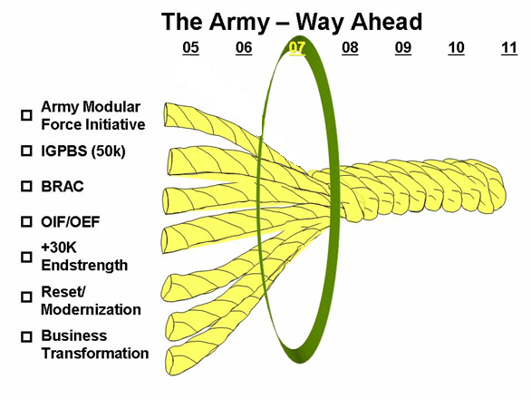
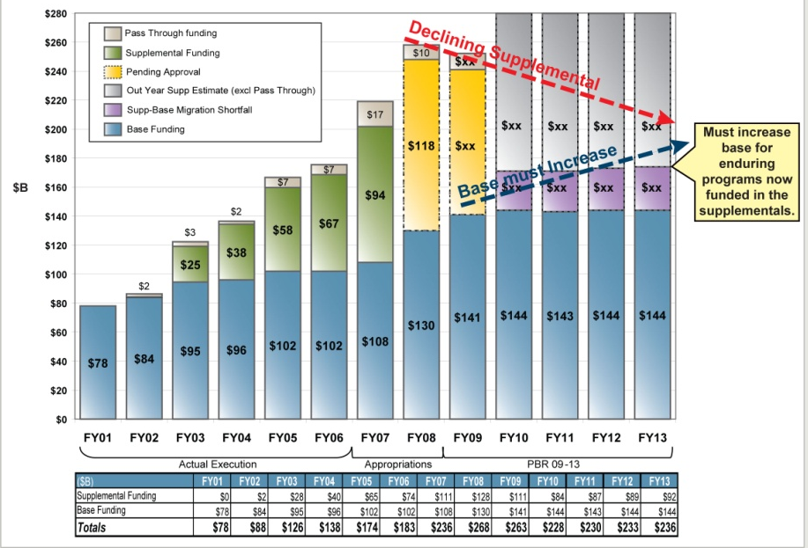
Army’s Imperatives for Change
Threats
Opportunities
More competing priorities for resources
Over reliance on supplemental funding
Migration of base budget requirements (training, maintenance, procurement) into supplementals
Supplemental funding likely to stop prior to end of hostilities/redeployment of forces
Understand cost to accomplish objectives
Optimize base resources as supplemental funding is discontinued
Understand depreciated value of current assets and effectively plan for the future
Develop clear and defensible impact analyses
Change the way the Army does business to leverage investment in ERP technology and LSS
Notes:
than ever before – OEF/OIF, BRAC/global rebasing, modularity, reset, soldier/family quality of life, RC/AC migration, business transformation

Slide 11
ASA(FM&C) Operational Priorities
Provide accurate, reliable, and timely financial information and integrated functional performance data to Army decision makers
Improve Army accountability and enable full cost management
Exchange information with customer and stakeholders
Achieve efficiencies and operate effectively
Enable the Army to receive and unqualified audit opinion on annual financial statements with respect to Army General Funds
Cost
Management
Financial
Management
ARMY HQ
Strategic
IMCOM HQ
Management
IMCOM
Installations
Operational
Notes:
b/c need to change > Army look to tools to help & needed to replace STAN FINS & Somards to be able to provide the type & level of information being requested.

Slide 12
Objective
In order to meet the first 4 operational priorities, the Army needs to establish a cost culture that:
  functions as a key and integral part of the Army’s overall management process
  adds value to the organization by enabling the effective use of resources in dynamic and competitive contexts
  provides continuous feedback on effective use of resources to create value for stakeholders

Slide 13
Vision
By obtaining the objectives, the Army can meet its overall vision of:
  Leaders use cost information for effective decision-making and performance management by:
      understanding both the near- and long-term cost implications of their decisions;
      making effective trade-off decisions to achieve the best possible use of limited resources; and
      holding subordinates accountable for improving the efficiency and effectiveness of their operations.
  Army soldiers/civilians along the value chain understand how their efforts contribute to the Army mission and impact Army resources

Slide 14
Many Types Costs
Direct costs— A cost such as labor, materials/supplies that can be directly traced to producing a specific output of an organization, product/service.
Indirect costs – A cost that cannot be directly traced to a specific organization, product/service output.
Funded Costs -- The value of goods or services received because of an obligation of funds (obligation authority), by the organization performing the work.
Unfunded costs – A cost that are financed by another organization's or activity's appropriations.
Variable Costs -- A cost that changes with change in output.
Fixed Cost -- A cost that remains the same regardless of the change in output.
Sunk Cost -- A cost incurred in the past that will not be affected by any present or future decision.
Incremental Cost: The increase or decrease in costs that would result from a decision to increase or decrease output levels.
Avoidable Costs – A cost incurred on an object that will no longer be incurred due to a decision to change the output.
Unavoidable Cost: A cost incurred on an object that will be incurred regardless of the decision to change.
Common Understanding of Types of Cost is Necessary for Informed Decision Making
Each Decision Should be Focused on Only Relevant Cost that Impact the Decision

Slide 15

Need to Understand What the Resources Buy – The Army Product
X
X
X
X
Sets Framework for Developing Army-wide Cost Structure
X
X
X
X
Heavy
Heavy
Heavy
X
X
Light
X
Light
X
Light
X
X
Stryker
X
Stryker
Stryker
UA
UA
UA
UA
SUST
SUST
SUST
SUST
SUST
SUST
FCS
FCS
FCS
Force Generation
$ to Reset
$ to Train
$ to Deploy
Training (Ind)
Training (Unit)
$ / Student Trng Day
$ / Mile
$ / Course Day
$ / Flying Hour
$ / Weapon System
Base Support
Personnel
Equipment
$ / Service
Military
-
$ / Soldier
$ / Brigade
-
New
$ / Brigade
Civilian
-
$ / FTE
$ / Brigade
-
Conversion
$ / Installation (SRM, BOS,
Contractor
-
$ / FTE
Ratio: Sppt $ / Brigade $
ENVR, FP)

Slide 16
ARFORGEN Process
Optimization Impacts Multiple Programs
Reset/Train
Ready
Available
Man
Equip
Train
Sustain
Operate
- HQDA
- IMCOM / REGION
- GARRISON
    Population Shifts (Deployments, Training, Etc.)
    Family Programs
    Facilities Utilization
    Maintenance & Repair
    Etc. ..
TRADOC
  Infantry School
    Course ABC
    Course XYZ
  National Training Center
    Event 123
    Event 456
    Etc…

Slide 17
Lesson 1: Wrap-Up
External Pressures provide an emotional trigger
Each level of stakeholders have different objectives & vision which should align and support total objectives & visions
Cost awareness and management as an approach will be used to shift the focus of budget only, e.g. what was spent, to performance, e.g. what did we do/get?

Slide 18

Question #1: Based on the HQDA Strategy of BCT being the Army Primary Product, How can IMCOM Impact that Strategy through Cost Management?
X
X
ANSWER:
X
X
X
X
X
X
Heavy
Heavy
Heavy
X
X
Light
X
Light
X
Light
X
X
Stryker
X
Stryker
Stryker
UA
UA
UA
SUST
UA
SUST
SUST
SUST
SUST
FCS
SUST
FCS
FCS
Force Generation
$ to Reset
$ to Train
$ to Deploy
Training (
Ind
)
Training (Unit)
$ / Student
Trng
Day
$ / Mile
$ / Course Day
$ / Flying Hour
$ / Weapon System
Base Support
Personnel
Equipment
$ / Service
Military
-
$ / Soldier
$ / Brigade
$ / Brigade
Civilian
-
$ / FTE
-
New
$ / Brigade
$ / Installation (SRM, BOS,
Contractor
-
Conversion
-
$ / FTE
Ratio:
Sppt
$ / Brigade $
ENVR, FP)

Slide 19
Question #2: What are some examples of how IMCOM is impacted by the Army’s optimization strategies, i.e. ARFORGEN Process?
Answer:
Reset/Train
Ready
Available
Man
Equip
Train
Sustain
Operate
- HQDA
- IMCOM / REGION
- GARRISON
    Population Shifts (Deployments, Training, Etc.)
    Family Programs
    Facilities Utilization
    Capacity Management (Workload/Output)
    Maintenance & Repair
    Etc.

Slide 20
Lesson 2: Cost Culture
Objective(s):
Understand the level of effort for deploying cost awareness throughout the Army, i.e. generating a Cost Culture

Slide 21
What is a Cost Culture?
Organizational Culture:
Comprises the Attitudes, Experiences, Beliefs & Values of an Organization
A Shared Behavior by People & Groups in an Organization
Most Experts Agree that it is the Shared “Taken-For-Granted” Assumptions, Beliefs, Values, Expectations & Rules that Members of a Work Unit Team or a Corporate Organization Hold
A Cost Culture is the Cultural Shift from “Accomplish the Mission at Any Cost” to “Accomplish the Mission Considering Cost”

Slide 22
Why Focus on Culture?
Deploying Systems, Improving Cost Models, Issuing Policies, Training Staff, Recruiting Experts
will not Enhance the Army’s ability to manage costs
unless Army Soldiers / Civilians Understand & Value the Need to Manage Costs
Knowing Our Costs & Managing Them To Increase Our Mission Capability Must Become Ingrained in Our Culture
Leaders Must Demand Cost Information & Use It In Decision-making — Otherwise It Provides No Utility To The Army
We Need A Lifestyle Change, Not A Diet!

Slide 23
Leadership Statements on
a Cost Culture
From Chief of Staff, Army:
Most Army processes lack a cross-functional focus and cost-benefit analysis which leads to grossly inefficient application of resources.
Large budgets in the past few years have produced a consumption-based culture that focuses on accomplishing missions without concern for more efficient delivery of capabilities.
From 2008 Army Posture Statement:
Integral to achieving our goals is the development of an Army-wide cost-management culture in which leaders better understand the full cost of the capabilities they use and provide and incorporate cost considerations into their planning and decision-making. This approach will enable us to achieve readiness and performance objectives more efficiently.
From HONORABLE Nelson Ford, ASA (FM&C):
The cultural change that is essential to Army financial management, and without which all the other improvements will leave us short of achieving our goals, is the adoption and integration of cost management into the Army culture.

Slide 24
Creating A Cost Culture
Cost Culture Vision:
Leaders Use Cost
Information for
Effective Decision-
Making &
Performance
Management by …
Understanding Both Near & Long-Term Cost Implications of Their Decisions
Making Effective Trade-Off Decisions to Achieve Best Use of Limited Resources
Holding Subordinates Accountable for Improving the Efficiency & Effectiveness of operations
Cost Culture Take - Aways:
Know the True Cost of What You Do - Not Knowing Cost Makes Everything Appear Free -- “Free Goods Have Infinite Demand”
Cost Management is Not Easy -- You Have to Know What Drives Costs & Take Action to Control Costs
Cost Management Goes Beyond “Do More With Less” - It Is Optimizing Resources to Efficiently and Effectively Meet Mission -- “Focused on Continuous Improvement”
Notes:
12
Basic business axiom = free goods have unlimited demand. Cost management and building a model that shows the spender what it costs to do whatever they are trying to do will result in the spender trying to use less than they would use otherwise. (e.g. you know what your home telephone costs are per minute, why don’t you know what your business costs are? Answer: because you are not paying the bill.)
Cost management says you should be aware of what your real costs are and therefore will try to bring them down.
Every instance of its use shows that is what happens

Slide 25

Business Culture Change Process
“Making a Square a Circle”
The Culture Is Defined By What, Who, Why, And How Business Is Conducted
The Culture Is Imbedded in People, Processes and Technologies
“We’ve Always Done It This Way”
Influencing A Culture Requires Changes To The Components Of A Culture
Visualize and Define What You Want To Be
“We’re going to be…”
People &
Other Resources
Policy
How
To’s
Processes,
Policies & Procedures
Tools &
Technologies
Enablers of Change

Slide 26
Army Cost Culture Change
“Making a Square a Circle”
“A Culture of Entitlement”
“A Culture of Influence”
Budget-focused
Spend rate driven – inputs
Performance objective -99.9% obligated
Free goods has infinite demands
Cost and performance focused
Results driven - output & outcome
Performance objective – resource consumption optimization (efficiency & effectiveness)
Use what is necessary to obtain the objective
Develop/Recruit Analysts
Enhance Training
Performance Focus (NSPS)
Policy
How
To’s
Process Improvement (Lean 6-Sigma)
Integrated Business Design
ERP Applications e.g. (GFEBS, LMP, GCSS)
Business Warehouses
Executive Scorecards
Enablers of Change

Slide 27
Cost Culture – Steps
(Maturation Process)
Obligations (STANFINS/SOMARDS)
Managerial / Cost Accounting
Cost & Performance Measures/Objectives
“What We Spent”
Input
Cost Measurement
“What It Actually Cost”
Inputs & Outputs
Cost Management
“What It Should Cost”
Outcomes
Budget Allocation
Obligations
Execution Reporting
Financial Accounting
Limited Analysis
Cost Allocation
Cost Centers
Cost Drivers
Cost Methods / Systems
Cost Accounting
Cost Planning
Cost Controls
Cost Behaviors
Non-Financial Measures
Performance Goals & Results

Slide 28
Cultural Change Video

Slide 29
Lesson 2: Wrap-Up
Culture is the Shared “Taken-For-Granted” Assumptions, Beliefs, Values, Expectations & Rules that Members of a Work Unit Team or a Corporate Organization Hold
Change management is required to move towards a Cost Culture
Change management impacts the areas of People & Other Resources, Processes, Policies & Procedures, and Technology
Cultural shift to a Cost Culture is a maturation process moving from “What We Spent”, to “What It Actually Costs”, to “What It Should Costs”

Slide 30
Question #1: What are the Enablers of Business
Culture Change
People/Other Resources
Processes, Policies & Procedures
Tools & Technologies

Slide 31
Question #2: What is the biggest obstacle to establishing a cost culture in the Army for you?
Answer: Discussion

Slide 32
Lesson 3: Cost vs Budget
Objective(s):
Understand how Costs differ from Budget

Slide 33
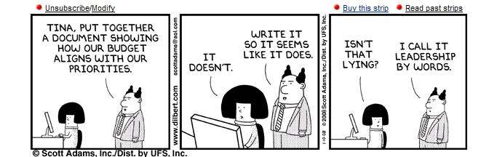

Slide 34
Where We Are Currently
Focused on the “Budget” domain
The “Budget” domain consists of creation of the Budget requests/submissions, determination of the year of execution Budget (e.g. availability control and informal Budgets), actual execution, and reporting of the status of execution against the Budget (i.e the PPB&E process)
Primary focus of budget execution is the Obligation (consumption of the Budget)
Budget Accounting focuses on 4 series accounts – status of Budget and consumption
Budget Management focuses on the status of available funds, which includes both current and prior years funds

Slide 35
Budget Terms
Budget = What Can Be Spent
Obligation = a promise to procure a product/ service (e.g. to spend)
Budget ≠ Obligations
Budget – Obligations = Availability (e.g. what is left to spend)
Expenditure is the receipt of the product/service which was obligated (e.g. what was spent)
Expenditures or collection of expenses/expenditures determines Costs

Slide 36

Cost versus Budget
Knowing your Obligations is not the same as knowing your Costs!
A legally binding commitment by the federal government that will result in outlays, immediately or in the future. Budgetary resources must be available before obligations can be incurred legally.
Obligations
Costs
The price or cash value of resources used (expenditures) to produce a program, project or activity. All relevant costs may not appear in the organization’s budget.
Cost ≠ Obligation
Full cost can exceed individual business unit budget allocations
Costs
Obligations
Cost will contain expenses from different years, source of funds, organizations, etc.

Slide 37
Budget ≠ Obligations ≠ Cost…
Cost Accounting / Management is New to Most of Army as a formalized process
Provides Financial and Managerial Information
Cuts Across financial and operational organizations
Is Driven by Information Needs of the Operational Army not solely the Financial Community

Slide 38
Management Domains
Financial Management
Budget
Management
Inputs
Outputs
Conversion
“Work”
Cost Management
All business operations, regardless of industry or function, require the conversion of inputs into the outputs of the organization
Budget Management provides ‘authority’ and control of the conversion activity in order to provide the agreed upon outputs of the agency (primarily input focused)
Cost Management provides ‘efficiency and effectiveness’ and control of the conversion activity in order to provide the agreed upon outputs of the agency (primarily output focused)
Financial Management provides ‘historical and comparative’ information of an externally defined view of the conversion activity

Slide 39
Budget vs Cost Domains
Performance
Budget Formulation
Budget Execution
Cost Management
Budget
  President’s financial plan and the priorities for the Federal Government
Budget Authority
  Authority to incur obligations
Cost
  Valuation of resources used to produce outputs, basis for decision making
Focus
  requirements
Focus
  availability, obligations
Focus
  full cost
Data Streams
  requirements, formulations
Data Streams
  budget, actual COED
Data Streams
  plan, target, actual expenses -> cost, rates, performance measures
Key Data Elements
  appropriation, FTE
Key Data Elements
  appropriations, EOR’s, PE, MDEP, projects, BLIN, etc.
Key Data Elements
  operational entity (e.g. cost centers), services, rates, products, projects, etc.
Performance

Slide 40
Budget vs Cost Domains (cont’d)
Performance
Budget Formulation
Budget Execution
Cost Management
Questions
  What do I need?
  What will I ask for?
Questions
  What funding did I get ?
  What obligations were executed?
Questions
  What was expensed?
  What did I get for it?
  How well was it used?
Process Dependencies
  budget requests are the base for appropriations
Process Dependencies
  consolidates operational expenditures across budget entities
Process Dependencies
  captures full cost components regardless of budget entities/authority
Performance

Slide 41
Budget - Color of Money
Appropriations
Program Elements
Fund Centers
$
OMA
$
IMCOM
BOS
$
$
SRM
Jackson
AFH
$
Benning
Knox
GFEBS
$
RDT&E
Elements
Of Resources
Supplies
Training
Travel
Equipment
Labor
Etc.

Slide 42

Costing Starts with Cost Centers
Fund Center
Cmdr. Ofs.
Special Staff
Ch, DOL
Ch, DPW
Ch, RM
Ch, MWR
Performs Funds
Management
Cost Centers
Cost Center Groups

Slide 43
Transforming The Army
Enhance Budgeting with a Cost Culture
Budget Culture
Cost Culture
ASA(FM&C)
PEGs
II PEG
Budget Process
Budget Process
MACOMs
IMCOM
MSC
MSC
MSC
Regions
Cost & Performance Management
Installations
Other Directorates
Dir of Logistics
Transportation
CIF
Food Services
25A –
Manage
CIF
25B –
Issue
OCIE
25C –
Provide
Clothing
25D –
Accept
OCIE
25E –
Receive
Shipments
25F –
Manage
Chemical

Slide 44
Lesson 3: Wrap-Up
Budget ≠ Obligations ≠ Costs
Budget Management is primarily “input” focused (color of money) where Cost Management is primarily “output” focused (products/services)
The Budget and Cost domains have different purposes, focuses, questions, optimization goals, while sharing the “expenditure” data stream
Fund Center is an organizational view of the funds paid for one or several cost centers; one of the costs centers performs the function of funds management

Slide 45
Question #1: Cost = Budget
True
False
✓
Question #2: Cost = Obligation
True
False
✓

Slide 46
Question #3: _______________ provides ‘authority’ and control of the conversion activity in order to provide the agreed upon outputs of the agency (primarily input focused)
Question #4: ______________ provides ‘efficiency and effectiveness’ and control of the conversion activity in order to provide the agreed upon outputs of the agency (primarily output focused)

Slide 47
Lesson 4: Cost Management
Objective(s):
Understand the definition of Cost Management
Understand the key components of the Cost Management Process
Identify who is involved in performing Cost Management

Slide 48
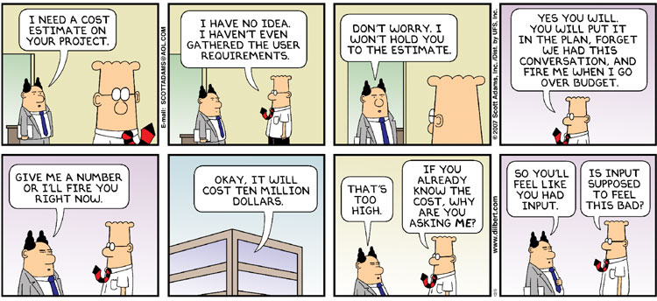

Slide 49
Cost Management
Managing Business Operations Efficiently & Effectively Through the Accurate Measurement & Thorough Understanding of the "Full Cost" of an Organization's Business Processes, Products & Services in Order to Provide the Best Value to Customers.
Efficiently is to doing things "right“, e.g. in the best and most economical way, wasting no resources
Effectively is to do the "right" things, e.g. setting targets to achieve an overall goal (the effect) and attaining the goal
Full Costs is the inclusion of all and only those costs related to generating the output
Best Value is a qualitative measurement to be taken into consideration

Slide 50
Cost Management
Managing Business Operations Efficiently & Effectively Through the Accurate Measurement & Thorough Understanding of the "Full Cost" of an Organization's Business Processes, Products & Services in Order to Provide the Best Value to Customers.
Cost
Accounting
Cost
Management
Process
Cost
Planning
Cost
Analysis
Cost
Controlling

Slide 51
Cost Planning
Cost Planning is the use of a Cost Model for “should-cost” forecasting to make informed decisions
Cost
Accounting
Often Performed for:
  Budget Requirements Requests
  Costs Estimations
  Output Quantities
  Capacity Management
  Risk Analysis
  Various Time Frames: Out year / Current year, Quarterly, Monthly
  Standard Rates
  Defining Targets to Measure Efficiency and Effectiveness
Cost
Planning
Cost
Management
Process
Cost
Analysis
Cost
Controlling

Slide 52
Cost Accounting
Cost Accounting translates the operational value chain into financial values
Cost
Accounting
  Cost Accounting is the dollar valuation of the cost measurements resulting from business operations
  Cost Measurement has meaning only when considering its purpose
  Defining Cost Measurement should be carefully considered and evaluated
  Alternative cost methods should be evaluated under operating environment
Cost
Planning
Cost
Management
Process
Cost
Analysis
Cost
Controlling
Purpose Is the key to Understanding the Army ERP Cost Design (GFEBS): To Provide Operational Managers With Relevant “True” Cost
Information to Make Sound Economic Decisions*
* Source: The Federal Accounting Standards Advisory Board (FASAB) No. 4. Managerial Cost Accounting Standards

Slide 53
Cost Analysis
Cost Analysis is the integration of functional outcome data with cost data to produce valid and verifiable information to conduct various forms of analysis
Cost
Accounting
Sample types of analysis include:
Organizational performance
Analysis of alternatives
Variance analysis
Economic analysis
Cost / Risk assessments
Trending
Cost
Planning
Cost
Management
Process
Cost
Analysis
Cost
Controlling

Slide 54
Cost Controlling
Cost Controlling is to take “Best Value” and/or “Best Practice” actions to realign the organization to achieve the defined objectives
Actions taken based on information provided from Cost Analysis results
Redeployment of resources between outputs
Change outputs (e.g. do more or less)
Update/revision of plan information, e.g. updated Std. Rate
Execution of trade-off decisions, e.g. OT versus external support
Cost
Accounting
Cost
Planning
Cost
Management
Process
Cost
Analysis
Cost
Controlling

Slide 55
Cost Management Involves
Capture and Valuate Data
  Accurate, timely and relevant data
  Connecting operational output/performance data to financial data
  Allocate Overhead
Cost Planning
  Set Cost Targets and Efficiency Goals
  Compute Standard Rates
Cost
Accounting
Cost Analysis
  Variances
  Depreciation
  Trends and forecasting
  Product, service or activity cost by element (labor, contract etc)
  Understanding full costs of organizations, operations, products and services
Cost
Planning
Cost
Management
Process
Cost
Analysis
Cost Controlling
  Move to action based on analysis
  Change targets
  Change resources
  Change quality
Cost
Controlling

Slide 56
Cost Management Process
(Who Is Involved?)
RM
Cost
Accounting
OM
Cost
Planning
Cost
Management
Process
Cost
Analysis
Cost
Controlling
Resource Managers (RM)
- Operational Managers (OM)

Slide 57
Army Cost Management Strategies for Efficiency & Continuous Improvement
Captures Low Hanging Fruit, Provides Initial Savings
Top Down / Centralized
Operational Level /
Approach
Decentralized Approach
- A-76
- Business Process
Reengineering
One Time
- Standardization
- Business Process
Fixes
Improvement
- Reorganizations
- Reorganizations
- Budget Management
Cost & Performance
Management
Continuous
- Reduction Targets
Improvement
- GPRA, PMA
Achieved through existing Financial Systems
Reduces Spending
Gains some Efficiencies
Requires Managerial Costing
Supported by Technology (GFEBS)
Leads to Efficiency & Effectiveness

Slide 58
Cost Structure
Today: Appropriation Organization MDEP Element of Resource (EOR) PE/AMSCO/APC Functional Cost Account Financial Obligation Data A Slice of Cost Financial Reporting Lacks Output Data | Tomorrow (GFEBS): Organization Product Service Customer Tenant Facility Based on Consumption By Transaction Focused on Full Cost For Management Use Linked to Output /Outcome
+

Slide 59
Lesson 4: Wrap-Up
Cost Management = Managing Business Operations Efficiently & Effectively Through the Accurate Measurement & Thorough Understanding of the "Full Cost" of an Organization's Business Processes, Products & Services in Order to Provide the Best Value to Customers.
Cost Management Process consists of Cost Planning, Cost Accounting, Cost Analysis, and Cost Controlling
Cost Management involves Operational Managers and Resource Managers

Slide 60
Question #1: What are the 3 Key Components of the Cost Management Definition?
ANSWER:
efficiently and effectively
"full cost"
best value to customers.
Cost Management: Managing business operations efficiently and effectively through the accurate measurement and thorough understanding of the "full cost" of an organization's business processes, products and services in order to provide the best value to customers.

Slide 61
Question #2: Which Sections of the Cost Management Process Primarily Involve:
- Resource Managers (RM)?
- Operational Managers (OM)?
RM
Cost
Accounting
OM
Cost
Planning
Cost
Management
Process
Cost
Analysis
Cost
Controlling

Slide 62
Question #3: Which Sections of the Cost Management Process Primarily Involve:
- HQDA/IMCOM HQ (HQ)?
- Field Level - Garrisons, Schools … & Below?
Cost
Accounting
Answer:
Field
HQ
Cost
Planning
Cost
Management
Process
Cost
Analysis
Cost
Controlling

Slide 63
Lesson 5: Cost Terms
Objective(s):
Understand the key terms involved with Cost Management

Slide 64
Cost Terms
There is a language to Cost Management, however there are many dialects!
There is an inconsistency of cost terms in the market driven by outgrowth from manufacturing to the introduction of service costing
Cost terms additionally differ based on costing philosophy (e.g. standard costing, activity-based costing, theory of constraints, etc.)
Army has determined the Cost Terms to be propagated to provide a level set language for understanding Cost information

Slide 65
Many Types Costs
Direct costs— A cost such as labor, materials/supplies that can be directly traced to producing a specific output of an organization, product/service.
Indirect costs – A cost that cannot be directly traced to a specific organization, product/service output.
Funded Costs -- The value of goods or services received because of an obligation of funds (obligation authority), by the organization performing the work.
Unfunded costs – A cost that are financed by another organization's or activity's appropriations.
Variable Costs -- A cost that changes with change in output.
Fixed Cost -- A cost that remains the same regardless of the change in output.
Sunk Cost -- A cost incurred in the past that will not be affected by any present or future decision.
Incremental Cost: The increase or decrease in costs that would result from a decision to increase or decrease output levels.
Avoidable Costs – A cost incurred on an object that will no longer be incurred due to a decision to change the output.
Unavoidable Cost: A cost incurred on an object that will be incurred regardless of the decision to change.
Common Understanding of Types of Cost is Necessary for Informed Decision Making
Each Decision Should be Focused on Only Relevant Cost that Impact the Decision

Slide 66
Type of Cost Functions

Slide 67
Funded vs Unfunded
The terms Funded and Unfunded define the relationship of the appropriation dollars consumed to the organization utilizing those funds.
Classification of the dollars input (utilized) in relationship to the organization responsible for the output

Slide 68
Funded Costs
Funded Costs – The value of goods or services received because of an obligation of funds (obligation authority), by the organization performing the work. (e.g. civilian labor, building and grounds maintenance). These costs are funded in the Annual Operating Budget of the organization.
  Labor
  Materials
  Contracts
  Travel
  Facilities
Example 1:
Example 2:
Director of
Logistics (DOL)
Cost Center/Resource Pool
Cost Center/Resource Pool
Central Issue Facility
Central Issue Facility

Slide 69
Unfunded Costs
Unfunded Costs – Costs that are financed by another organization's or activity's appropriations. These costs do not result in any obligation of funds by the organization; examples include depreciation, military labor, and military rations.
Military
Labor
Cost Center/Resource Pool
Example:
Central Issue Facility
Depreciation

Slide 70
Direct vs. Indirect Costs
Direct and Indirect define the relationship of the cost incurred to the output provided
Direct and Indirect are often contentious terms since they imply responsibility for control (view changes depending on where you sit in the organization)
Cost Center
$$$
$$ Relationship with # output…
# HRS
CIV
HR
# HRS
MIL
HR

Slide 71
Direct Costs
Director of
Logistics (DOL)
Direct Costs – A cost such as labor, materials/ supplies that can be directly traced to producing a specific output of an organization, product/service
Cost Center: CIF
DOL Support $$$
Labor $$$
Material $$$
Military
Labor
Contracts $$$
Travel $$$
Military Labor $$$
Facilities $$$
CIV
HR
MIL
HR

Slide 72
Indirect Costs
Director of
Logistics (DOL)
Indirect Costs – Costs that cannot be directly traced to a specific output. They are often allocated on some predetermined basis and are generally synonymous with overhead, such as general and administrative expenses.
Cost Center: CIF
DOL Support $$$
Labor $$$
Material $$$
Military
Labor
Contracts $$$
Travel $$$
Military Labor $$$
Facilities $$$
CIV
HR
MIL
HR

Slide 73
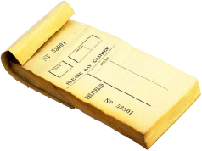
Primary vs Secondary
The terms Primary and Secondary define the relationship of the market from which the resources are procured (i.e. externally or internally)
Army Orgs
$$ relationship with who bought from
Cost Center
$$$
QTYs
CIV
HR
Vendors
$$$
Internal Markets
# HRS
CIV
HR
Labor Market
# HRS
MIL
HR
External Markets

Slide 74
Primary Costs
Primary Costs – Expenditures externally sourced are termed Primary Costs, such as most of today’s EORs. Primary costs are typically (but not necessarily e.g., depreciation) indicative of cash out flows.
Director of
Logistics (DOL)
Cost Center: CIF
DOL Support $$$
Labor $$$
Material $$$
Military
Labor
Contracts $$$
Travel $$$
Military Labor $$$
Facilities $$$
CIV
HR
MIL
HR

Slide 75
Secondary Costs
Secondary Costs - Costs assigned/service fees to an object for consuming products/services providing by another object.
Director of
Logistics (DOL)
Cost Center: CIF
DOL Support $$$
Labor $$$
Material $$$
Military
Labor
Contracts $$$
Travel $$$
Military Labor $$$
Facilities $$$
CIV
HR
MIL
HR

Slide 76
Fixed vs Variable
Fixed and Variable define the influence on the dollar relationship of the cost incurred to the output provided
Are defined within a relevant time, such as the plan cycle (i.e. 1 year.)
Cost Center
Influence on $$s in relationship with # output…
$$$
# HRS
CIV
HR
# HRS
MIL
HR

Slide 77
Fixed and Variable Costs
Fixed Cost - A cost that remains the same regardless of the change in output, within a relevant range (e.g., rent, supervisor).
Variable Costs - A cost that changes with change in output (e.g., cost of material, labor, utilities).
Cost Center: CIF
Fix Var
DOL Support $$$
Labor $$$ $$$
Material $$$
Military
Labor
Contracts $$$ $$$
Travel $$$
Military Labor $$$
CIV
HR
Facilities $$$
MIL
HR
CNTR
HR

Slide 78
Fixed and Variable Cost & Quantities
Inputs are considered Fixed if they do not change as a result of differences in output measures.
Inputs are considered Variable if they increase or decrease as a result of changes in output.
Help Desk Mgr. Alice Red
Output: Help Desk Hours 3,000
Fixed Variable
Staff Salaries
Mgr. Salaries
Licenses
Supplies
Disk Space (MB)
CPU Time (Mins)
Facilities (Sqft)
$ 0
$10,000
$ 30
$ 0
Qty
0
0
300
$ 15,000
$ 0
$ 0
$ 598
46,000
4,000
0

Slide 79
Decision Specific
Cost Concepts
Avoidable Costs - A cost incurred on an object that will no longer be incurred due to a decision to change the output, such as contract labor to operate the test range
Unavoidable Cost - A cost incurred on an object that will be incurred regardless of the decision to change output, such as depreciation on equipment

Slide 80
Lesson 5: Wrap-Up
Cost Management = Managing Business Operations Efficiently & Effectively Through the Accurate Measurement & Thorough Understanding of the "Full Cost" of an Organization's Business Processes, Products & Services in Order to Provide the Best Value to Customers.
Cost Management Process consists of Cost Planning, Cost Accounting, Cost Analysis, and Cost Controlling
Cost Management involves Operational Managers and Resource Managers
A common understanding of the types of costs in order to make informed decisions

Slide 81
Questions:
Difference between Direct and Indirect?
Difference between Funded and Unfunded?
Difference between Fixed and Variable?
Difference between Avoidable and Unavoidable?

Slide 82
Answers to 1 through 4
Direct costs - directly traced to producing a specific output
Indirect costs - cannot be directly traced to a specific output
Funded Costs - funded in the Annual Operating Budget of the your organization
Unfunded costs –financed by another organization's or activity's appropriations
Variable Costs - changes with change in output
Fixed Cost - remains the same regardless of the change in output (within a relevant range)
Avoidable Costs - will no longer be incurred due to a decision to change the output
Unavoidable Cost - will be incurred regardless of the decision to change output

Slide 83
Question #5: Provide Examples of When Labor is?
Direct costs
Indirect costs
Funded Costs
Unfunded costs
Variable Costs
Fixed Cost
Avoidable Costs
Unavoidable Cost
Answer: Discussion

