Slide 1
Financial and Performance Assessment
Enterprise Wide Performance Results
Mort Anvari
Director, Programs and Strategy
US Army, ASA(FM&C)
http://www.anvari.net/
http://s1093575.instanturl.net/anvari.net/
Executive Comptroller Course
Syracuse University
Wednesday, June 15, 2016
10:30 AM-12:00 PM

Slide 2
Agenda
Evolution of Army Cost Management
Cost Management Direction and Guidance
Linking Outcomes to Costs – the Cost Management Framework
Enterprise Cost Management Initiatives:
Cost of Training Readiness (COTR)
Installation Management Data Integrity Program (IMDIP)
People are Our Most Important Resource - Cost Management Training
What’s Hot for the Army Analytics in 2016?
2

Slide 3
Evolution of Cost Management
3

Slide 4
Historical & Current Situation
Costs are typically tracked vertically either by organization level and then by commodity (examples: Civilian labor at AMC HQ, Fuel at the 101st CAB, travel costs at ATEC) OR by key 4 line of accounting
Fund (APPN, FY, Base/Supplemental); Command; SAG/APE; and MDEP
The costs for “horizontal” Army processes are typically not tracked, particularly those that cross organizational boundaries, yet processes are how the Army accomplishes its primary Title 10 missions—training, equipping, recruiting, acquiring, maintaining, etc.
The full fielding of the General Fund Enterprise Business System (GFEBS) provides unprecedented capability to better determine Army costs
Budget constraints place a greater emphasis on better informed decision making
4

Slide 5
Cost Management DIRACTION AND GUIDANCE
5

Slide 6
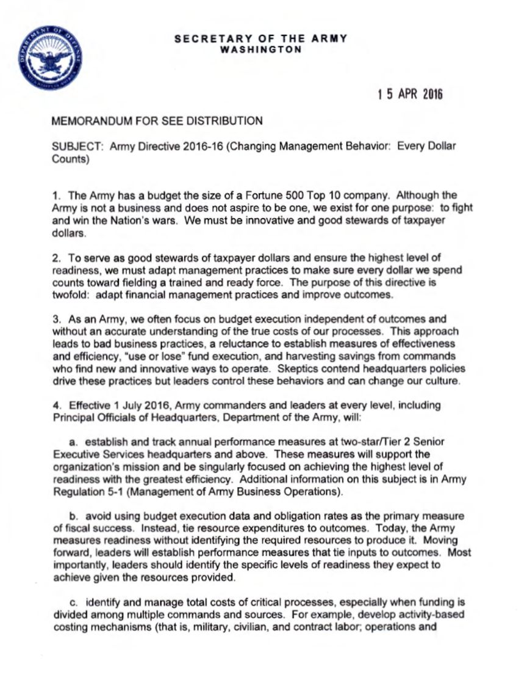
Army Directive 2016-16 Changing Management Behavior: Every Dollar Counts
On 15 Apr 16, SecArmy directed: Army commanders and leaders at 2Star HQ level and above will:
Establish & track annual performance measures…focus on the highest level of readiness with the greatest efficiency;
Tie resources expenditures (costs) to outcomes and levels of readiness;
Identify and manage total costs;
Eliminate ‘use or lose’ funding practices;
Reward leaders & organizations who demonstrate exemplary stewardship & innovative ideas.
Can we focus the energy of this directive to advance the Army toward a “cost culture”?
Notes:
1) Army Directive 2016-16 (Changing Management Behavior: Every Dollar Counts) is dated 15 Apr 16. It directs that effective 1 Jul 16, Army commanders and leaders at every level, including Principal Officials of Headquarters, Department of the Army, will do the following:
* Establish and track annual performance measures, at two-star/Tier 2 SES headquarters and above. These measures will be singularly focused on achieving the highest level of readiness with the greatest efficiency.
* Identify the specific levels of readiness they expect to achieve given the resources provided.
* Avoid using budget execution data and obligation rates as the primary measure of fiscal success; instead, tie resource expenditures to outcomes, and establish performance measures that tie inputs to outcomes.
* Identify and manage total costs of critical processes, especially when funding is divided among multiple commands and sources.
* Eliminate "use or lose" funding practices.
* Reward leaders and organizations who demonstrate exemplary stewardship and innovative ideas.
2) Stand-To! announces Army Directive 2016-16 in "Changing Management Behavior: Every Dollar Counts"
3) An associated army.mil article, "End-of-year 'use it or lose it' budget mindset to get tossed," dated 14 Apr 16.
4) Army Regulation 5-1 (Management of Army Business Operations) addresses performance measures. Army Office of Business Transformation is the proponent for AR 5-1 and the co-proponent for Army Directive 2016-16 (along with ASA(FM&C)).
5) CGSC A983 - CPI Slides for Majors at Intermediate Level Education (ILE) to give them an overview/introduction of Lean and Six Sigma.
Source links for the attached, in the order referenced above:
http://www.army.mil/e2/c/downloads/431118.pdf
http://www.army.mil/standto/archive_2016-04-18/?s_cid=standto
http://www.army.mil/article/166098
http://www.apd.army.mil/pdffiles/r5_1.pdf

Slide 7
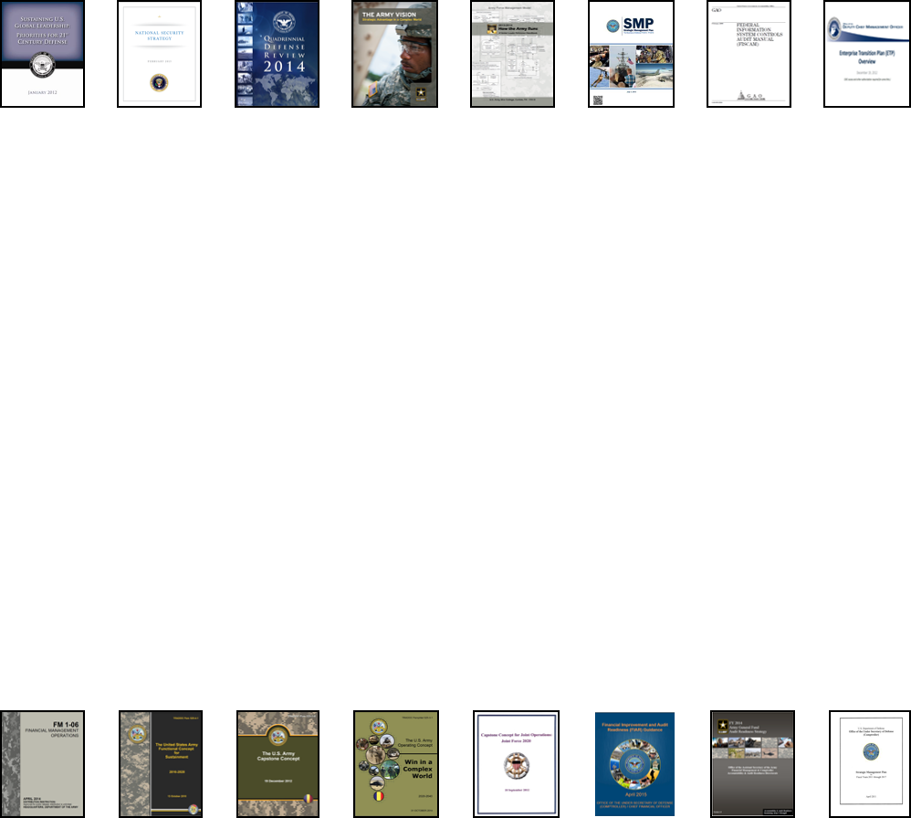
Driving Change in Army FM Enterprise
Strategic Environment
AFMO Campaign Plan
AFMO Objectives
(1) Achieve and Sustain Auditability
(2) Deliver FM Operations Efficiently and Effectively
(3) Improve and Sustain Readiness in FM Elements
(4) Provide Financial Information and Business Analytic Support for Improved Decision Making
AFMO End State
An integrated effective and efficient end-to-end financial management enterprise operation, optimized to provide necessary resources to meet the Army’s missions with proper stewardship and accountability of resources and providing accurate and timely financial information and analysis for actionable decision making that will receive a favorable Financial Statement clean audit opinion.
LOE 1: Systems Domain
LOE 2: Business Processes
LOE 3: Organizations
LOE 4: FM Professional Workforce
LOE 5: Internal Controls Environment
LOE 6: Army Cost Management
LOE 7: Strategic Management
& Communications
Notes:
LOE 6 Cost Management Definition: Managing business operations efficiently and effectively through the accurate measurement and thorough understanding of "full relevant cost“ of an organization's business processes, inputs, outcomes, products, and services in order to provide the best value to customers using the five steps of the E2E CM process: Develop & Maintain Cost Frameworks; Cost Planning; Cost Accounting; Cost Analysis; and Cost Controlling.
LOE 6 Major Objectives:
Align strategic (performance) goals with cost objectives, models, and reporting
Integrate CM policy, procedures, models (e.g. FORCES, OSMIS) and reporting across key decision forums (e.g. PPBC, Mid Year Review)
Establish and manage the Army’s Cost Framework leveraging ERPs
Establish, document & maintain audit compliant CM E2E process
Establish, sustain and recognize Cost Managed Organizations (CMO)

Slide 8
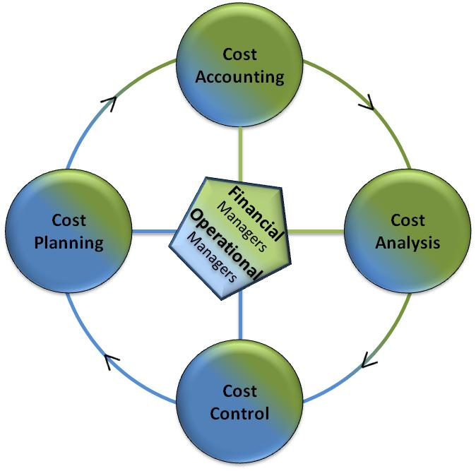
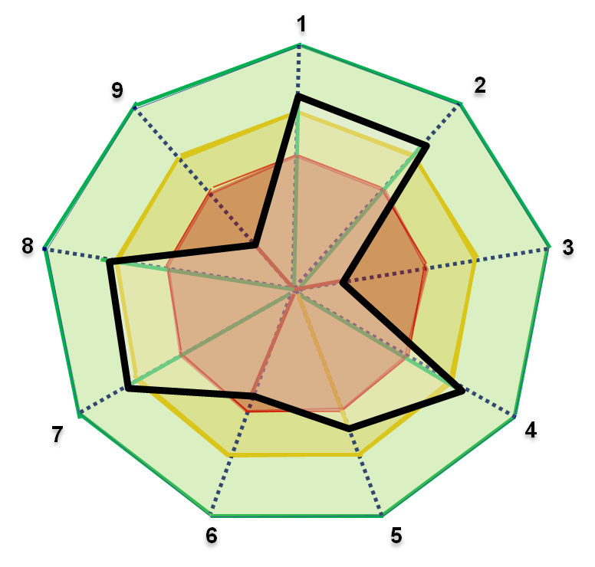
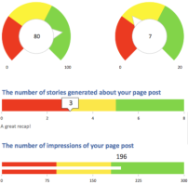
Army Cost Management (CM) is working
People
Leadership Commitment
Training
FM Workforce (AFMO)
CM Process Model
Technology
Data Quality (ERP Cost Data, Performance Metrics)
Tools & Models (Analytics, BI)
Process
Cost Planning (Cost Estimates, …...)
Cost Analysis (CBA, AoA, ….)
Cost Integration to Requirement, Acquisition & Resource
Cost Control (LSS, AFBRT, …..)
Training
CM Maturity Model
CM Goal: Better Value for Lower Cost
Stewardship of nation’s resources
Cost informed decision making
Continuous improvement
Accountability for costs
Tracking progress
Data Quality
Cost Analysis
8

Slide 9
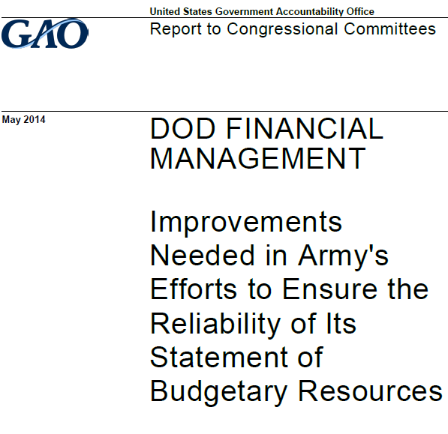
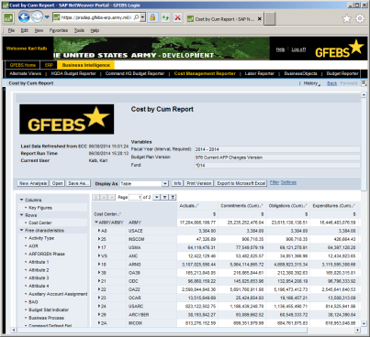
Army Financial Transparency
Challenges
DOD Audit Readiness
Visibility into Cost and Spending
Meaningful Business Analytics for Decision Making
Financial System Interface Errors and Rework
Opportunity
Army Cost Data Capture Strategy and CM
Progress
Cost Culture and Cost Management (CM) Initiatives
Army General Fund Enterprise Business System (GFEBS)
Addressing Financial Material Weaknesses - LSS
Army Financial Benefits Reporting and Tracking (AFBRT)
Army CM Steering Group
Army Financial Management Optimization (AFMO)
9

Slide 10
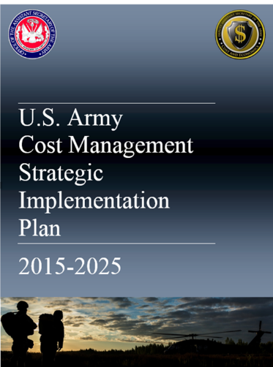
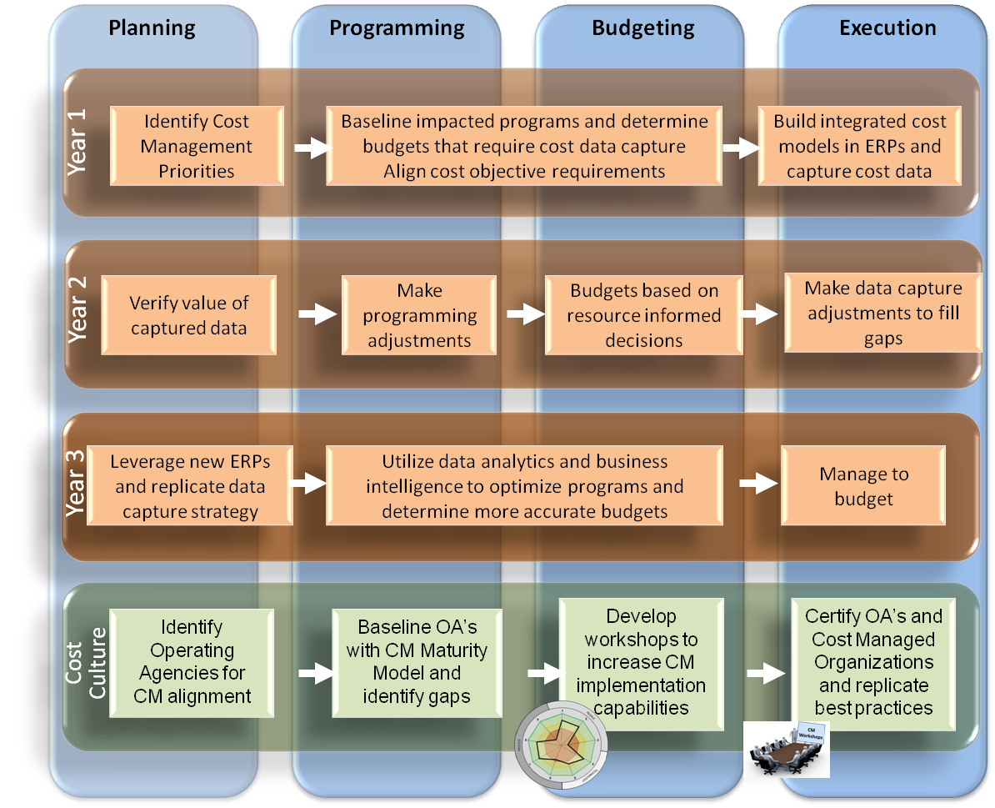
Cost Management Data Capture Strategy
Improve data quality and cost data visualization tools for decision making.
Incorporate rigorous Cost Management in funding decision to reduce future cost risk.
Plan for capture of execution data in support of CM and PPBE processes.
Cost Management Steering Group (CMSG)
Prioritized, Aligned, and Optimized Cost Data Capture
Integrate Cost Management into PPBE and Core
End-to-End processes
10

Slide 11
How Are We Going to Get There? Army Cost Management Strategic Implementation Plan (CMSIP)
I
Align strategic goals with cost objectives, framework, and reporting
Integrate analytical capabilities in key decision making forums
Utilize the CM Framework to leverage the Enterprise Resource Planning (ERP) for better decision making
Document & sustain audit ready CM process
Establish, Sustain, & Recognize Cost Managed Organizations (CMO) through training, best practices, and knowledge management
II
III
IV
V
Notes:
Align strategic goals with cost objectives, framework, and reporting
Align priority Performance Outcome Goals to Cost Objectives, ACF (e.g. inputs, outputs, processes), & Reporting
Measure success – Army highest level of readiness with greatest efficiency
Oversight from the Cost Management (CM) Steering Group
Integrate analytical capabilities in key decision making forums.
All key forums (e.g. PPBC, AROC, ASARC)
Leverage current cost models (e.g. FORCES,OSMIS)
Integrate CM policy, audit compliant procedures, models, and ‘Cost by’ reporting
Utilize the CM Framework to leverage the Enterprise Resource Planning (ERP) for better decision making
Document & sustain audit compliant CM process
Establish, Sustain, & Recognize Cost Managed Organizations (CMO) through training, best practices, and knowledge management.

Slide 12
LINKING OUTCOMES TO COSTS – THE COST MANAGEMENT FRAMEWORK

Slide 13
Align Strategic Goals with Cost Objectives, Cost Framework and Reporting
INFLUENCERS
ASA(FM&C)
CMSG
POLICY
EXTERNAL
HQDA / PEG
READINESS
USARC
FORSCOM
USAREUR
…
WEAPON SYSTEM
RECRUITING
REQUIREMENTS
CMSG Prioritization
Army Cost Framework
Methodology
ARMY COST FRAMEWORK (ACF)
Enterprise CFs
READINESS
WEAPON SYSTEM
Org CFs
FORSCOM
TRADOC
USARC
USAREUR
UNIT
RECRUITING
…
…
E2E Cost Management Processes
Scope and Requirements
Cost Model Blueprint
Design Rationale
Implement. Plan
Verification and Validation
COPIS Business Model
CM
Plan
Account
Analyze
Control
ARMY WORKFORCE
POLICY
TRAINING
TOOLS
ENABLERS
13

Slide 14
What is Army Cost Framework (ACF)?
Scope and Requirements
Cost Model Blueprint
Design Rationale
Implementation Plan
Verification and Validation
COPIS Business Model
A standard approach to defining strategic and operational cost structure and measures to inform leadership resource decision making and enable Army’s desired mission outcomes (performance goals)
Includes processes and documentation artifacts to define business models (COPIS) and cost management models
A pre-requisite to Cost Management that links performance and cost metrics to maximizing Army’s value
ARMY COST FRAMEWORK (ACF)
Enterprise CFs
READINESS
Org CFs
WEAPON SYSTEM
FORSCOM
USARC
USAREUR
TRADOC
…
UNIT
RECRUITING
…
COPIS: Tool to define, link, and document Customers – Outputs – Processes – Inputs – Suppliers associated with enterprise and/or organizational business models
14

Slide 15
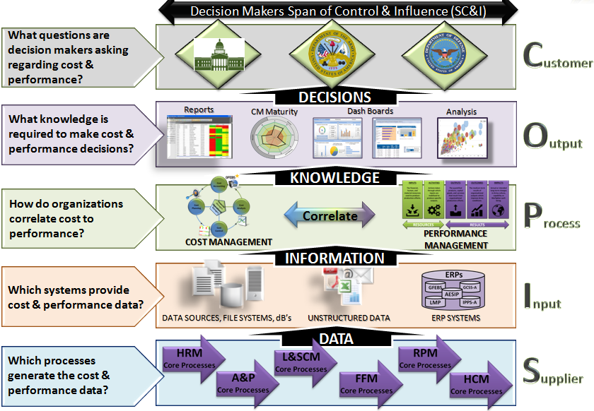
ACF Provides Leadership Cost Information Needs

Slide 16
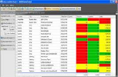
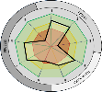
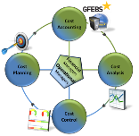
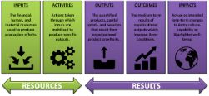
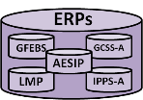
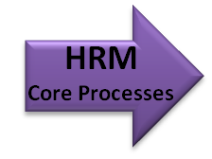
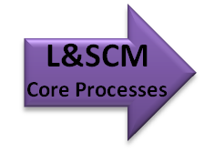
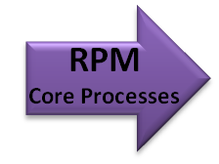
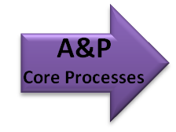
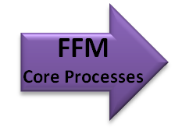
Readiness Example
Decision Makers Span of Control & Influence (SC&I)
President
Congress Army Ldrs
How big does the Army need to be?
DECISIONS
Cost of Soldiers?
Cost of Training?
Cost of Equipment?
Cost of Standard Services?
Reports
CM Maturity
Dash Boards
Analysis
Program
Budget
Execution
Force Structure
KNOWLEDGE
Correlate
Cost of Readiness
What is readiness?
COST MANAGEMENT
PERFORMANCE
MANAGEMENT
INFORMATION
OSMIS / FORCES / AMCOS
SMS
Unit/Installation Status
Trained Units
$’s Spent
DATA SOURCES, FILE SYSTEMS, dB’s
UNSTRUCTURED DATA
ERP SYSTEMS
DATA
GFEBS
GCSS-A
LMP
SMS
Transactions
Reports
Notes:
The data capture architecture is also the basis of an enterprise strategy to understand the relationship of data to information to knowledge and decisions regardless of where
the decision maker is as long as the decisions are within the decision makers Span of Control & Influence.
The SC&I scopes the decision making framework that aligns the data sources to the eventual reports and dashboards needed for knowledge to make accurate decisions.
Cost management and Performance Management are correlated to enable the decision maker to iterate the process to achieve better knowledge and understand the impacts of cost performance to non-financial measures of performance,
such as quality, cycle time, or other measures of effectiveness and efficiency.
At each level of the SIPOC, questions must be answered in order to understand how the decision maker should correlate cost and performance into an integrated resource informed decision making environment.

Slide 17
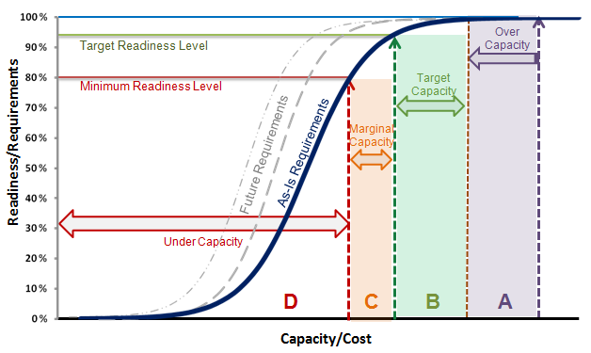
CM: Cost of Readiness
Readiness/Requirements vs. Capacity/Cost
Notional Example:
Cost of Readiness for Personnel
Requirement
Cost
Illustrative Data
Illustrative Data
Capacity’s Impact on Readiness
Readiness Component Capacity Baseline
Zone | Capacity/Cost | Readiness
A |  | No Change
B
C
D | Under Capacity | Below Minimum
Readiness Component | A | B | C | D
Personnel | P
Supply-on hand |  | P
Readiness-Equipment | P
Training |  |  | P
Illustrative Data
17

Slide 18
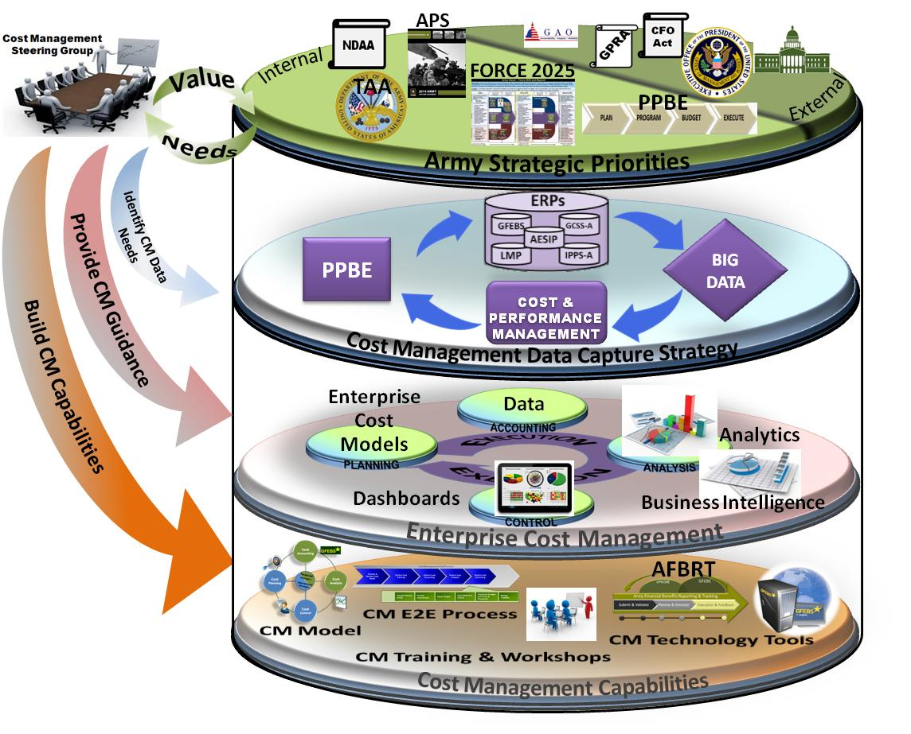
Army Cost Management Architecture
Army Enterprise Cost Management Needs & FM Transparency
Data Capture Strategy (Big Data)
Advanced Analytics
Advanced Capabilities
Cost Performance knowledge will improve with subsequent iterations
18

Slide 19
Enterprise CM Data Need
1. Customers
Views
Full Visibility - Big Cost Data
2.Contracts
1
# Tables = N * (N-1) / 2
for 10 views 45 cost visibility table is needed
2. Contracts
Multi-dimensional Polygon Cost Visibility
1- Customers by Contracts
2- Customers by Services
3- Customers by Funding
4- Customers by Cost Centers
5- Contracts by Service
6- Contracts by Funding
7- Contracts by Cost Centers
8- Services by Funding
9- Service by Cost Centers
10 –Funding by Cost Centers
3.Services
2
5
3. Services
4.Funding
3
6
8
4. Funding
5.Cost Centers
4
7
9
10
.
.
.
.
.
.
.
Org, Year, Supplier, Type . . ?
19

Slide 20
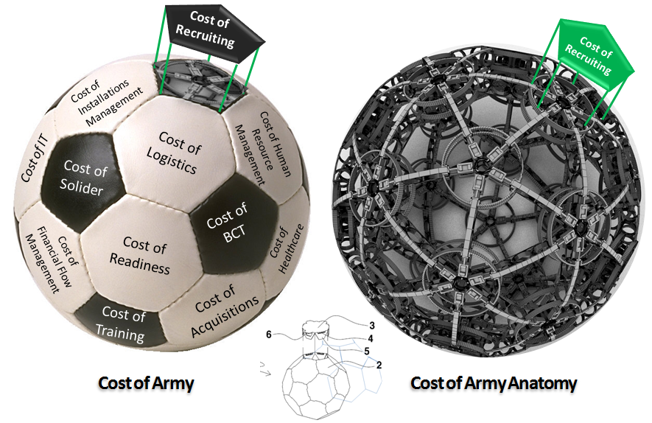
CM: Visualization of Cost Interdependencies
Notes:
Army activity, process, product, or service costs can be visualized as a polyhedron sphere, like a soccer ball, of interrelated costs. These costs can be generalized as O&M, Staff MPA, base ops, and other MPA costs to name a few.
When a question is asked to calculate the cost of an Army product or service, the calculations are “pulled” from the interior of the sphere and the total cost is determined by the category of cost and the percentage applied
depending on who is pulling out the section and what costs they want to consider based on what there span of control and influence is.
Because a single section of the sphere is based on cost interdependencies, the total costs of all Army activities will always exceed the total budget because costs can be represented in many types of cost of something.

Slide 21
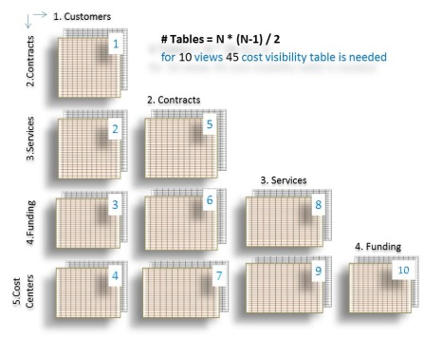
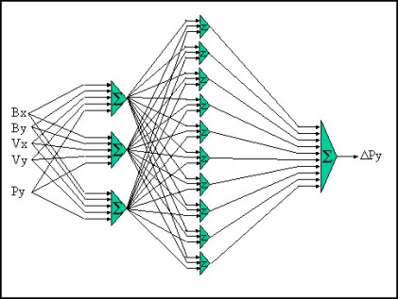
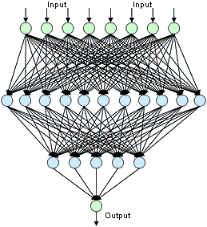
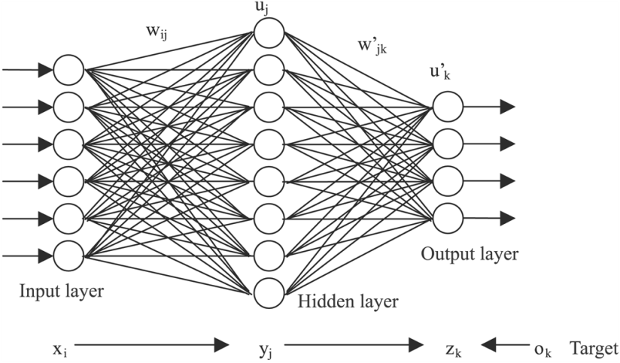
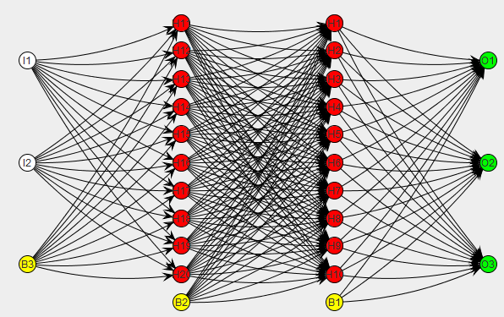
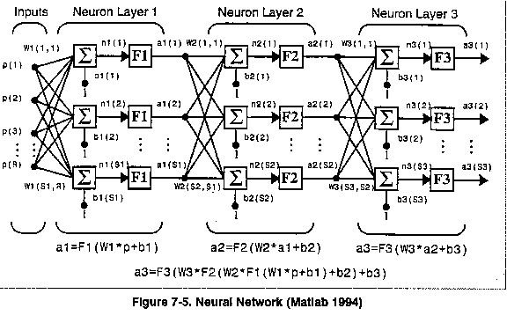
CM: Cost Attribution Models
Data Views
21

Slide 22
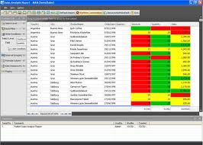
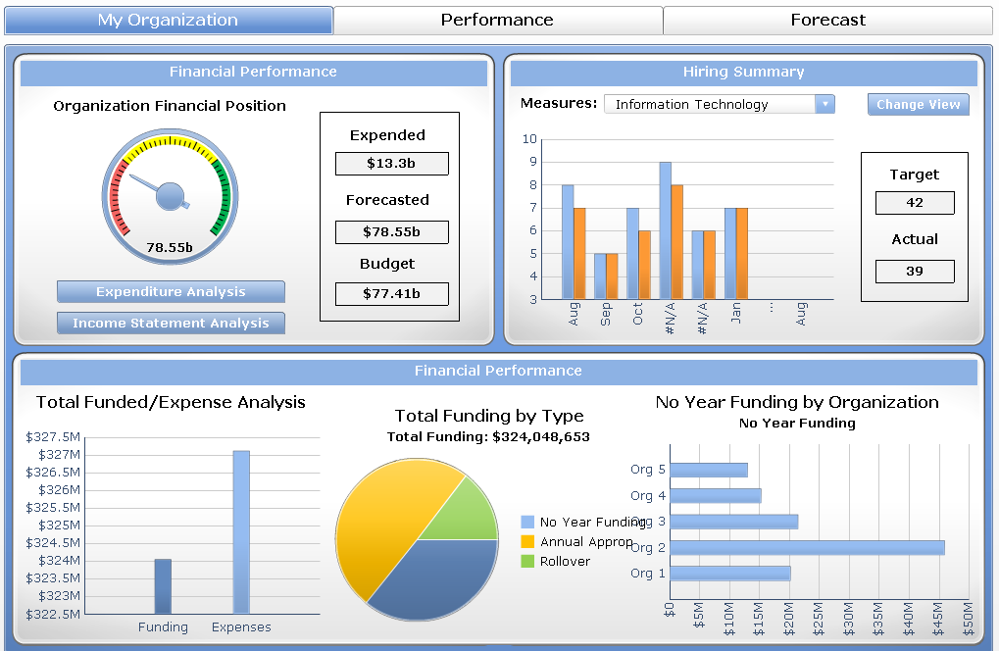
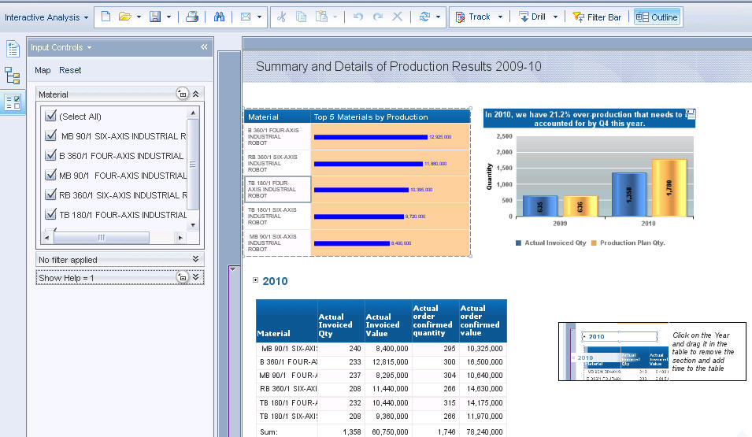
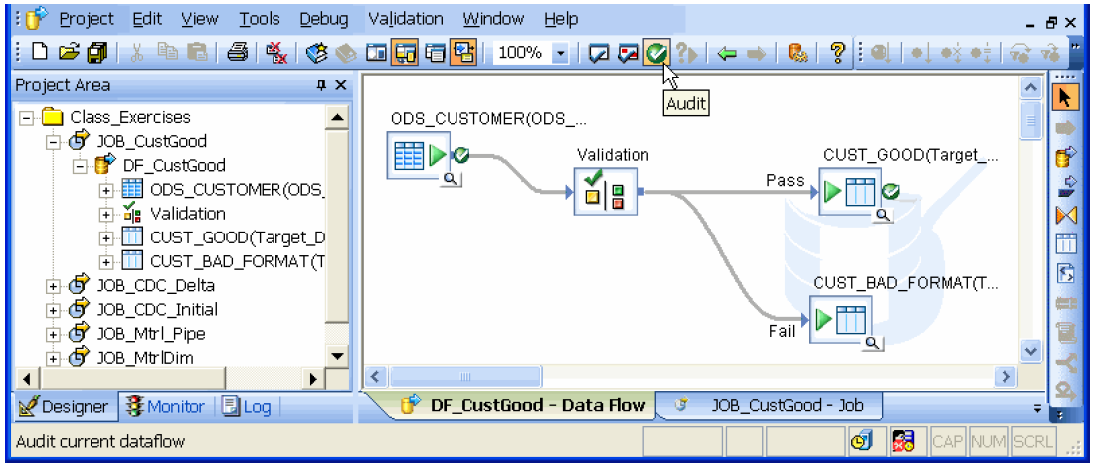
Cost Management Data Architecture
Reports
Dash Boards
Analysis
Presentation
Layer
Data
Standardization
A
Data
Warehouse
& Information
Management
Layer
BI Engine
OLAP
Data Warehouse
(AESIP)
Data Marts
Common Data Value
Common Exchange Mechanism
Common Entity Model
Data
Integration
Layer
Unstructured Data
ETL
Data Sources
Layer
IPPS-A
GCSS-A
GFEBS
B
Sources
Databases
Unstructured Data
File
Systems
ERPs
SOA, ESB,
Web
GFM-DI
High Cost of Data Standardization at Data Source Layer ?
22

Slide 23
Army Cost Management Business Process
Strategic Environment
AFMO Campaign Plan
AFMO Objectives
(1) Achieve and Sustain Auditability
(2) Deliver FM Operations Efficiently and Effectively
(3) Improve and Sustain Readiness in FM Elements
(4) Provide Financial Information and Business Analytic Support for Improved Decision Making
AFMO End State
An integrated effective and efficient end-to-end financial management enterprise operation, optimized to provide necessary resources to meet the Army’s missions with proper stewardship and accountability of resources and providing accurate and timely financial information and analysis for actionable decision making that will receive a favorable Financial Statement clean audit opinion.
LOE 1: Systems Domain
LOE 2: Business Processes
LOE 3: Organizations
LOE 4: FM Professional Workforce
LOE 5: Internal Controls Environment
LOE 6: Army Cost Management
LOE 7: Strategic Management
& Communications

Slide 24
Cost Management Process
Resource-Informed Decision Making
Managing Business Operations Efficiently & Effectively Through the Accurate Measurement & Thorough Understanding of the "Full Cost" of an Organization's Business Processes, Products & Services in Order to Provide the Best Value.
Capture and Valuate Data
Accurate, timely and relevant data
Connecting operational output/performance data to financial data
Allocate Overhead
Cost Planning
Set Cost Targets and Efficiency Goals
Compute Standard Rates
Cost Analysis
Variances
Depreciation
Trends and forecasting
Product, service or activity cost by element (labor, contract etc)
Understanding full costs of organizations, operations, products and services
Cost Controlling
Move to action based on analysis
Change targets
Change resources
Change quality

Slide 25
Army Cost Management End-to-End Process
Develop & Maintain Cost Framework
Perform Cost Planning
Perform Cost Accounting
Perform Cost Analysis
Perform Cost Controlling
Determine Cost Objectives
Maintain Cost Model
CM Process Activities Level One
Establish Planned Output
Establish Planned Costs (inputs)
Develop Cost and Performance Targets
Develop Metrics
Capture Actual Costs
Capture Actual Outputs
Perform Cost Assignment
Perform Period End Close
Capture Actual Costs
Capture Actual Outputs
Perform Cost Assignment
Perform Period End Close
CM Process Activities Level Two
Compare Results to Plan
Process Improvement
Adjust Targets
Select Method of Control
Implement (changes to) Policies & Procedures
Manage Tradeoffs
25

Slide 26
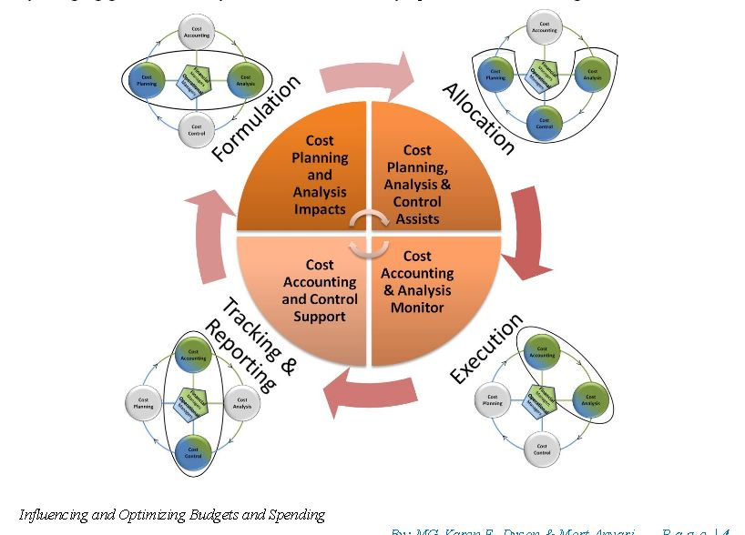
Army Cost Management and PPBE
Integrating Cost Management with PPBE Process
26

Slide 27
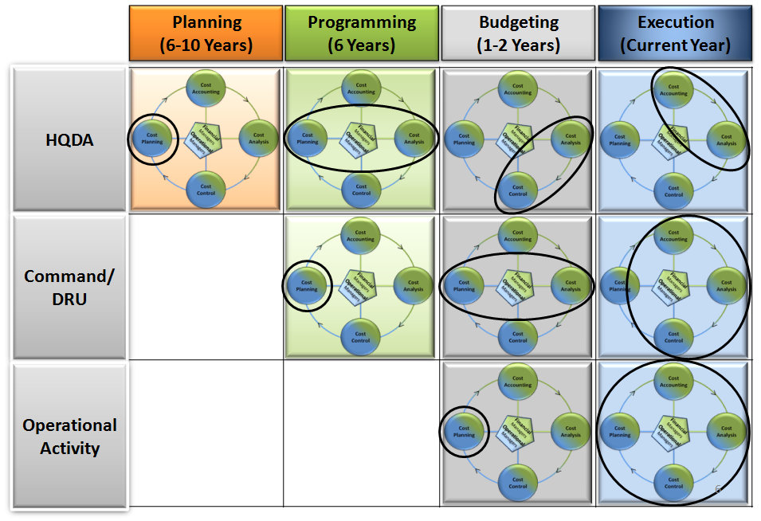
Aligned CM to PPBE
27

Slide 28
CM Activities and PPBE Phases
Planning
Programming
Budgeting
Execution
(6 - 10 Years)
(6 Years)
(1-2 Years)
(Current Year)
Strategic Decision-Making:
Outyear Forecasting:
Formulation / Justification:
Allocation/Funds Distribution:
- Cost Benefit Analysis
- Cost Factors & Models
- Cost Factors
- Cost Analysis to Support
- Analysis of Alternatives
* TRM/OSMIS
* OPTEMPO Cost Factors
* Cash Management
- Army Cost Position (LCCE)
* FORCES Costing Model
* Mil Pay Rates
* Reprogramming
HQDA
- Cost Models / Tools
* AMCOS / Civ Pay Rates
* Civ Pay Rates
* Rate of Executution
* FORCES Costing Model
- Army Cost Position (LCCE)
- Cost & Spend Plans
- Budget vs Actual (Variance)
* Capability Costing Tool
- Contingency Cost Model
- Include AFBRT Initiatives
- Monitor Will /Should Cost
- Cost of Army
- CBA's, LSS
- Historical Trend Analysis
- Track Cost Savings (ARFIT)
- Workforce Analysis
- Incorporate AFBRT Benefits
- Establish Should Cost Goals
- Mid-Year Reviews
Strategic Planning:
Outyear Plans / Controls:
Measure & Control:
- Cost Benefit Analysis
- Cost Targets/
- Variance Analysis
- Cocept Plans
- Annual Efficiency Goals
(Cost & Output)
Command
- Workforce Mgmt
- Assess Cost & Spend Plans
- Benchmarking Best Practices
- Submit Initiatives to AFBRT
- Plan Output (Capacity Mgmt)
- Adjust Cost Targets
/ DRU
- Trend Analysis
- Cost Benefit Analysis
- Mid-Year Reviews
- Cost Models / Tools
- Trade Space Analysis
- Measure Reduction Initiatives
- Investment Decisions
- Establish AFBRT Milestones
- Adjust Allocation Rules
- Identify Efficiency Initiatives
- TRAPS
Operational Planning:
Continuous Improvement:
- Establish Annual Cost Plans
- Qtrly Cost Mgmt Reviews
- Set Output Goals / Objectives
- Variance Analysis
Operational
- Optimize Capacity
* Resources (Inputs)
- Adjust to Directives
* Labor Rates
Activity
(e.g. TRAPS)
* Output (Unit Cost, Qty)
- Establish Activity Rates
- Budget vs Actual (Variance)
(Labor / Equip)
- OH Allocations
- Estimate OH Allocations
- Product/Service $, Customer $
28

Slide 29
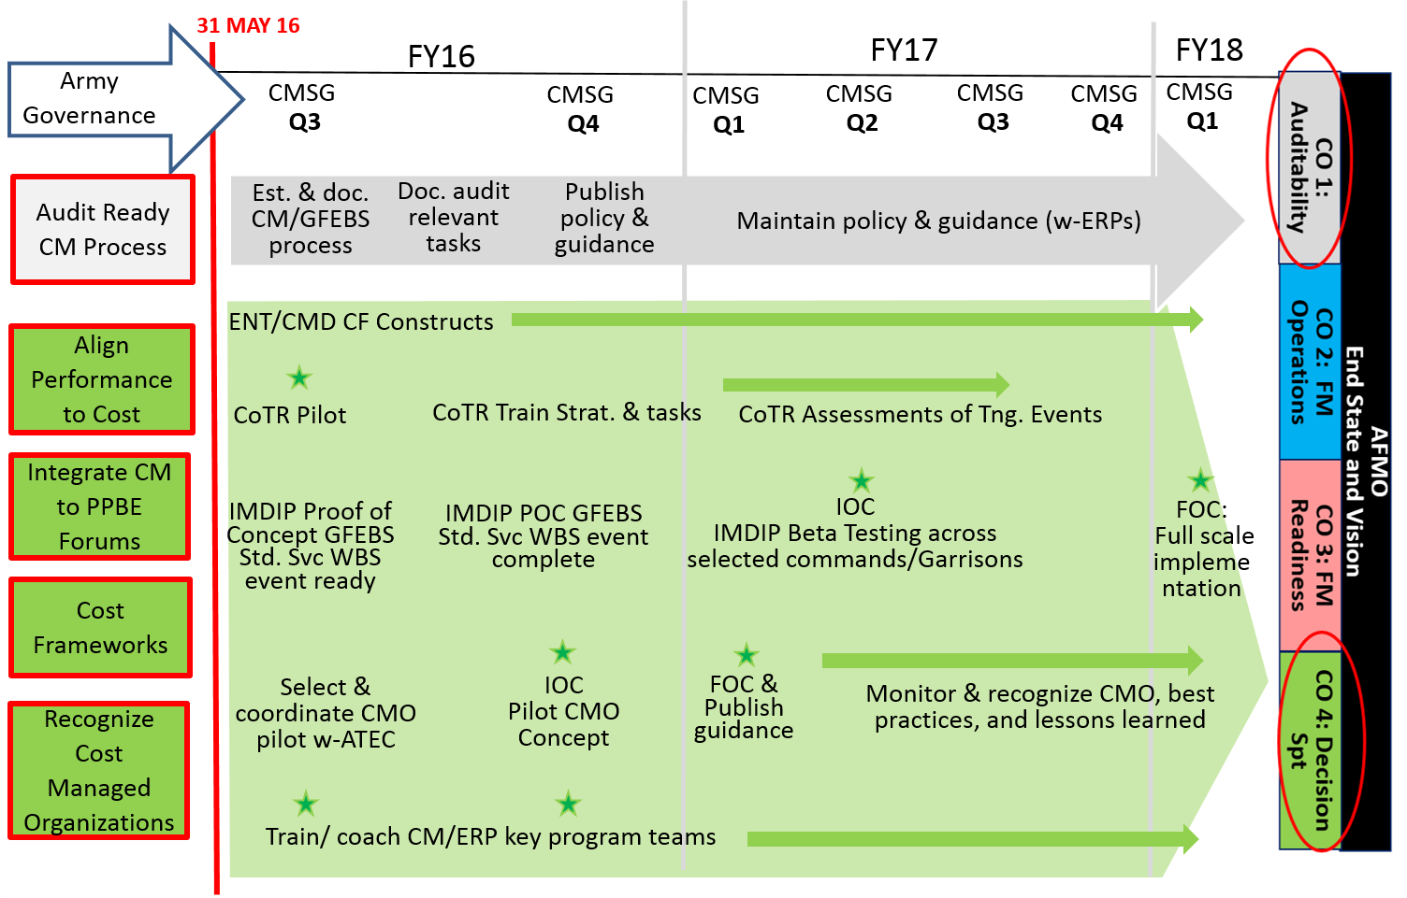
Army Cost Management POAM

Slide 30
Enterprise Cost Management Initiatives:
Cost of Training Readiness (COTR)
Installation Management Data Integrity Program (IMDIP)

Slide 31
Cost of Training Readiness (CoTR)
Lead: G3/5/7; Co-Lead: G-8 PA&E
Support: DASA-CE
Problem: The CSA believes units are overstating readiness and many leaders do not understand unit training management; placing Army resources at risk.
Opportunity: Gain a better understand of how funding applied to training achieves desired readiness levels. HQDA with co-leads G-37 TR and G-8 PA&E conducts a CSA directed CoTR PPBE review to document all phases of the PPBE processes as they relate to training readiness IOT achieve transparency through the process and develop the necessary feedback mechanisms to inform future requirements.
Key Tasks:
Design an Institutional governance PROCESS that influences ARMY READINESS and PPBE using existing and future READINESS METRICS.
Capture information from ENTERPRISE RESOURCE SYSTEMS enabling comparative analyses.
Establish a more OBJECTIVE T-RATING assessment that allows the LINKAGE BETWEEN RESOURCES AND TRAINING READINESS.
Develop a STANDARDIZED COST STRUCTURE for training that links unit training activities to cost.
Outcome:
Identify means to MAXIMIZE READINESS, improve confidence in the process, ensure transparency, optimize the EFFECTIVENESS OF RESOURCE INVESTMENT, and develop trade space for Army senior leader decisions
Develop an institutional process that informs senior leaders of the costs associated with training readiness
Sustain and Inform the models that link training events and training expenditures to sustainable readiness demand
Timeline/Milestones:
MAY: Completed USAR site visits for 3 F/MF Bde’s and ESC
MAY: First iteration with 3/1 CAV (Focus: GFEBS, DTMS, GCSS-A, QC data accuracy)
JUL: Second iteration with 3/1 CAV (Focus: Objective-T, T&EO’s, Training Events)
AUG: Begin CAB Pilot, 101st CAB (Focus: training strategy and tasks)
SEP: Third iteration with 3/1 CAV (Assess modifications to process and systems, GCSS-A, GFEBS, DTMS)
31

Slide 32
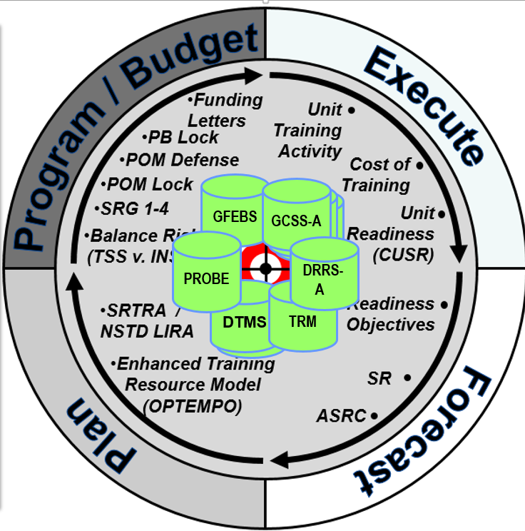
Developing a Standardized Cost Structure to Inform Senior Leaders in Key POM and YE Decision Making Forums
Cost of Training Readiness
Guiding Principles / Intent:
Preserve Cdr flexibility
Improve transparency to better see ourselves
Create feedback loop to improve Program / Budget
Link resources to readiness
Training Enterprise centric vs. TT PEG
Enhance Training Resource Model
Training Activity vs. Miles
Account for location / type
Forecast based on readiness objectives and SR
Challenges:
Cost capture:
As a single cost
Without transactions in ERPs
Cost to change readiness levels
Analytical Decision Support Capabilities:
Target for CoTR to inform the POM and YE
Utilization of Cost Centers (e.g. Cost by unit reporting)
Validation of new/current cost factors
Leveraging current Cost Models (TRIMS) with ERPs to inform senior leaders decision making process in PPBE POM and YE Key Decisions

Slide 33
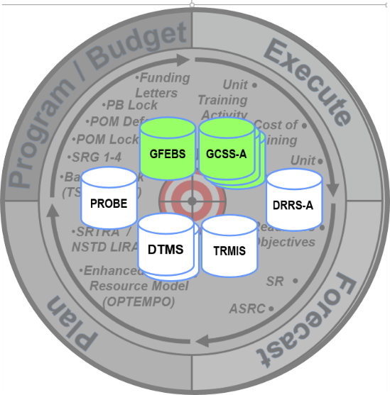
Leveraging Enterprise Resource Planning (ERPs) for
Cost Informed Decision Making
Cost of Training Readiness
Building ERP/CM Analytical
Capabilities & Strategies
Key Challenges
Policy for GFEBS and DTMS operator usage
Leveraging G-Army through its implementation
Objective T-Implementation guidance for improved awareness & understanding
Capture information from ERPs
Enabling comparative analyses
Inform senior leaders
of the costs associated
with training readiness
Sustain and Inform the models that link training events and training expenditures to sustainable readiness demand

Slide 34
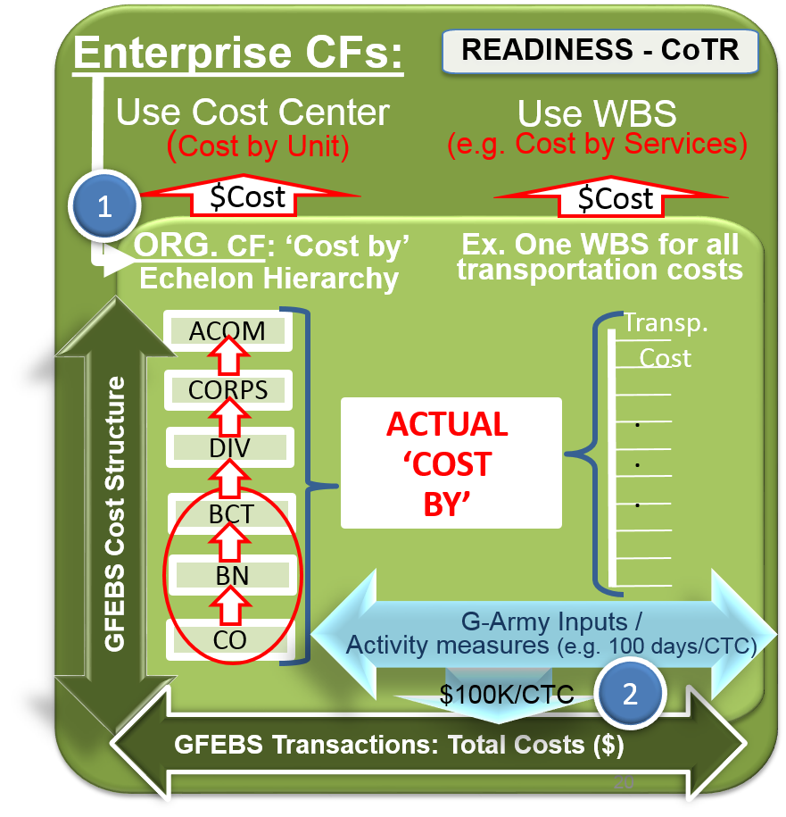
Cost of Training Readiness:
Standardized Business Policy
Key Challenges:
Standardized funds distribution scheme
Consistent use of Cost Centers
Standardized Work Breakdown Structure (WBS)
Link unit / Service cost to activity measures
1
2
Cost Data and Activity Data Linked to Objective-T Measures
Notes:
SPEAKING POINTS:
Goal: Increase visibility of funds and cost to the BCT level to inform programming, budgeting, and year of execution more timely & accurately on efficiency & effectiveness achieved levels achieved.
Linking funding and cost data structures consistently across the Army echelons in two fold:
On the fund center side, the location of the fund center in GFEBS is standardized at the Brigade level (e.g. Visibility into how much funding a BCT received for training readiness)
On the cost object side, the collection of costs is done with WBS (cost by events) or CC (echelon hierarchy) by commitment item as follows:
WBS standardization:
Cost Structure - HQDA to BCT level (e.g. All transportations use same WBS)
Naming convention - HQDA to BCT level (e.g. NTC Transportation WBS)
Cost Center Location:
Consistency to the unit level

Slide 35
Installation Management Data Integrity Project (IMDIP) Lead: ACSIM Support: DASA-CE & OBT

Slide 36
Installation Management Data Integrity Project (IMDIP)
Problem/Opportunity:
The installation management community requires change across DOTMLPF-P to effectively manage the planning, programming, budgeting, execution, and reporting of Installation Programs across all Army financial systems
Timeline/Milestones:
NEAR TERM:
Installations Services Construct completed (Q2-FY16)
Proof of Concept Event ready (Q3-FY16)
Proof of Concept Completed (Q4-FY16)
MID-LONG TERM:
Beta testing across selected Garrisons (Q1-FY17)
IOC – Across selected Commands/Garrisons (Q2-FY17)
FOC – Full scale implementation(Q1-FY18)
Proof of Concept Completed (Q4-FY16)
Outcome:
Improve Installation Management program, budget, and execution linkage, visibility and data quality needed to drive full cost visibility and operational efficiencies; and integrate disparate data sources needed to LINK PROGRAM AND BUDGET DATA TO COST & PERFORMANCE DATA
Current requirements are being met with internal manpower of stakeholders
Resource Requirements:
Next Steps:
May 16 - Begin Proof of Concept A-testing across ASC
Jun 16 - Begin Proof of Concept B-testing across selected Garrisons (Redstone, Bragg, Stewart, Belvoir)
Jul 16 – Analyze results and debrief participating Garrisons
Jul 16 - Complete proof of concept
36

Slide 37
Synchronizing Installation Management Performance Outcomes to Cost
(IMDIP)
Cost and Performance Measures:
Performance and cost measures aligned to:
Cost structures (WBS),
Activities,
Processes,
BEA
Project Definition – Base Support Activities (Direct)
Level 1 (Installation) – Overall Garrison Level Metrics
Level 2 (Major Service Group) – Overall E2E process metrics, or major functions. (e.g. logistics)
Level 3 (Primary Service Element) – Service level performance measures (currently collected)
Level 4 (Major Activity) – Metrics for specific activities. Efficiency measures and organization specific effectiveness.
Level 5 (Tasks) – Metrics for specific projects. Efficiency and utilization measures.
Level 6 and below – Measures linked to specific events.
New Capabilities:
Installation Services Cost Structure Captures Costs at Multiple Levels to Meet Both Headquarters and Field Cost Information Needs
Performance Metrics can be tied to each level of the Cost Structure
Object levels can be mapped to Capture the Cost of Cross domain Concepts such as “Readiness”
37

Slide 38
Developing a Common Cost Structure to Inform Senior Leaders in Key POM and YE Decision Making Forums
(IMDIP)
IMDIP Fundamentally Changes Execution Information.
This information feeds:
Official Reporting
Cost Estimates
Requirements
Funding

Slide 39
People are Our Most Important Resource - Cost Management Training

Slide 40
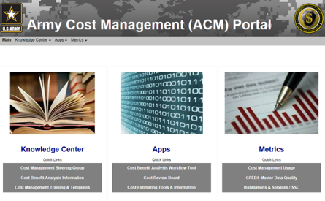
High Level CM Training Strategy
High Level Strategy:
Train analysts and leaders in key decision making positions (What does “right” look like?)
Integrate Army CM policy into Army’s CM/RM Career Training Programs (What does “Army right” look like?)
Recognize CM Excellence:
CM integrated in decision forums
Cost Managed Organization
https://acm.army.mil

Slide 41
Cost Management Training & Education
Graduate Level Education
Army Training
at the University of South Carolina
TERP10 | 4 week | 12 | * Credits count towards USC MBA * Army sustainers gain an operational level understanding of SAP * Provide better understanding of Army interrelated ERP systems (GFEBS, GCSS-A, IPPS-A)
Business Analytics Course | 4 Week | 12 | *Provides analytic training that never before existed within the Army * Leverages untapped capabilities within GFEBS/Business Intelligence environment *CPE credits for CDFM, and FM Certification Program
CMCC | 4 Week | 12 | * FM Professionals receive industry best practices in business/ finance * Fulfills requirement for DoD Certification Program and CDFM
at Army Financial Management School
Principles of Cost Accounting & Mgmt | 3 Weeks | * Cost Terms * Cost Concepts * Fundamentals of Cost Accounting * Practical Exercises
Intermediate Cost Accounting & Mgmt | 3 Weeks | * Cost Flow Methods * Analysis and Reporting * Practical Exercises * Complex Case Studies * Decision Support
at Command General Staff College
Financial Based Decision Making | TBD | * CGSS willing to offer future elective * Cost Management and/or CBA focus *Class in Development with DASA-CE/OBT
Cost Benefit Analysis Training
Command Sponsored Certification
at PDI
CBA Training for Analysts | 3 hour | * Analyst focused familiarization course *FM Certification Program
CBA Training for Managers & Execs | 3 hour | * Management focused familiarization course *FM Certification Program
local and CE trainers
4 Day CBA Course | 4.5 Days | * Case based course leveraging HQDA lessons learned * HQDA certified trainers and CE trainers * Analytically focused methodologies
locally offered
Cost Management Basics Course | 2 weeks | * Certification Focused Training with using existing training: CBA Fam, LSS Green Belt, on-line DL, 1 week in class
https://acm.army.mil

Slide 42
What’s Hot for the Army Analytics in 2016?
42

Slide 43
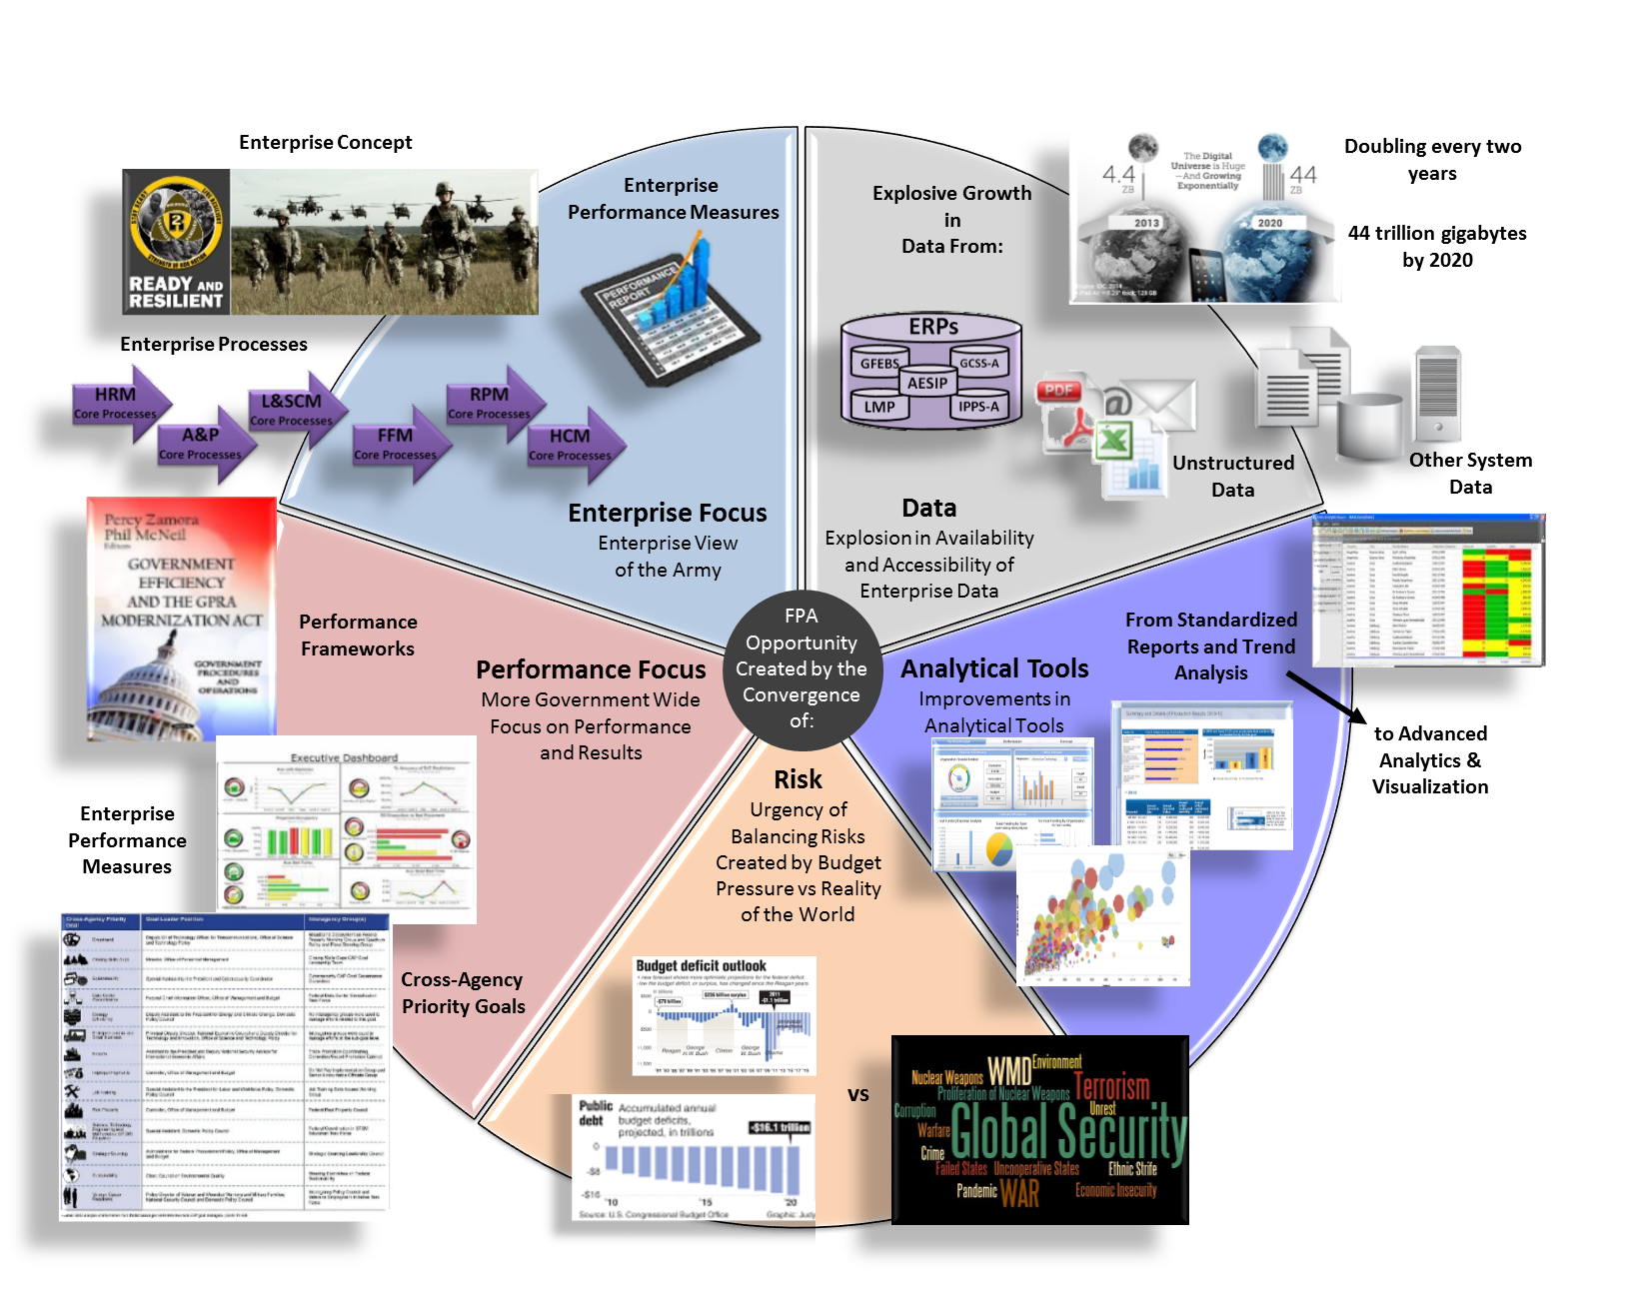
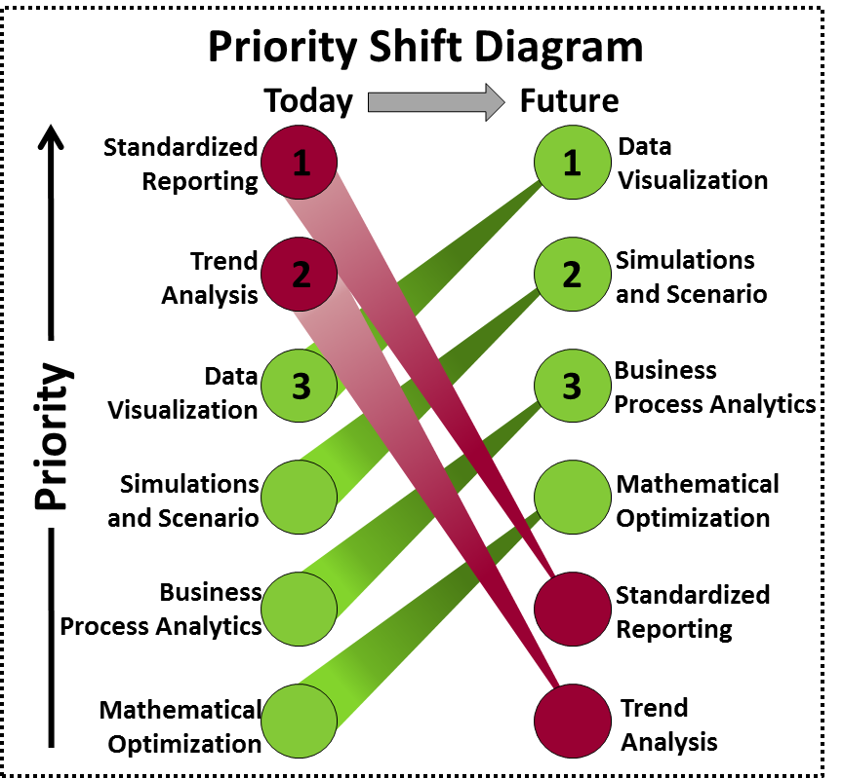
Financial Management &
Performance Assessment (FPA) Opportunity
(Start in the Middle)
1
2
3
4
5
Notes:
Data Notes
Business Insider, June 9, 2015
The amount of digital data in the universe is growing at an exponential rate, doubling every two years, and changing how we live in the world.
“The rate at which we're generating data is rapidly outpacing our ability to analyze it,” Professor Patrick Wolfe, Executive Director of the University College of London’s Big Data Institute, tells Business Insider. “The trick here is to turn these massive data streams from a liability into a strength.”
Just about 0.5% of all data is currently analyzed, and Wolfe says that percentage is shrinking as more data is collected.
http://www.businessinsider.com/mind-blowing-growth-and-power-of-big-data-2015-6
Data Growth, Business Opportunities, and the IT Imperatives (http://www.emc.com/leadership/digital-universe/2014iview/executive-summary.htm)
This is the digital universe. It is growing 40% a year into the next decade, expanding to include not only the increasing number of people and enterprises doing everything online, but also all the “things” – smart devices – connected to the Internet, unleashing a new wave of opportunities for businesses and people around the world.
Like the physical universe, the digital universe is large – by 2020 containing nearly as many digital bits as there are stars in the universe. It is doubling in size every two years, and by 2020 the digital universe – the data we create and copy annually – will reach 44 zettabytes, or 44 trillion gigabytes.

Slide 44
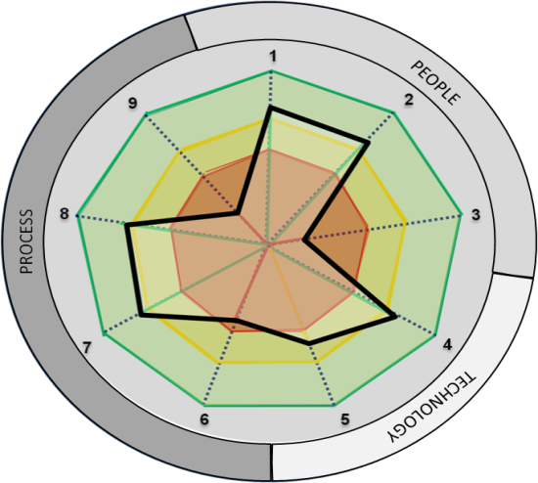
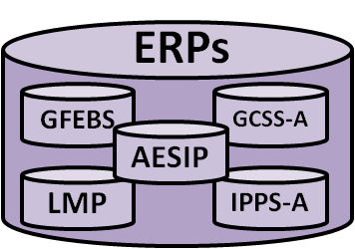
FPA Concept
Decision Makers Span of Control & Influence (SC&I)
What questions are decision makers asking regarding resources & performance?
Customer
DECISIONS
What knowledge is required to make resources & performance decisions?
Reports
Maturity Models
Dash Boards
Analysis
Output
KNOWLEDGE
How do organizations correlate resources to performance?
Process
Correlate
INFORMATION
Which systems provide financial & performance data?
Input
DATA SOURCES, FILE SYSTEMS, dB’s
UNSTRUCTURED DATA
ERP SYSTEMS
DATA
Which processes generate the financial & performance data?
Supplier
44
Notes:
The data capture architecture is also the basis of an enterprise strategy to understand the relationship of data to information to knowledge and decisions regardless of where
the decision maker is as long as the decisions are within the decision makers Span of Control & Influence.
The SC&I scopes the decision making framework that aligns the data sources to the eventual reports and dashboards needed for knowledge to make accurate decisions.
Cost management and Performance Management are correlated to enable the decision maker to iterate the process to achieve better knowledge and understand the impacts of cost performance to non-financial measures of performance,
such as quality, cycle time, or other measures of effectiveness and efficiency.
At each level of the SIPOC, questions must be answered in order to understand how the decision maker should correlate cost and performance into an integrated resource informed decision making environment.

Slide 45
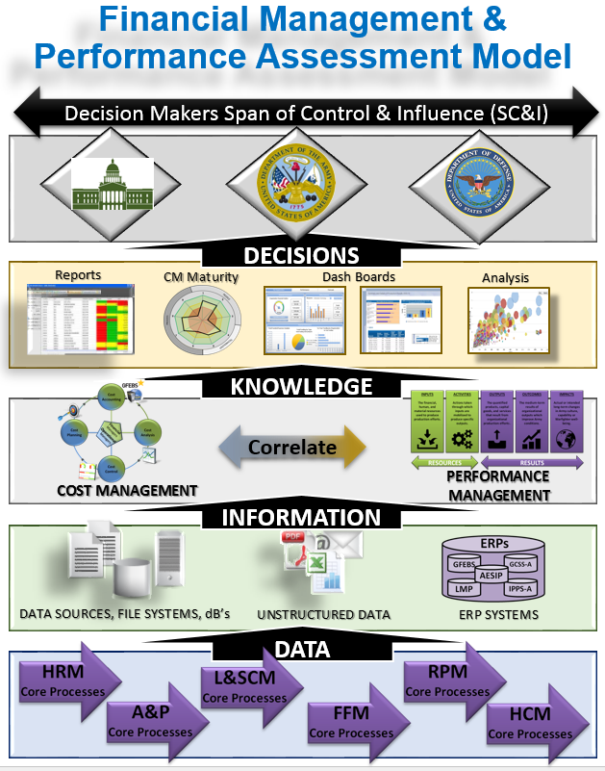
Improve Financial Management and Performance Assessment (FPA)
Timeline/Milestones
Strategic Alignment:
SD 3, SA 6, FMC 1, 2, 4
Concept Initiatives
Data Capture Strategy
FM and PM Correlation
Cost of Training
Cost of Recruiting
Development
Financial Management & Performance Assessment (FPA) Model
SAG 432 Improve OP-5 project
Build PM architecture
Cost of Logistics Readiness
Implementation
Improve all SAG
Design dashboards based on SAG FPA
Implement FPA to support Resource Informed Decision Making (RIDM)
Realization
Integrate FPA into PPBE process
CPI SAG OP-5 process
Expand RIDM model to Enterprise
Manage and evolve
Oct 2014 – Aug 2015
Sept 2015 – Dec 2015
Jan 2016 – Sept 2016
Sept 2016 – 2017
Goal: To develop a repeatable and scalable process to correlate financial resources to performance measures that align with readiness and effectively measure outcomes throughout the Army Enterprise that aligns with the overall Defense Strategy.
Initiatives: FM&C has actively been working Cost Management, Performance Management, Cost of Training and Cost of Recruiting initiatives to enable improved Resource Informed Decision Making across the Army Enterprise.
Next Steps:
Utilize the Justification Books to define Performance Criteria and Evaluation Summaries to set FPA measures, align with Title 10 Functions and E2E Processes
Complete a proof-of-concept project to improve the OP-5 report for SAG 432 for O&M.
Begin addressing Cost of Logistics Readiness.
Replicate best practices from SAG 432 project to all SAGs and all appropriation J-Books.
Develop a FPA architecture to design strategically relevant and aligned dashboards for Enterprise wide RIDM.
Integrate FPA into PPBE process, POM development and budget formulation process for optimized financial execution.
45

Slide 46
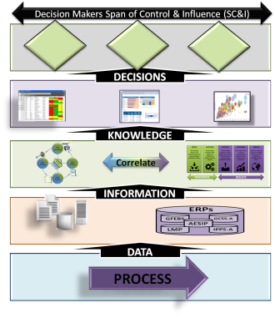
Financial and Performance Assessment (FPA) Align to Title 10 Functions
TITLE 10 FUNCTIONS
(1) Recruiting
(2) Organizing
(3) Supplying
(4) Equipping
(5) Training
(6) Servicing
(7) Mobilizing
(8) Demobilizing
(9) Administering
(10) Maintaining
(11) Construction-E
(12) Construction-B
Which Title 10 function best describes the mission?
Identify the span of control and influence your organization has on that function?
What performance measures are needed to show the organization is meeting the Title 10 requirements?
What data sources are available or need to be discovered that will reflect resource execution?
Which process are utilized to deliver products and services that meet Title 10 deliverables?
46

Slide 47
Financial and Performance Assessment (FPA) Align to E2E Processes
ARMY End-to-End Processes
Procure-to-Pay (P2P)
Order-to-Cash (O2C)
Budget-to-Report (B2R)
Cost Management (CM)
Acquire-to-Retire (A2R)
Hire-to-Retire (H2R)
Deploy-to-Redeploy/Retrograde (D2RR)
Concept-to-Product (C2P)
Environmental Liabilities (EL)
Service Request-to-Resolution (SR2R)
Plan-to-Stock (P2S)
Market-to-Prospect (M2P)
Prospect-to-Order (P2O)
Service-to-Satisfaction (S2S)
Proposal-to-Reward (P2R)
1. Identify Span of Control and Influence along an E2E process.?
2. What decisions will be made that require information and financial resources?
3. What performance measures are needed and what BI is required for dashboards?
4. What systems and data will provide the data for resource informed decision making?
47

Slide 48
FPA Branding
FPA:
Resource Informed Decision Making with Analytics, Insights, and Results
FPA is an organization that is agile in financial and performance data analysis, integration strategies for enterprise insights, and providing methods, products and services that optimize the correlation of financial resources to performance measures to reduce the Army’s PPBE decision risk over time.
The FPA directorate will provide Methodologies, Products & Services that:
Support subject matter experts to understand the domain of the problem to help navigate the analysis. Economic analysis & PPBE
Facilitate the understanding of existing or new data sources needed to derive useful information from data
Provide consultation on developing themes on which data must be mined to provide direction to explore with analytics
Enable the generation of questions under themes by which to apply analytics and gain insights
Provide rapid results or manage an embedded and recurring capability for long-term requirements
48

Slide 49
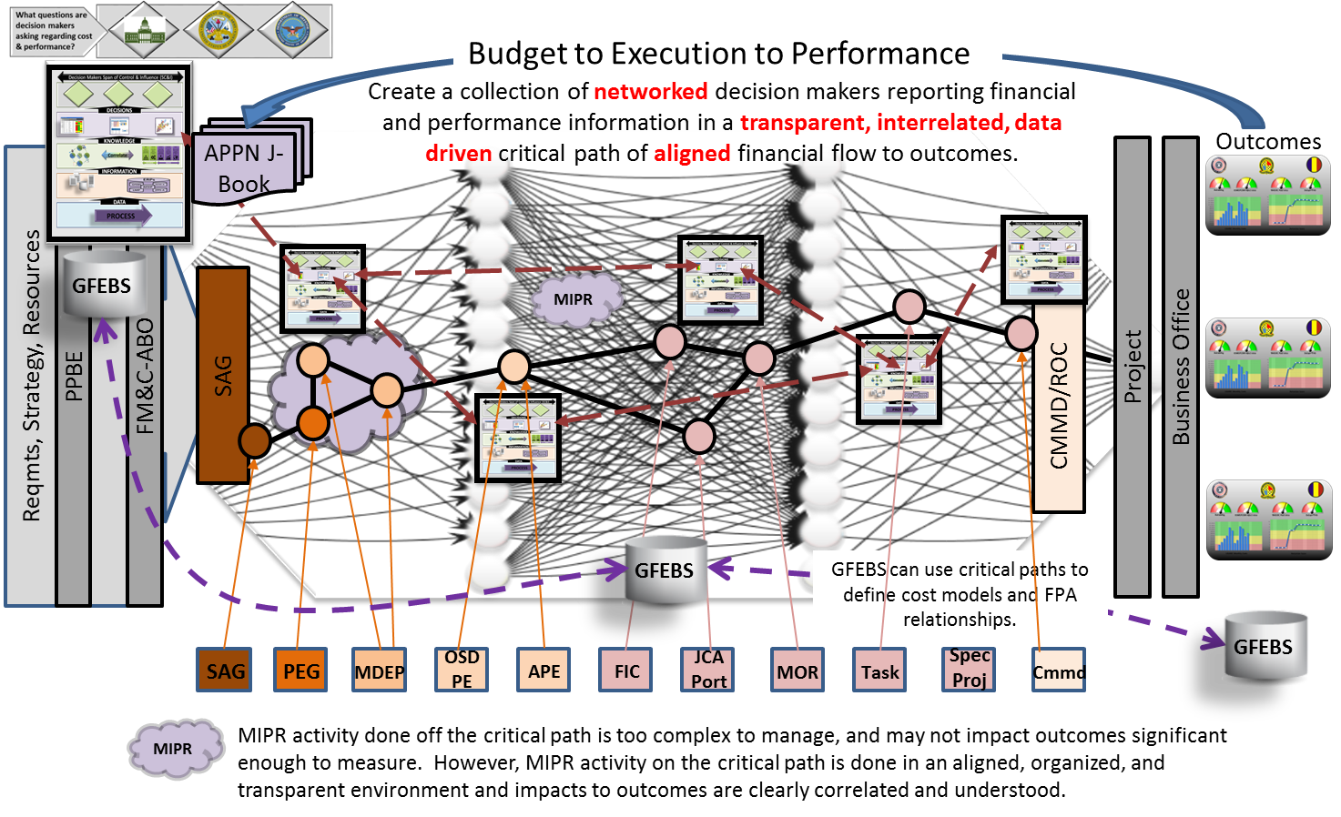
FPA: Networked, Enterprise Resource Informed Decision Making
49

Slide 50
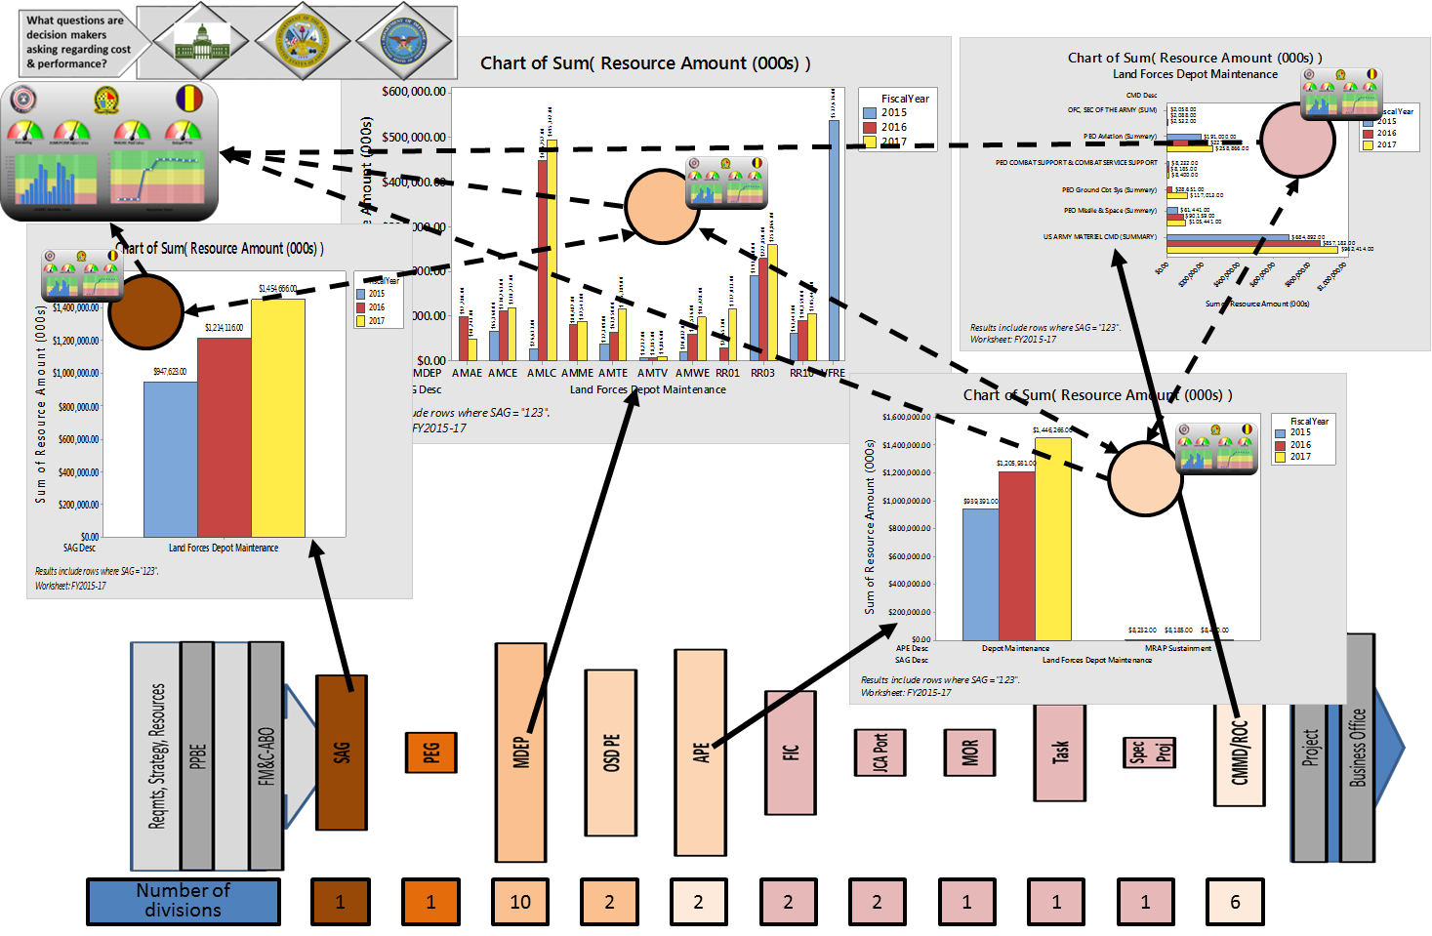
Land Forces Depot Maintenance
FPA Application
50

Slide 51
FPA: Data Analytics Priority Shift Diagram
Priority Shift Diagram
Today
Future
Standardized
Reporting
1
1
Data
Visualization
Trend
Analysis
2
2
Simulations
and Scenario
Data
Visualization
3
3
Business
Process Analytics
Priority
Simulations
and Scenario
Mathematical
Optimization
Business
Process Analytics
Standardized
Reporting
Mathematical
Optimization
Trend
Analysis
51

Slide 52
Table of Acronyms
ABO | Army Budget Office
AC | Active Component
AG | Adjutant General
AR | Army Reserve
AESIP | Army Enterprise Systems Integration Program
AFMIS | Army Food Management Information System
AFMO | Army Financial Management Optimization
AFMS | Army Financial Management School
AFQT | Armed Forces Qualification Test
APE | Army Program Element
APM | Acquisition & Procurement Management
APPN | Appropriation
AMRG | Army Marketing Research Group
ARNG | Army National Guard
ASVAB | Armed Services Vocational Aptitude Battery
BAG | Budget Activity Group
BI | Business Intelligence
BOS | Base Operations Support
CE | Cost & Economics
CM | Cost Management
CMD | Command
CONUS | Continental United States
COPIS | Customers, Outputs, Process, Inputs, Suppliers
CSRB | Critical Skills Retention Bonus
DASA-CE | Deputy Assistant Secretary of the Army for Cost & Economics
DASA-FIM | Deputy Asst. Secretary of the Army for Financial Information Management
DASA-FO | Deputy Assistant Secretary of the Army for Financial Operations
dB's | Databases
DFAC | Dining Facility
DFAS | Defense Finance & Accounting Services
DHP | Defense Health Program
DLA | Defense Logistics Agency
DSS | Decision Support System
ERP | Enterprise Resource Planning
ESB | Enterprise Service Bus
ETL | Extract, Transform, Load
F&PM | Financial & Performance Management
FCM | Funds Control Module
FFM | Financial Flow Management
FIM | Financial Information Management
FM | Financial Management
FM&C | Financial Management & Comptroller
FMSOC | Financial Management Support Operations Center
FO | Financial Operations
GCSS-A | Global Combat Support System-Army
GFEBS | General Fund Enterprise Business System
GFM-DI | Global Force Management Data Initiative
HM | Healthcare Management
HQDA | Headquarters Department of the Army
HRM | Human Resource Management
IDES | Integrated Disability Evaluation System
IMCOM | U.S. Army Installation Management Command
IMT | Initial Military Training
IPSS-A | Integrated Personnel and Pay System-Army
LMP | Logistics Modernization Program
LOE | Line of Effort
LSCM | Logistics & Supply Chain Management
M&RA | Manpower & Reserve Affairs
MDEP | Management Decision Package
MEDCOM | Medical Command
MEPCOM | Military Entrance Processing Command
MOS | Military Occupation Specialties
MP | Military Police
MPA | Military Pay Army
NGB | National Guard Bureau
O&M | Operations & Maintenance
OA | Operating Agency
OCS | Officer Candidate School
OBT | Office of Business Transformation
OLAP | Online Analytical Processing
OMA | Operation and Maintenance
OPA | Other Procurement Army
OPR | Official Party Responsible
OSD | Office of the Secretary of Defense
OTJAG | Office of the Judge Advocate General
PCS | Permanent Change of Station
POS | Point of Service
PPBE | Programming, Planning, Budgeting, & Execution
PROBE | Program Optimization and Budget Evaluation
RBM | Results Based Management
RC | Reserve Component
RIDM | Resource Informed Decision Making
ROTC | Reserve Officers Training Corps
RPM | Real Property Management
RSW (OA22) | Resource Services Washington (Operating Agency22)
SAG | Sub Activity Group
SC&I | Span of Control & Influence
SMS | Strategic Management System
SOA | Service Oriented Architecture
SOF | Special Operations Forces
SRB | Selective Reenlistment Bonus
STORES | Subsistence Total Order and Receipt Electronic System
TF | Task Force
TRADOC | Training & Doctrine Command
TTHS | Trainees, Transients, Holdees, & Students
UIC | Unit Identification Code
USACE | United States Army Corps of Engineers
USAFMCOM | United States Army Financial Management Command
USAREC | United States Army Recruiting Command
USASOC | United States Army Special Operations Command
USMA | United States Military Academy
USMEPCOM | United States Military Entrance Processing Command
Notes:
Please note any acronyms that may have been missed

Slide 53
Key Takeaways
Cost Management = Good Stewardship
We are learning how to harness our data to work for us
Help create the demand for CM - how we inform Army decisions will change the culture
Notes:
CM is an Army analytical decision support capability used to manage operations effectively and efficiently – Enables “Every Dollar Counts”
ACF links inputs and outputs to organizational outcomes (performance goals), answering the: “So what?” or “what did it get me?”; hence providing a clear value proposition in terms of effectiveness and efficiency performance.
Provides relevant and full costs associated with achieving value against leadership’s mission and performance goals.
It is a key pre-requisite to Cost Management to provide better analysis for leadership decision making and requires updating to reflect the most current leadership’s requirements and performance goals.
RMs and OMs engagement is critical to create ACF to include operational and financial inputs, outputs, and outcomes required for mission success.

Slide 54
Big Data !
54

